Slide 1
Overview
Become inspired

Slide 2
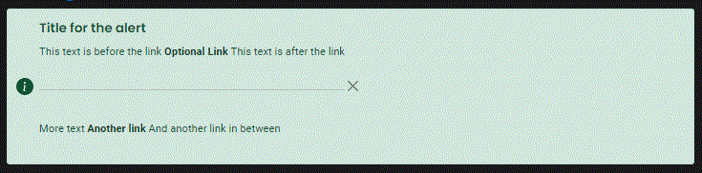
Alerts:
Create a wide variety of alerts.

Slide 3

Banner:
Create banners

Slide 4
Banner action button:
Create banners with button and title.

Slide 5
Banner icon based info title/sub title:
Create banners with one or multiple icons and text segments.

Slide 6

Banner with central button

Slide 7
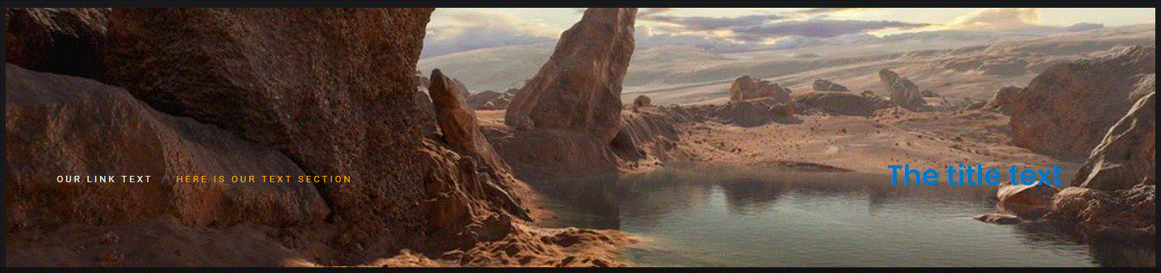
Banner with see through background

Slide 8
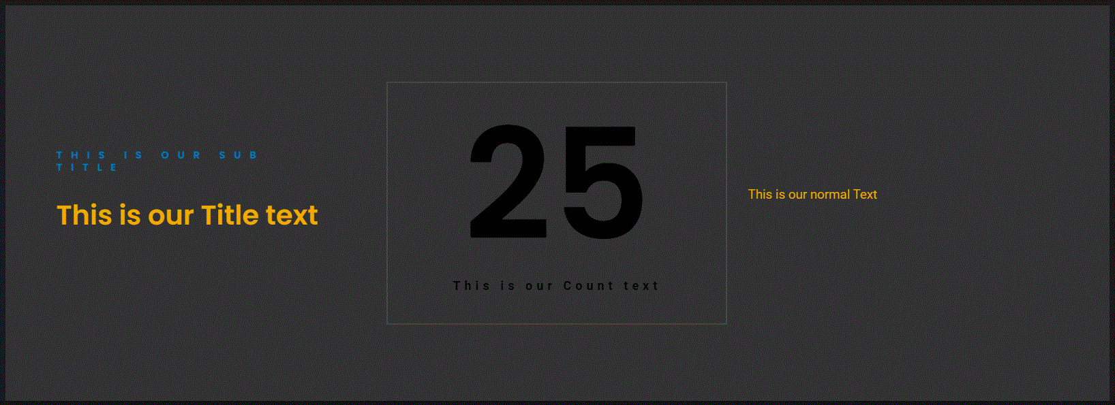
Banner with title, text and counter
The order of the 3 sections can be changed.

Slide 9
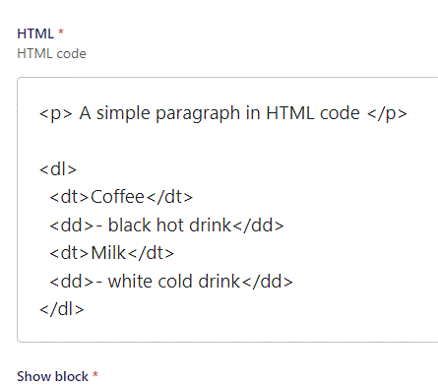
HTML:
Create simple or complex HTML code freely.

Slide 10

Counter:
Create counters and give them icons and text.

Slide 11
Counter percentage bar:
Create one or many percentage bar(s).

Slide 12
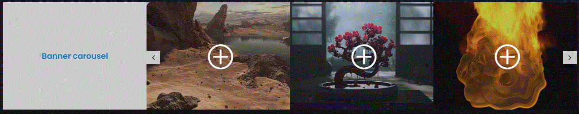
Banner with multiple images in carousel.

Slide 13
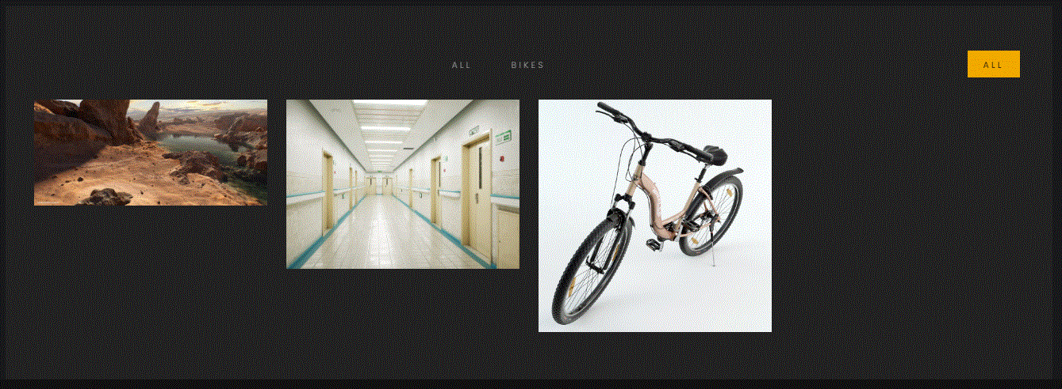
Gallery with image groups and links:
Create galleries with filterable buttons.

Slide 14
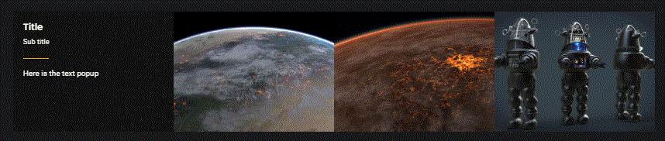
Image gallery with personal info on hoover:
The user can hoover over an image to see a popup as seen on the first image to the left.

Slide 15
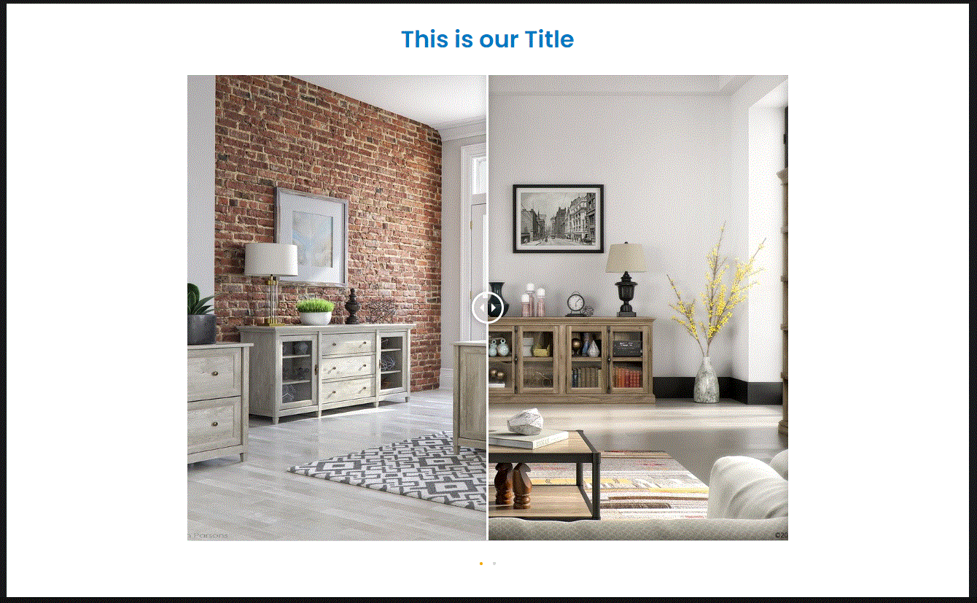
Image before & after:
You can create before and after image displays, where the user can drag the bar in the middle to either side to reveal more or less of the two images.

Slide 16
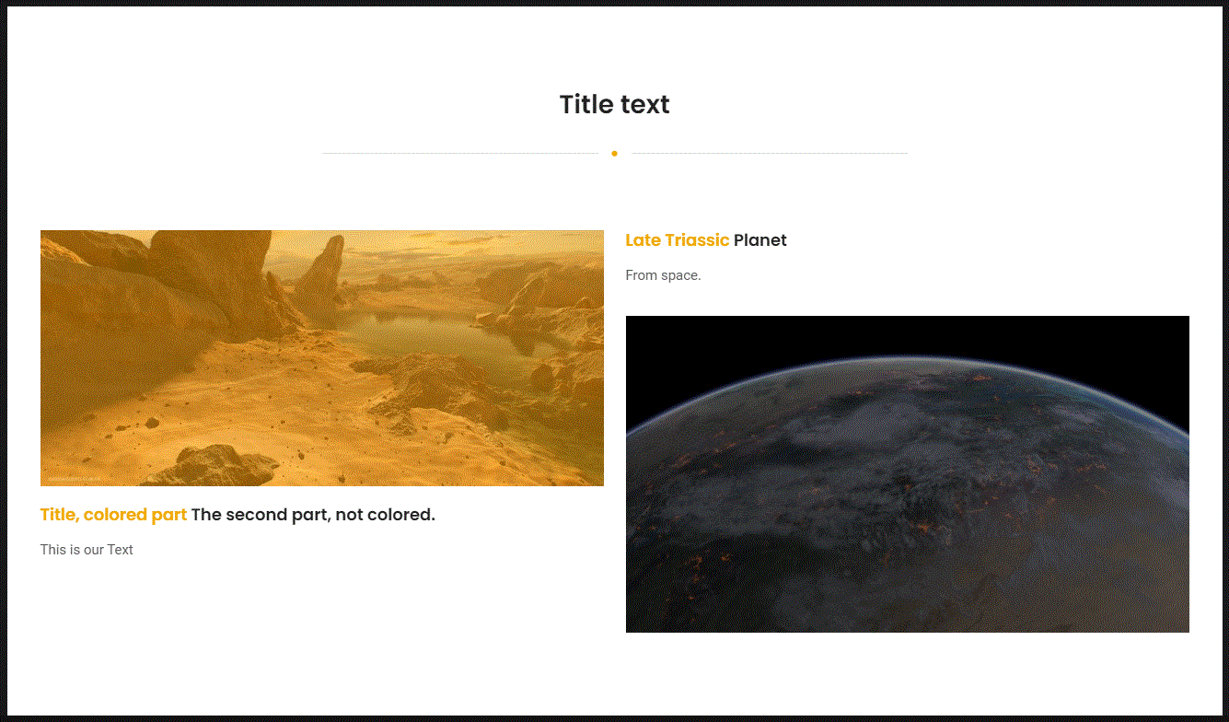
Image horizontal column:
Show image and information in horizontal columns.

Slide 17
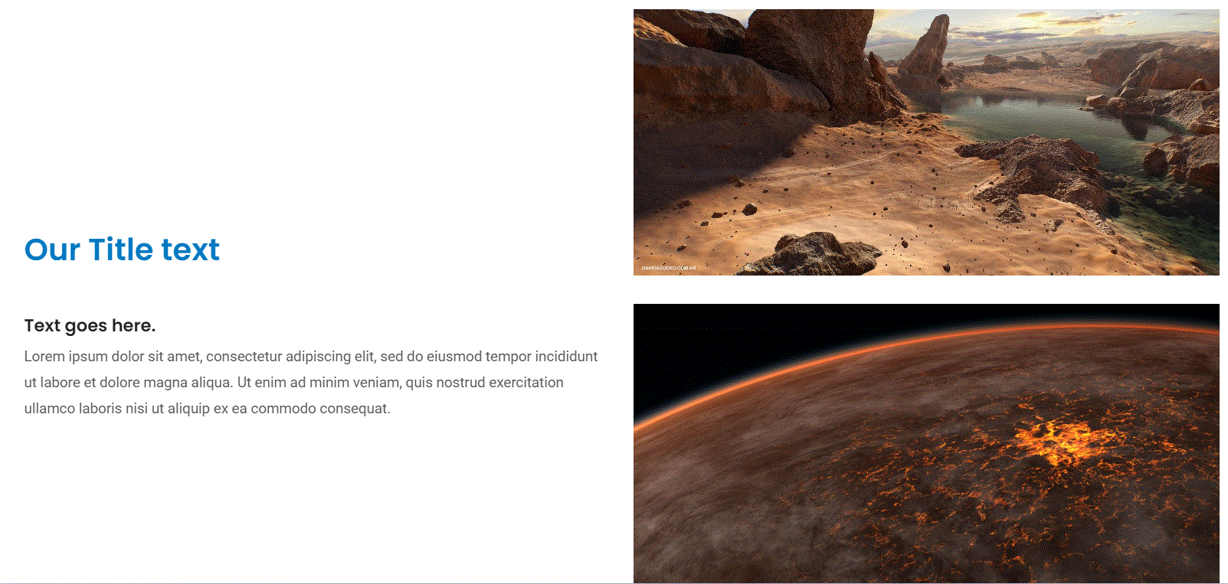
Image information multiple images –item:
Create sections containing multiple images with information displayed on other side.

Slide 18
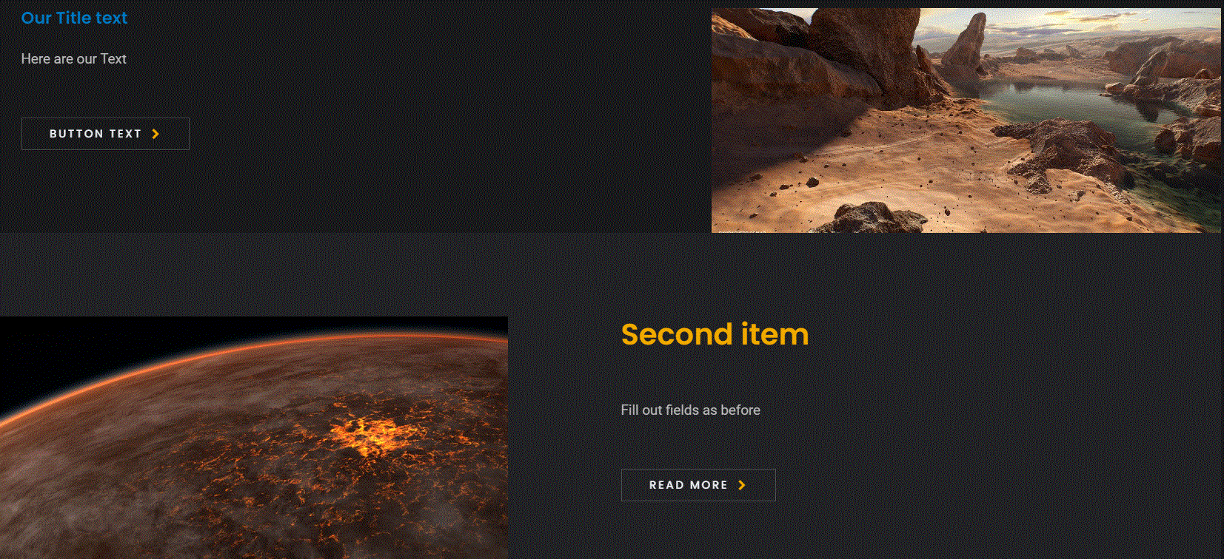
Image information with text right and left:
You can choose to have the image on the right or left side.

Slide 19
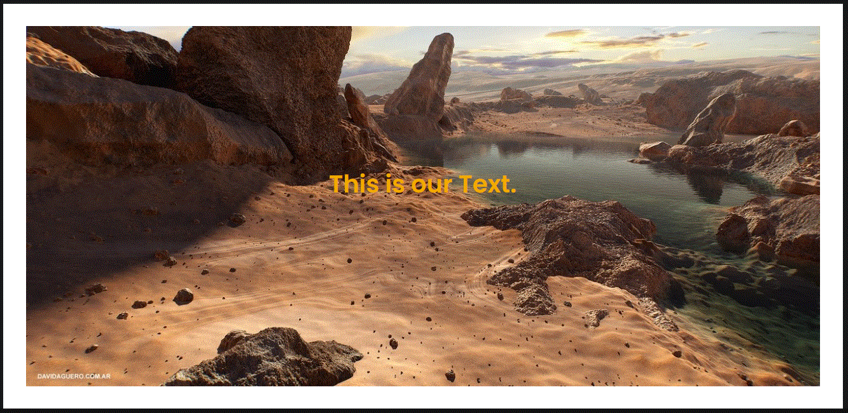
Image single with text:
You can have the text centered inside the image, or outside the image to either left/right or below image.

Slide 20
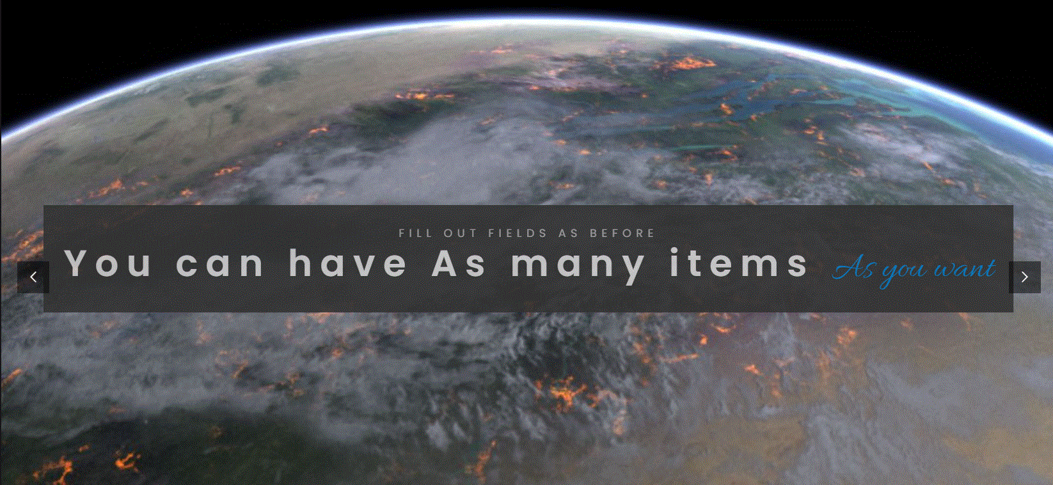
Intro:
Create intro pages with full screen background image and sliding titles.

Slide 21
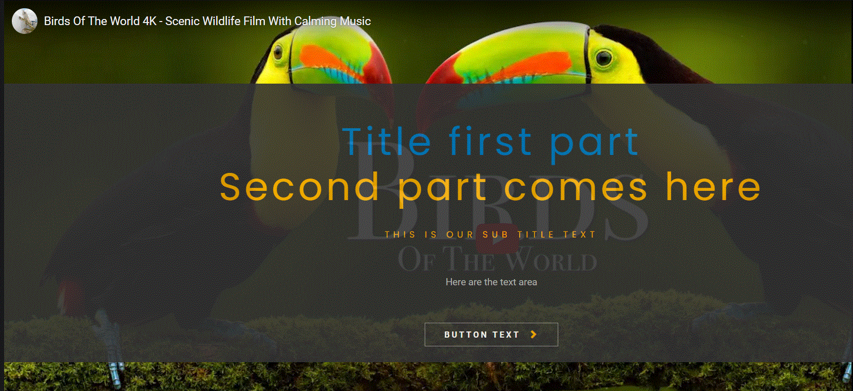
Title slides, movie in background, sub title and text:
Option for movie playing in the background with sliding title/text.

Slide 22

Breadcrumb:
You can select between many separator styles.

Slide 23
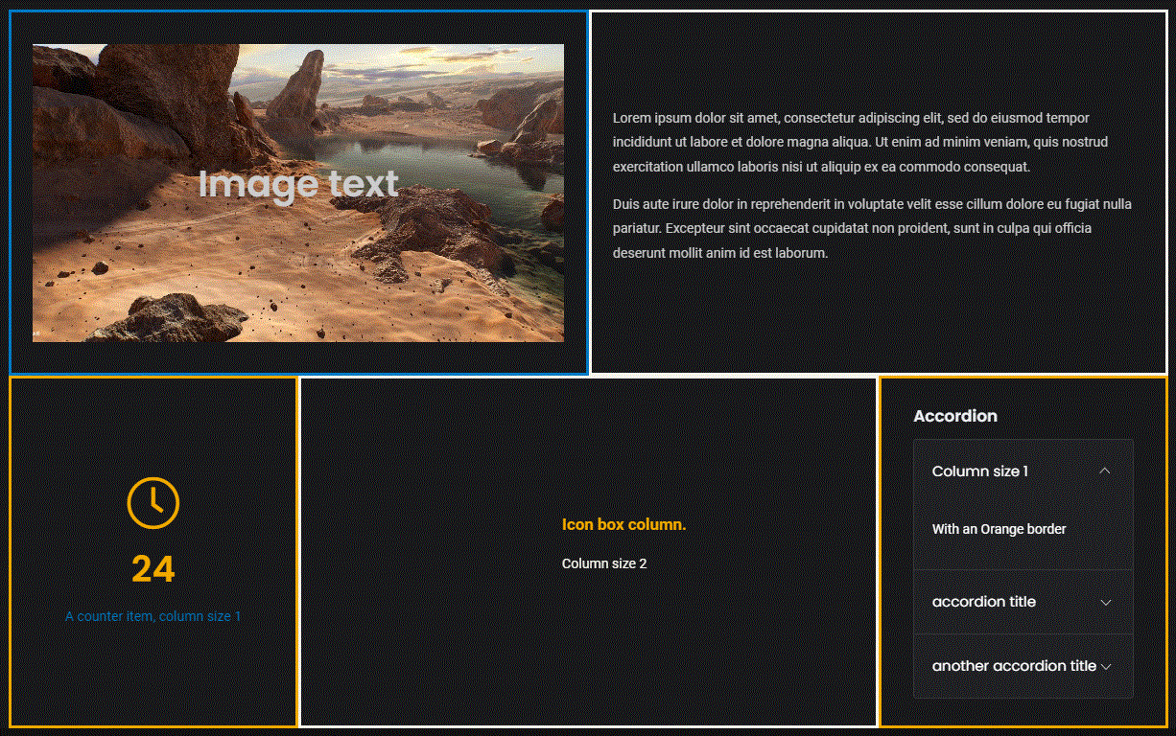
Columns:
Create complex pages with many sections of columns.

Slide 24
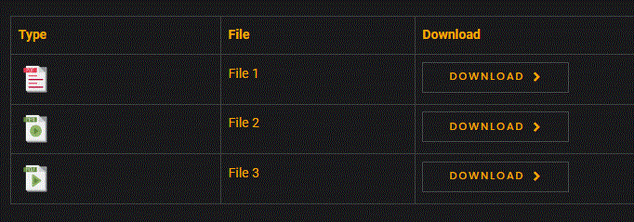
File download:
Create pages where users can download files, like this one. Choose between a list (shown here) or card style.

Slide 25
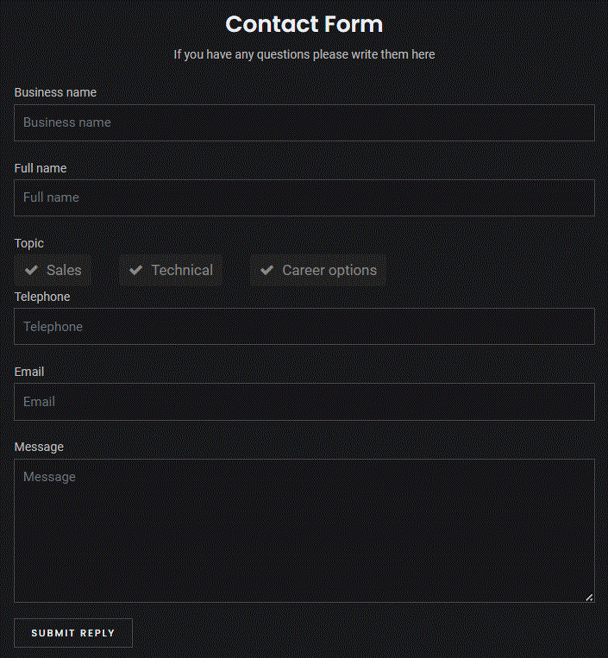
Form:
Create forms of many forms.

Slide 26
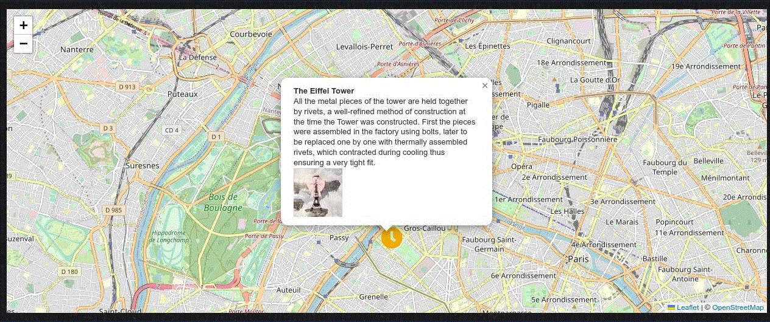
Map:
Create interactive maps.

Slide 27
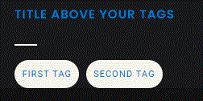
Tag:
Create tags with optional link.

Slide 28

Testimonial

Slide 29

Icon box:
Create one or more boxes containing optional icon, title and text.

Slide 30

Timeline:
Create good overview of processes.

Slide 31
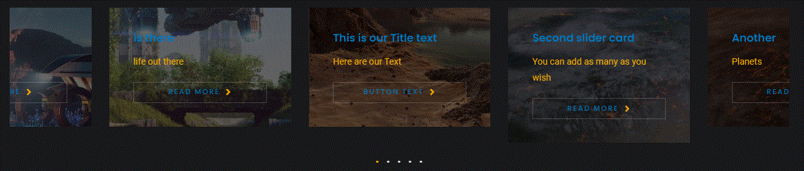
Slider card:
Create display of images with optional button, where users can slide between the images.

Slide 32
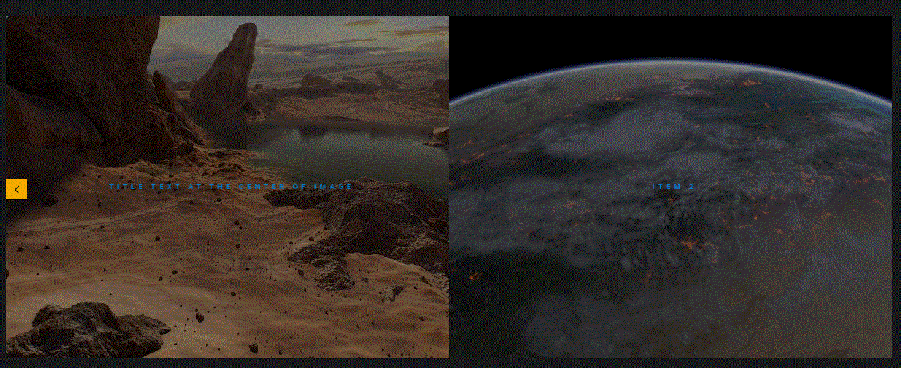
Slider carousel image:
Display images the user can slide between.

Slide 33
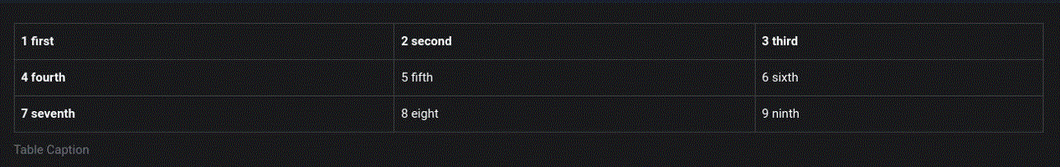
Table

Slide 34
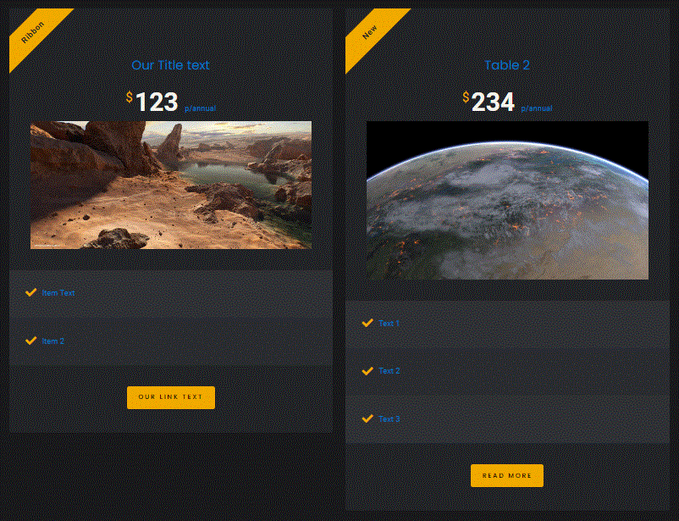
Table pricing:
Display product advantages and price easily.

Slide 35
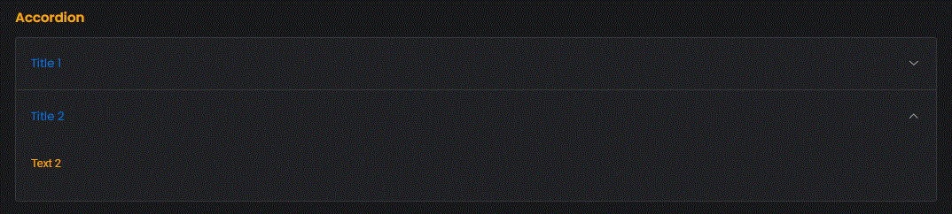
Accordion:
Create drop down information tabs.

Slide 36

Step:
Show steps, if user click on a step information will be displayed at the bottom.

Slide 37

Tab:
Setup tabs, multiple styles available.

Slide 38
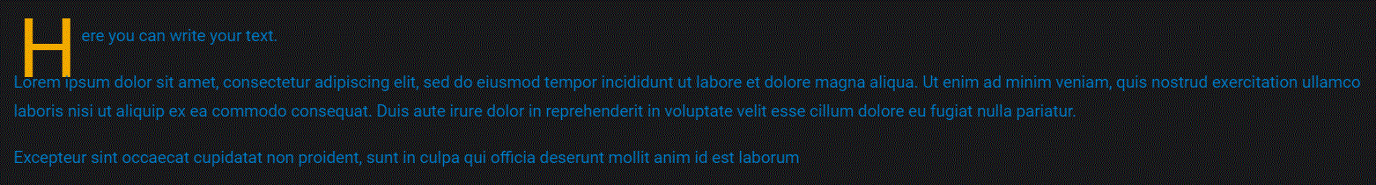
Text

Slide 39

Title

Slide 40
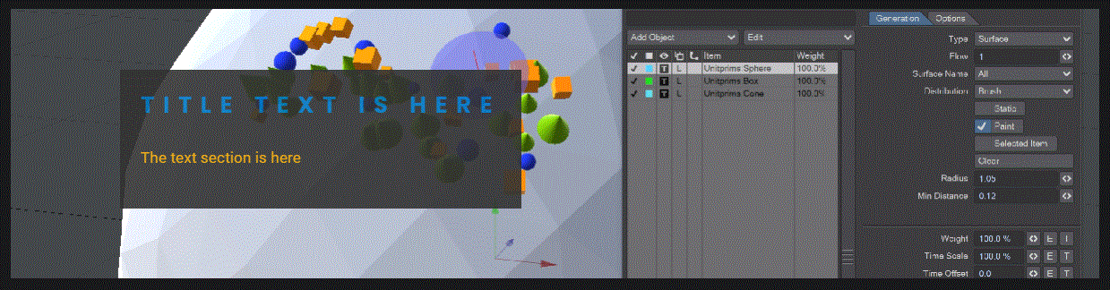
Banner with full width video:
Create banners with video.

Slide 41
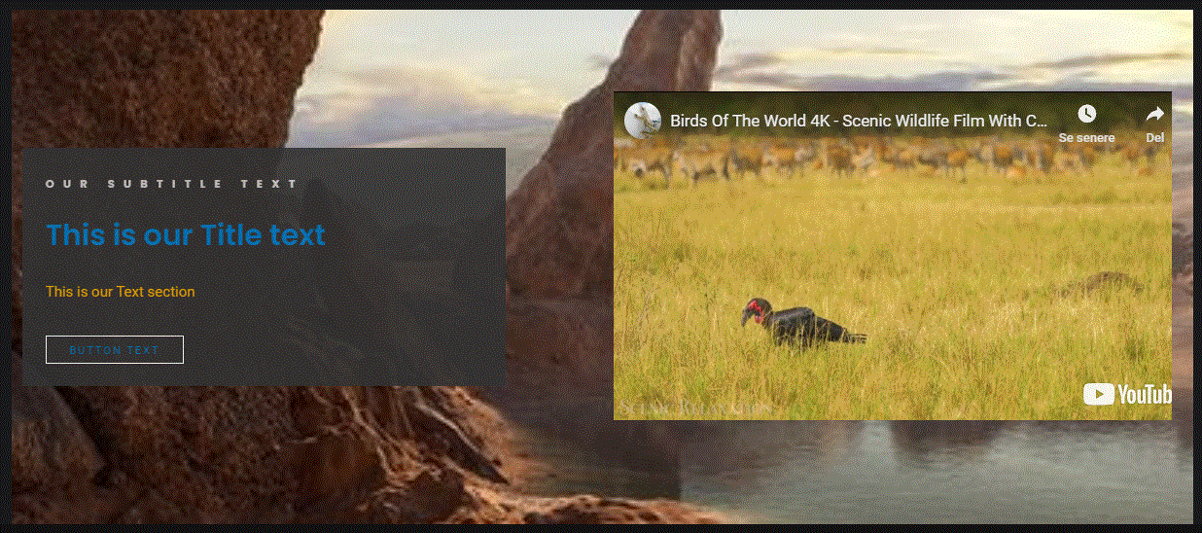
Banner with see through background and video:
Create beautiful video sections with nice backgrounds.

Slide 42
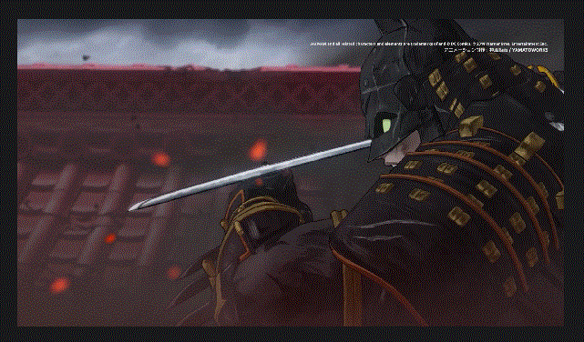
Video:
Insert a simple video player.

Slide 43
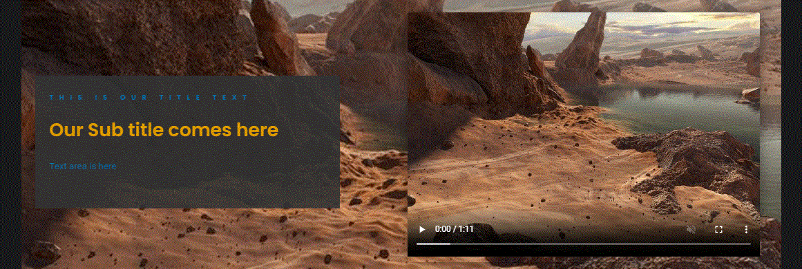
Video with an image background:
You can have a background image be displayed until user starts video.

