Slide 1
Guide for
Video Block

Slide 2
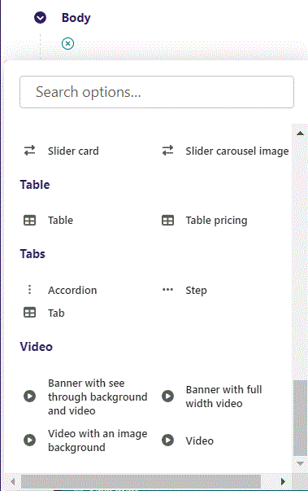
First click the small plus symbol. Then click Video to begin creating.

Slide 3
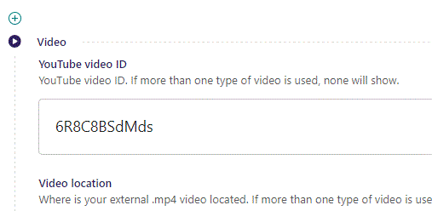
At the top you can set YouTube video ID. Note to only use the video ID and not the whole embed link.

Slide 4
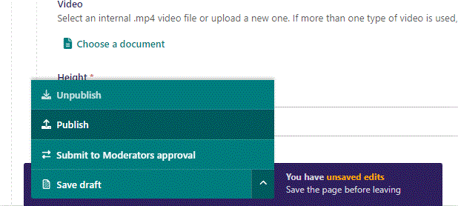
To go live first click the arrow to open the menu. Then click Publish.

Slide 5
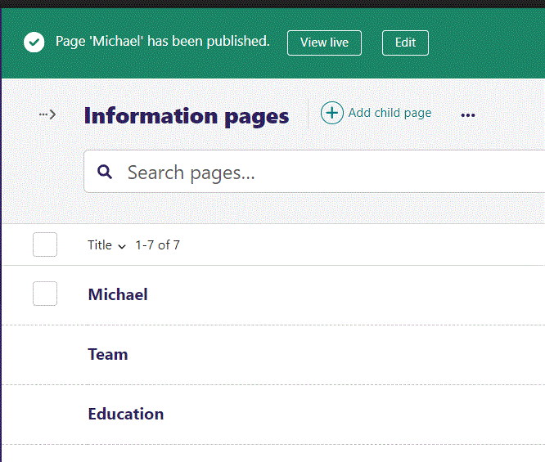
Click View live to open your webpage and see what you created.

Slide 6
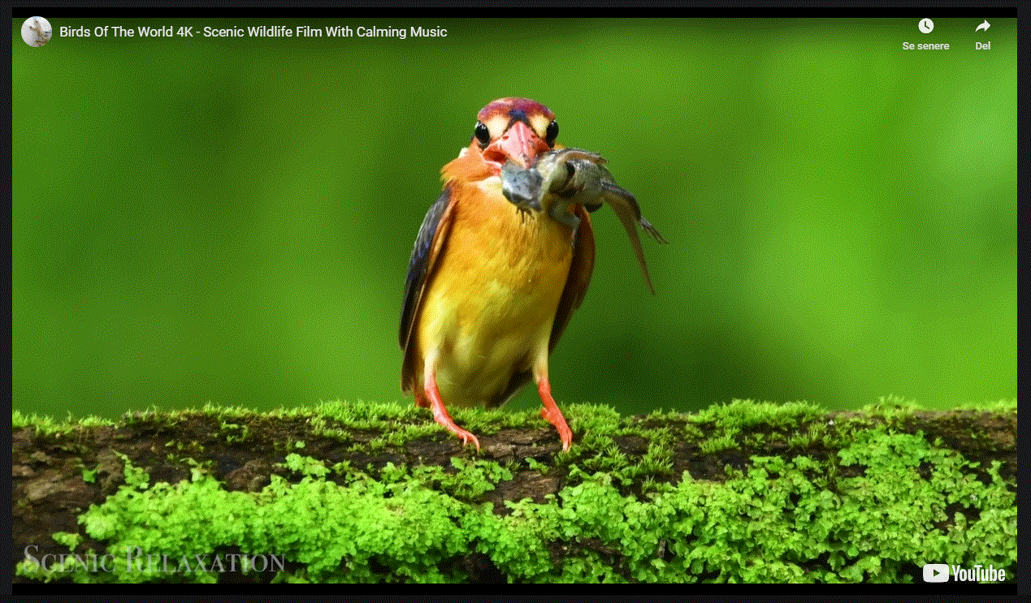
Going live we can see our full screen video have been added.

Slide 7
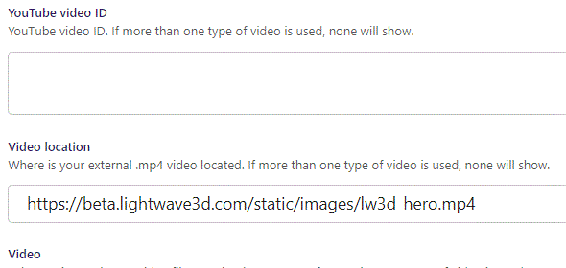
Beneath YouTube video ID you can set Video location as an external .mp4 video link.

Slide 8
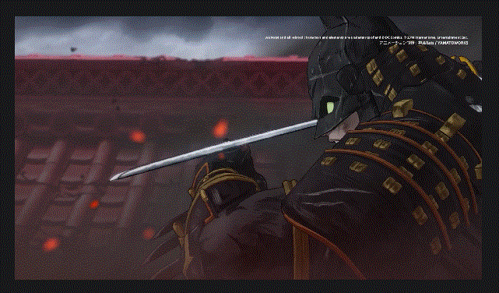
Going live we can see our .mp4 video have been added.

Slide 9
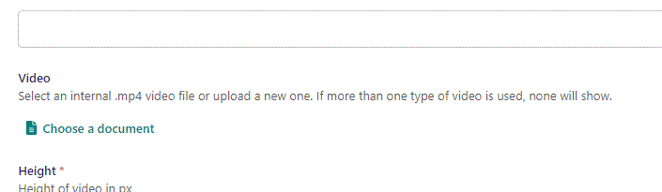
Beneath Video location you can set Video as an internal .mp4 video file or upload a new one.

Slide 10
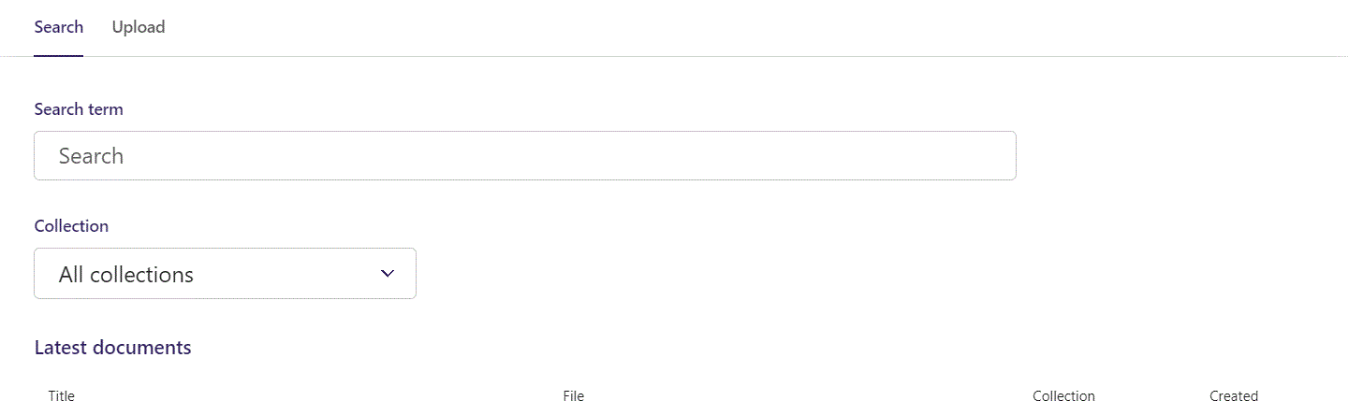
Here you can write Search term.

Slide 11
You can also filter based on Collection.

Slide 12
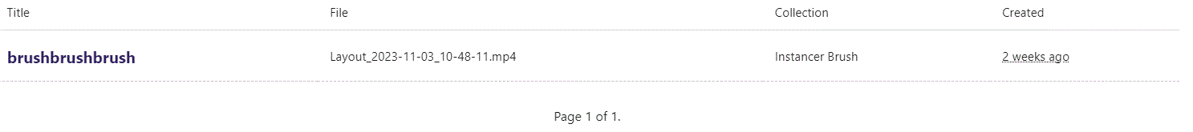
At the bottom section of the Search window, you can select the file you want.

Slide 13
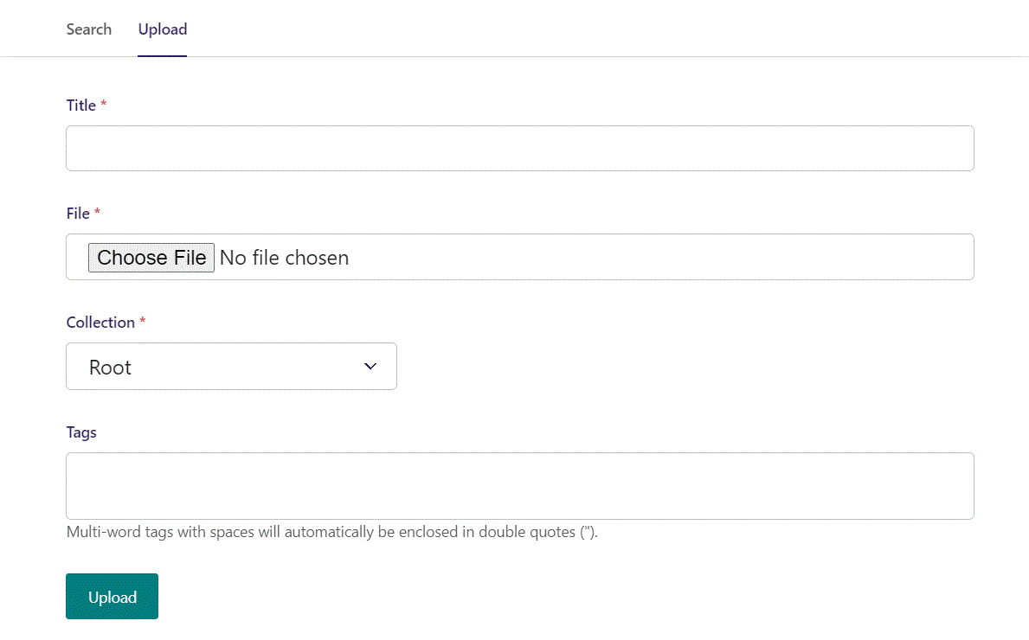
Switching to the Upload window.

Slide 14
Here you can name the file you want to upload.

Slide 15
Here you can pick the file to upload.

Slide 16
Here you can pick a Collection to add your file to.

Slide 17
Here you can associate your file with Tags.

Slide 18
To Upload your file, click here.

Slide 19
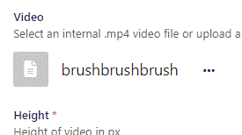
Video chosen.

Slide 20
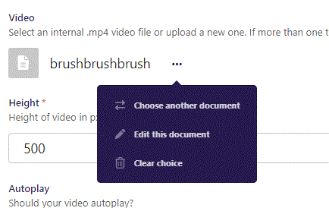
Clicking the 3 dots you can Choose another document, Edit this document or Clear choice.

Slide 21
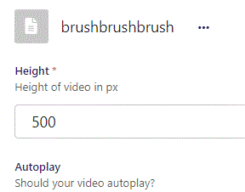
Beneath Choose a document you can set Height. This will set height of the video in px.

Slide 22
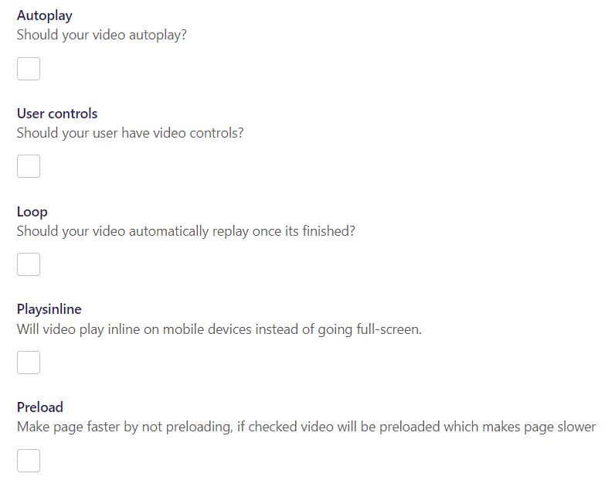
You have several Video options:
Autoplay: Makes your video start automatically when page loads.
User controls: Give your user video controls in the player.
Loop: makes the video automatically repeat.
Playsinline: On mobile devices makes the video play inline instead of full-screen.
Preload: Preload the video before showing page.

