Slide 1
Guide for
Banner with see through background and video Block

Slide 2
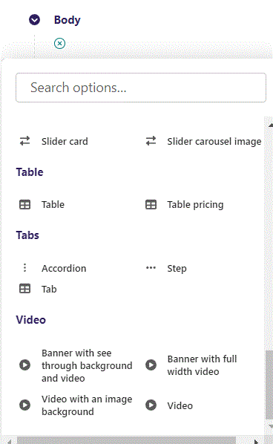
First click the small plus symbol. Then click Banner with see through background and video to begin creating.

Slide 3
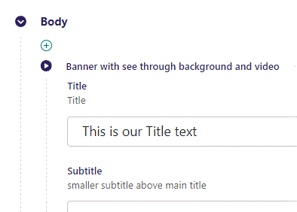
At the top you can write Title.

Slide 4
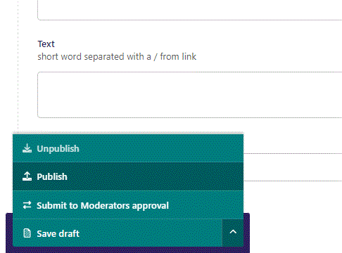
To go live click the arrow to open the menu. Then click Publish.

Slide 5
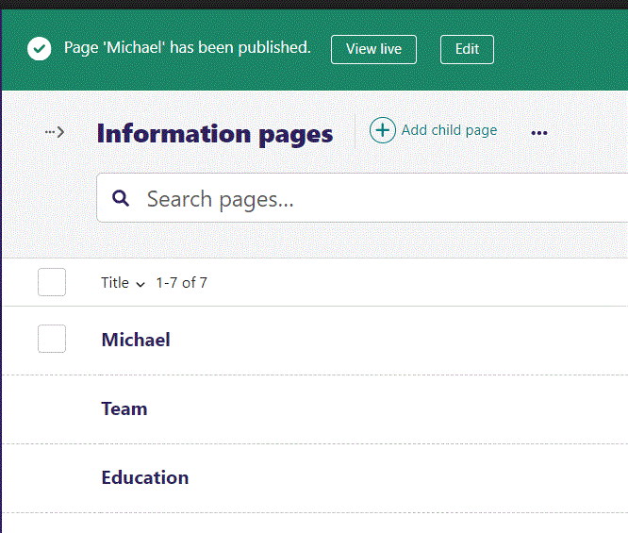
Click View live to open your webpage and see what you created.

Slide 6

Going live we can see our Title text.

Slide 7
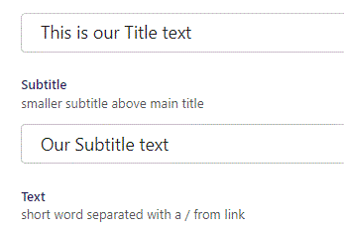
Beneath Title you can write Subtitle.

Slide 8

Going live we can see our Subtitle.

Slide 9
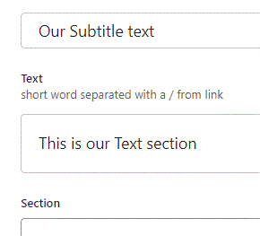
Beneath Subtitle you can write Text.

Slide 10

Going live we see our Text section.

Slide 11
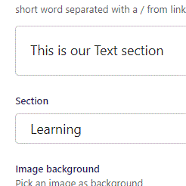
Below Text, you can designate a section that your page will belong to. It is a bookmark for the menu.

Slide 12
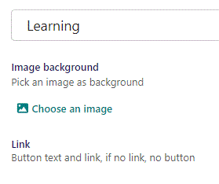
Beneath Section you can Choose an image.

Slide 13
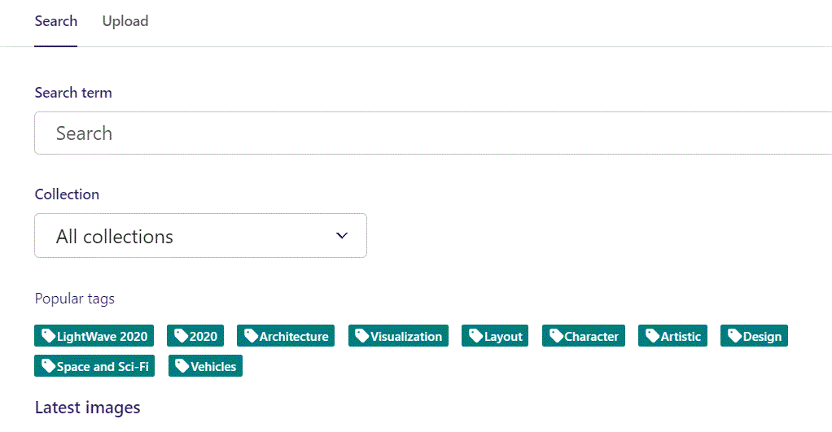
Here we see the top part of the image chooser screen. You can choose to either use an image on the server already or Upload a new image here.
First let’s use an image already on the server.

Slide 14
Here you can write a search term.

Slide 15
Here you can select a Collection of images.

Slide 16
At the bottom you can also sort with Popular tags.

Slide 17
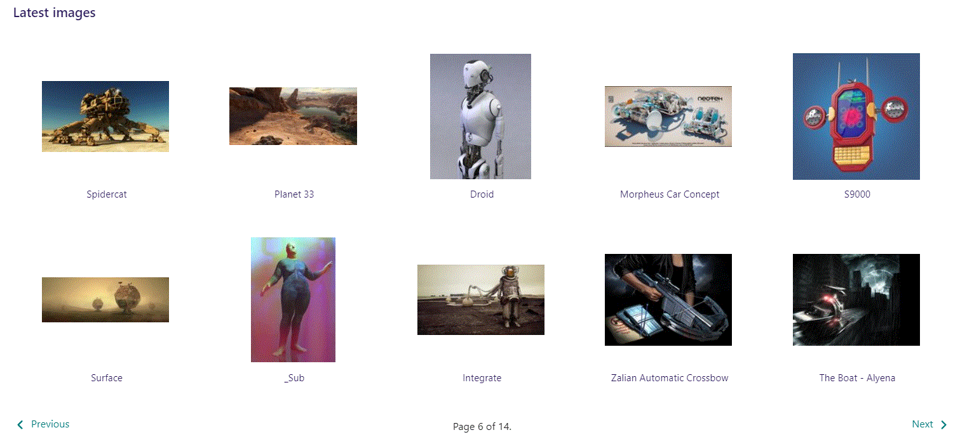
At the bottom of the image selector screen there are navigation buttons.

Slide 18
You can select an image by clicking it.

Slide 19
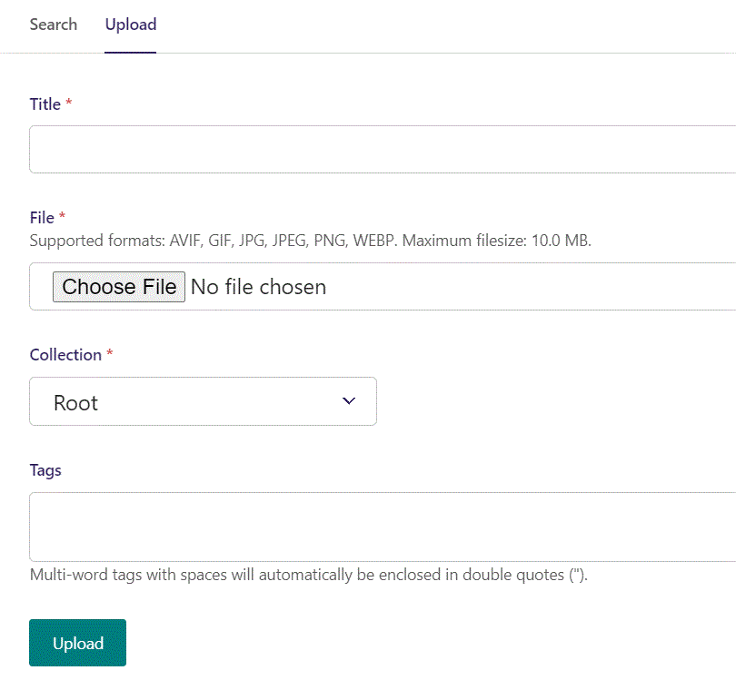
You can also upload an image by clicking Upload.

Slide 20
Name your image here.

Slide 21
Click Choose File to pick your image.

Slide 22
Select which Collection the uploaded image belongs to.

Slide 23
Assign tags to your image. Separate them with a comma.

Slide 24
Finally click Upload, to upload the image.

Slide 25
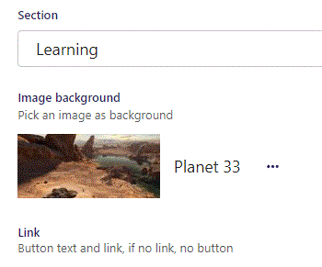
Image chosen.

Slide 26
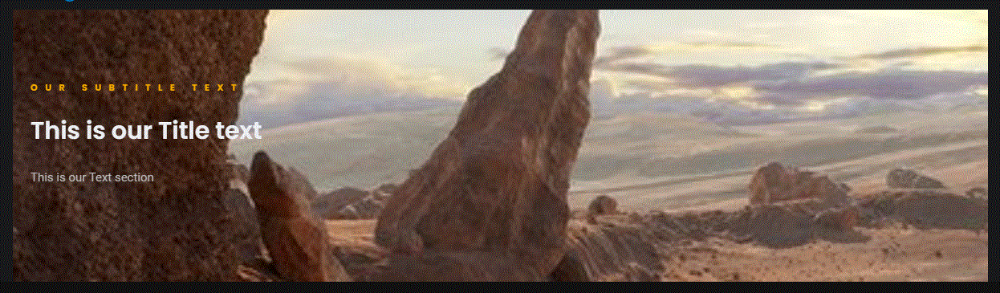
Going live we can see our image have been added.

Slide 27
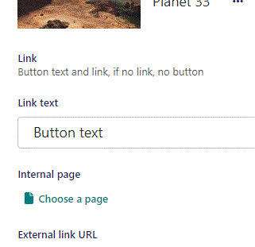
Beneath Choose an image you can write Link text. This functions as the Button text. It will not show until we give it a link below.

Slide 28
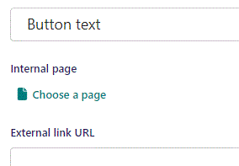
Beneath Link text you can Choose a page as an Internal page link for the Button.

Slide 29
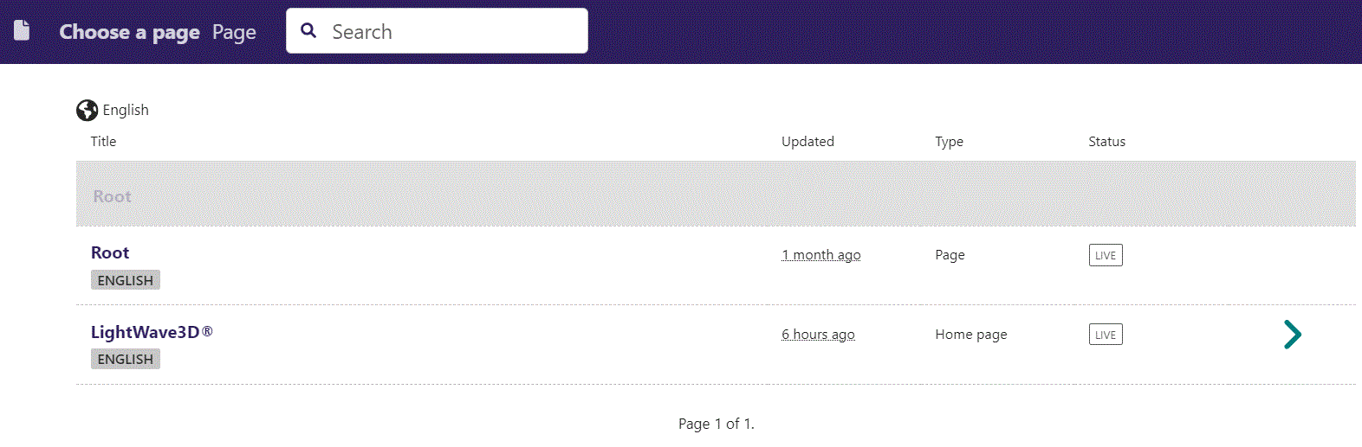
In the page chooser window you can search for the page here.

Slide 30
If a page on the list have pages under it, you can click here to see them.

Slide 31
You select a page by clicking here.

Slide 32
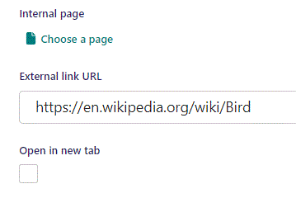
Beneath Choose a page you can write an External link URL as link for the button.

Slide 33
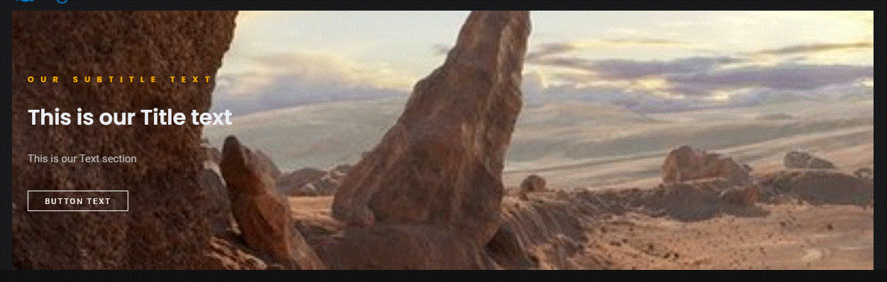
Going live we can see our Button have been added.

Slide 34
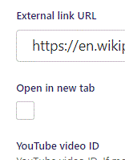
Beneath External link URL you can set Open in new tab. If True, the browser will open the link in a new tab when viewer clicks the button.

Slide 35
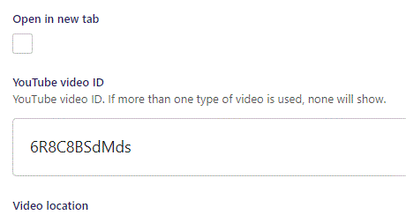
Beneath Open in new tab, you can set YouTube video ID. Note that you should only use the video ID and not the whole embed link.

Slide 36

Going live we can see our YouTube video have been added.

Slide 37
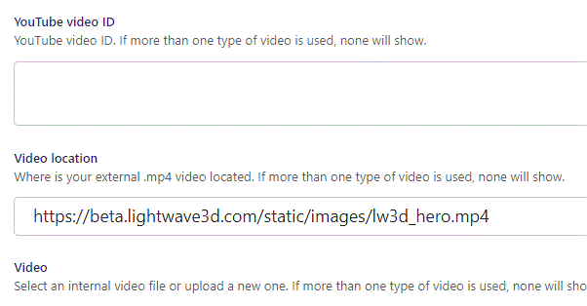
Beneath YouTube video ID you can link to a .mp4 Video location.

Slide 38
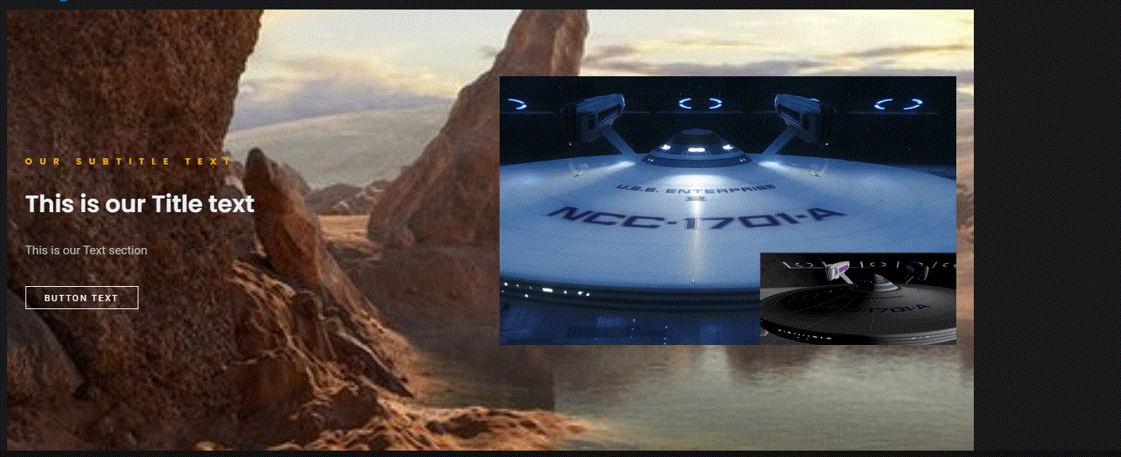
Going live we can see our video have been added.

Slide 39
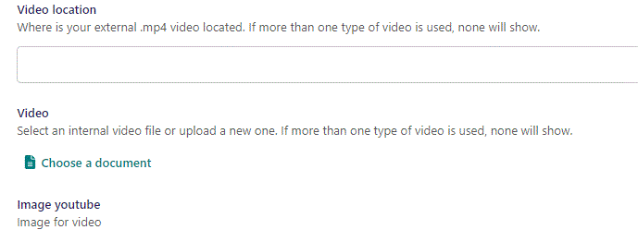
Beneath Video location you can set Video to put an internal video on the HTML page.

Slide 40
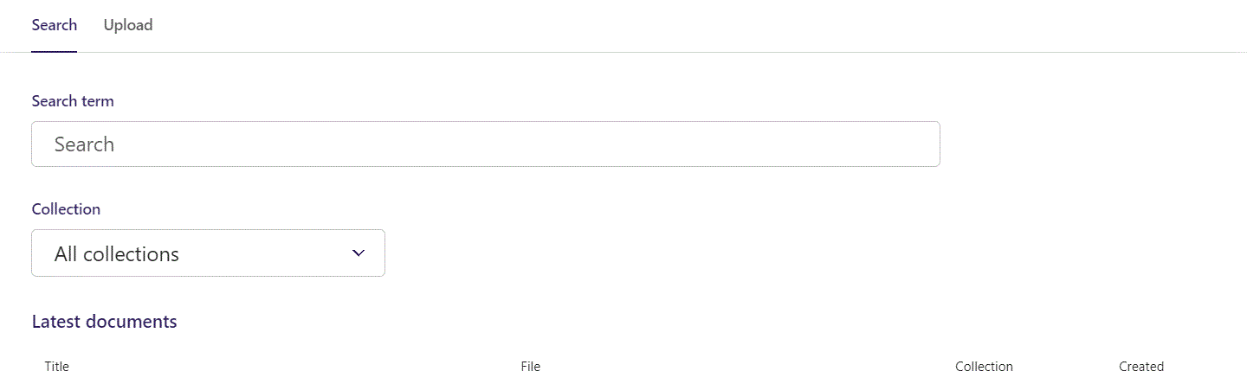
Here you can write Search term.

Slide 41
You can also filter based on Collection.

Slide 42
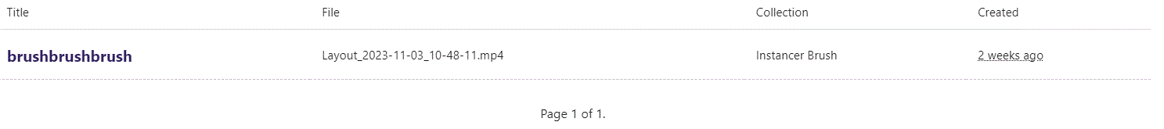
At the bottom section of the Search window, you can select the file you want.

Slide 43
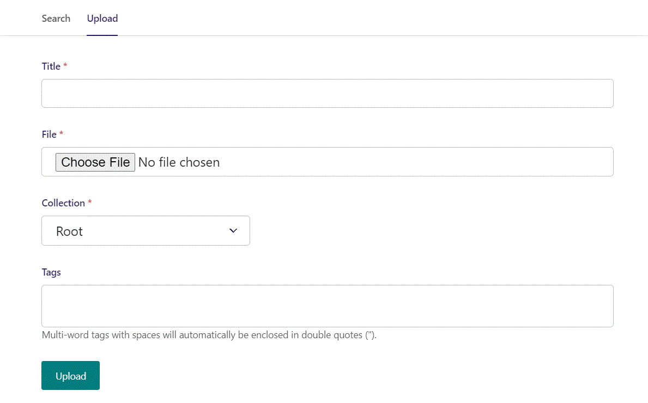
Switching to the Upload window.

Slide 44
Here you can name the file you want to upload.

Slide 45
Here you can pick the file to upload.

Slide 46
Here you can pick a Collection to add your file to.

Slide 47
Here you can associate your file with Tags.

Slide 48
To Upload your file, click here.

Slide 49
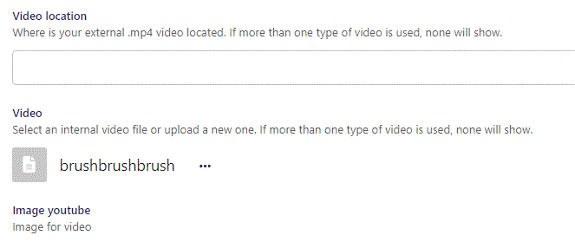
Video chosen.

Slide 50
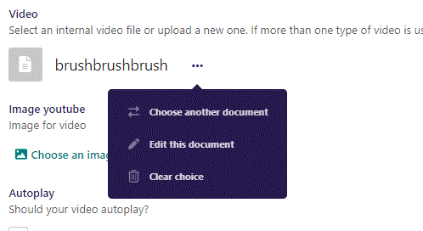
Clicking the 3 dots you can Choose another document, Edit this document or Clear choice.

Slide 51
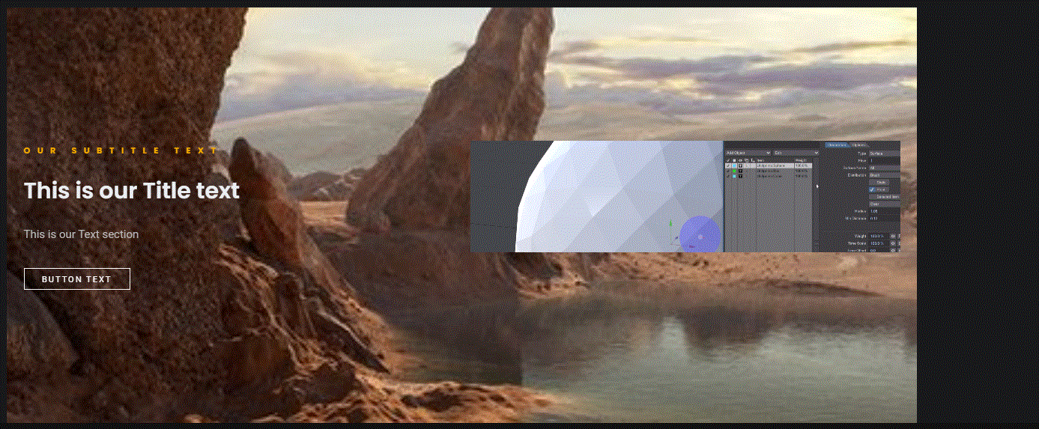
Going live we can see our internal video have been added.

Slide 52
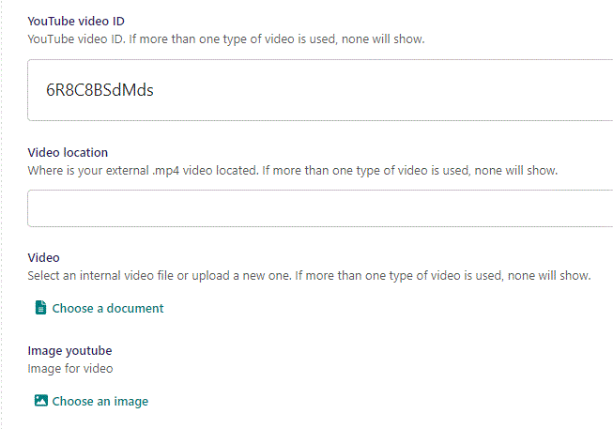
Beneath Video you can Choose an image for YouTube video.

Slide 53
Here we see the top part of the image chooser screen. You can choose to either use an image on the server already or Upload a new image here.
First let’s use an image already on the server.

Slide 54
Here you can write a search term.

Slide 55
Here you can select a Collection of images.

Slide 56
At the bottom you can also sort with Popular tags.

Slide 57
At the bottom of the image selector screen there are navigation buttons.

Slide 58
You can select an image by clicking it.

Slide 59
You can also upload an image by clicking Upload.

Slide 60
Name your image here.

Slide 61
Click Choose File to pick your image.

Slide 62
Select which Collection the uploaded image belongs to.

Slide 63
Assign tags to your image. Separate them with a comma.

Slide 64
Finally click Upload, to upload the image.

Slide 65
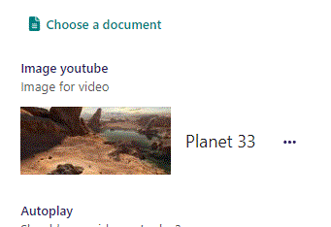
Image chosen.

Slide 66
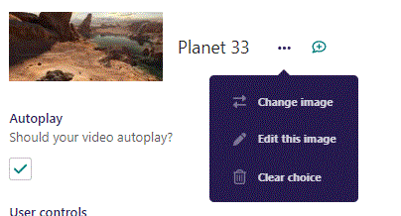
Click the 3 dots to Change image, Edit this image or Clear choice.

Slide 67
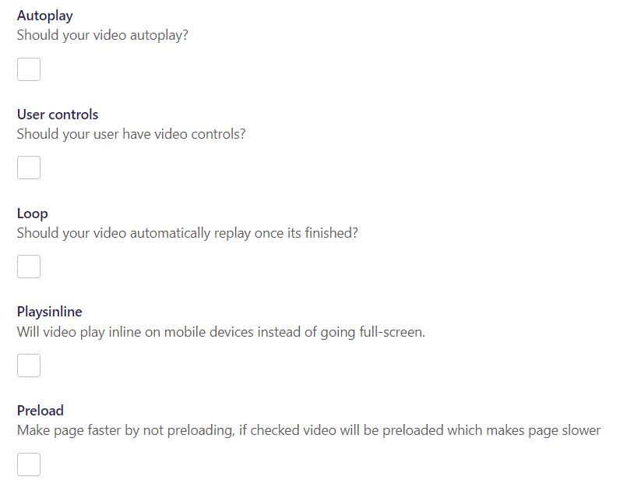
You have several Video options:
Autoplay: Makes your video start automatically when page loads.
User controls: Give your user video controls in the player.
Loop: makes the video automatically repeat.
Playsinline: On mobile devices makes the video play inline instead of full-screen.
Preload: Preload the video before showing page.

Slide 68
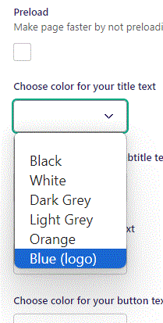
Beneath Preload you can Choose color for your title text. Let’s change it to Blue (logo).

Slide 69
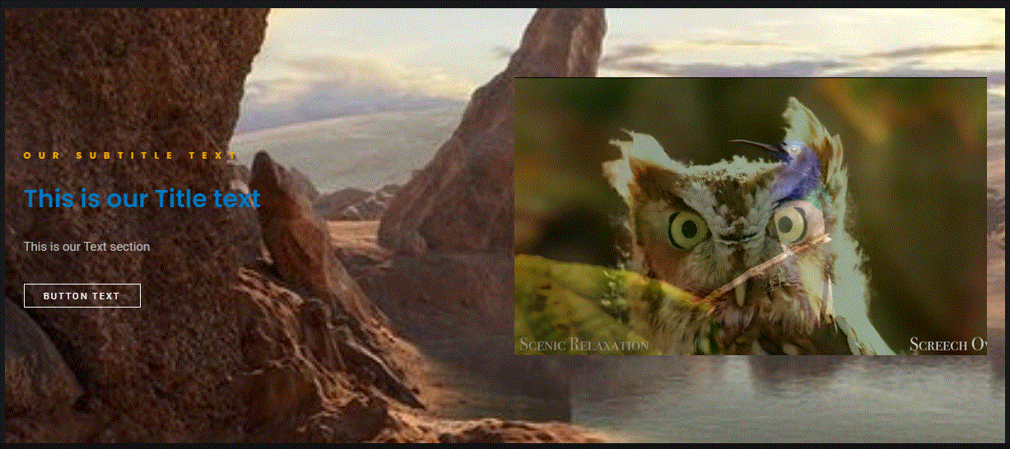
Going live we can see our Title text is now in blue.

Slide 70
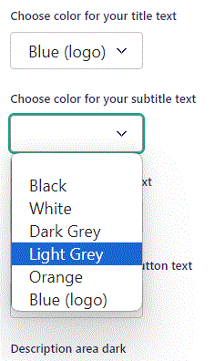
Beneath Choose color for your title text you can Choose color for your subtitle text. Let’s change it to Light Grey.

Slide 71

Going live we can see our Sub title have changed color to Light Grey.

Slide 72
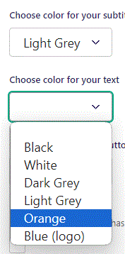
Beneath Choose color for you subtitle you can Choose color for your text. Let’s change it to Orange.

Slide 73
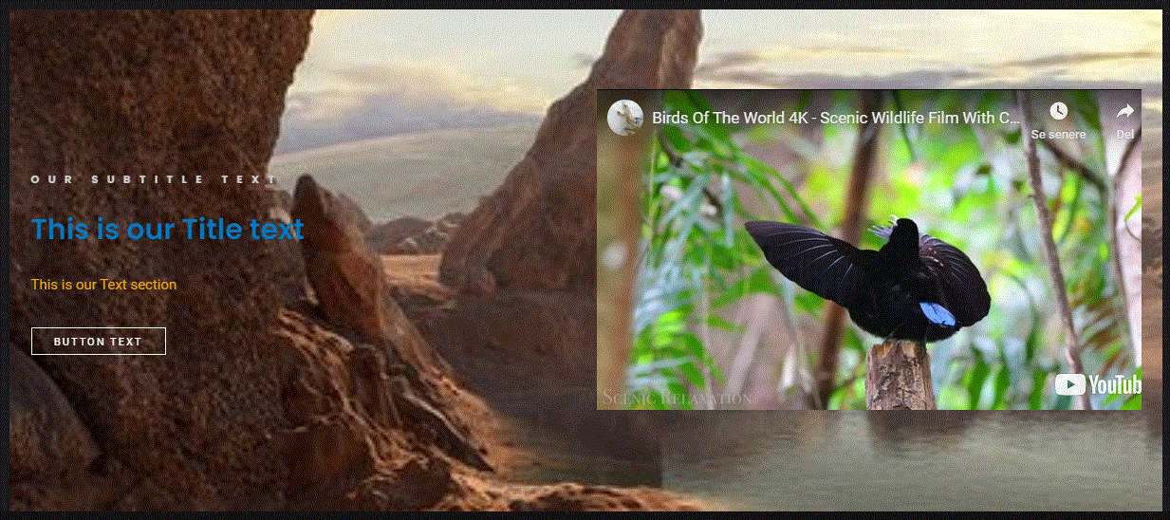
Going live we can see the color of our Text have changed to Orange.

Slide 74
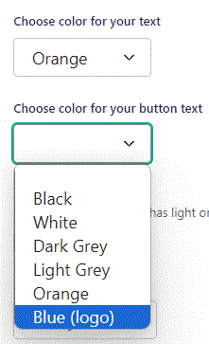
Beneath Choose color for your text you can Choose color for your button text.

Slide 75
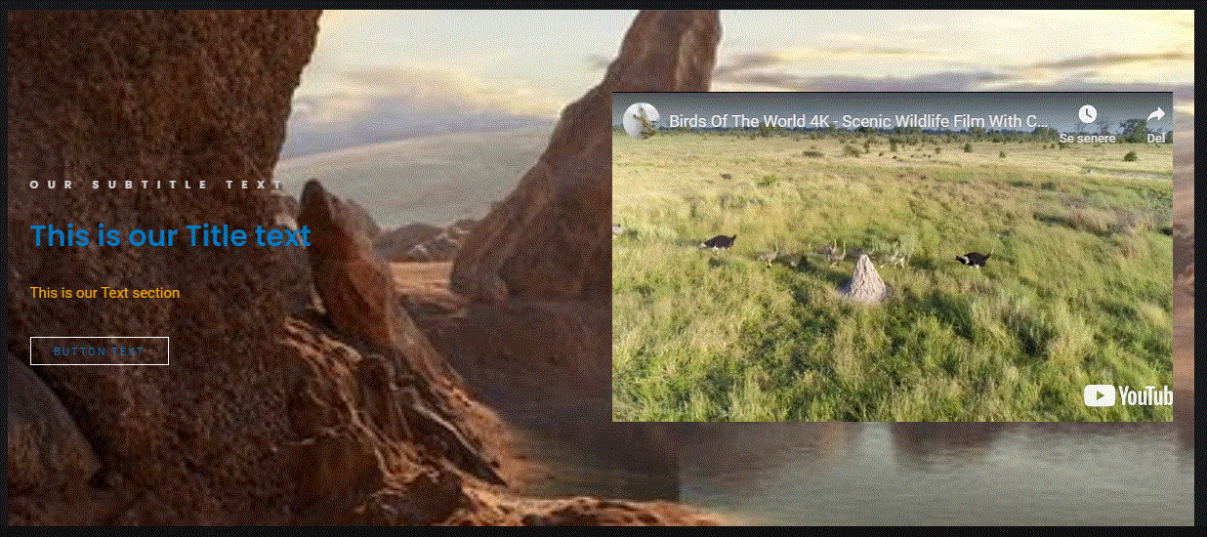
Going live we can see the Button text have changed color to blue.

Slide 76
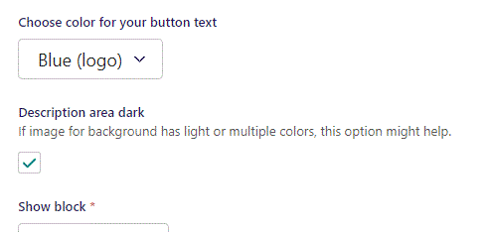
Beneath Choose color for your button text you can set Description area dark. Here we change it to True.

Slide 77
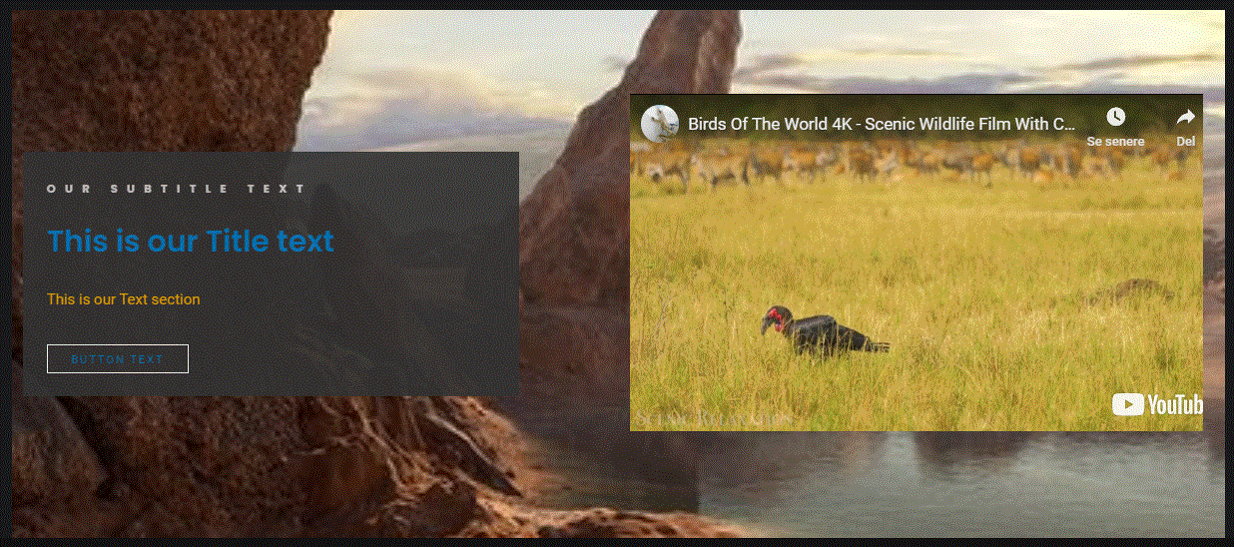
Going live we now have a Dark Grey background in our text area.

Slide 78
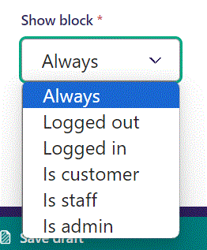
Below Background theme, you can select when or for whom the block will be shown.
Always: Will always show.
Logged out: Only shows when viewer is logged out.
Logged in: Only shows when viewer is logged in.
Is customer: Only shows when viewer is a customer.
Is staff: Only shows if viewer is a staff.
Is admin: Only shows when viewer is an admin.

