Slide 1
Guide for
Banner with full width video Block

Slide 2
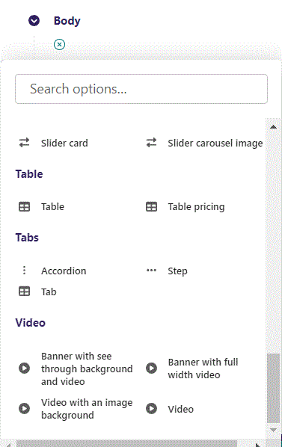
First click the small plus symbol. Then click Banner with full width video to begin creating.

Slide 3
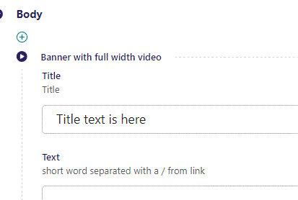
At top you can write Title.

Slide 4
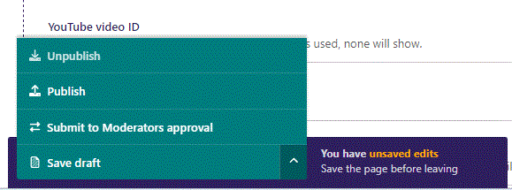
To go live first click the arrow to open the menu. Then click Publish.

Slide 5
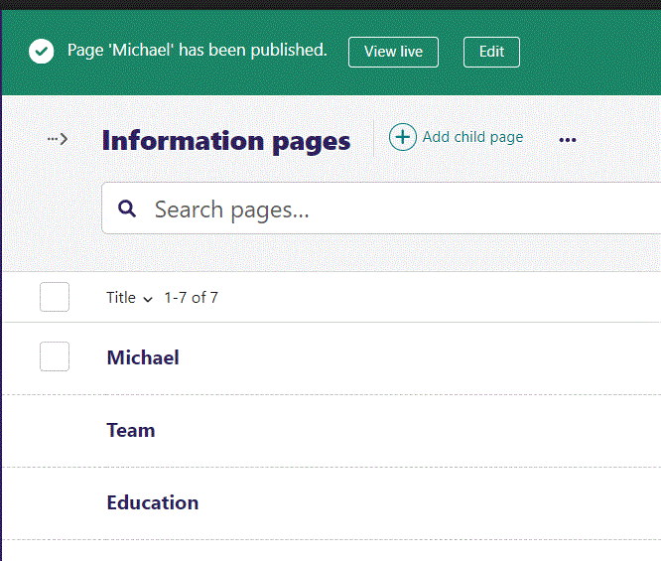
Click View live to open your webpage and see what you created.

Slide 6

Going live we can see our Title text have been added.

Slide 7
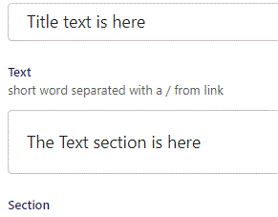
Beneath Title you can write Text.

Slide 8

Going live we can see our Text have been added.

Slide 9
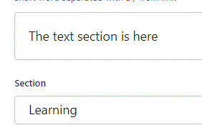
Below Text, you can designate a section that your page will belong to. It is a bookmark for the menu.

Slide 10
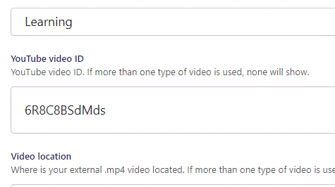
Beneath Section you can set YouTube video ID. Note: Only use video ID and not whole embed link.

Slide 11

Going live we can see our video have been added.

Slide 12
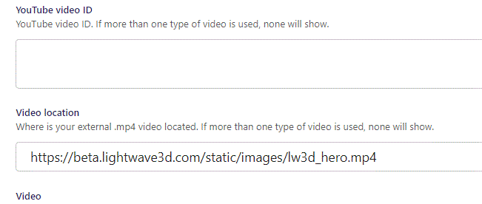
Beneath YouTube video ID you can set Video location for an external .mp4 video.

Slide 13
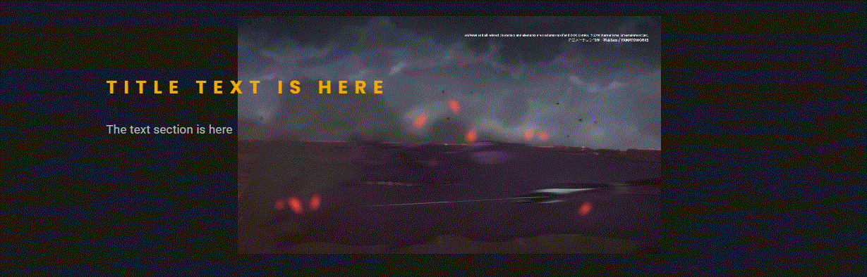
Going live we can see our external video has been added.

Slide 14
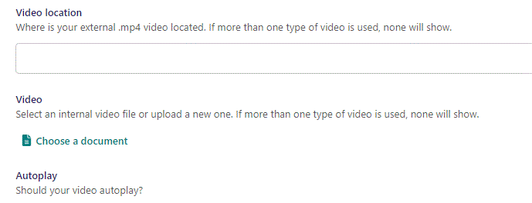
Beneath Video location you can set Video, as an internal video file or upload a new one.

Slide 15
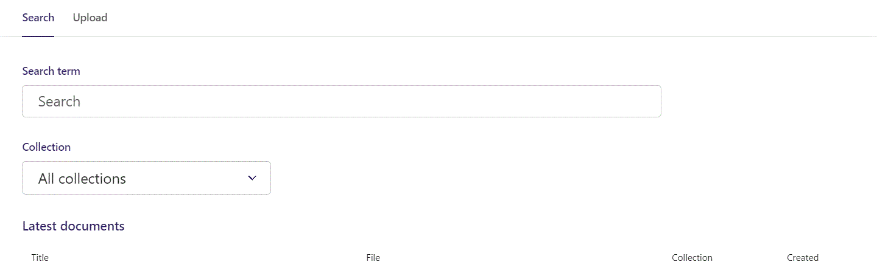
Here you can write Search term.

Slide 16
You can also filter based on Collection.

Slide 17
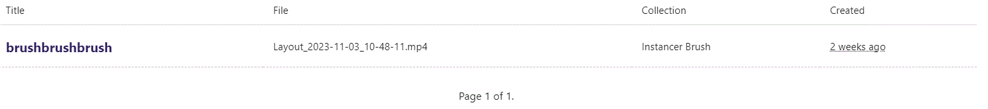
At the bottom section of the Search window, you can select the file you want.

Slide 18
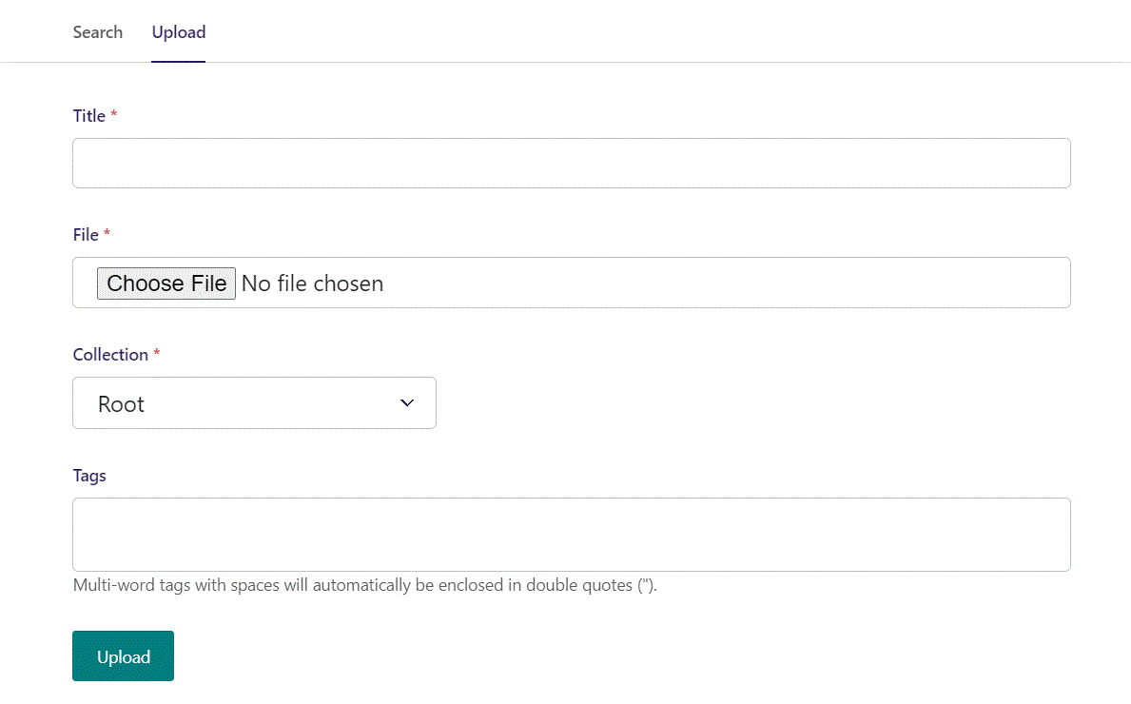
Switching to the Upload window.

Slide 19
Here you can name the file you want to upload.

Slide 20
Here you can pick the file to upload.

Slide 21
Here you can pick a Collection to add your file to.

Slide 22
Here you can associate your file with Tags.

Slide 23
To Upload your file, click here.

Slide 24
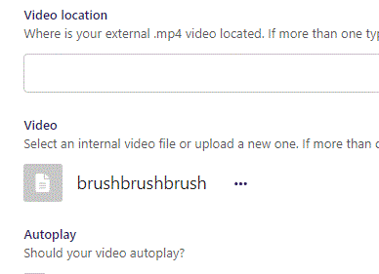
Video chosen.

Slide 25
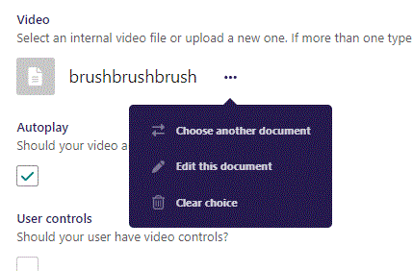
Clicking the 3 dots you can Choose another document, Edit this document or Clear choice.

Slide 26
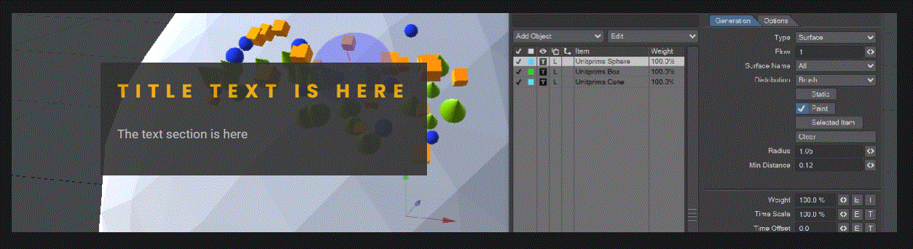
Going live we can see our video has been added. Note that with the right video size format, it can take up the entire banner.
Note we have added a Dark Grey background to our text. More on that later.

Slide 27
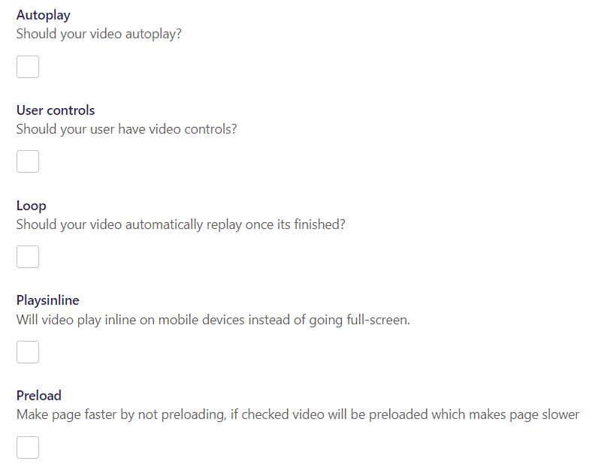
You have several Video options:
Autoplay: Makes your video start automatically when page loads.
User controls: Give your user video controls in the player.
Loop: makes the video automatically repeat.
Playsinline: On mobile devices makes the video play inline instead of full-screen.
Preload: Preload the video before showing page.

Slide 28
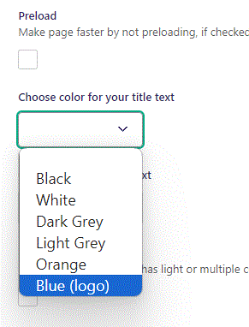
Beneath Preload you can Choose color for your title text. Let’s set it to Blue (logo).

Slide 29
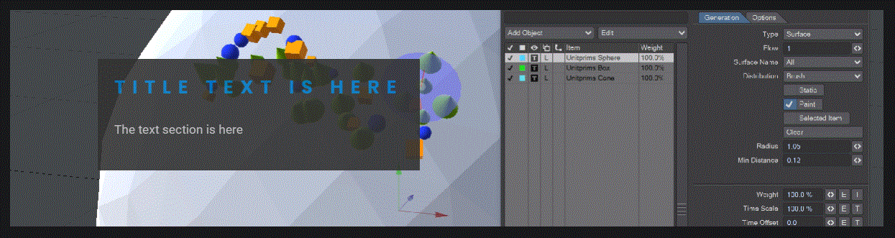
Going live we can see the color of our Title have changed to blue.

Slide 30
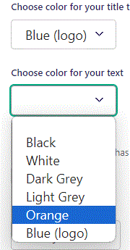
Beneath Choose color for you title you can Choose color for your text. Let’s change it to Orange.

Slide 31
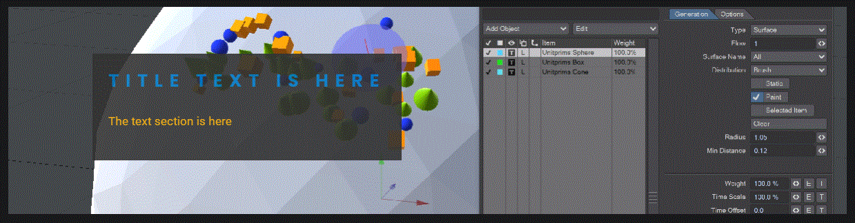
Going live we can see the color of our Text have changed to Orange.

Slide 32
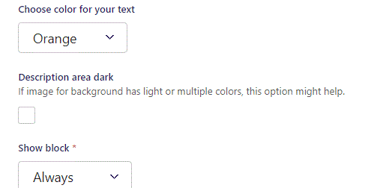
Beneath Choose color for your text you can set Description area dark. We have had it set to Let’s change it to False.

Slide 33
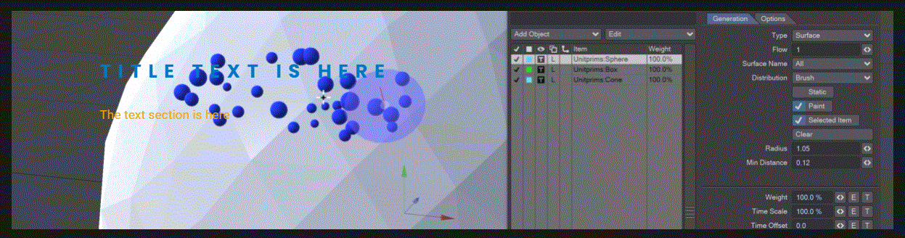
Going live we can see the Dark Grey background behind our text has been removed.

Slide 34
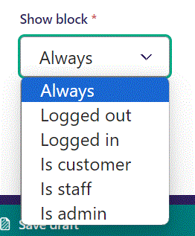
Below Description area dark, you can select when or for whom the block will be shown.
Always: Will always show.
Logged out: Only shows when viewer is logged out.
Logged in: Only shows when viewer is logged in.
Is customer: Only shows when viewer is a customer.
Is staff: Only shows if viewer is a staff.
Is admin: Only shows when viewer is an admin.

