Slide 1
Guide For
Title Block

Slide 2
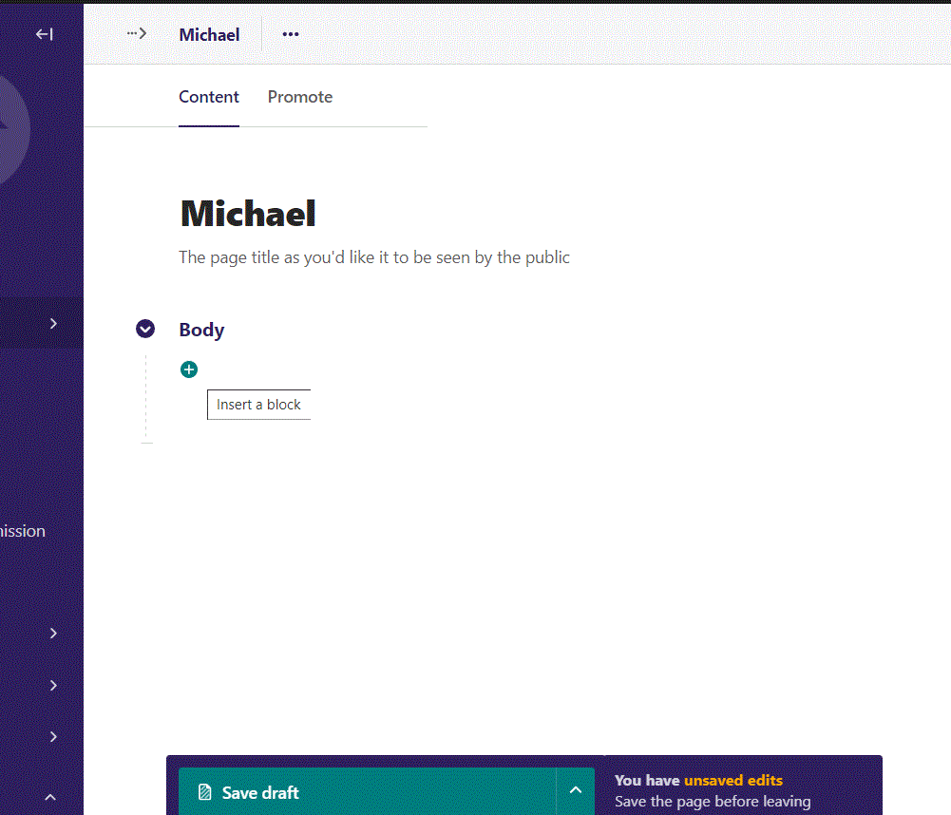
Click the plus symbol to open block menu

Slide 3
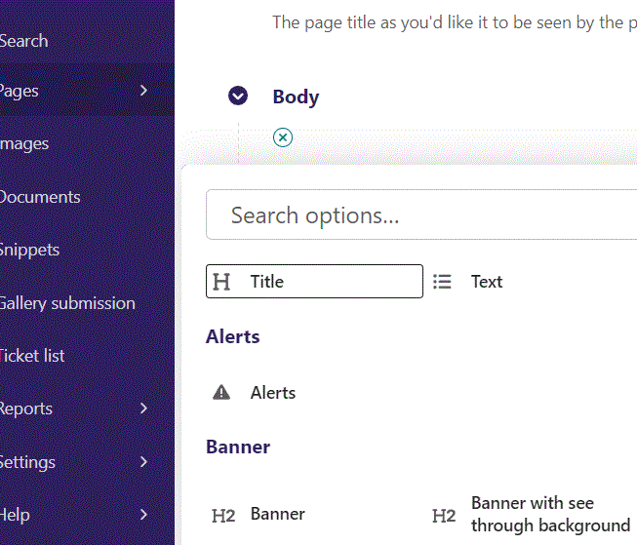
Click Title

Slide 4
Write your Title text

Slide 5
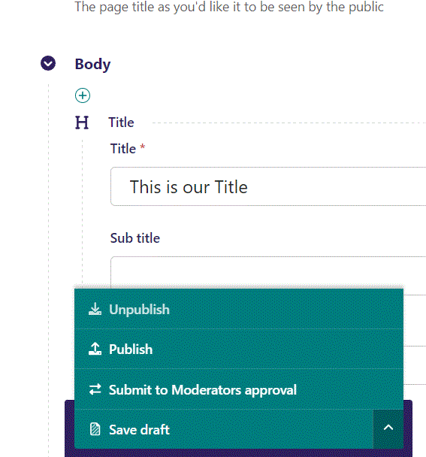
Publish your work by first clicking the arrow, then select Publish from the menu.

Slide 6
Click View live to open your webpage and see what you created.

Slide 7
Your Title on the webpage.

Slide 8
Going back to Wagtail Admin, we can also add a Sub title. It’s just below Title. Remember to publish your work.

Slide 9
Here we see our Sub title live, located just below our Title.

Slide 10
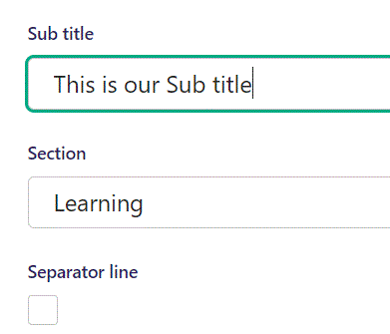
Below Sub title, you can designate a section that your page will belong to. It is a bookmark for the menu.

Slide 11
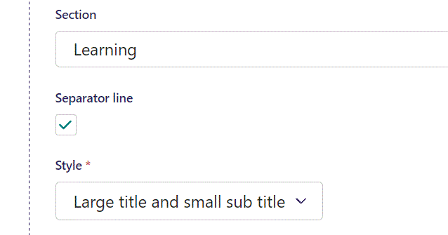
Below Section, you can select if you want a Separator line.

Slide 12
Going live, our separator line appears below Title and Sub title.

Slide 13
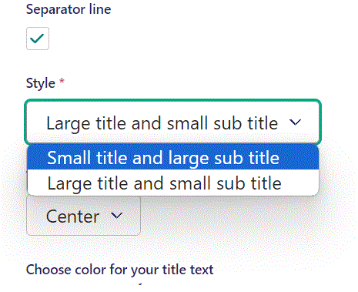
Below Separator line, you can select Style. There are two options, shown here. Previously we had Large title and small sub title. Let's pick Small title and large sub title.

Slide 14
Going live, after publishing our changes, our Sub title is now the biggest type, and the Title have changed into the smaller type.

Slide 15
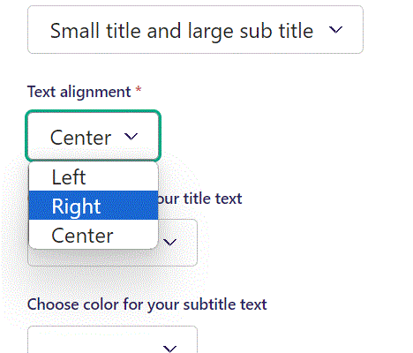
Below style, we can select Text alignment. You can select between Left, Right or Center for alignment. Lets make our Title align to the Right.

Slide 16
Going live, our Title text are now aligned to the right side of the screen.

Slide 17
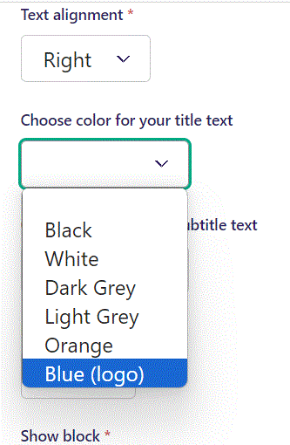
Below alignment, we can select a different color for our Title text. Lets select Blue (logo).

Slide 18
Going live, our Title has now changed color, to blue.

Slide 19
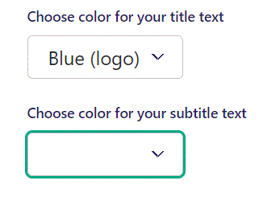
You can also change the color of your Sub title, in the same manner as for Title.

Slide 20
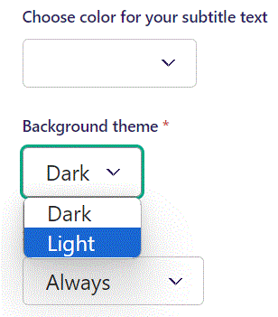
Below sub title color choice, you can select Background theme. Let’s switch to a Light Background theme.

Slide 21
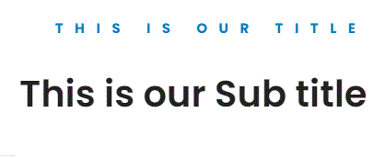
Going live, we can see that our background color changed from dark to a light color.

Slide 22
Below Background theme, you can select when or for whom the block will be shown.
Always: Will always show.
Logged out: Only shows when viewer is logged out.
Logged in: Only shows when viewer is logged in.
Is customer: Only shows when viewer is a customer.
Is staff: Only shows if viewer is a staff.
Is admin: Only shows when viewer is an admin.

