Slide 1
Guide for
Text Block

Slide 2
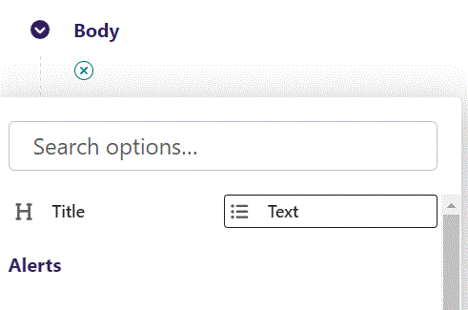
First click the small plus symbol. Then click Text to begin creating a Text block.

Slide 3
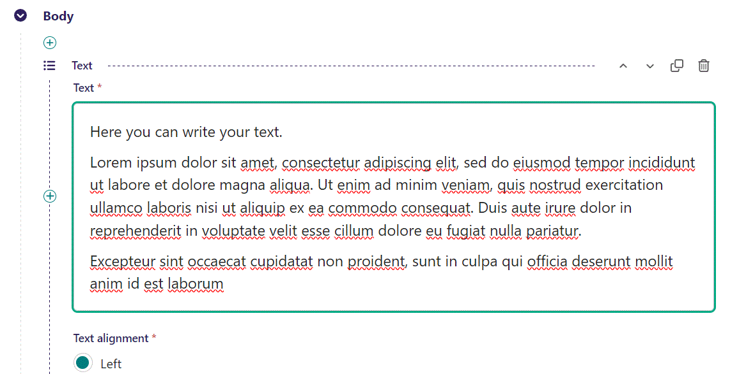
In the text field you can write your text.

Slide 4
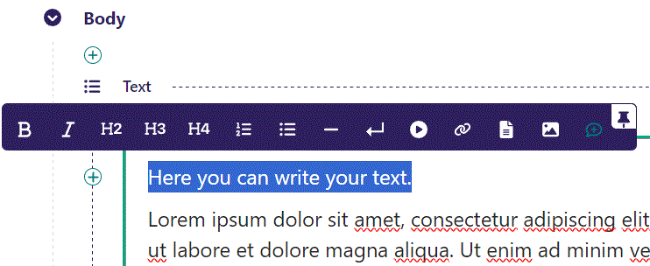
The text field is a rich text editor. By marking a section, a menu will appear. Here you can do simple editing, and insert videos, links, images or a documents.
Let’s change the first line to a H2 and publish.

Slide 5
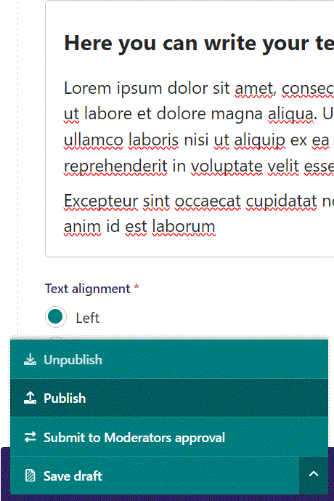
Publish your work by first clicking the arrow, then select Publish from the menu.

Slide 6
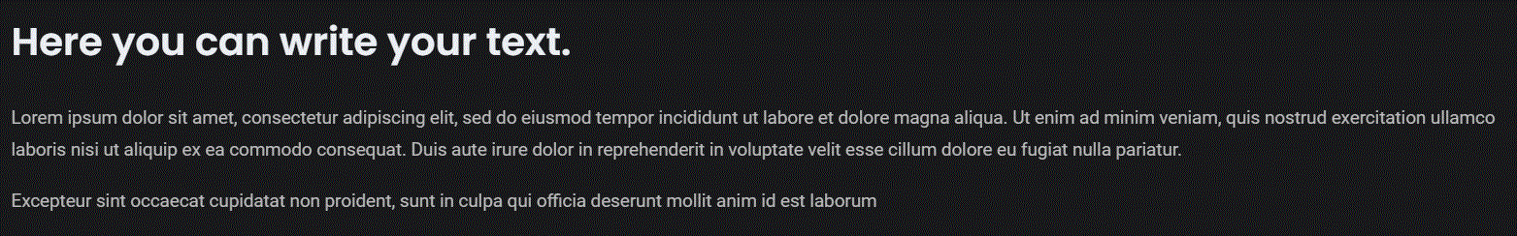
Our text shown live.

Slide 7
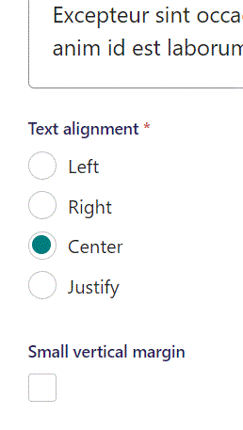
Below the text field, you can adjust Text alignment. Let’s set it to Center.

Slide 8
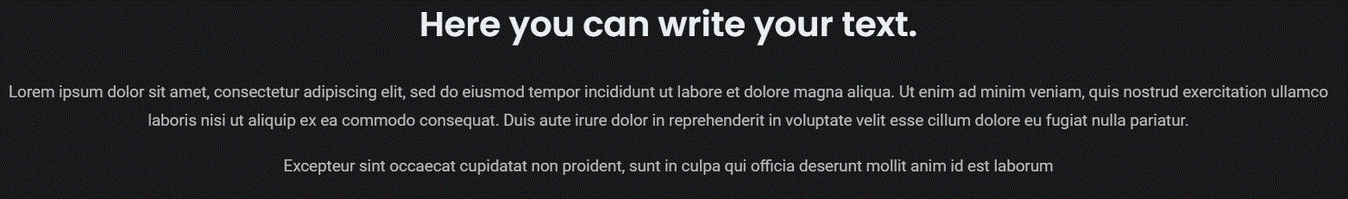
Our text is now centered.

Slide 9
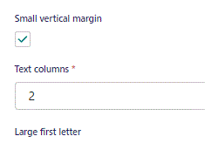
Below Text alignment you can select Smal vertical margin. This makes the distance below and above the block smaller.
Below Small vertical margin, you can select number of Text columns. Let’s set this to 2 and see the result live.

Slide 10
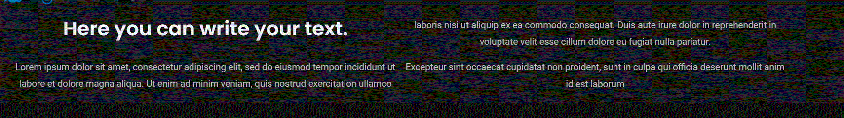
Going live we can see we now have two text columns.
Also, you can see that the lighter gray background color, showing the size of the Text block is now small.

Slide 11
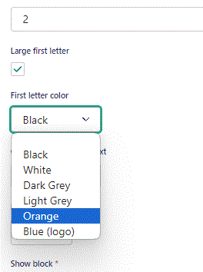
Below Text columns, you can select to have a Large letter first,
You can also set what color this larger first letter have. Let’s make a large first letter and set it to be Orange.

Slide 12
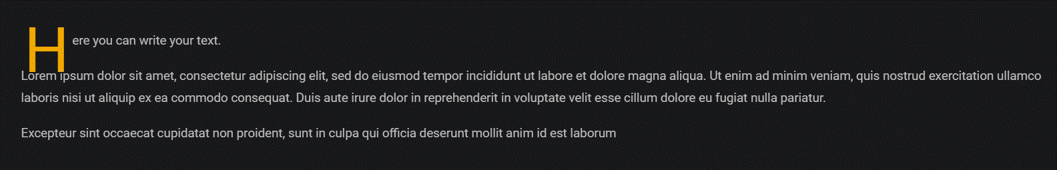
Going live. To keep it simple we have set columns to 1 and reverted the first line into a normal line.
You can see the first letter, a H, is now big and orange.

Slide 13
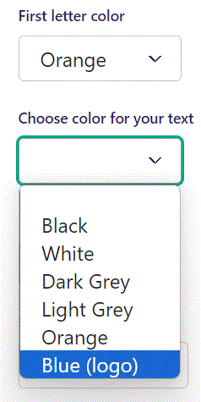
Below First letter color, you can set Choose color for your text. Let’s set it to Blue (logo).

Slide 14
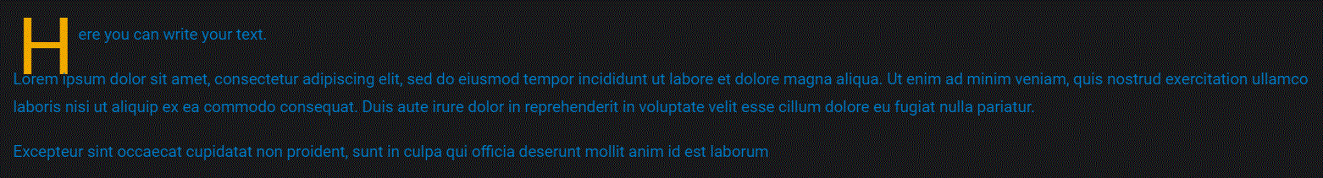
Going live, we can see our text is now blue.

Slide 15
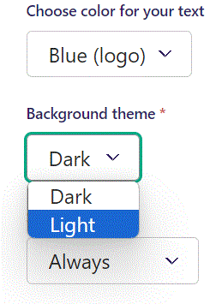
Below Choose color for your text, you can set the Background theme. Let’s set it to Light.

Slide 16
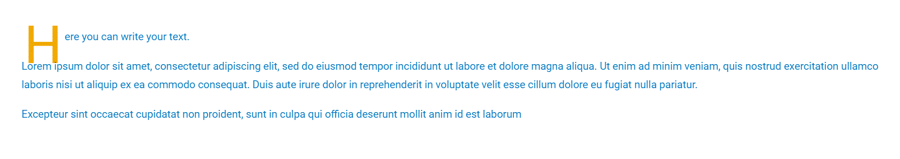
Going live, we can see our background have changed from a dark to a light color.

Slide 17
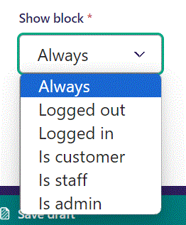
Below Background theme, you can select when or for whom the block will be shown.
Always: Will always show.
Logged out: Only shows when viewer is logged out.
Logged in: Only shows when viewer is logged in.
Is customer: Only shows when viewer is a customer.
Is staff: Only shows if viewer is a staff.
Is admin: Only shows when viewer is an admin.

