Slide 1
Guide for
Tab Block

Slide 2
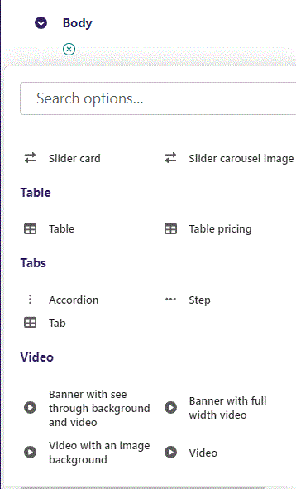
First click the small plus symbol. Then click Tab to begin creating.

Slide 3
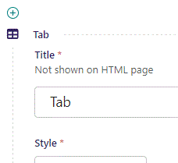
At the top you can write Title. It will not show on HTML page but will function as a title in admin.

Slide 4
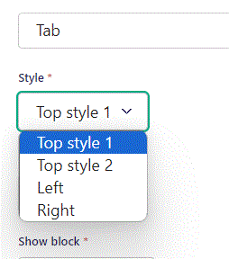
Beneath Title you can set Style. Let’s go through the 4 choices.

Slide 5
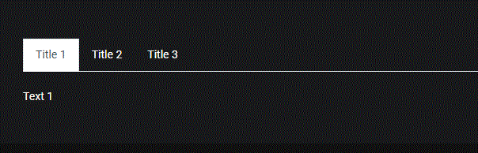
Style: Top style 1.

Slide 6
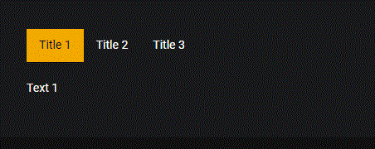
Style: Top style 2.

Slide 7
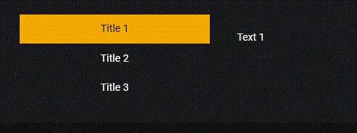
Style: Left.

Slide 8
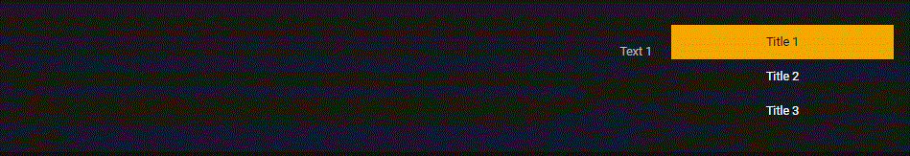
Style: Right.

Slide 9
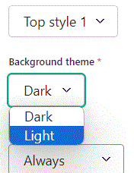
Beneath Style you can set Background theme.

Slide 10
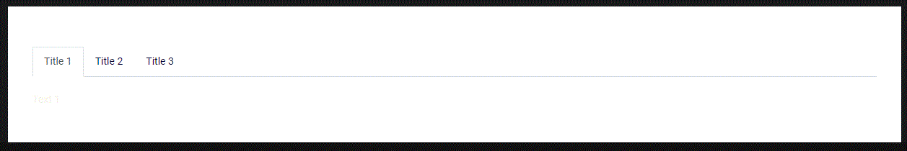
Background theme: Light.

Slide 11
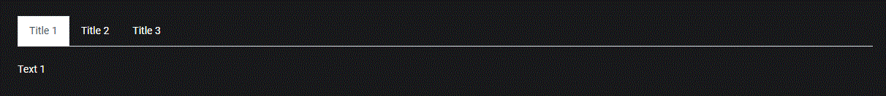
Background theme: Dark.

Slide 12
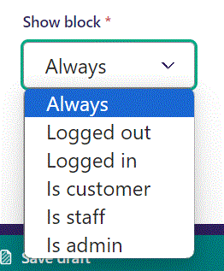
Below Background theme, you can select when or for whom the block will be shown.
Always: Will always show.
Logged out: Only shows when viewer is logged out.
Logged in: Only shows when viewer is logged in.
Is customer: Only shows when viewer is a customer.
Is staff: Only shows if viewer is a staff.
Is admin: Only shows when viewer is an admin.

Slide 13
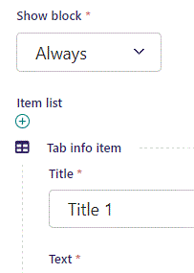
Beneath Show block you can write Title.

Slide 14
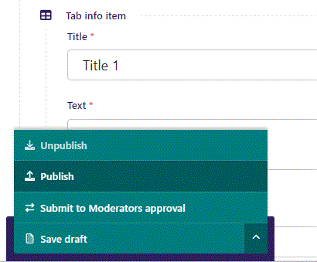
To go live first click the arrow to open the menu. Then click Publish.

Slide 15
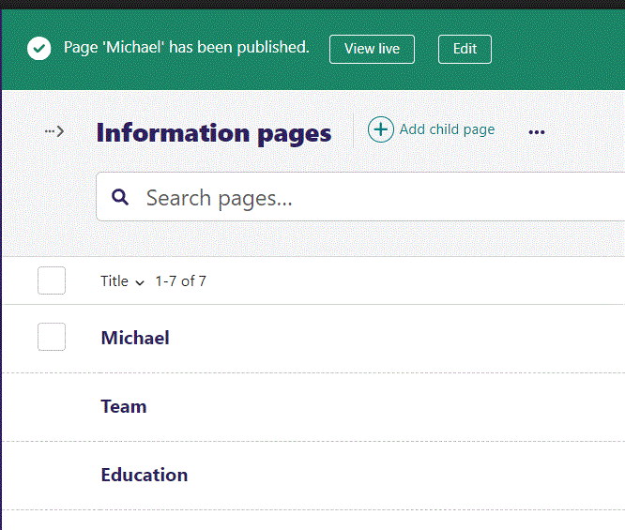
Click View live to open your webpage and see what you created.

Slide 16
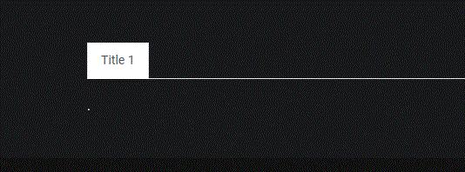
Going live we see our Title.

Slide 17
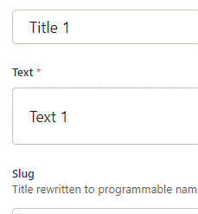
Beneath Title you can write Text.

Slide 18
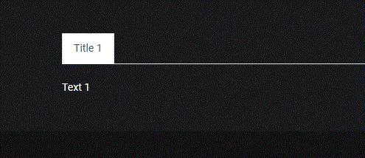
Going live we can see our Text.

Slide 19
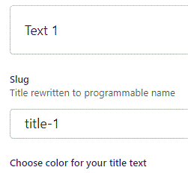
Beneath Title is Slug. This is automatically generated for the code.

Slide 20
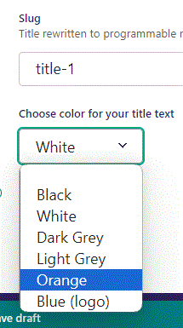
Beneath Slug you can Choose color for your title text. Let’s set it to Orange.

Slide 21
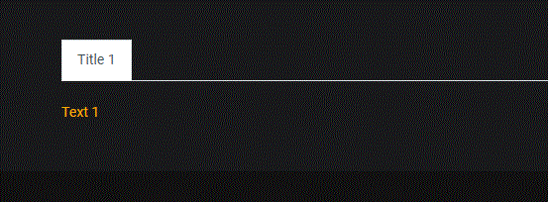
Going live we can see our Text is now Orange.

Slide 22
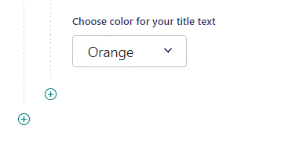
To create a new item, click the plus icon.

Slide 23
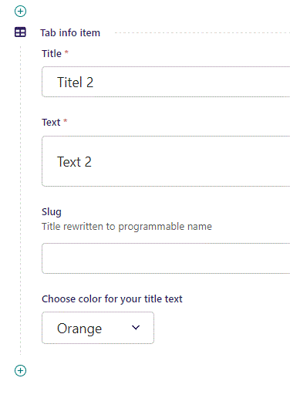
Fill out the fields as previous.

Slide 24
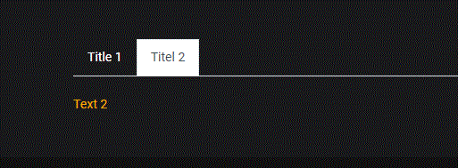
Going live we can see our new item have been added.

