Slide 1
Guide for
Step Block

Slide 2
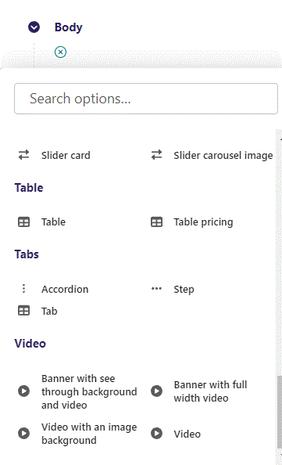
First click the small plus symbol. Then click Step to begin creating.

Slide 3
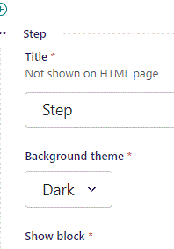
At the top you can write Title. This will not be shown in the HTML page. It will be a title in the admin.

Slide 4
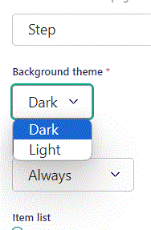
Beneath Title you can set Background theme.

Slide 5
Background theme: Light

Slide 6
Background theme: Dark.

Slide 7
Below Background theme, you can select when or for whom the block will be shown.
Always: Will always show.
Logged out: Only shows when viewer is logged out.
Logged in: Only shows when viewer is logged in.
Is customer: Only shows when viewer is a customer.
Is staff: Only shows if viewer is a staff.
Is admin: Only shows when viewer is an admin.

Slide 8
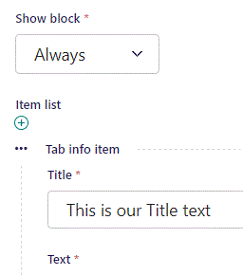
Beneath Show block you can write Title.

Slide 9
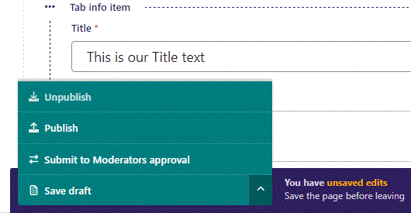
To go live first click the arrow to open the menu. Then click Publish.

Slide 10
Click View live to open your webpage and see what you created.

Slide 11
Going live we can see our Title text.

Slide 12
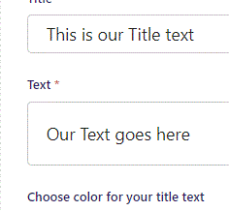
Beneath Title you can write Text.

Slide 13
Going live we see our Text.

Slide 14
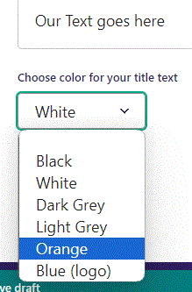
Beneath Text you can Choose color for your title text. Let’s change it to Orange.

Slide 15
Going live we can see the color of our Text have changed to Orange.

Slide 16
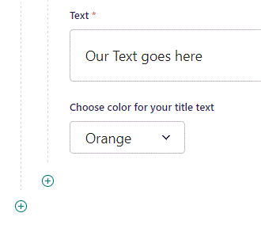
To add a new item, click the plus icon.

Slide 17
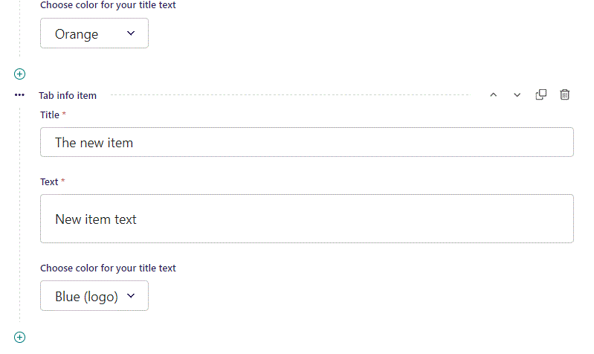
Fill out the fields as previously.

Slide 18
Going live we can see our new item have been added.

