Slide 1
Guide for
Accordion Block

Slide 2
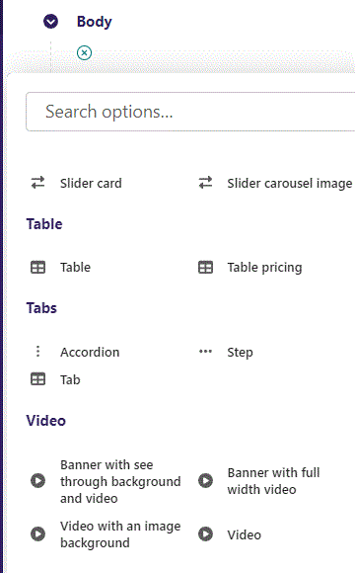
First click the small plus symbol. Then click Accordion to begin creating.

Slide 3
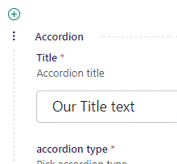
At the top you can write Title.

Slide 4
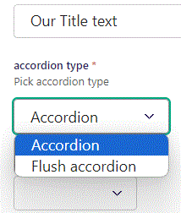
Beneath Title you can choose accordion type. Two types are available.

Slide 5
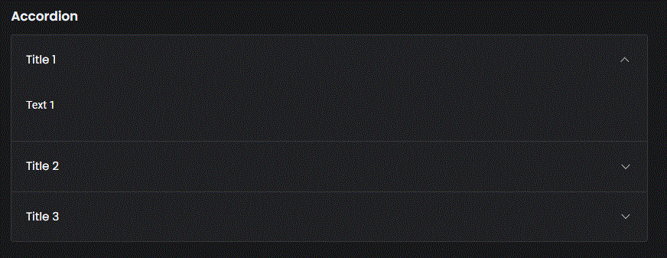
Accordion type: Accordion. Notice the rounded corners.

Slide 6
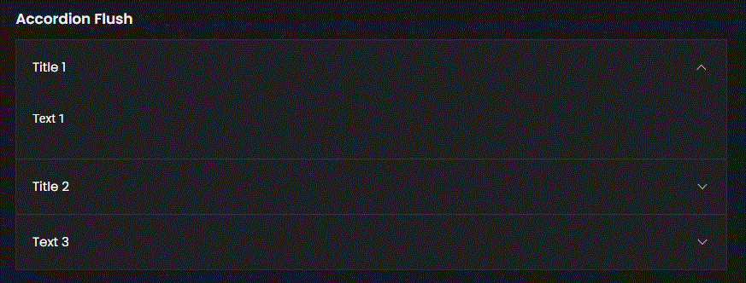
Accordion type: Flush accordion. Notice the sharp corners.

Slide 7
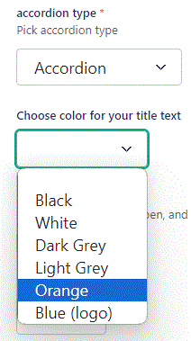
Beneath accordion type you can Choose color for your title text. Let’s change it to Orange.

Slide 8
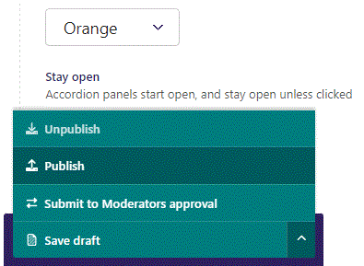
To go live first click the arrow to open the menu. Then click Publish.

Slide 9
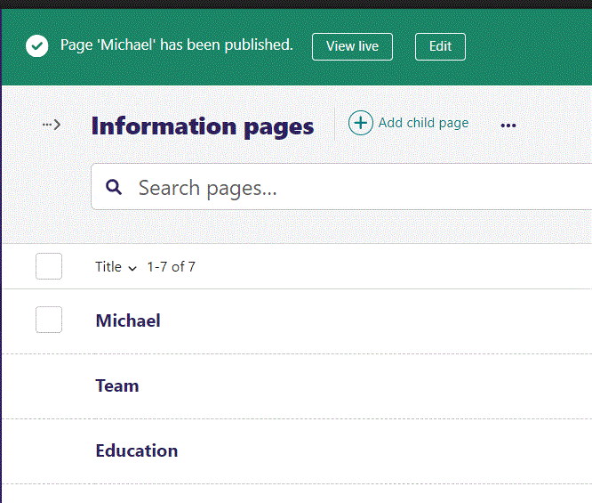
Click View live to open your webpage and see what you created.

Slide 10
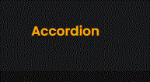
Going live we can see our Title is now in Orange color.

Slide 11
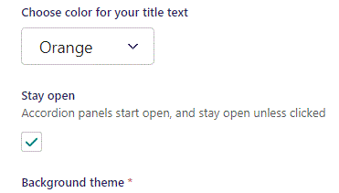
Beneath Choose color for your Title you can set Stay open.

Slide 12
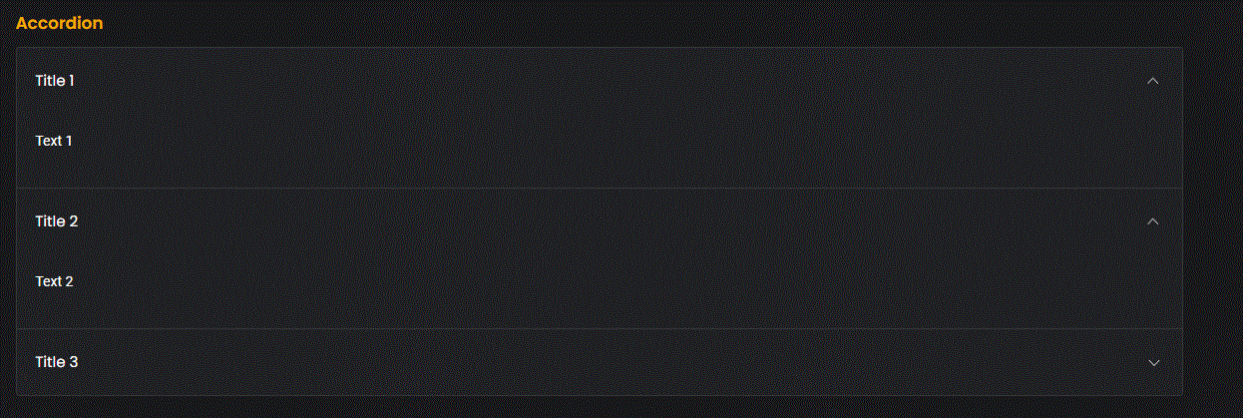
Going live we can see that with Stay open we can open more than one panel at a time.

Slide 13
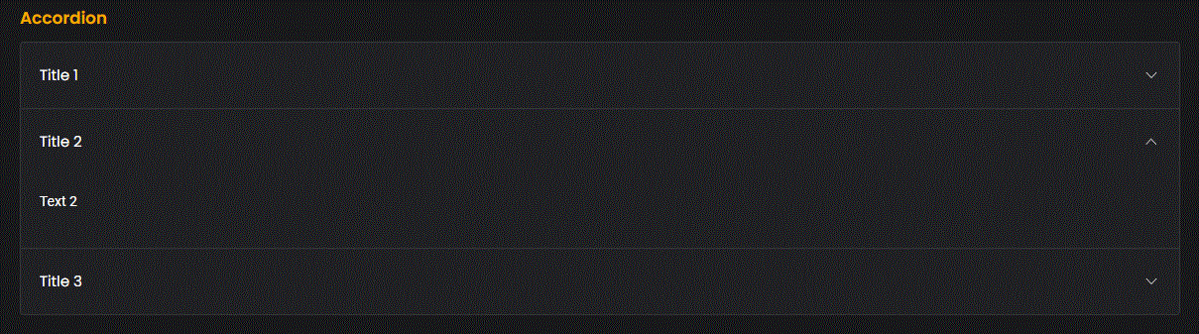
When Stay open is False we can only open 1 panel at a time.

Slide 14
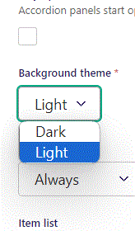
Beneath Stay open you can set Background theme.

Slide 15
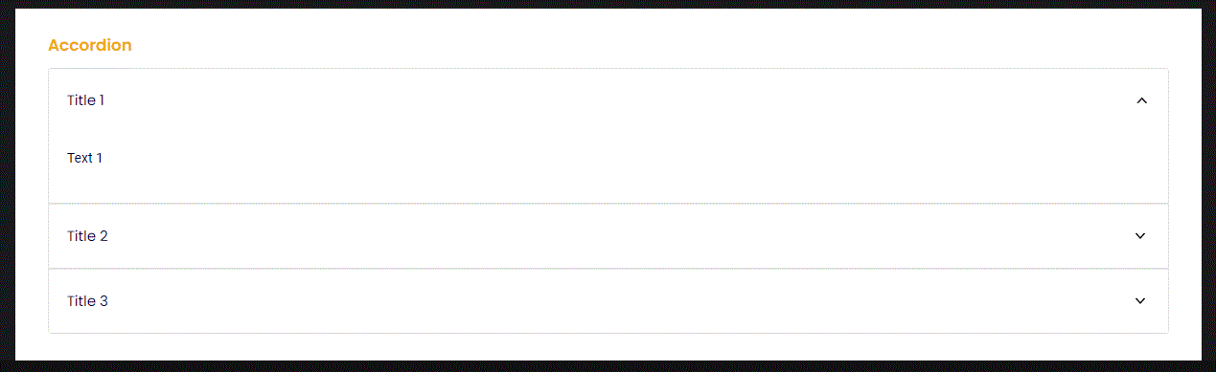
Going live with Background theme Light.

Slide 16
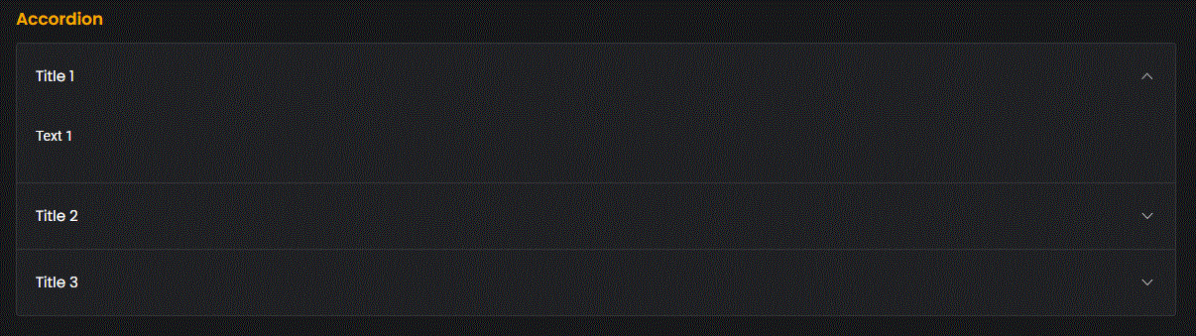
Going live with Background theme Dark.

Slide 17
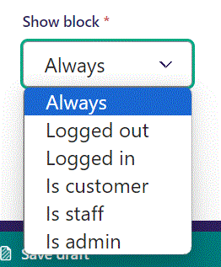
Below Background theme, you can select when or for whom the block will be shown.
Always: Will always show.
Logged out: Only shows when viewer is logged out.
Logged in: Only shows when viewer is logged in.
Is customer: Only shows when viewer is a customer.
Is staff: Only shows if viewer is a staff.
Is admin: Only shows when viewer is an admin.

Slide 18
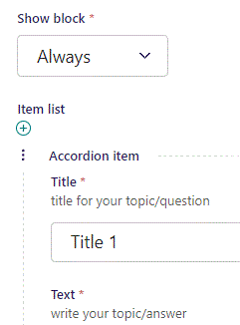
Beneath Show block you can write Title.

Slide 19
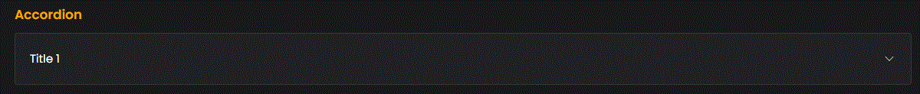
Going live we can see our panel, Title.

Slide 20
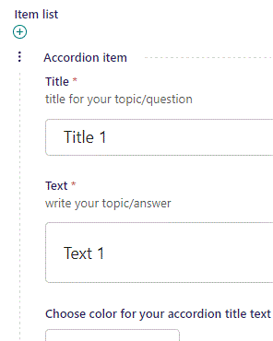
Beneath Title you can write Text.

Slide 21
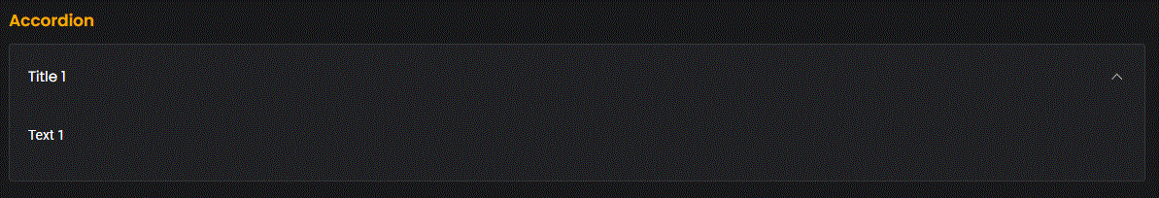
Going live we can see our Text

Slide 22
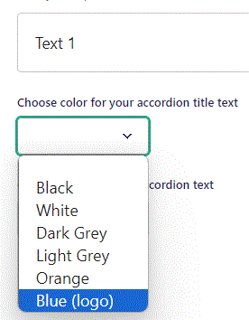
Beneath Text you can Choose color for your accordion title text. Let’s change it to Blue (logo).

Slide 23
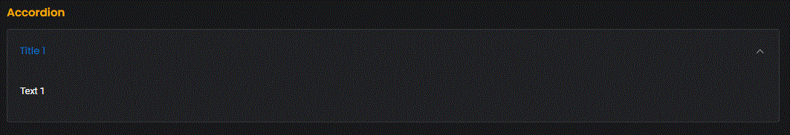
Going live we can see our accordion title text is now blue.

Slide 24
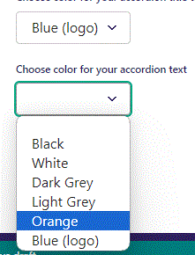
Beneath Choose color for your accordion title text you can Choose color for your accordion text. Let’s change it to Orange.

Slide 25
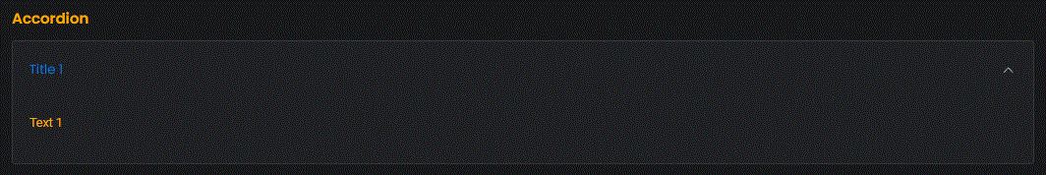
Going live we can see the text color is now Orange.

Slide 26
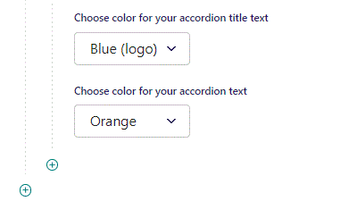
To add a new item, click the plus icon.

Slide 27
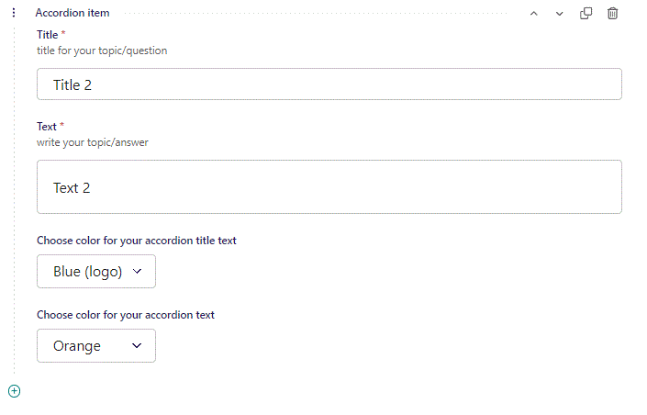
Fill out the fields as before.

Slide 28
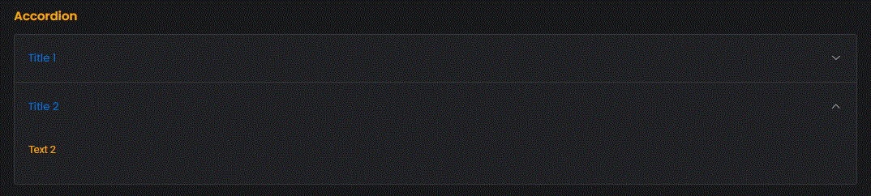
Going live we can see our new item have been added.

