Slide 1
Guide for
Table pricing Block

Slide 2
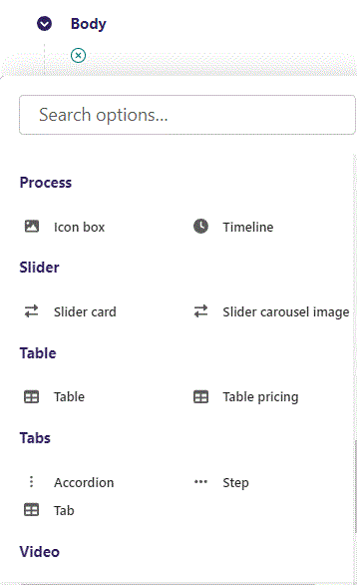
First click the small plus symbol. Then click Table pricing to begin creating.

Slide 3
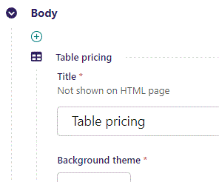
At the top you can write Title. It is not shown on the HTML page, but will be used as a title in the admin.

Slide 4
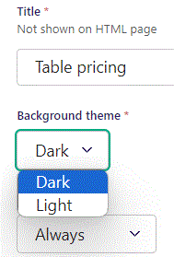
Beneath Title you can set Background theme. Dark theme will give your block a dark background. The Light setting will give it a light background color. We will set it to Dark.

Slide 5
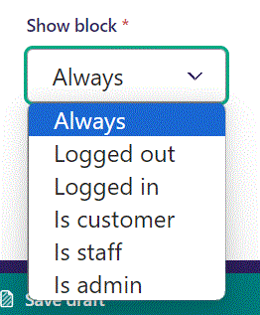
Below Background theme, you can select when or for whom the block will be shown.
Always: Will always show.
Logged out: Only shows when viewer is logged out.
Logged in: Only shows when viewer is logged in.
Is customer: Only shows when viewer is a customer.
Is staff: Only shows if viewer is a staff.
Is admin: Only shows when viewer is an admin.

Slide 6
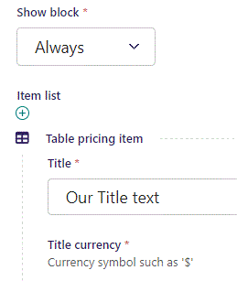
Beneath Show block you can write Title.

Slide 7
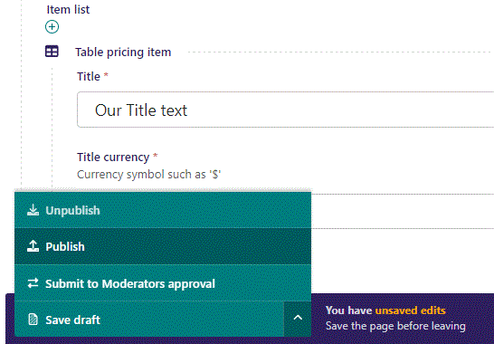
To go live first click the arrow to open the menu. Then click Publish.

Slide 8
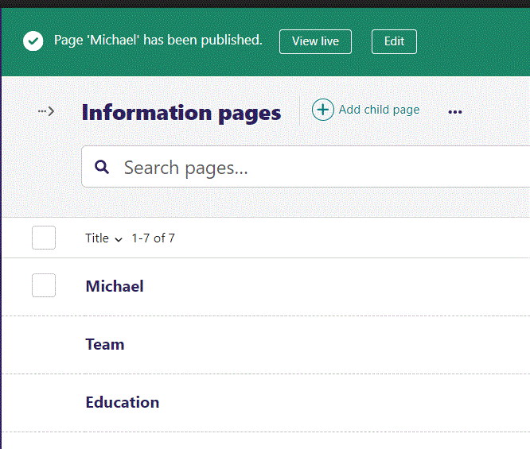
Click View live to open your webpage and see what you created.

Slide 9

Going live our Title text shows up. We will get back to the other elements.

Slide 10
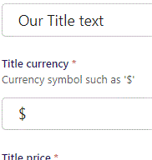
Beneath Title you can set Title currency.

Slide 11

Going live we can see Title currency.

Slide 12
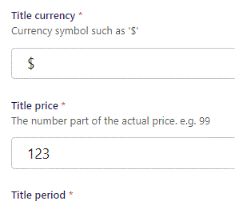
Beneath Title currency you can set Title price.

Slide 13

Going live we see our Title price.

Slide 14
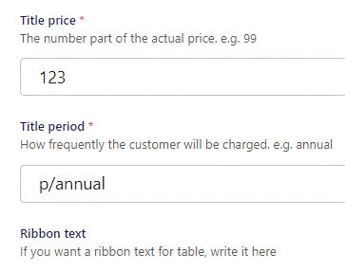
Beneath Title price you can set Title period.

Slide 15

Going live we see our Title period.

Slide 16
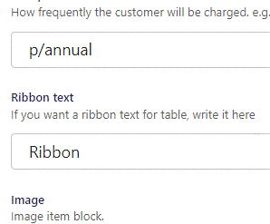
Beneath Title period you can write Ribbon text.

Slide 17

Going live we can see our Ribbon.

Slide 18
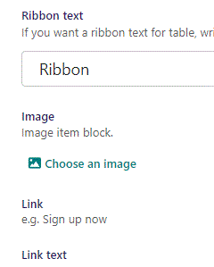
Beneath Ribbon text you can Choose an image.

Slide 19
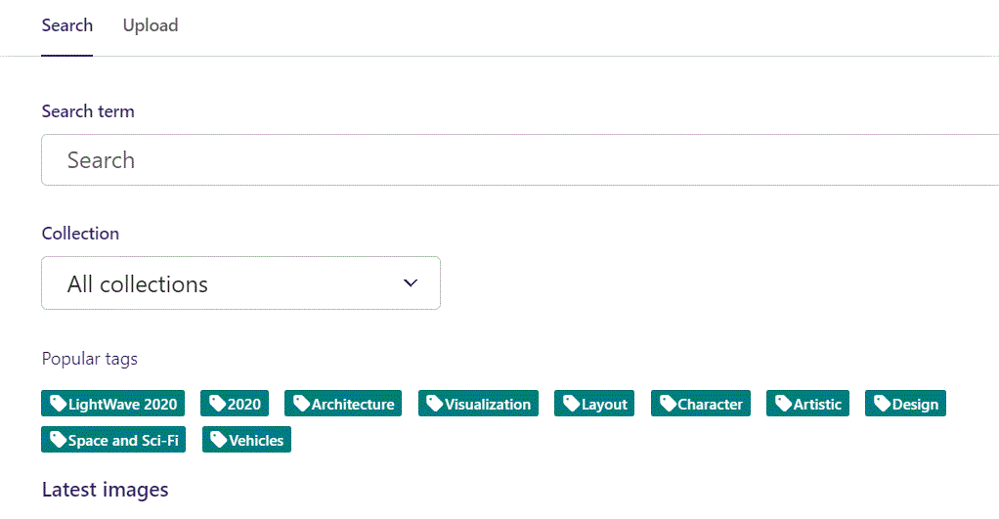
Here we see the top part of the image chooser screen. You can choose to either use an image on the server already or Upload a new image here.
First let’s use an image already on the server.

Slide 20
Here you can write a search term.

Slide 21
Here you can select a Collection of images.

Slide 22
At the bottom you can also sort with Popular tags.

Slide 23
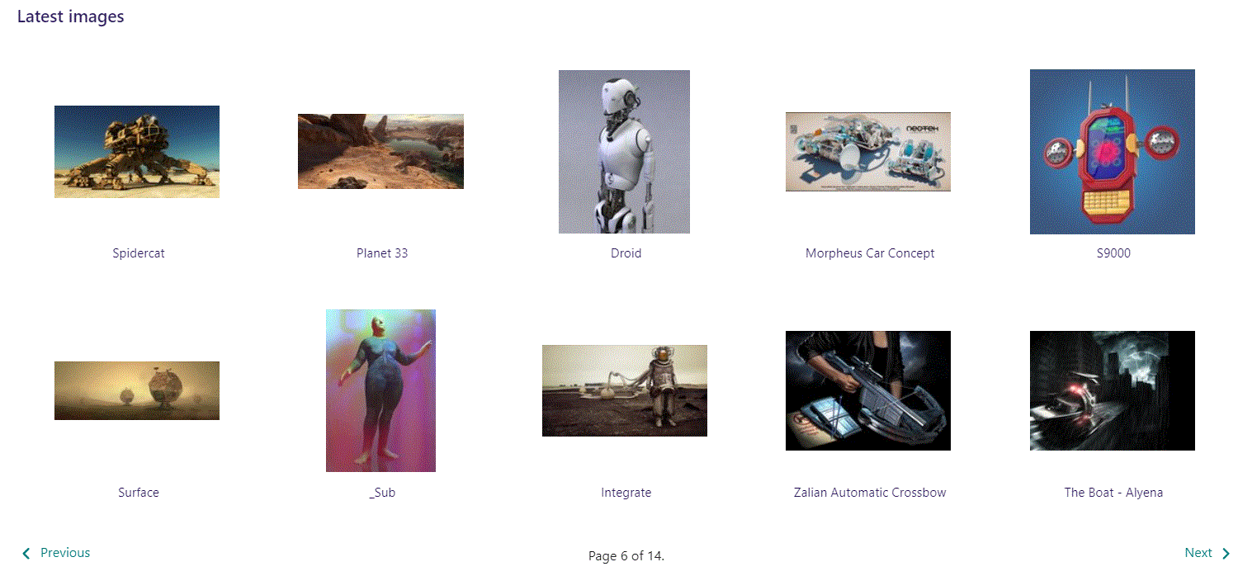
At the bottom of the image selector screen there are navigation buttons.

Slide 24
You can select an image by clicking it.

Slide 25
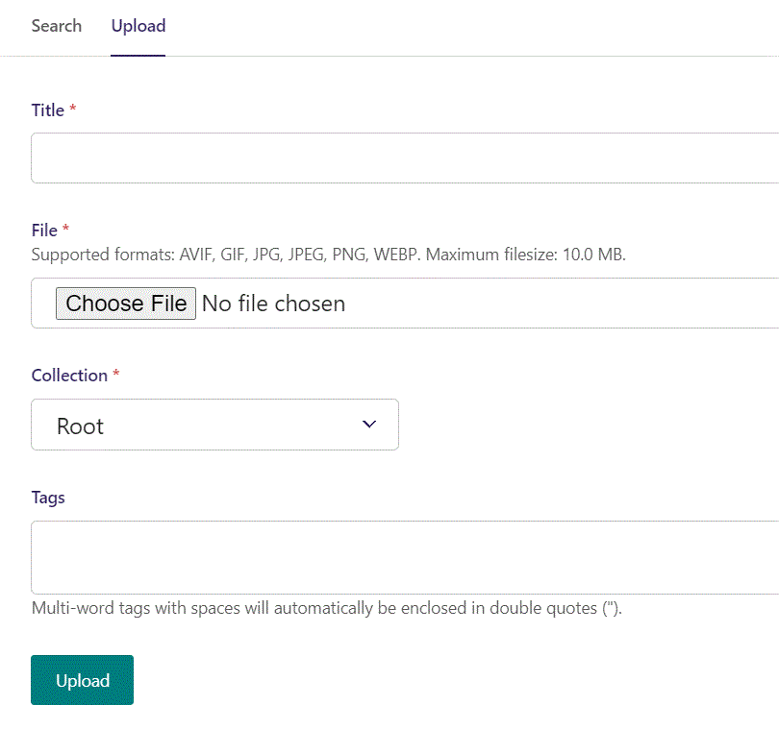
You can also upload an image by clicking Upload.

Slide 26
Name your image here.

Slide 27
Click Choose File to pick your image.

Slide 28
Select which Collection the uploaded image belongs to.

Slide 29
Assign tags to your image. Separate them with a comma.

Slide 30
Finally click Upload, to upload the image.

Slide 31
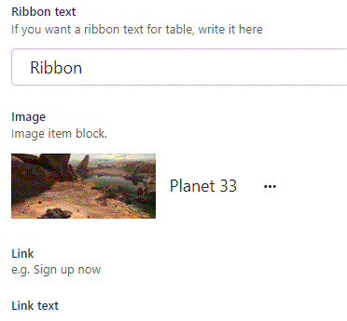
Image chosen.

Slide 32
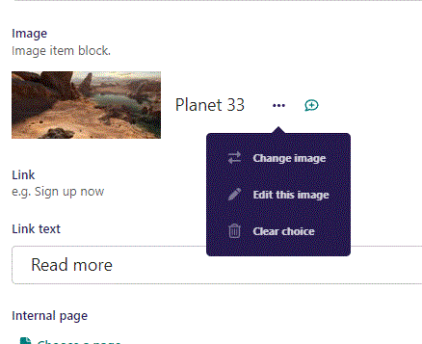
Clicking the 3 dots you can Change image, Edit this image or Clear choice.

Slide 33
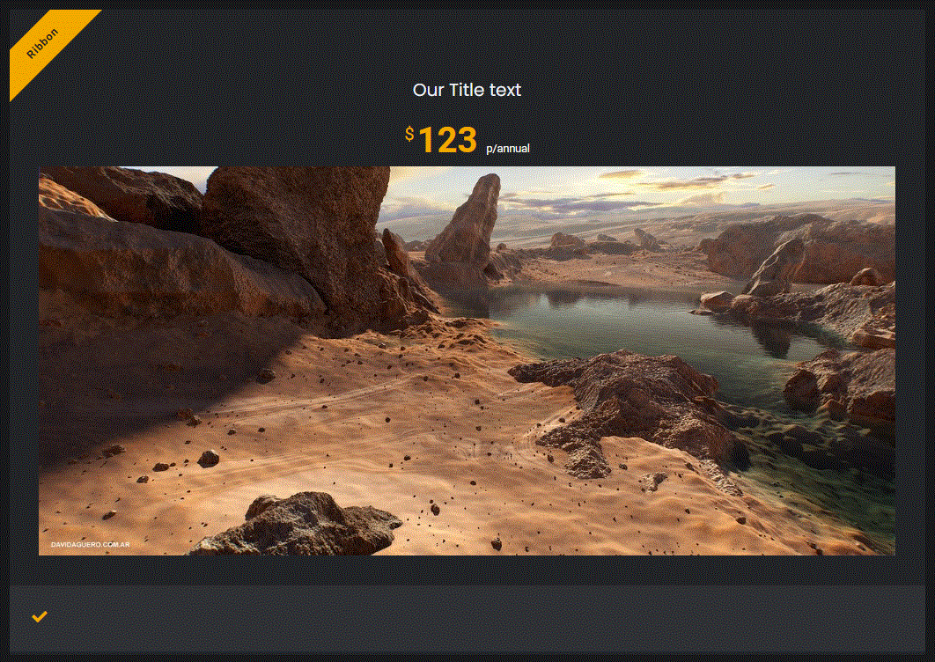
Going live we can see our image have been added.

Slide 34
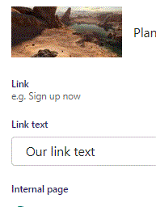
Beneath Choose an image you can write Link text. It will first show when we provide a link below.

Slide 35
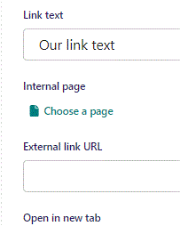
Beneath Link text you can Choose a page as an Internal page link.

Slide 36
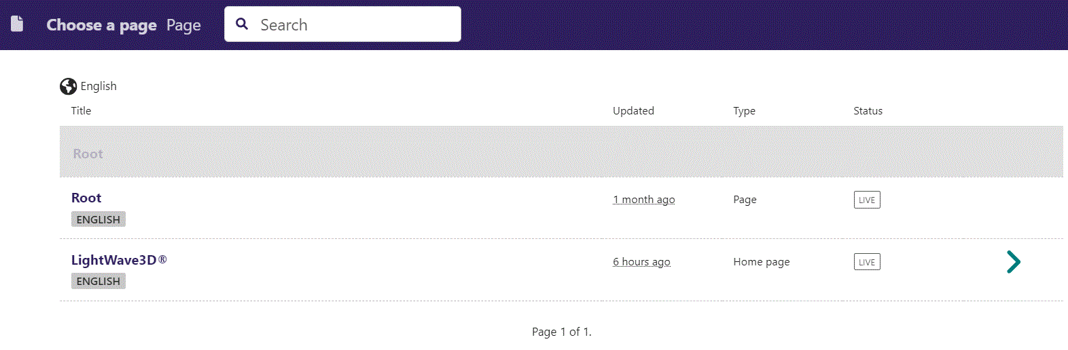
In the page chooser window you can search for the page here.

Slide 37
If a page on the list have pages under it, you can click here to see them.

Slide 38
You select a page by clicking here.

Slide 39
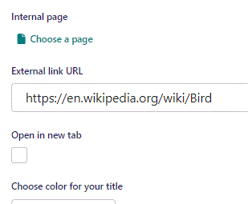
Beneath Choose a page you can write External link URL.

Slide 40
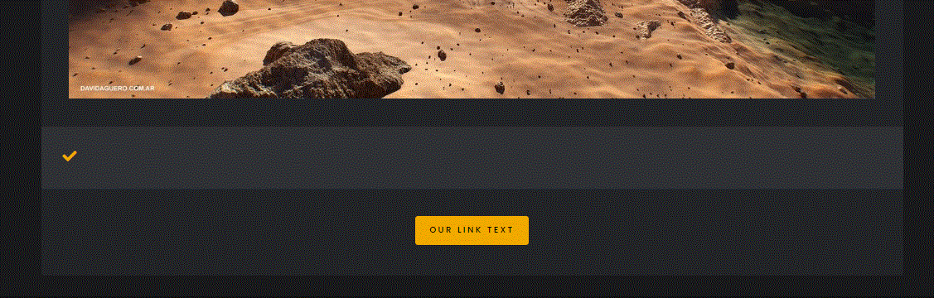
Going live our button now shows up beneath the image.

Slide 41
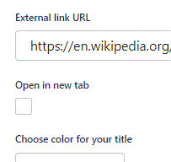
Beneath External link URL you can set Open in new tab. If True, the browser will open a new tab if the viewer clicks the button.

Slide 42
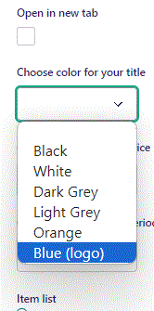
Beneath Open in new tab, you can Choose color for your title. Let’s change it to Blue (logo).

Slide 43
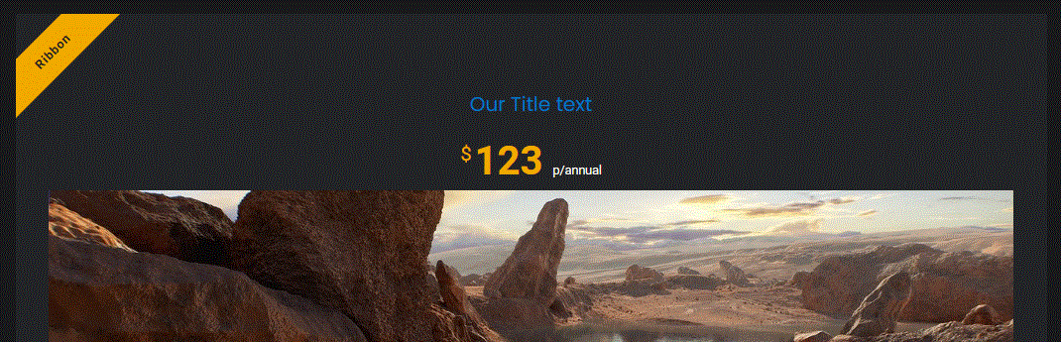
Going live we can see our Title text is now in blue.

Slide 44
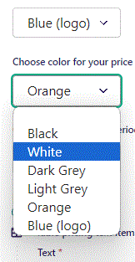
Beneath Choose color for your title you can Choose color for your price. Let’s change it to White.

Slide 45

Going live we can see our Price is now in White.

Slide 46
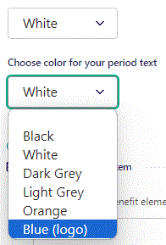
Beneath Choose color for your price you can Choose color for your period text. Let’s change it to Blue (logo).

Slide 47

Going live we can see our Period text is now in blue.

Slide 48
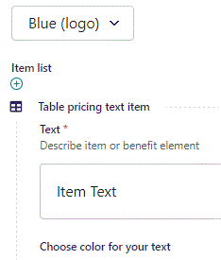
Beneath Choose color for your period text you can write Text.

Slide 49
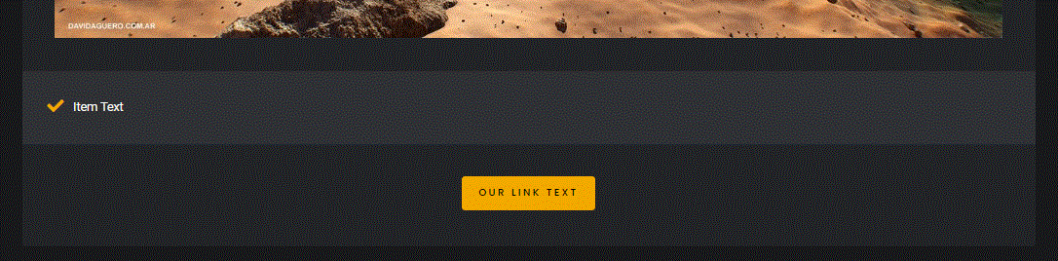
Going live we see our Text appear beneath the Image.

Slide 50
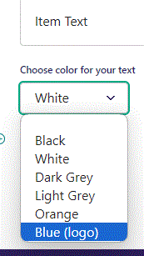
Beneath of Text you can Choose color for your text. Let’s change it to Blue (logo).

Slide 51
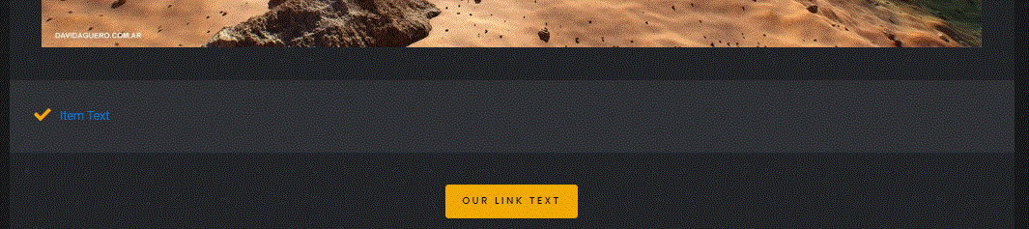
Going live we can see our Text is now in blue.

Slide 52
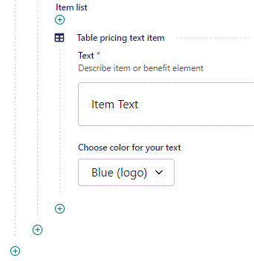
To add another Text item, click the plus icon.

Slide 53
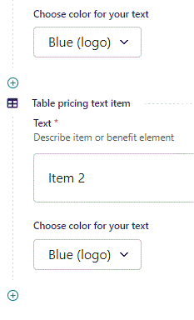
Fill out the fields as before.

Slide 54
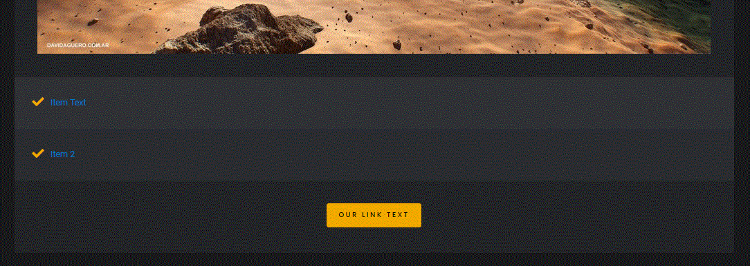
Going live we can see our new Text item have been added.

Slide 55
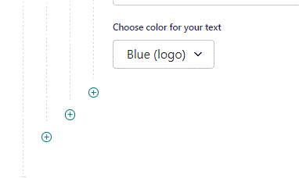
To add a new Table, click the plus icon.

Slide 56
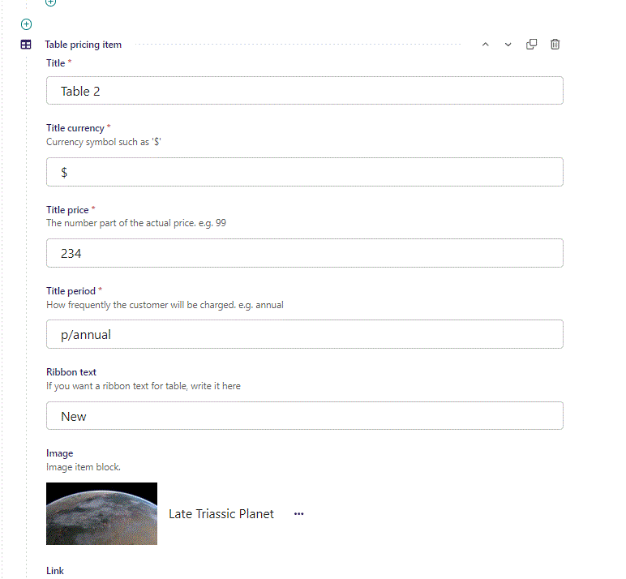
Fill out the fields as before.

Slide 57
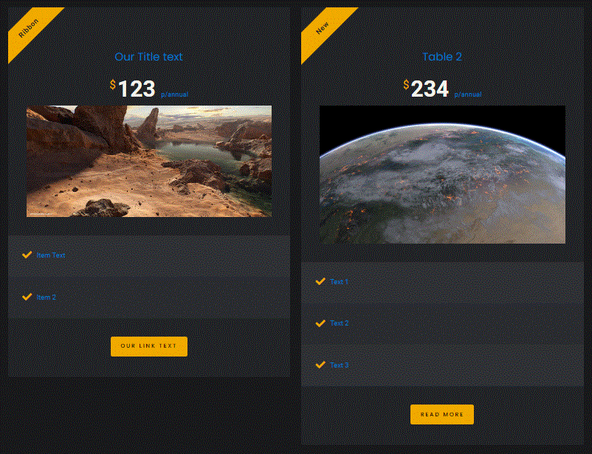
Going live we can see our new Table have been added.

