Slide 1
Guide for
Table Block

Slide 2
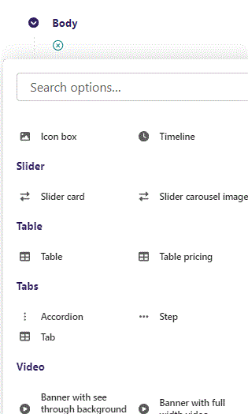
First click the small plus symbol. Then click Text to begin creating.

Slide 3
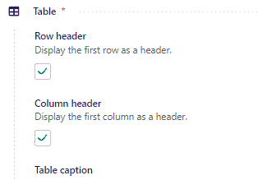
At the top you can set Row and Column header. This will display the first row/column as a header. Let’s change it to True for both.

Slide 4
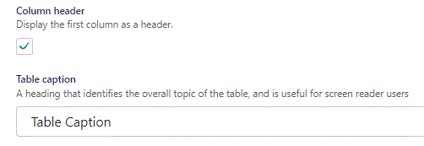
Beneath Column header you can write Table caption.

Slide 5
Beneath Table caption you can fill out the Table itself.

Slide 6
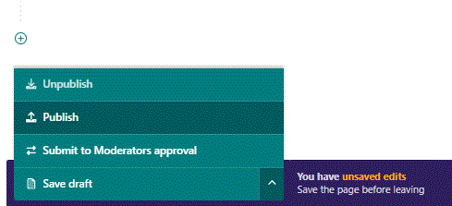
To go live first click the arrow to open the menu. Then click Publish.

Slide 7
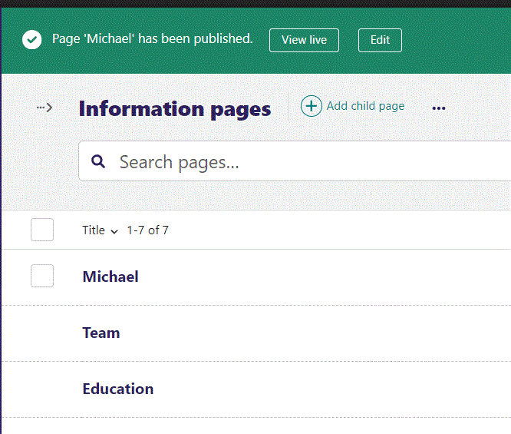
Click View live to open your webpage and see what you created.

Slide 8
Going live we can see our Table. Notice that the first Column and Row is in bold, marking them as headers. Table caption is below the table.

