Slide 1
Guide for
Slider carousel image Block

Slide 2
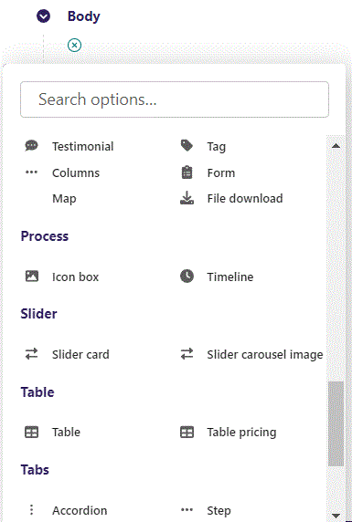
First click the small plus symbol. Then click Slider carousel image to begin creating.

Slide 3
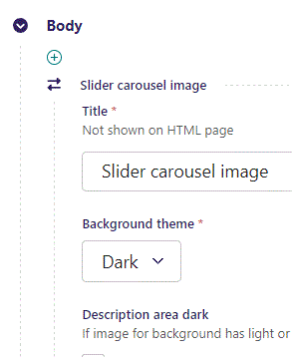
At the top you can write Title. It will not show on HTML page, but will function as a title on the admin.

Slide 4
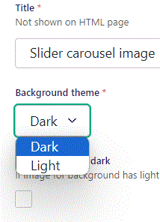
Beneath Title you can set Background theme. You can select a Dark theme which will make your block have a dark background. The Light option gives a light background.

Slide 5
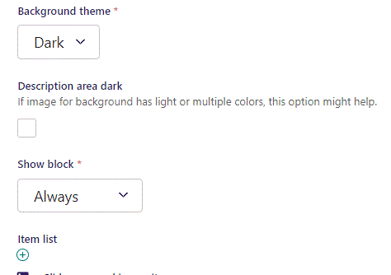
Beneath Background theme you can set Description area dark. It will add a dark grey background to your text elements.

Slide 6
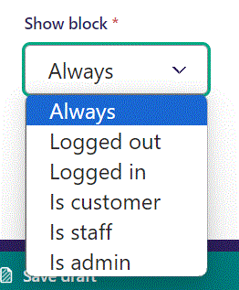
Below Background theme, you can select when or for whom the block will be shown.
Always: Will always show.
Logged out: Only shows when viewer is logged out.
Logged in: Only shows when viewer is logged in.
Is customer: Only shows when viewer is a customer.
Is staff: Only shows if viewer is a staff.
Is admin: Only shows when viewer is an admin.

Slide 7
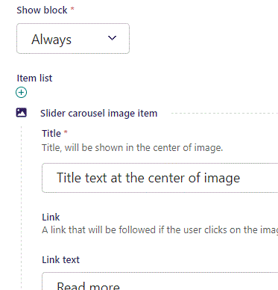
Beneath Show block you can write Title.

Slide 8
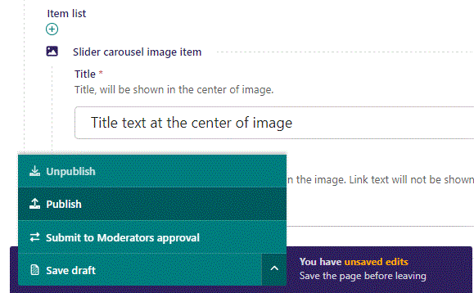
To go live first click the arrow to open the menu. Then click Publish.

Slide 9
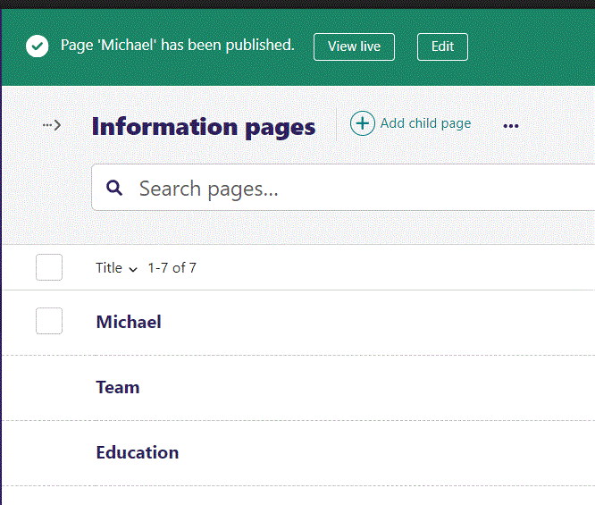
Click View live to open your webpage and see what you created.

Slide 10
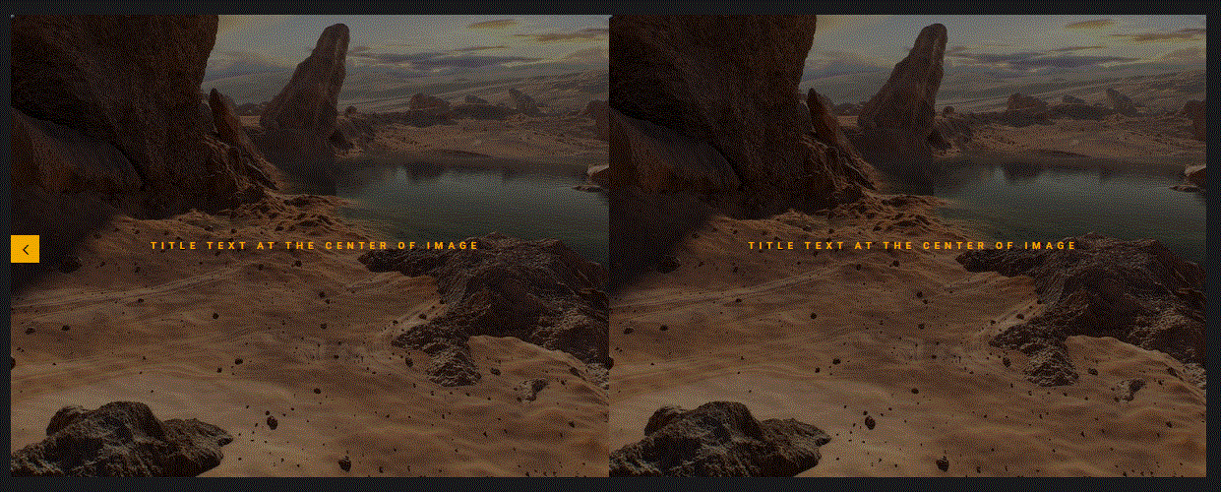
Going live we can see our Title text. We will get to adding images later. Also notice our image is duplicated. Once we add more than one image this will no longer be a problem.

Slide 11
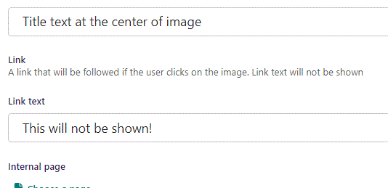
Beneath Title you can write Link text. This will not be shown.

Slide 12
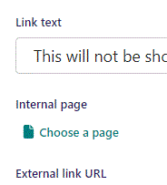
Beneath Link text you can Choose a page as an Internal page link that the viewer will go to if they click the image.

Slide 13
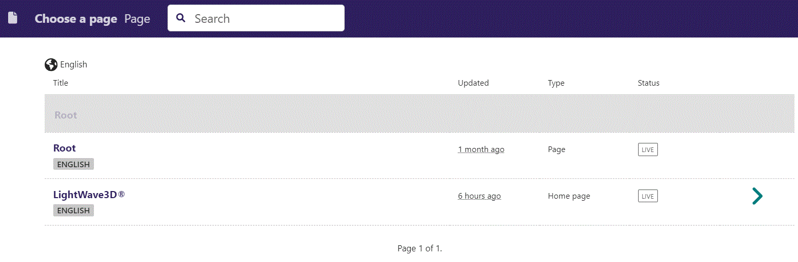
In the page chooser window you can search for the page here.

Slide 14
If a page on the list have pages under it, you can click here to see them.

Slide 15
You select a page by clicking here.

Slide 16
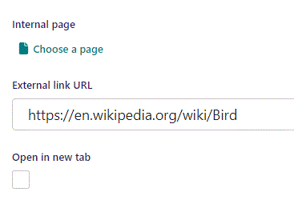
Beneath Choose a page you can set External link URL.

Slide 17
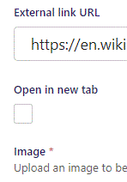
Beneath External link URL you can set Open in new tab. If True browser will open new tab when viewer clicks image.

Slide 18
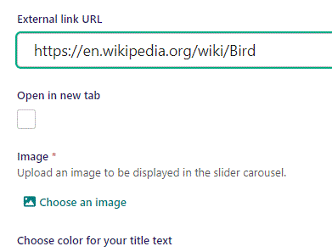
Beneath Open in new tab, you can Choose an image to be displayed in the slider carousel.

Slide 19
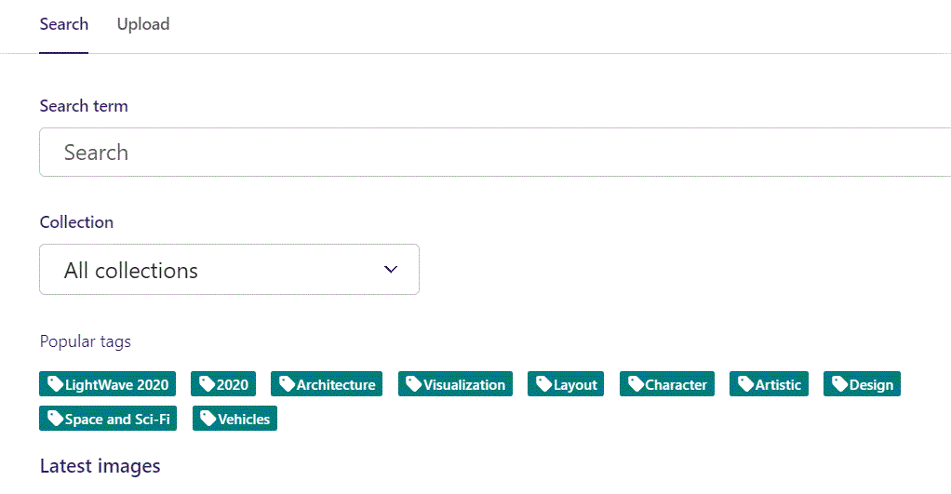
Here we see the top part of the image chooser screen. You can choose to either use an image on the server already or Upload a new image here.
First let’s use an image already on the server.

Slide 20
Here you can write a search term.

Slide 21
Here you can select a Collection of images.

Slide 22
At the bottom you can also sort with Popular tags.

Slide 23
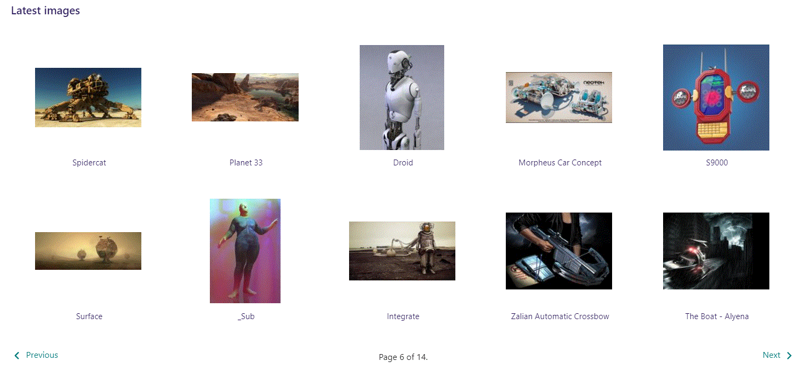
At the bottom of the image selector screen there are navigation buttons.

Slide 24
You can select an image by clicking it.

Slide 25
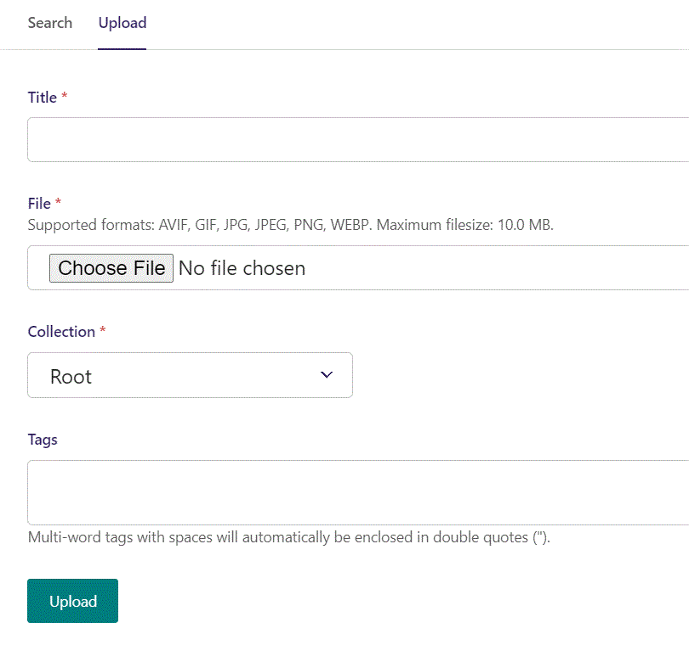
You can also upload an image by clicking Upload.

Slide 26
Name your image here.

Slide 27
Click Choose File to pick your image.

Slide 28
Select which Collection the uploaded image belongs to.

Slide 29
Assign tags to your image. Separate them with a comma.

Slide 30
Finally click Upload, to upload the image.

Slide 31
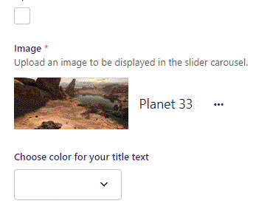
Image chosen.

Slide 32
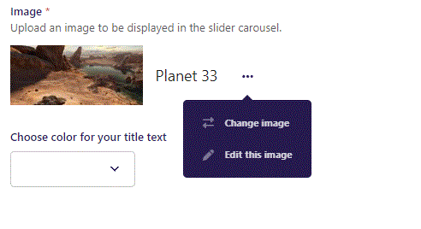
By clicking the 3 dots you can Change image or Edit this image.

Slide 33
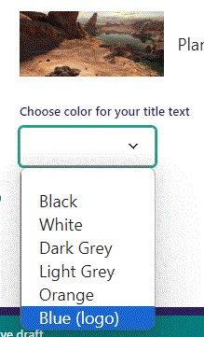
Beneath Choose an image you can Choose color for your title text. Let’s make it Blue (logo).

Slide 34
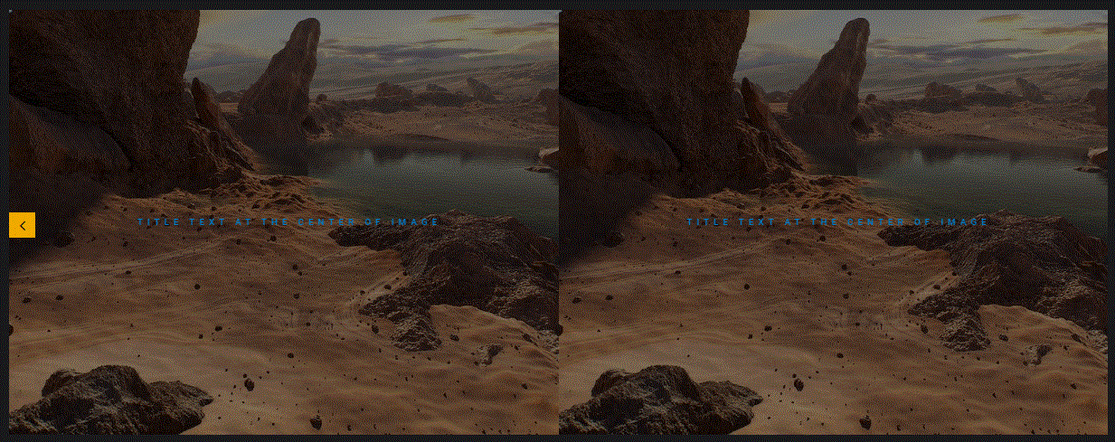
Going live we can see our Title text is now in blue.

Slide 35
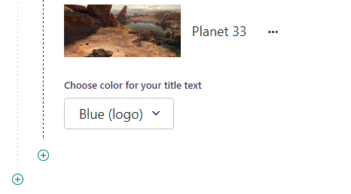
To add a new item, click the plus icon.

Slide 36
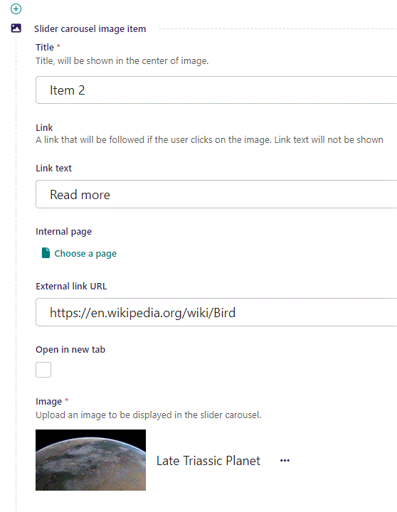
Fill out the fields as earlier.

Slide 37
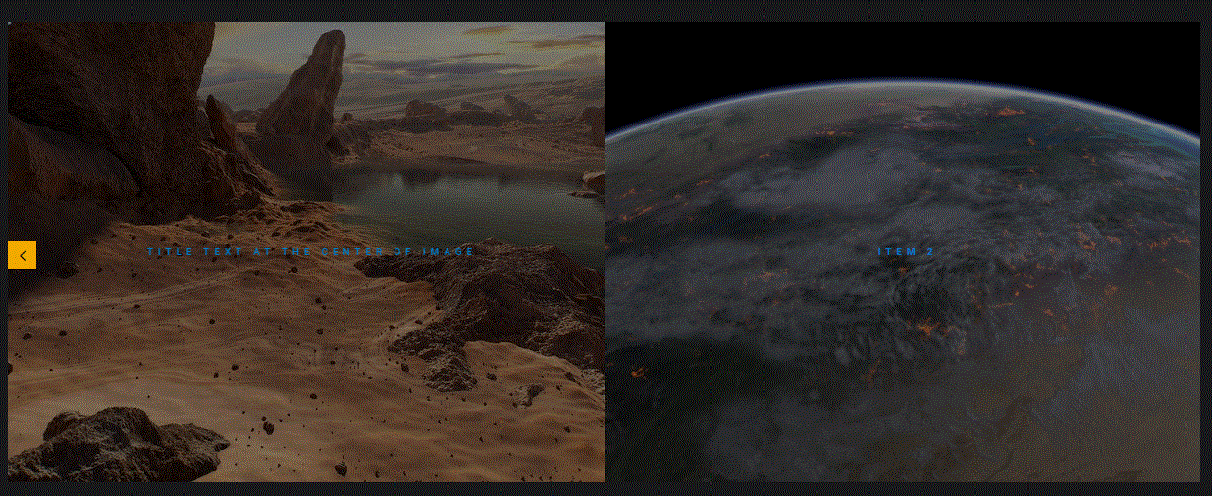
Going live we see our newly added item. You can add many more images. You can slide between the images by holding left mouse and dragging left or right.

