Slide 1
Guide for
Slider card Block

Slide 2
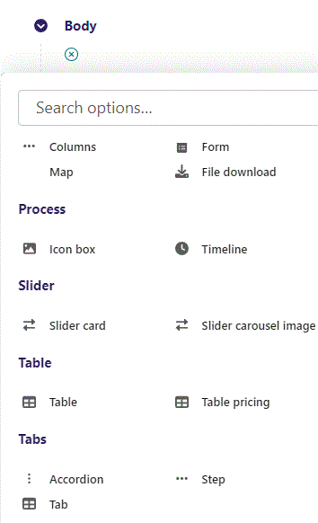
First click the small plus symbol. Then click Slider card to begin creating.

Slide 3
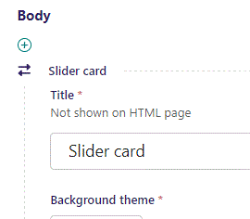
At the top you can write Title. It will not be shown on the HTML page but will function as a title in admin.

Slide 4
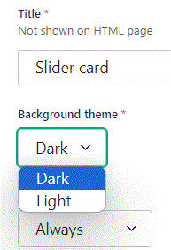
Beneath Title you can set Background theme. Let’s set it to Dark for our block to have a dark background. Light gives the block a light background.

Slide 5
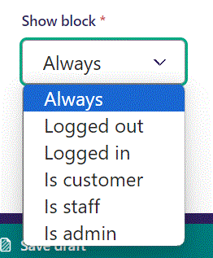
Below Background theme, you can select when or for whom the block will be shown.
Always: Will always show.
Logged out: Only shows when viewer is logged out.
Logged in: Only shows when viewer is logged in.
Is customer: Only shows when viewer is a customer.
Is staff: Only shows if viewer is a staff.
Is admin: Only shows when viewer is an admin.

Slide 6
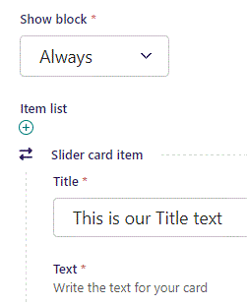
Beneath Show block you can write Title.

Slide 7
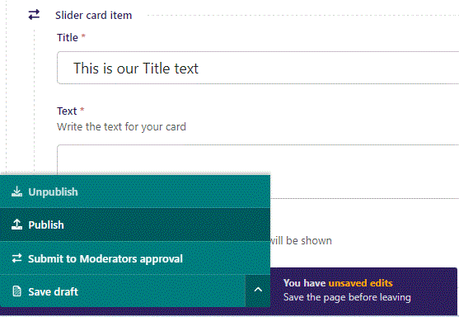
To go live first click the arrow to open the menu. Then click Publish.

Slide 8
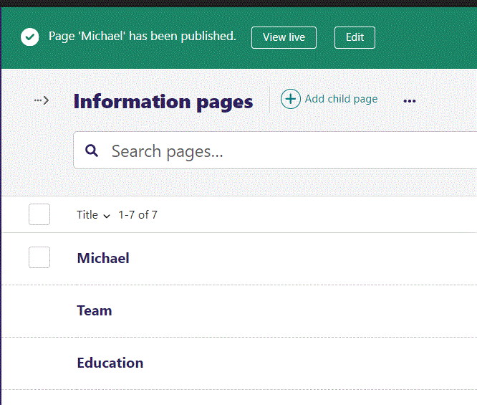
Click View live to open your webpage and see what you created.

Slide 9
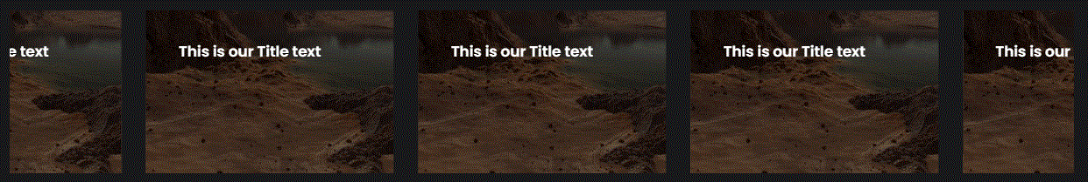
Going live we can see our Title. We only have one image, which makes the block repeat the image many times. We will get to adding images later.

Slide 10
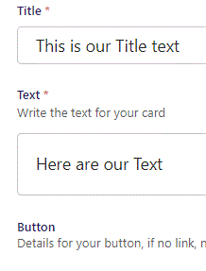
Beneath Title you can write Text.

Slide 11
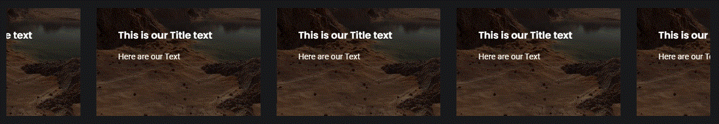
Going live we see our Text.

Slide 12
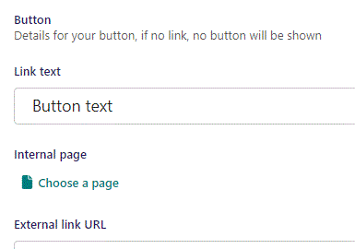
Beneath Text you can write Link text. It functions as the Button text. It will not show until we provide an Internal page or an External page as a link.

Slide 13
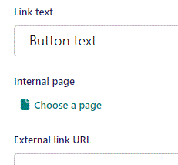
Beneath Link text you can Choose a page as an internal page link for the button.

Slide 14
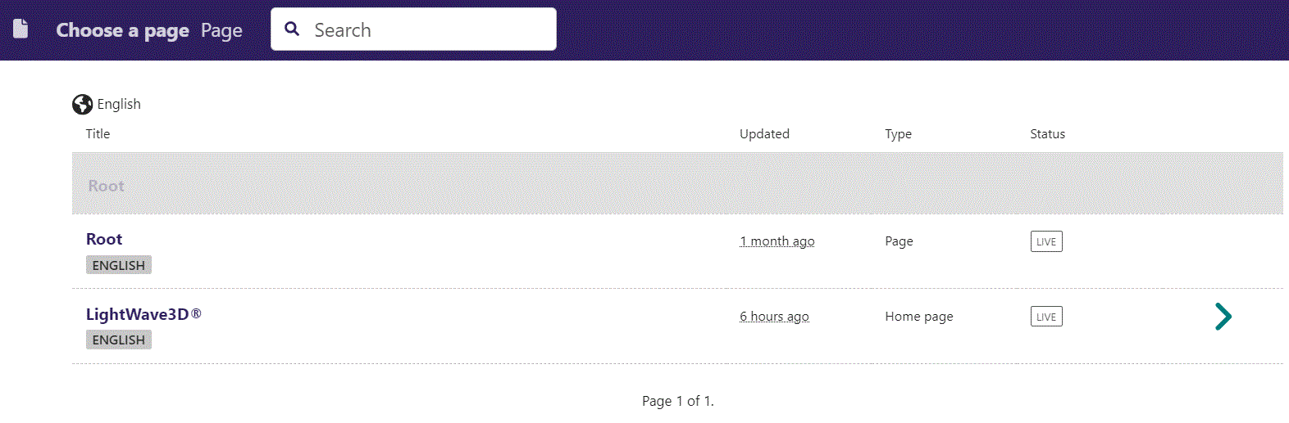
In the page chooser window you can search for the page here.

Slide 15
If a page on the list have pages under it, you can click here to see them.

Slide 16
You select a page by clicking here.

Slide 17
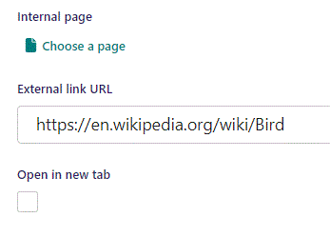
Beneath Choose a page you can set External link URL as the link for the button.

Slide 18
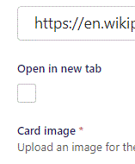
Beneath External link URL you can set Open in new tab. If True, the browser will open a new link if the viewer clicks the button. We leave it at False.

Slide 19
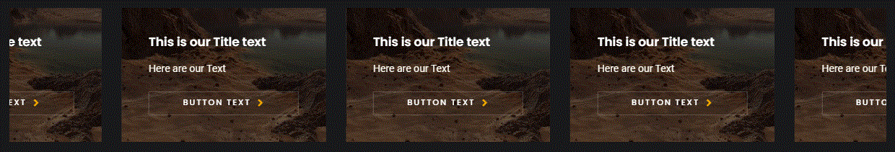
Going live we can see our Button have been added below our Text.

Slide 20
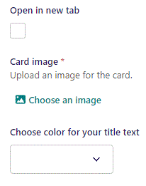
Beneath Open in new tab, you can Choose an image as the Card image.

Slide 21
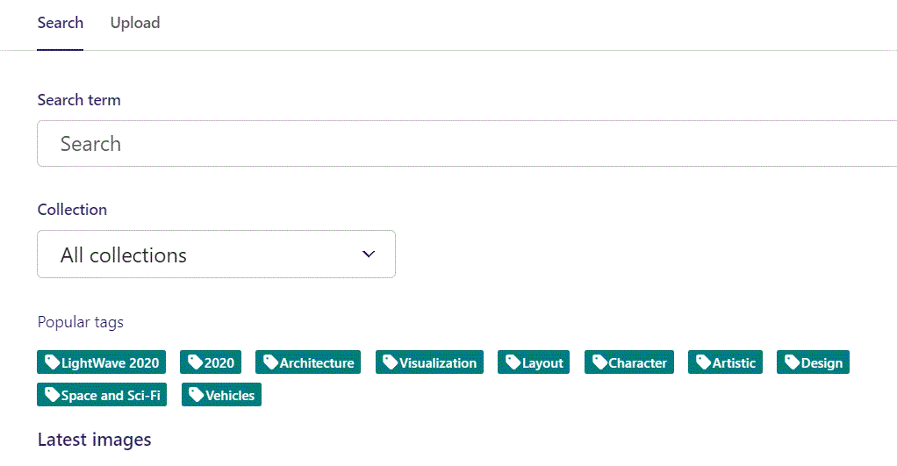
Here we see the top part of the image chooser screen. You can choose to either use an image on the server already or Upload a new image here.
First let’s use an image already on the server.

Slide 22
Here you can write a search term.

Slide 23
Here you can select a Collection of images.

Slide 24
At the bottom you can also sort with Popular tags.

Slide 25
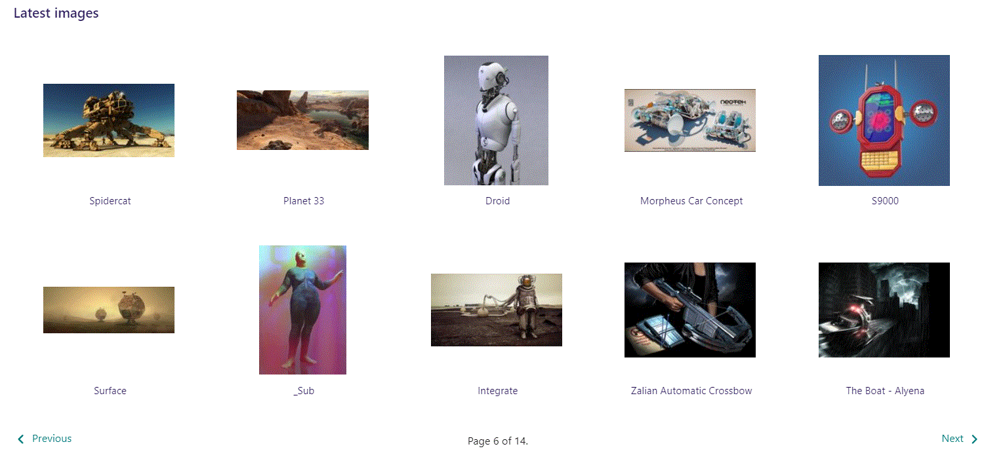
At the bottom of the image selector screen there are navigation buttons.

Slide 26
You can select an image by clicking it.

Slide 27
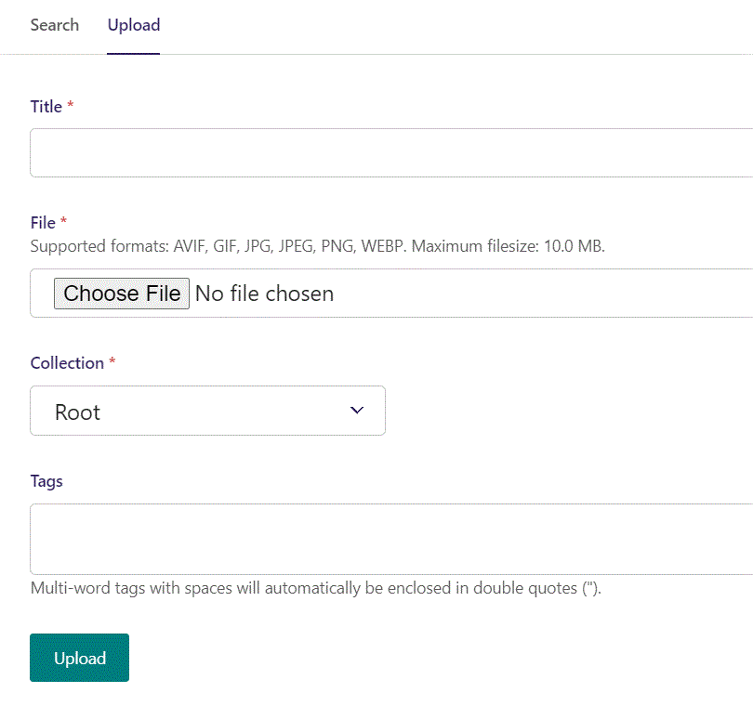
You can also upload an image by clicking Upload.

Slide 28
Name your image here.

Slide 29
Click Choose File to pick your image.

Slide 30
Select which Collection the uploaded image belongs to.

Slide 31
Assign tags to your image. Separate them with a comma.

Slide 32
Finally click Upload, to upload the image.

Slide 33
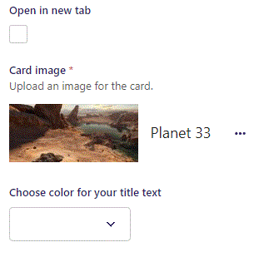
We have now selected an image.

Slide 34
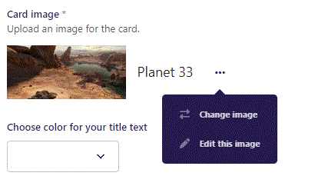
Clicking the 3 dots you can Change image or Edit this image.

Slide 35
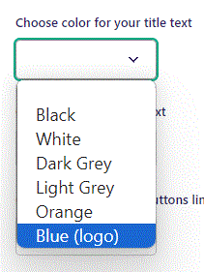
Beneath Choose an image you can Choose color for your title text. Let’s set it to Blue (logo).

Slide 36
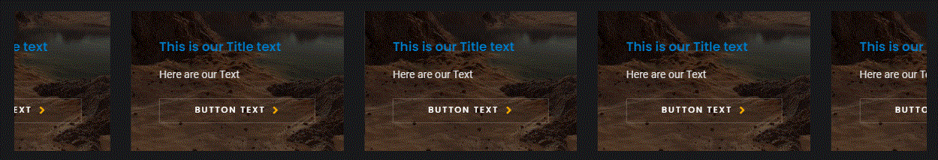
Going live we can see our Title text is now in blue.

Slide 37
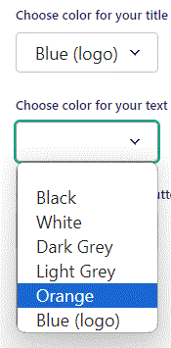
Beneath Choose color for your title you can Choose color for your text. Let’s set it to Orange.

Slide 38
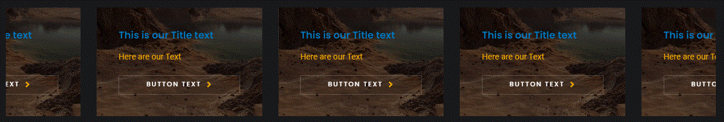
Going live we can see our Text is now in Orange.

Slide 39
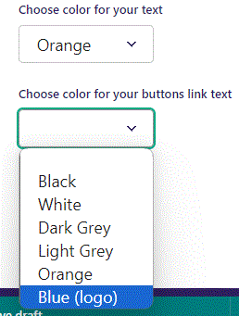
Beneath Choose color for your text you can Choose color for your buttons link text. Let’s set it to Blue (logo).

Slide 40
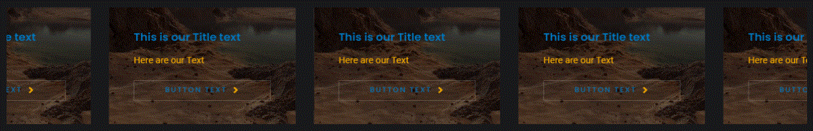
Going live we can see our Button text is now in blue.

Slide 41
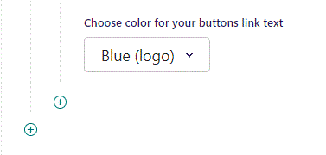
To add another item, click the plus icon.

Slide 42
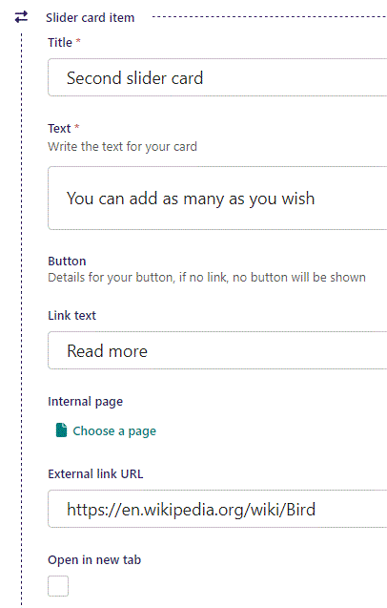
Fill out the fields as earlier.

Slide 43
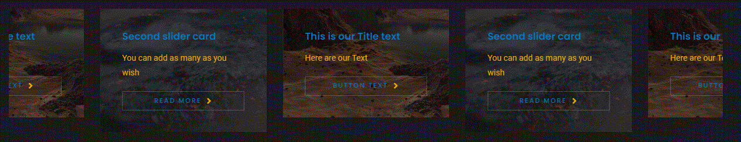
Going live we can see our new item added.
Note we still see doubling of our images.

Slide 44
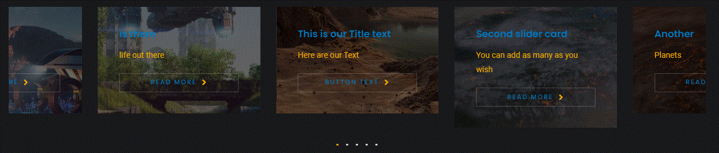
Adding 5 images we no longer have duplication. Note the navigation dots below the images. You can also slide the images by holding left mouse button and dragging either right or left.

