Slide 1
Guide for
Timeline Block

Slide 2
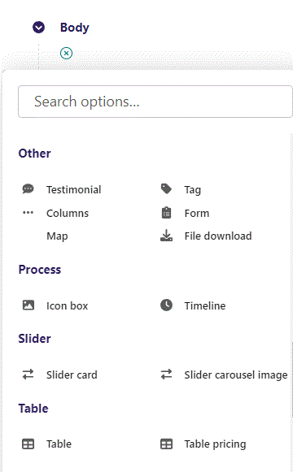
First click the small plus symbol. Then click Timeline to begin creating.

Slide 3
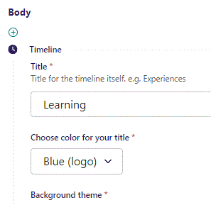
At the top you can write Title.

Slide 4
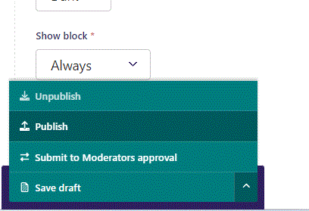
To go live first click the arrow to open the menu. Then click Publish.

Slide 5
Click View live to open your webpage and see what you created.

Slide 6
Going live we can see our Title text.

Slide 7
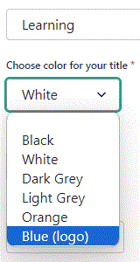
Beneath Title you can Choose color for your title. Let’s change it to Blue (logo).

Slide 8
Going live we can see our Title is now in blue.

Slide 9
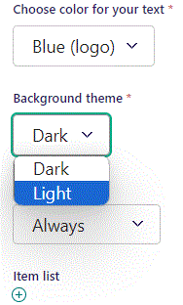
Beneath Choose color for your text you can set Background theme. Let’s change it to Light.

Slide 10
Going live we can see our Background theme has changed to Light.

Slide 11
Below Background theme, you can select when or for whom the block will be shown.
Always: Will always show.
Logged out: Only shows when viewer is logged out.
Logged in: Only shows when viewer is logged in.
Is customer: Only shows when viewer is a customer.
Is staff: Only shows if viewer is a staff.
Is admin: Only shows when viewer is an admin.

Slide 12
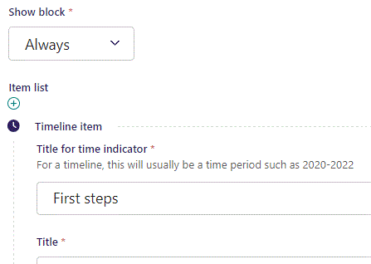
Beneath Show block you can write Title for time indicator.

Slide 13
Going live we can see our Title for time indicator.

Slide 14
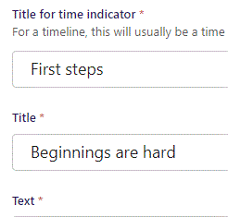
Beneath Title for time indicator, you can write Title.

Slide 15
Going live we can see our Title.

Slide 16
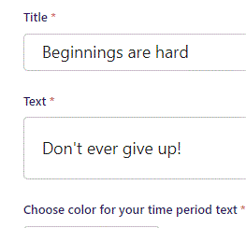
Beneath Title you can write Text.

Slide 17
Going live we can see our Text.

Slide 18
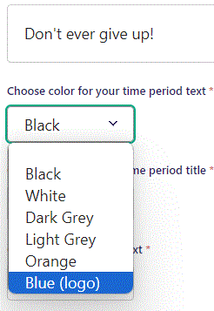
Beneath Text you can Choose color for your time period text. Let’s change it to Blue (logo).

Slide 19
Going live we can see our time period text changed to a blue color.

Slide 20
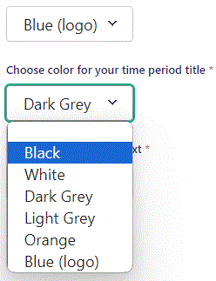
Beneath Choose color for your time period text you can Choose color for your time period title. Let’s change it to Black.

Slide 21
Going live we can see our time period title is now colored black.

Slide 22
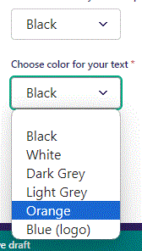
Beneath Choose color for your time period title you can Choose color for your text. Let’s change it to Orange.

Slide 23
Going live we can see the color of our Text is now Orange.

Slide 24
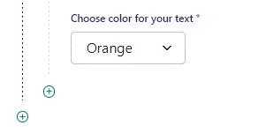
To add a new item, click the plus icon.

Slide 25
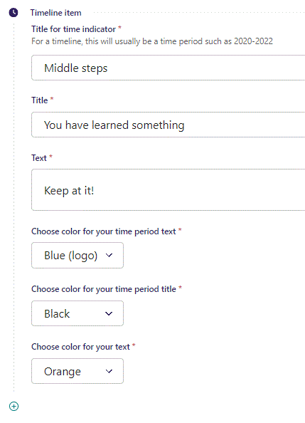
Fill out the fields as previously.

Slide 26
Going live we can see our new item have been added.

