Slide 1
Guide for
Icon box Block

Slide 2
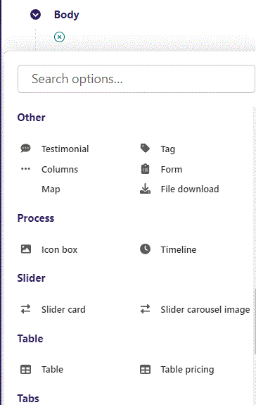
First click the small plus symbol. Then click Icon box to begin creating.

Slide 3
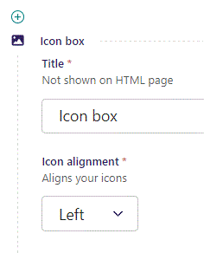
At the top you can write Title. It will not be shown on the HTML page, instead it will work as a Title in the admin.

Slide 4
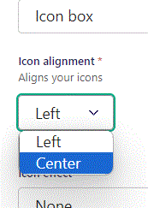
Beneath Title you can set Icon alignment. Let’s set it to Center.

Slide 5
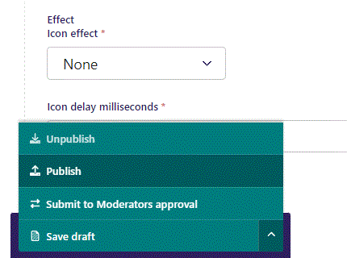
To go live first click the arrow to open the menu. Then click Publish.

Slide 6
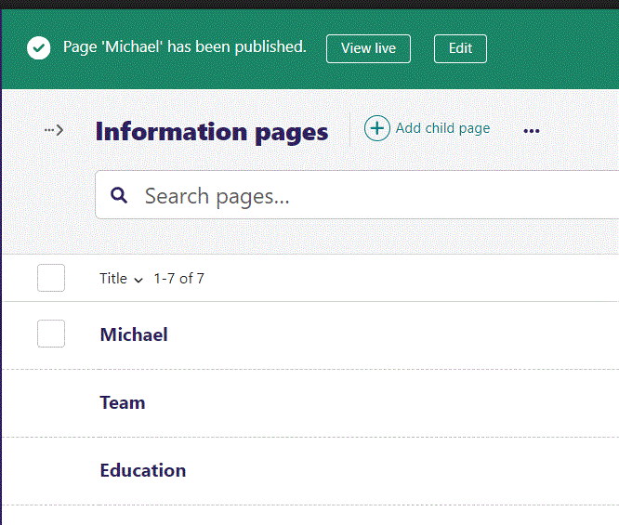
Click View live to open your webpage and see what you created.

Slide 7
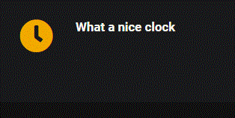
Going live we can see our Icon at the left side.

Slide 8

Here Icon is aligned Center.

Slide 9
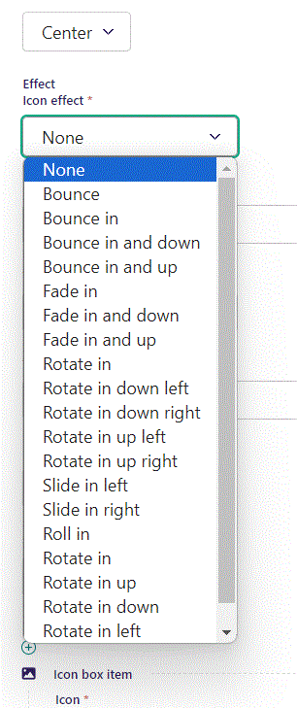
Beneath Icon alignment you can set Effect for your icon. These will animate your icon according to description. There are many options.

Slide 10
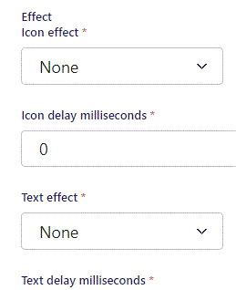
Beneath Effect you can set Icon delay milliseconds. This is the delay time before the Icon will show after the viewer scrolls down to it.

Slide 11
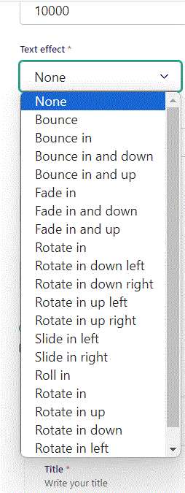
Beneath Icon delay milliseconds you can set Text effect.

Slide 12
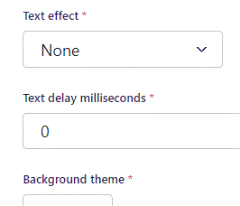
Beneath Text effect you can set Text delay milliseconds. It works the same way as Icon delay.

Slide 13
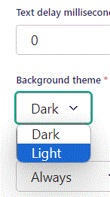
Beneath Text delay milliseconds you can set Background theme. Let’s change it to Light.

Slide 14

Going live we can see our Background theme has changed to Light.

Slide 15
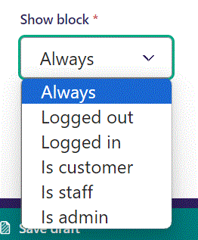
Below Background theme, you can select when or for whom the block will be shown.
Always: Will always show.
Logged out: Only shows when viewer is logged out.
Logged in: Only shows when viewer is logged in.
Is customer: Only shows when viewer is a customer.
Is staff: Only shows if viewer is a staff.
Is admin: Only shows when viewer is an admin.

Slide 16
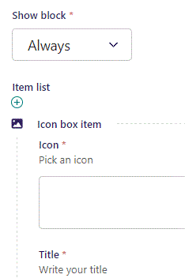
Beneath Show block you can pick an Icon.

Slide 17
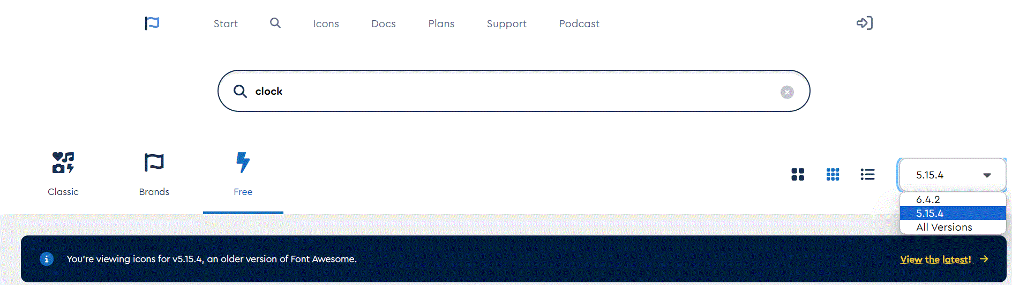
To find icons go to: https://fontawesome.com/search?o=r&m=free
In the right lower side of the top section, you can select icon version. Select version 5.15.4.

Slide 18
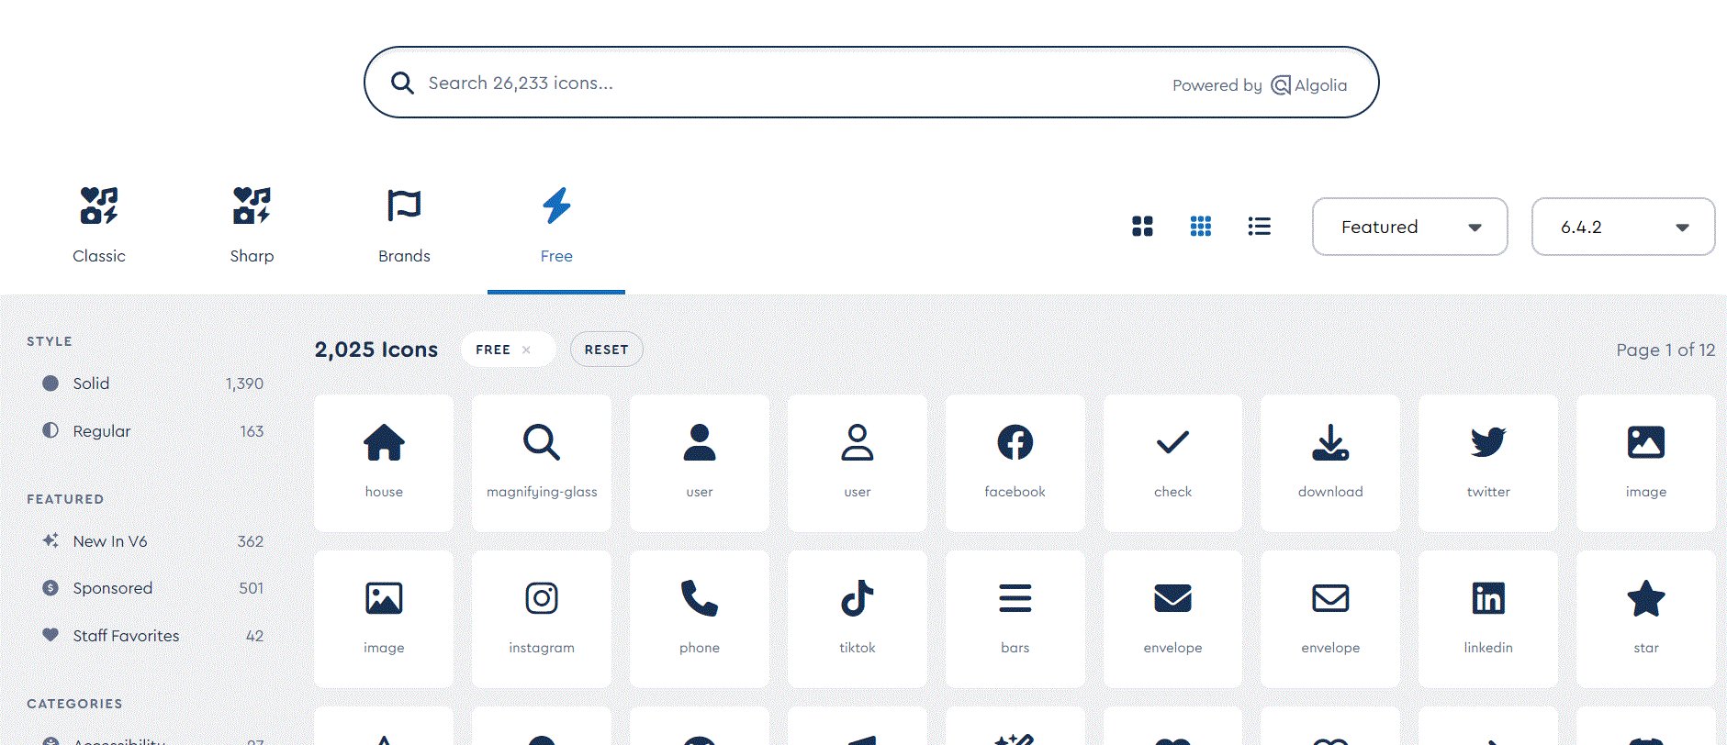
In the top you can search for an icon

Slide 19
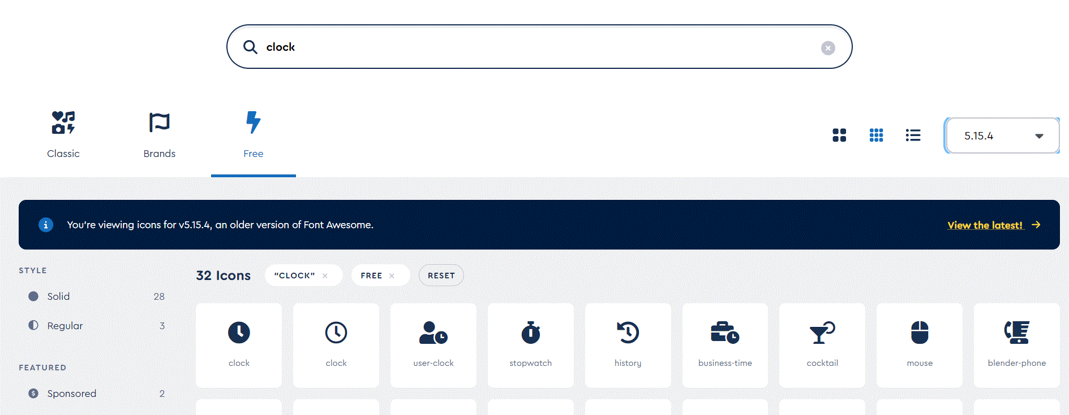
When you find an icon click it.

Slide 20
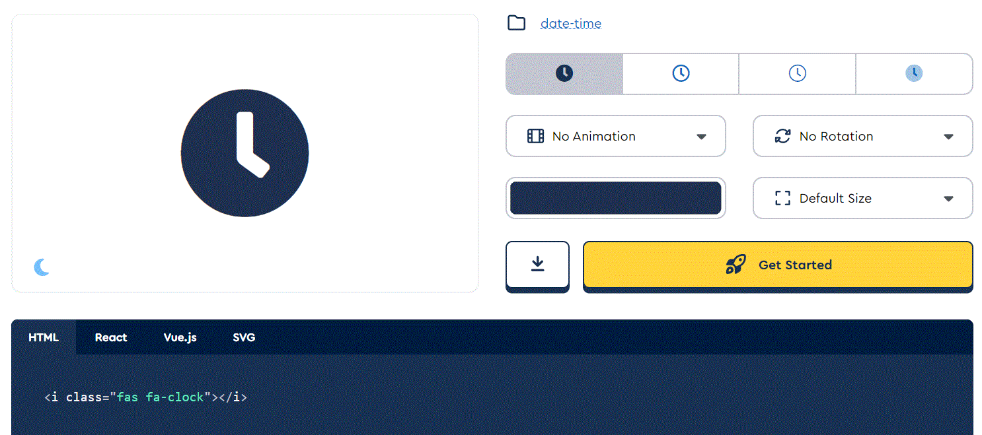
A window pop up, where you can see the code, you need to use in the Icon field. Here the code is:
fas fa-clock

Slide 21
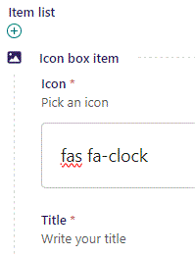
Icon selected.

Slide 22

Going live we can see our Icon inserted.

Slide 23
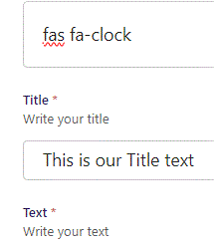
Beneath Icon you can write Title.

Slide 24

Going live we can see our Title text.

Slide 25
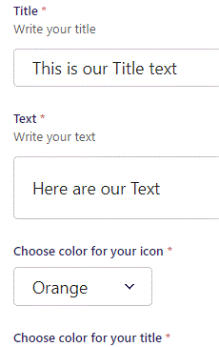
Beneath Title you can write Text.

Slide 26

Going live we can see our Text beneath the Title.

Slide 27
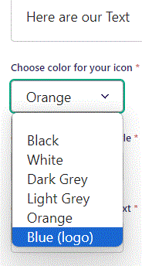
Beneath Text you can Choose color for your icon. Let’s change it to Blue (logo).

Slide 28

Going live we can see our Icon is now blue.

Slide 29
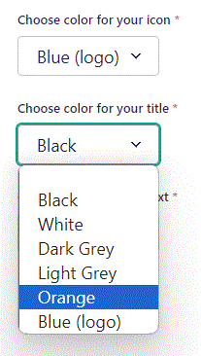
Beneath Choose color for your icon you can Choose color for your title. Let’s change it to Orange.

Slide 30

Going live we can see our Title are now Orange.

Slide 31
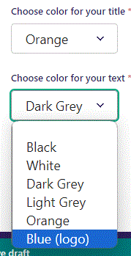
Beneath Choose color for your title you can Choose color for your text. Let’s change it to Blue (logo).

Slide 32

Going live we can see our Text are now blue.

Slide 33
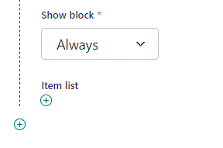
Click plus icon to add new item.

Slide 34
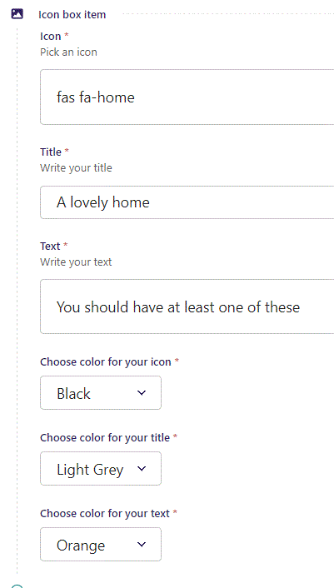
Fill out the fields as before.

Slide 35

Going live we can see our new item have been added.

