Slide 1
Guide for
Testimonial Block

Slide 2
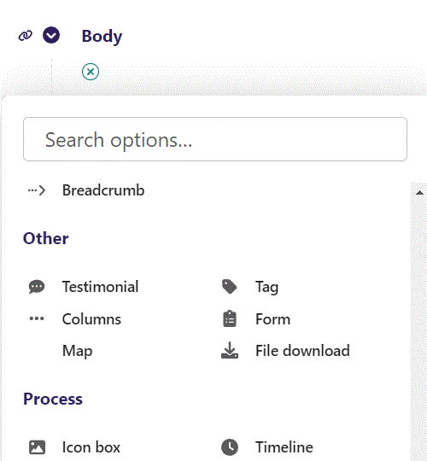
First click the small plus symbol. Then click Testimonial to begin creating.

Slide 3
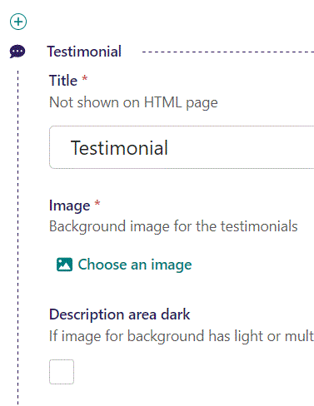
At the top you can write Title. This will not be shown on HTML page, but will be the title in the admin.

Slide 4
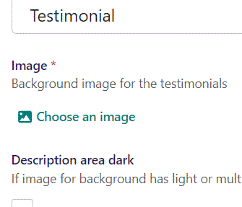
Beneath Title you can Choose an image as background for the testimonials.

Slide 5
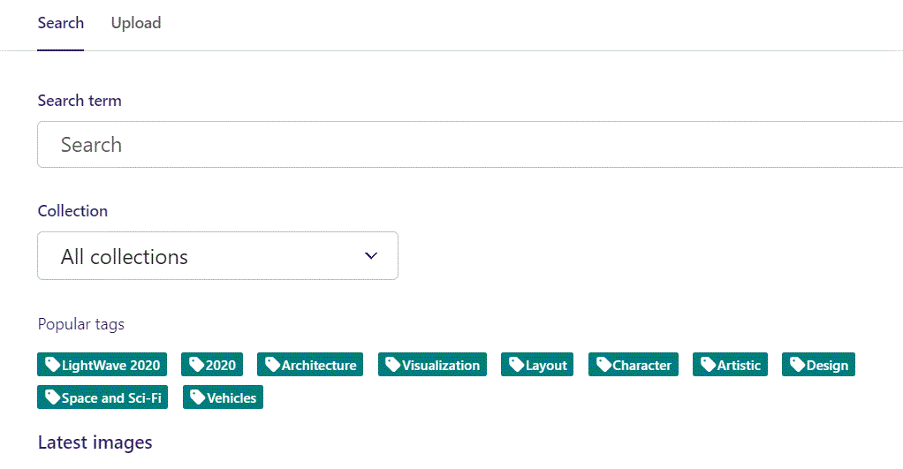
Here we see the top part of the image chooser screen. You can choose to either use an image on the server already or Upload a new image here.
First let’s use an image already on the server.

Slide 6
Here you can write a search term.

Slide 7
Here you can select a Collection of images.

Slide 8
At the bottom you can also sort with Popular tags.

Slide 9
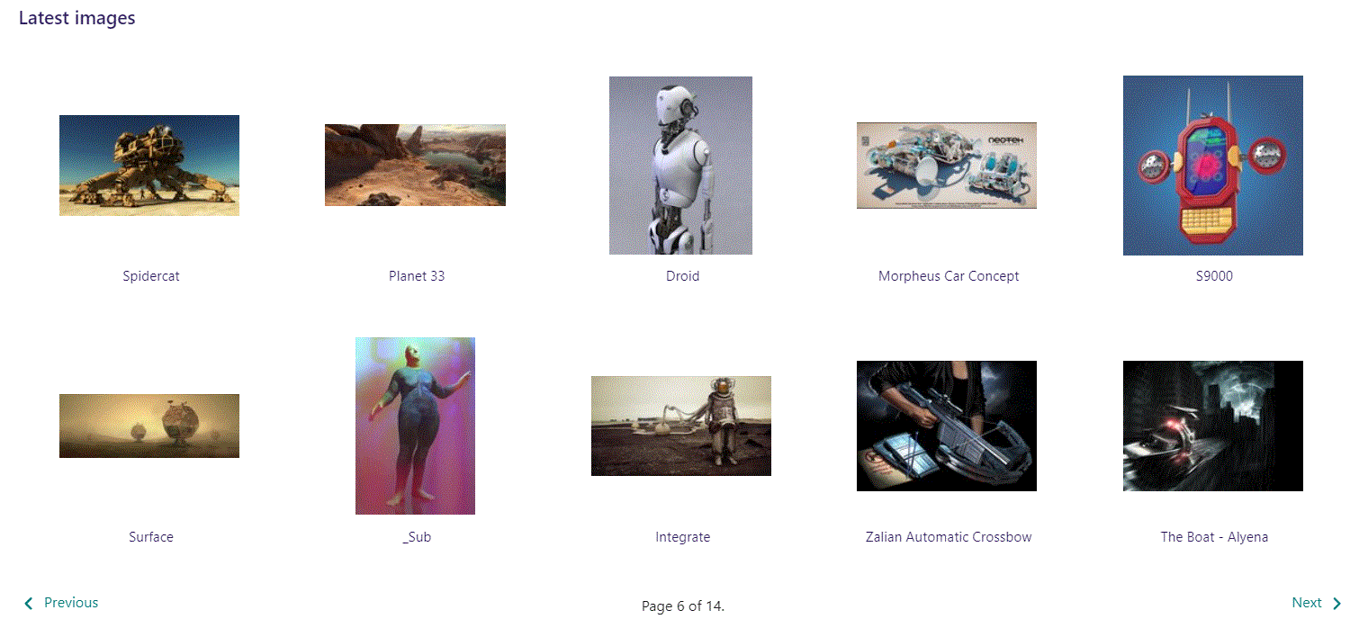
At the bottom of the image selector screen there are navigation buttons.

Slide 10
You can select an image by clicking it.

Slide 11
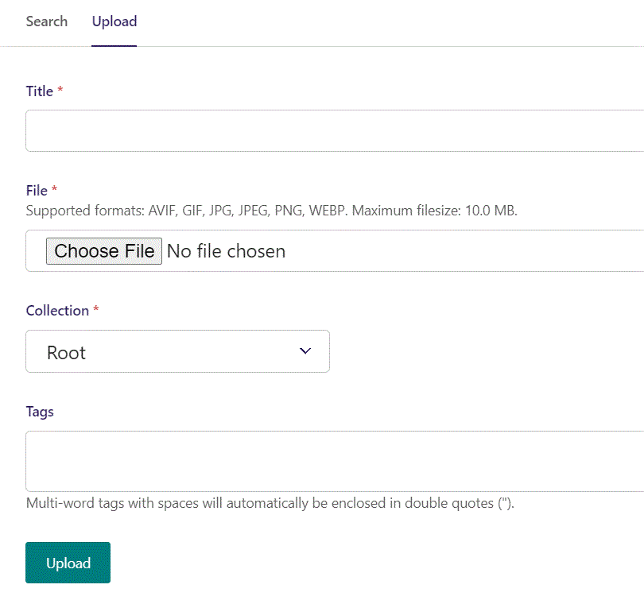
You can also upload an image by clicking Upload.

Slide 12
Name your image here.

Slide 13
Click Choose File to pick your image.

Slide 14
Select which Collection the uploaded image belongs to.

Slide 15
Assign tags to your image. Separate them with a comma.

Slide 16
Finally click Upload, to upload the image.

Slide 17
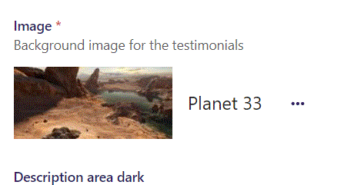
We have now chosen an image.

Slide 18
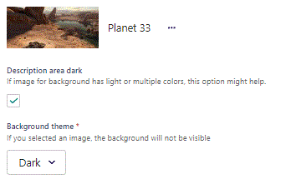
Beneath Choose an image you can set Description area dark. Here we set it to True.

Slide 19
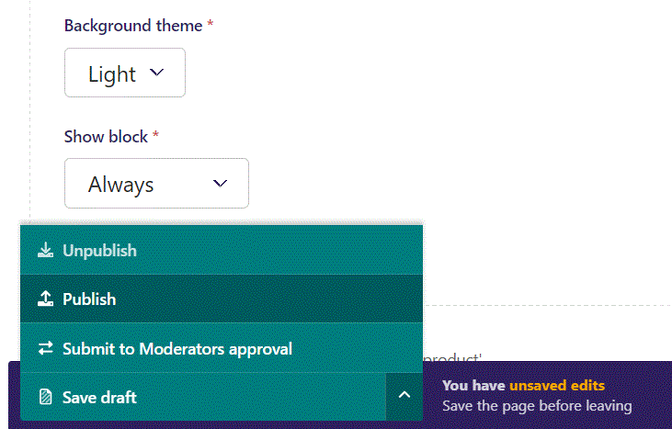
To go live first click the arrow to expand the menu. Then click Publish.

Slide 20
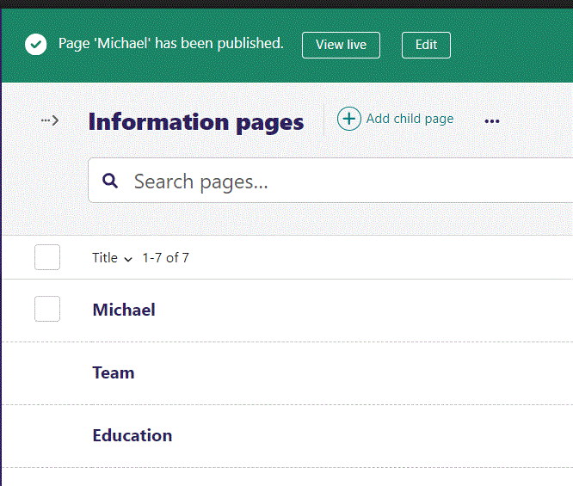
Click View live to open your webpage and see what you created.

Slide 21
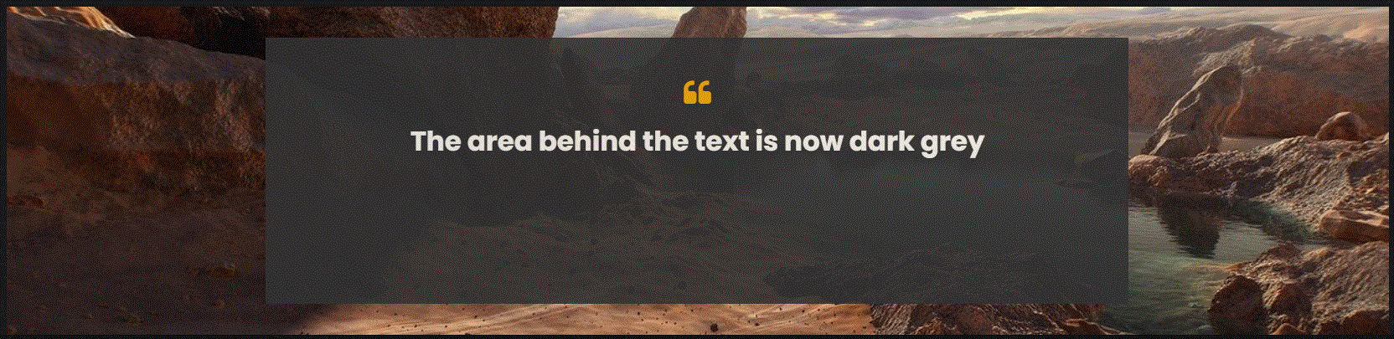
Going live we can see the area behind our text is now dark grey. We will get to adding the text and other elements later.

Slide 22
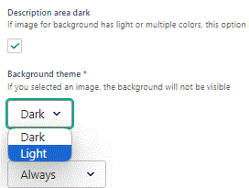
Beneath Description area dark you can set Background theme. Let’s change it to Light.

Slide 23
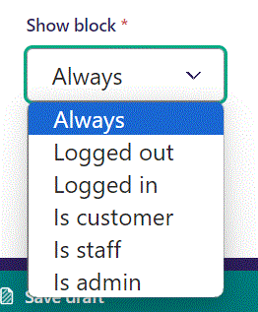
Below Background theme, you can select when or for whom the block will be shown.
Always: Will always show.
Logged out: Only shows when viewer is logged out.
Logged in: Only shows when viewer is logged in.
Is customer: Only shows when viewer is a customer.
Is staff: Only shows if viewer is a staff.
Is admin: Only shows when viewer is an admin.

Slide 24
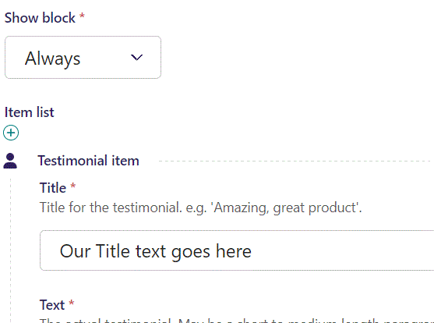
Beneath Show block at the top of the Item list you can write Title.

Slide 25
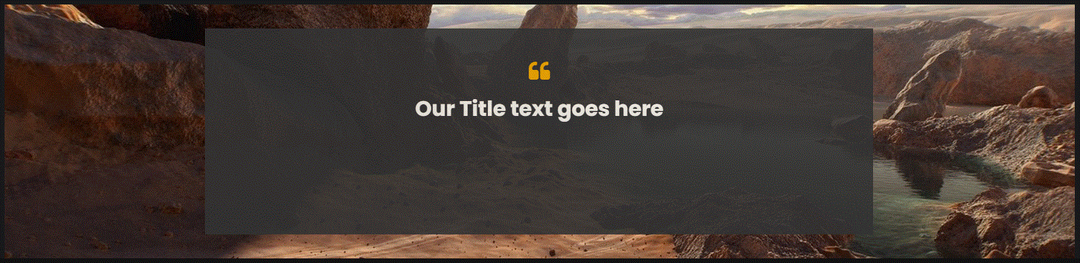
Going live we can see our Title text.

Slide 26
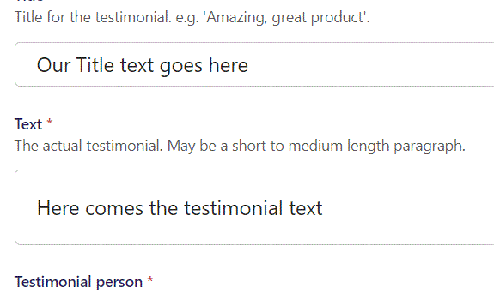
Beneath Title you can write Text.

Slide 27
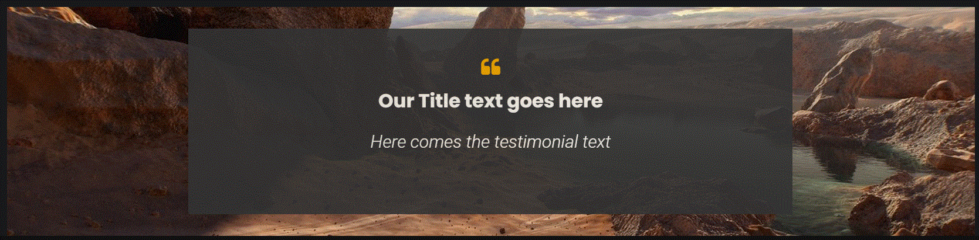
Going live we can see our Text appear beneath the Title text.

Slide 28
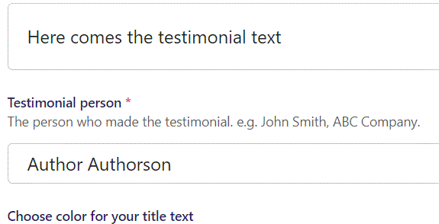
Beneath text you can write Testimonial person.

Slide 29
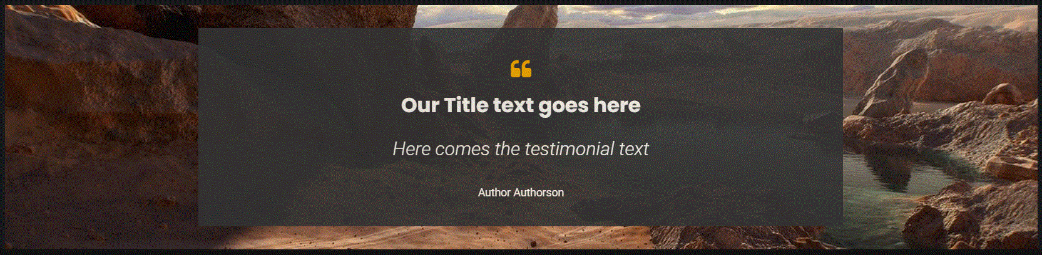
Going live we can see our Author beneath the testimonial text.

Slide 30
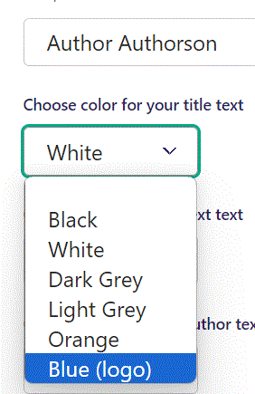
Beneath Testimonial person you can Choose color for your title text. Let’s set it to Blue (logo).

Slide 31
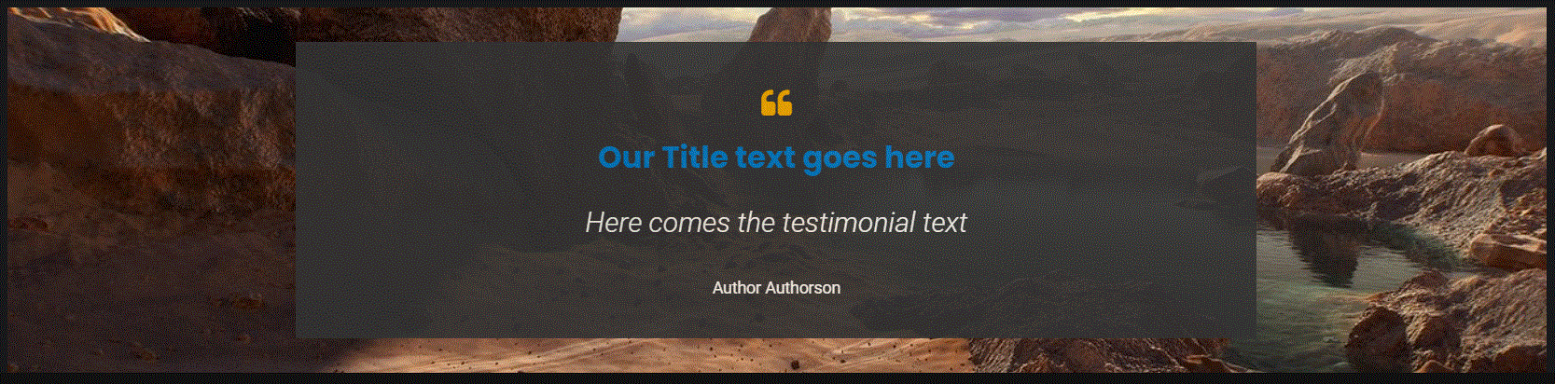
Going live we can see our Title text is now in blue.

Slide 32
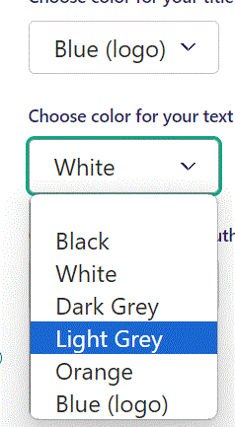
Beneath Choose color for your title text you can Choose color for your text. Let’s change it to Light Grey.

Slide 33
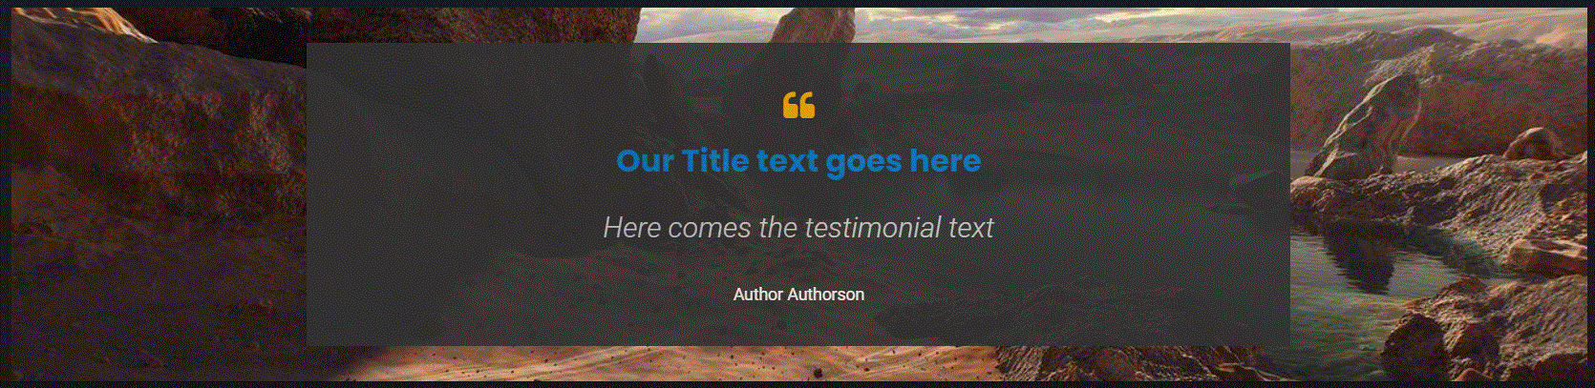
Going live we can see our testimonial text is now in a Light Grey color.

Slide 34
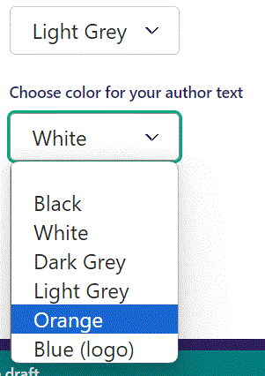
Beneath Choose color for your text you can Choose color for your author text. Let’s change it to Orange.

Slide 35
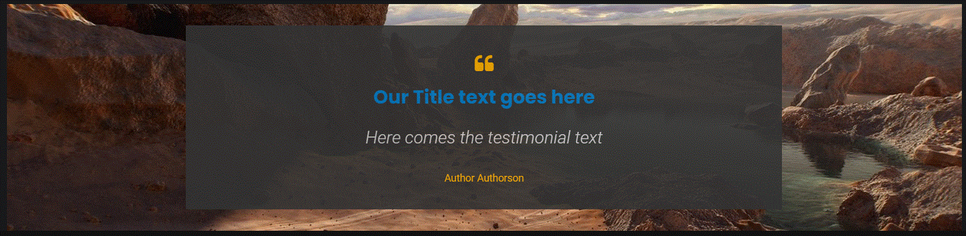
Going live we can see our Author is now in Orange.

Slide 36
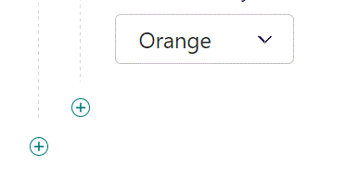
To add another item, click the plus icon.

Slide 37
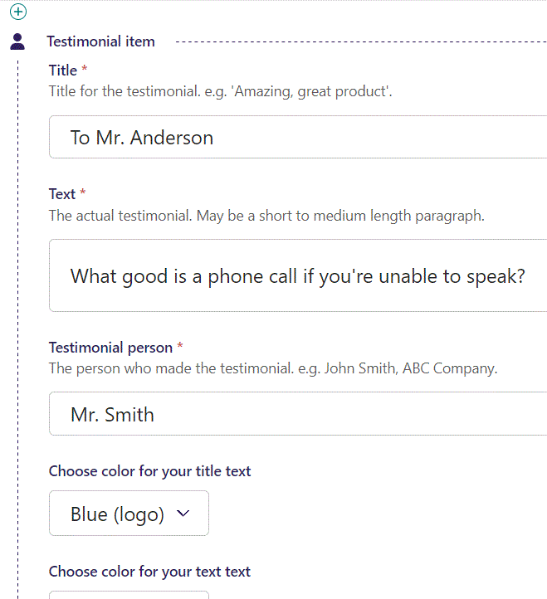
Fill out the fields like before.

Slide 38
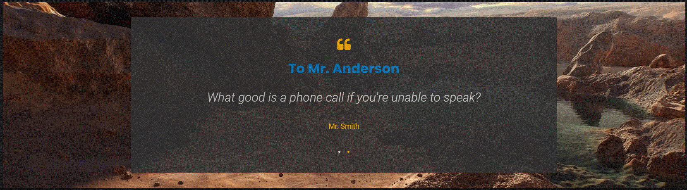
Going live we can see our new item. Notice the navigational dots at the bottom. Also, the page will switch between the items automatically.

