Slide 1
Guide for
Tag Block

Slide 2
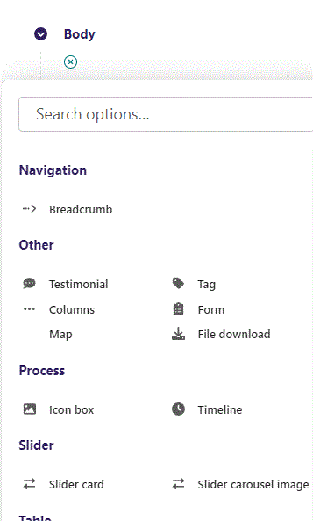
First click the small plus symbol. Then click Tag to begin creating.

Slide 3
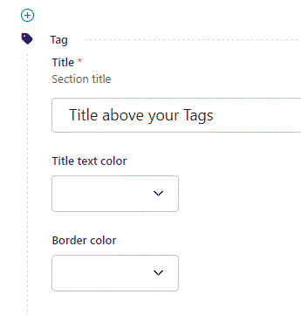
At the top you can write Title.

Slide 4
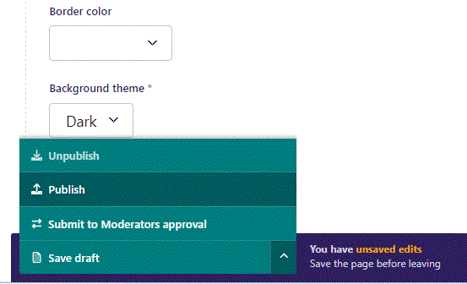
To go live first click the arrow to open up the menu. Then click Publish.

Slide 5
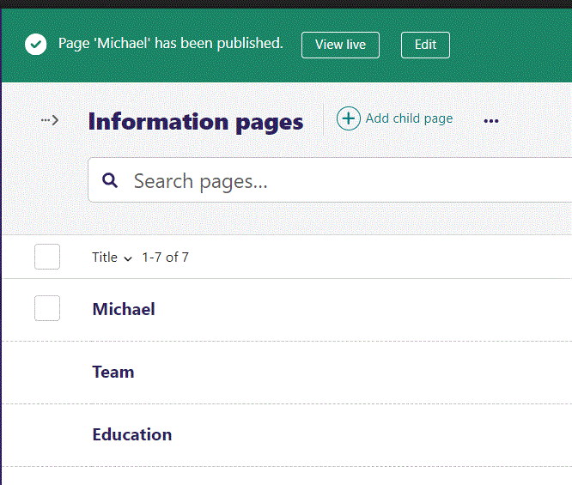
Click View live to open your webpage and see what you created.

Slide 6

Going live we can see our Title above our Tags, separated by a yellow line.

Slide 7
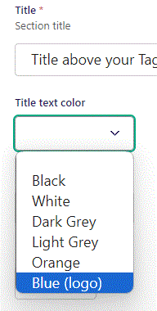
Beneath Title you can set Title text color. Let’s set it to Blue (logo).

Slide 8

Going live we can see our Title are now in a blue color.

Slide 9
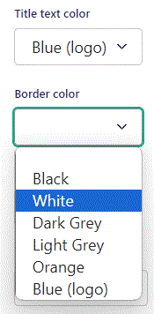
Beneath Title text color you can set Border color. Let’s change it to White.

Slide 10

Going live we can see our border line has changed color to White.
It will also set the color of our tags background.

Slide 11
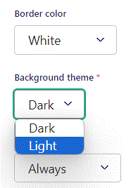
Beneath Border color you can set Background theme. Let’s change it to Light.

Slide 12

Going live we can see our Background theme is now Light. We will reset it to Dark as we go on with this guide.

Slide 13
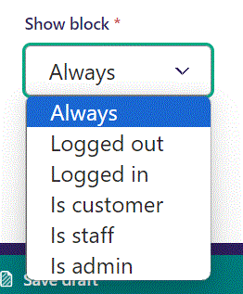
Below Background theme, you can select when or for whom the block will be shown.
Always: Will always show.
Logged out: Only shows when viewer is logged out.
Logged in: Only shows when viewer is logged in.
Is customer: Only shows when viewer is a customer.
Is staff: Only shows if viewer is a staff.
Is admin: Only shows when viewer is an admin.

Slide 14
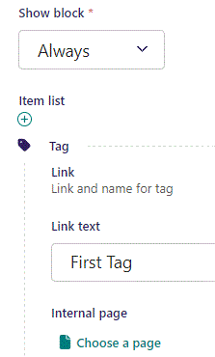
Beneath Show block you can set Link text. It functions as the text inside our Tag.

Slide 15
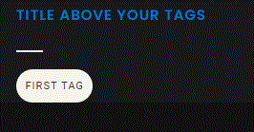
Going live we can see our first tag.

Slide 16
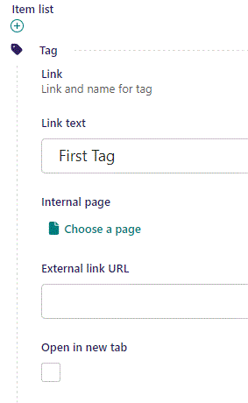
Beneath Link text you can set an Internal page as a link by Choose a page.

Slide 17
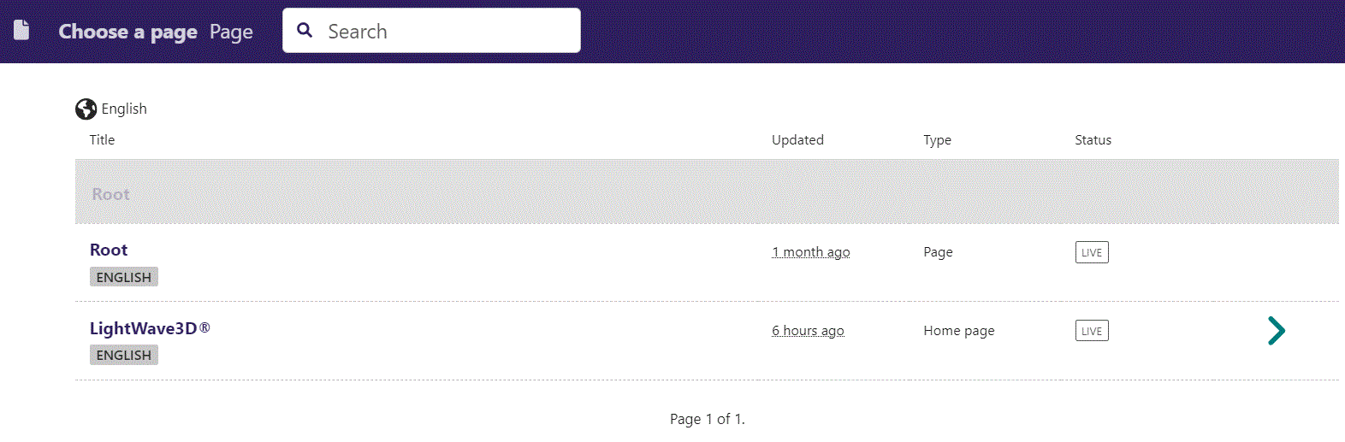
In the page chooser window you can search for the page here.

Slide 18
If a page on the list have pages under it, you can click here to see them.

Slide 19
You select a page by clicking here.

Slide 20
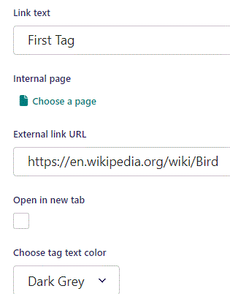
Beneath Internal page you can set External link URL to lead the viewer to if they click the tag.

Slide 21
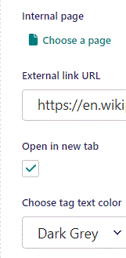
Beneath External link URL you can set Open in new tab. If set to True, like here, the browser will open the link in a new tab when viewer clicks the tag.

Slide 22
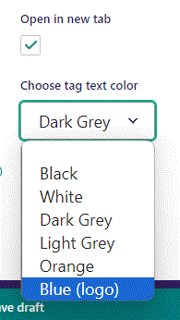
Beneath Open in new tab, you can Choose tag text color. Let’s change it to Blue (logo).

Slide 23
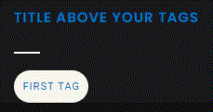
Going live we can see our Tag text have changed color to blue.

Slide 24
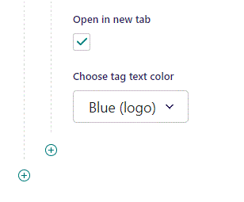
To add a new item, click the plus icon.

Slide 25
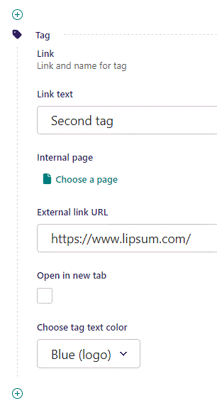
Fill out the fields as before.

Slide 26
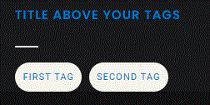
Going live we can see our second tag have been added.

