Slide 1
Guide for
Map Block

Slide 2
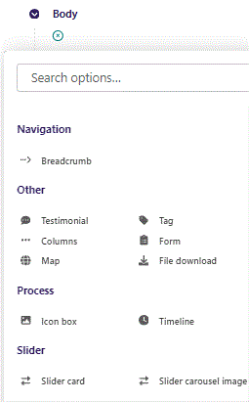
First click the small plus symbol. Then click Map to begin creating.

Slide 3
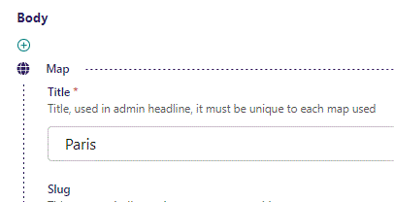
At the top you can write Title. This will not show in the HTML page, but will function as a title in the admin. Also, it must be unique, as it also work as an identifier in the code.

Slide 4
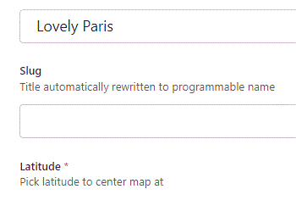
Beneath Title you’ll find Slug. This will be automatically generated and is used in the programming.

Slide 5
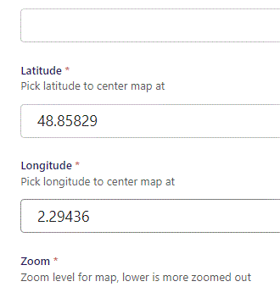
Beneath Slug you can set Latitude and Longitude.

Slide 6
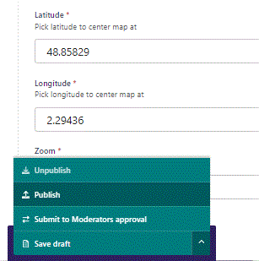
To go live first click the arrow to open the menu. Then click Publish.

Slide 7
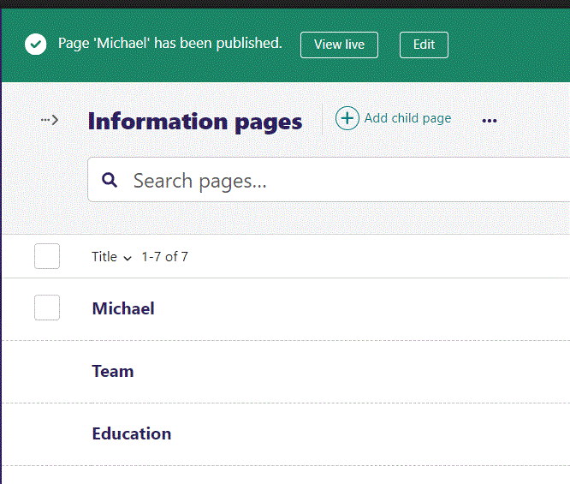
Click View live to open your webpage and see what you created.

Slide 8
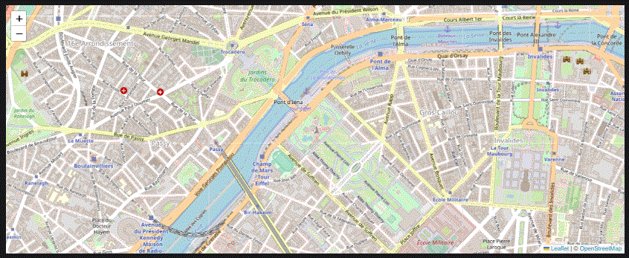
Going live we have our map added.

Slide 9
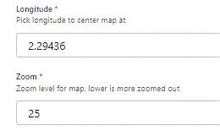
Beneath Longitude you can set Zoom. The lower this number the more zoomed out the map starts. Default is 15, let’s change it to 25.

Slide 10
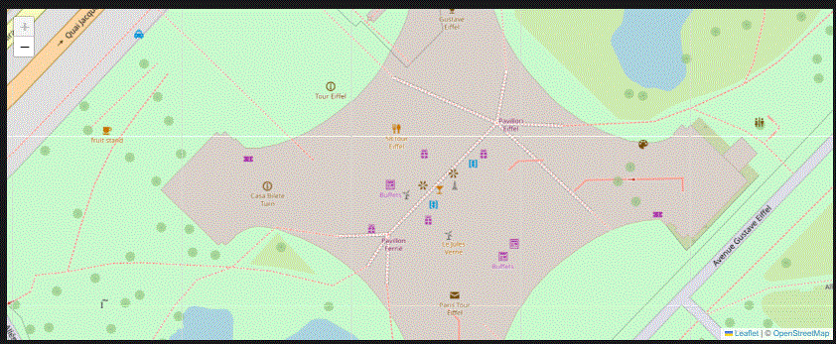
Going live we can see we are now very close to the Eifel tower.
Also note that the zoom plus button is greyed out, because we are as close as we can get.
We will reset it to 15 for this guide.

Slide 11
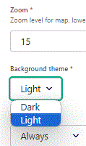
Beneath Zoom you can set Background theme. Let’s change it to Light.

Slide 12
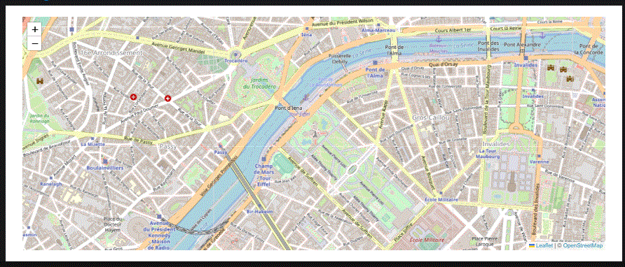
Going live we can see our map now have a Light Background theme.

Slide 13
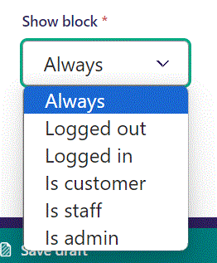
Below Background theme, you can select when or for whom the block will be shown.
Always: Will always show.
Logged out: Only shows when viewer is logged out.
Logged in: Only shows when viewer is logged in.
Is customer: Only shows when viewer is a customer.
Is staff: Only shows if viewer is a staff.
Is admin: Only shows when viewer is an admin.

Slide 14
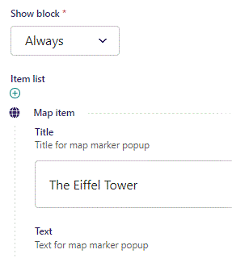
Beneath Show block you can start adding map markers.
At the top you can write Title.

Slide 15
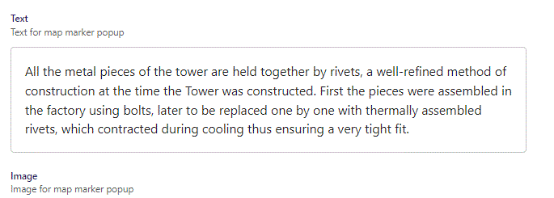
Beneath Title you can write Text.

Slide 16
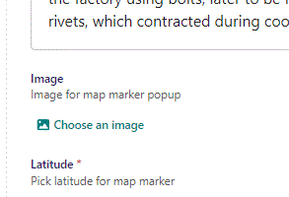
Beneath Text you can Choose an image for the map marker popup.

Slide 17
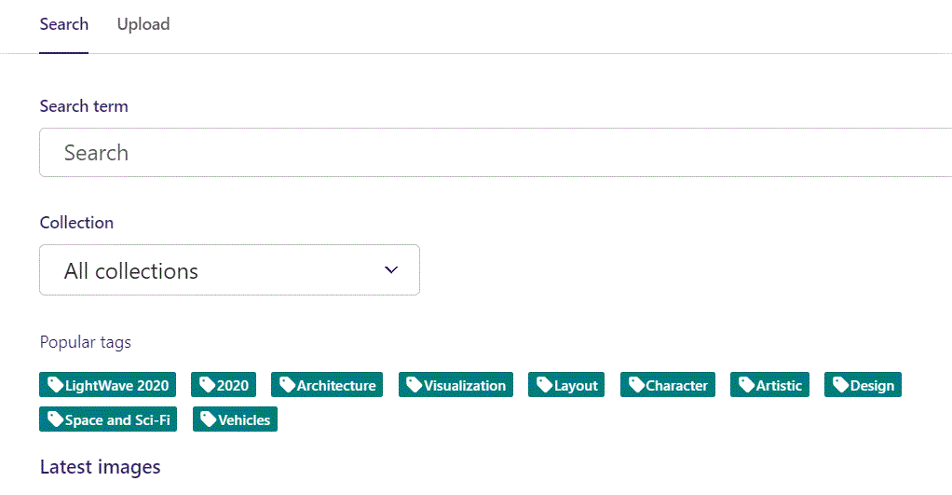
Here we see the top part of the image chooser screen. You can choose to either use an image on the server already or Upload a new image here.
First let’s use an image already on the server.

Slide 18
Here you can write a search term.

Slide 19
Here you can select a Collection of images.

Slide 20
At the bottom you can also sort with Popular tags.

Slide 21
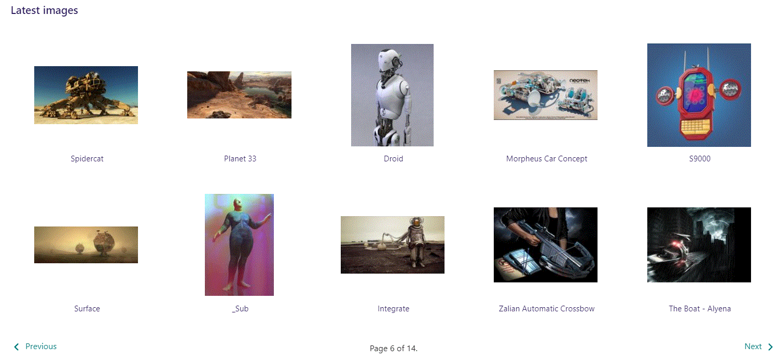
At the bottom of the image selector screen there are navigation buttons.

Slide 22
You can select an image by clicking it.

Slide 23
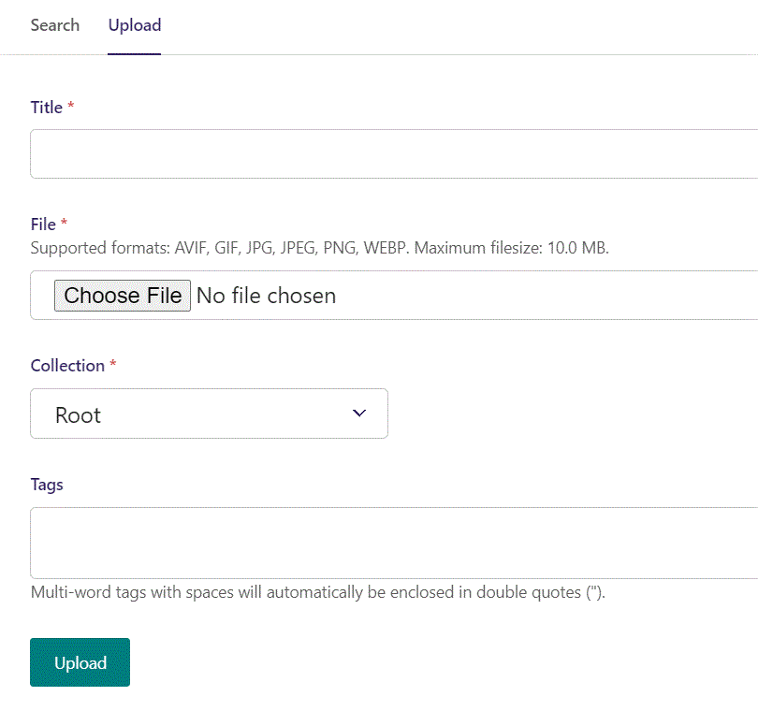
You can also upload an image by clicking Upload.

Slide 24
Name your image here.

Slide 25
Click Choose File to pick your image.

Slide 26
Select which Collection the uploaded image belongs to.

Slide 27
Assign tags to your image. Separate them with a comma.

Slide 28
Finally click Upload, to upload the image.

Slide 29
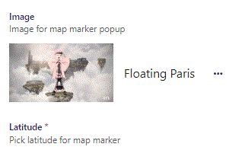
Image chosen.

Slide 30
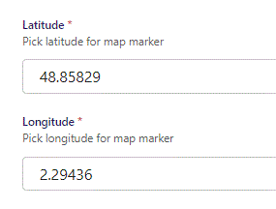
Beneath Choose an image you can set Latitude and Longitude for your map marker.

Slide 31
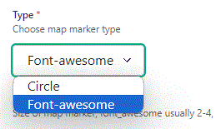
Beneath Longitude you can set Type of map marker.
Circle: Puts a circle with a radius in m. given in Size below Type.
Font-awesome: Select an icon. We will get to how later.

Slide 32
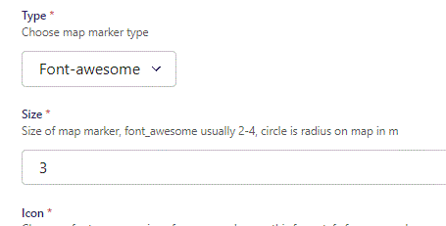
Beneath Type you can set Size. Note that size for a font-awesome icon usually is 2, 3 or 4. A circle size is radius in m.
Since we are using Font-awesome we set a Size of 3.

Slide 33
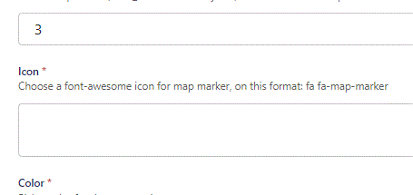
Beneath Size you can select an Icon.

Slide 34
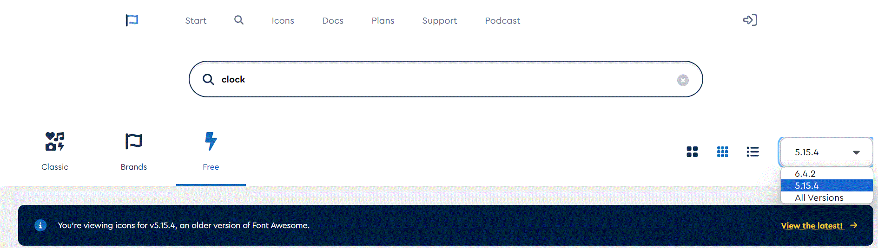
To find icons go to: https://fontawesome.com/search?o=r&m=free
In the right lower side of the top section, you can select icon version. Select version 5.15.4.

Slide 35
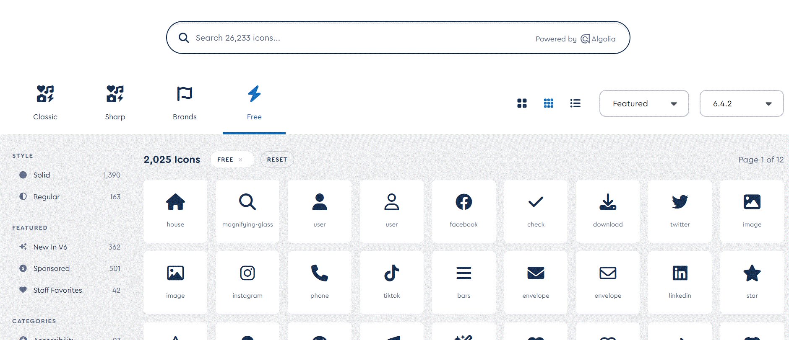
In the top you can search for an icon

Slide 36
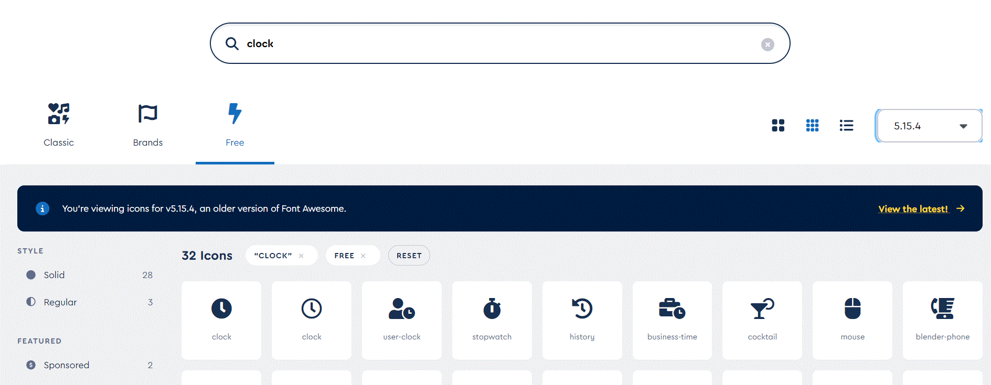
When you find an icon click it.

Slide 37
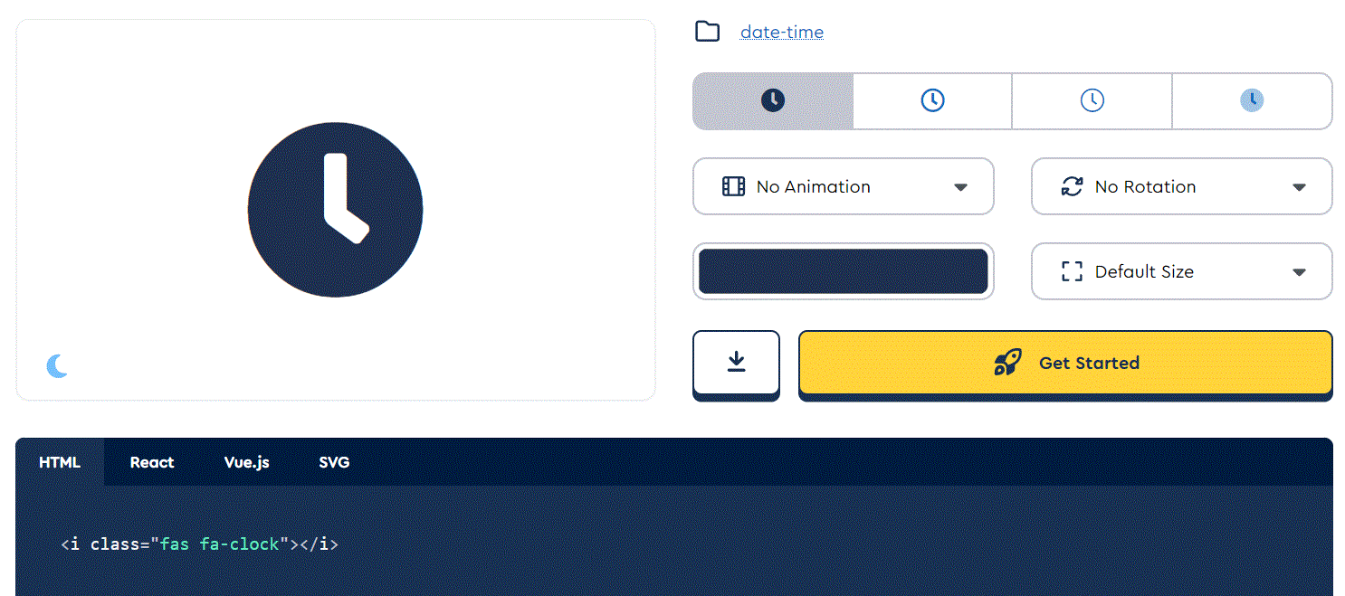
A window pop up, where you can see the code, you need to use in the Icon field. Here the code is:
fas fa-clock

Slide 38
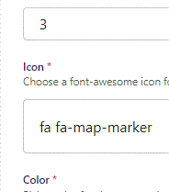
Icon chosen. Since we are creating a map, we will use the default marker.

Slide 39
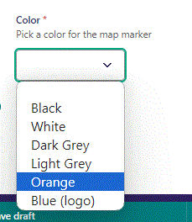
Beneath Icon you can set Color for your map marker. Let’s make it Orange.

Slide 40
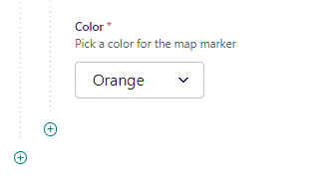
To create a new item, click the plus icon.

Slide 41
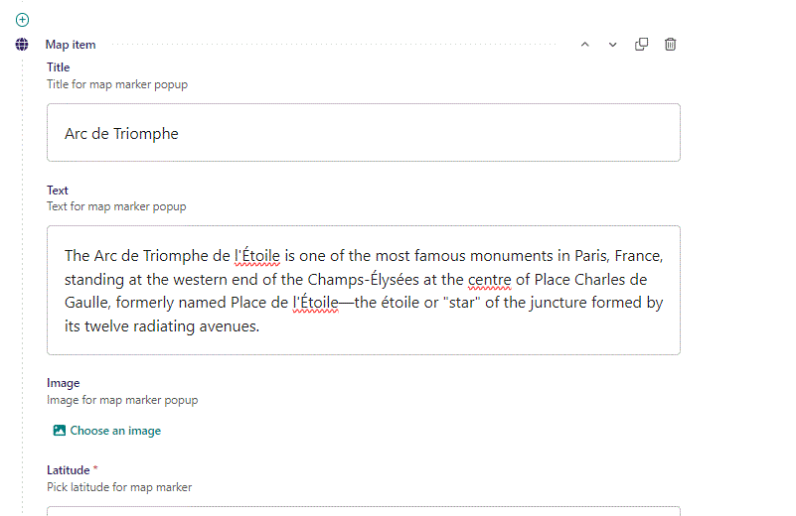
Fill out the fields like before.

Slide 42
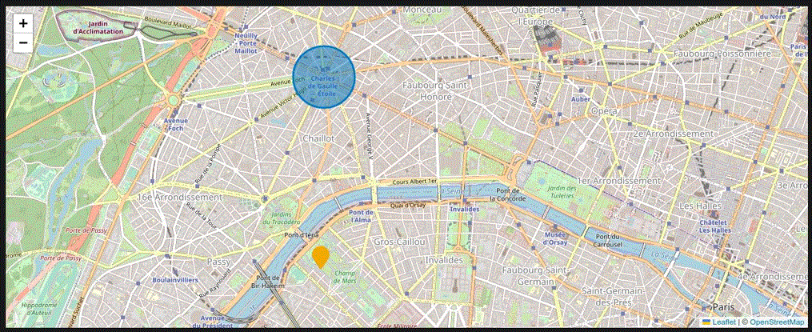
Going live we can see our two items. The yellow font-awesome icon and the blue Circle.

Slide 43
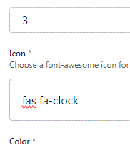
You can change to any font-awesome icon you like. Here we change it to a clock.

Slide 44
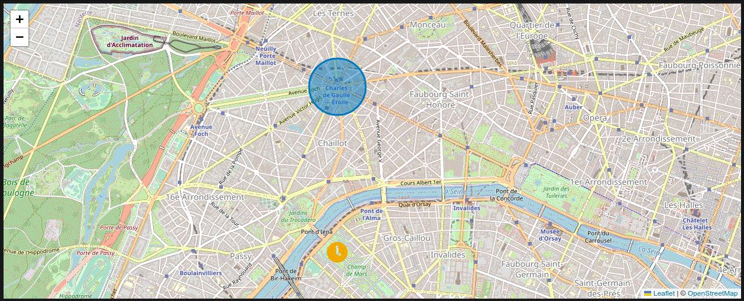
Going live we can see the Icon have changed to a clock icon.

Slide 45
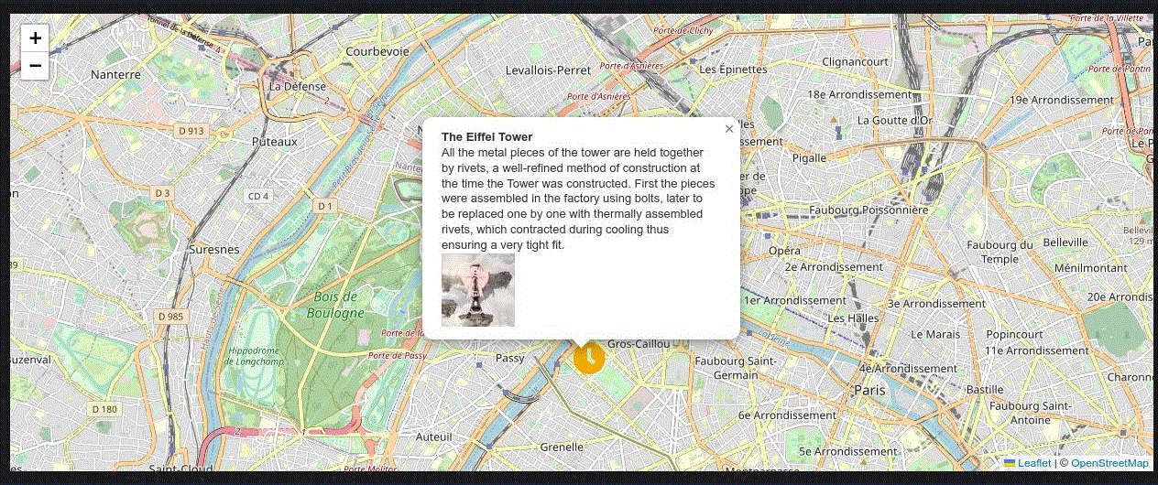
Clicking an Icon or Circle will show a popup. Here you can see the Title at the top, followed by a Text section and in the bottom an Image.

