Slide 1
Guide for
Form Block

Slide 2
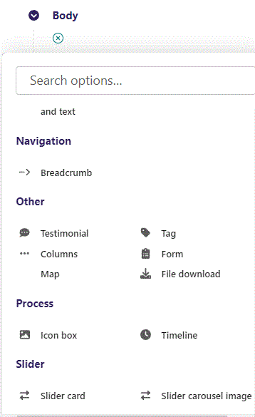
First click the small plus symbol. Then click Form to begin creating.

Slide 3
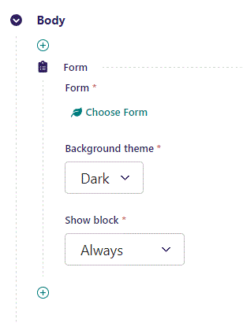
At the top you can Choose Form.

Slide 4
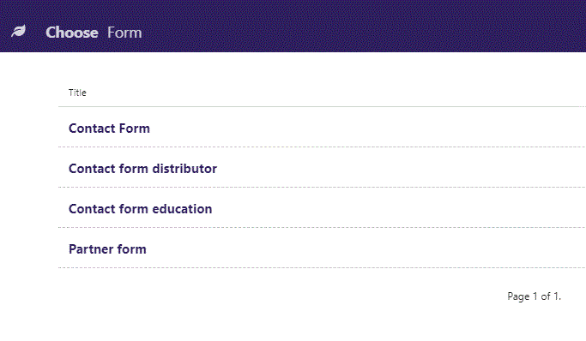
In the Choose Form window you can select from the Forms you have created. You create Forms by going to Snippets → Forms.
Click on the Form you want. Here we select Contact Form.

Slide 5
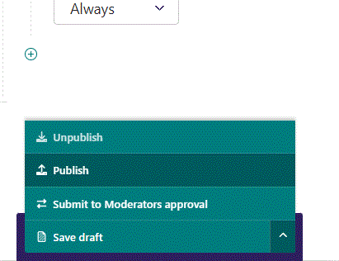
To go live first click the arrow to open the menu. Then click Publish.

Slide 6
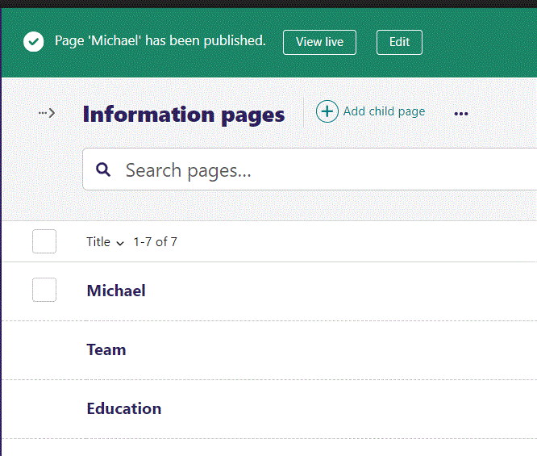
Click View live to open your webpage and see what you created.

Slide 7
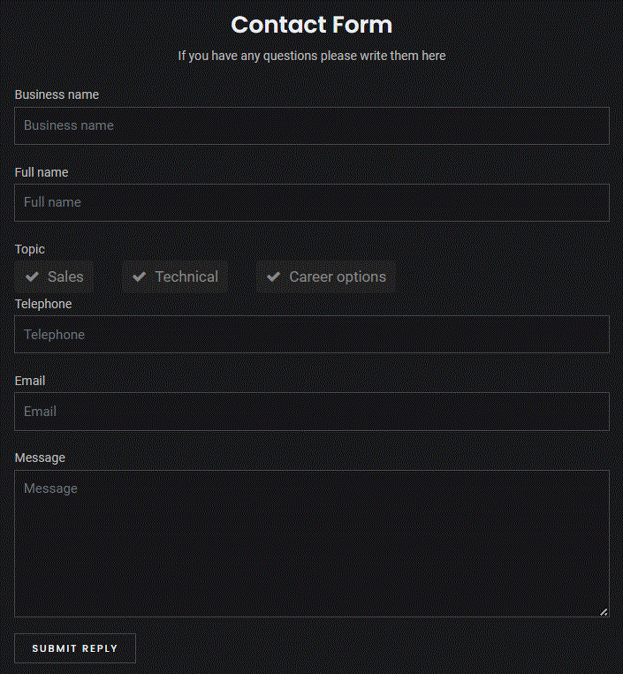
Going live we can see our Form.

Slide 8
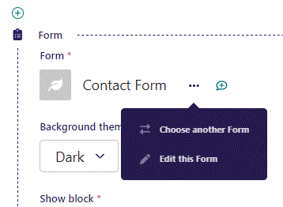
Clicking the 3 dots you can Choose another Form or Edit this Form.

Slide 9
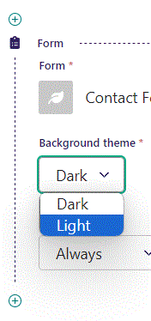
Beneath Choose Form you can set Background theme. Let’s change it to Light.

Slide 10
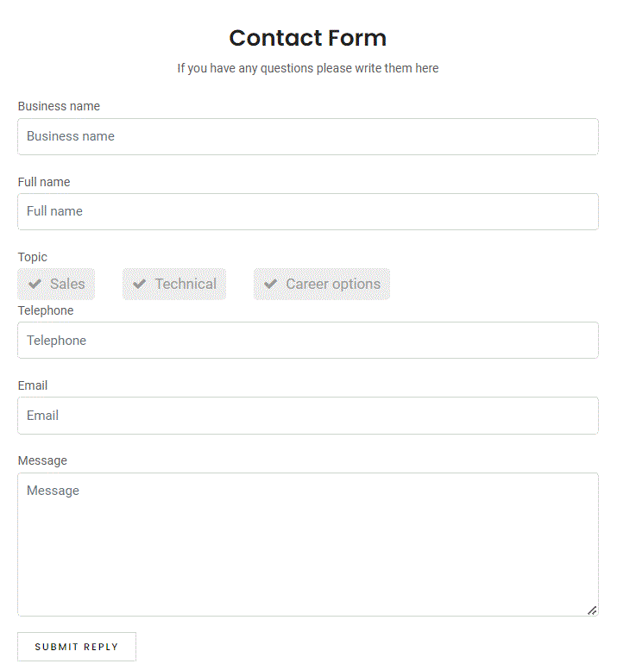
Going live our Background theme is now Light.

Slide 11
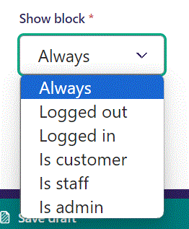
Below Background theme, you can select when or for whom the block will be shown.
Always: Will always show.
Logged out: Only shows when viewer is logged out.
Logged in: Only shows when viewer is logged in.
Is customer: Only shows when viewer is a customer.
Is staff: Only shows if viewer is a staff.
Is admin: Only shows when viewer is an admin.

