Slide 1
Guide for
File download Block

Slide 2
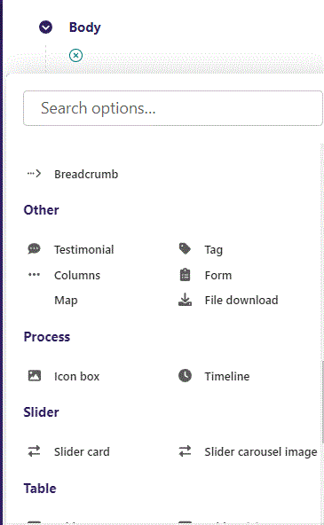
First click the small plus symbol. Then click File download to begin creating.

Slide 3
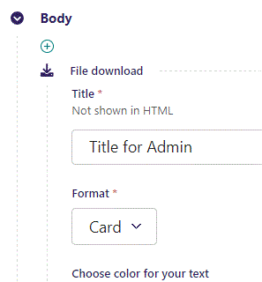
At the top you can write a Title. This will not be shown in HTML but will function as a title in admin.

Slide 4
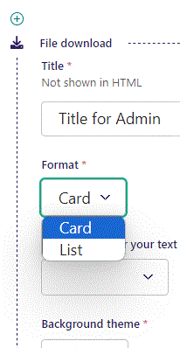
Beneath Title you can set Format. First let’s see Card live, then List.

Slide 5
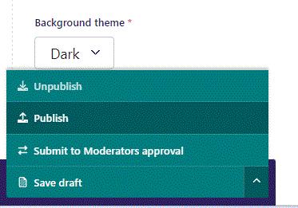
To go live first click the arrow to open the menu. Then click Publish.

Slide 6
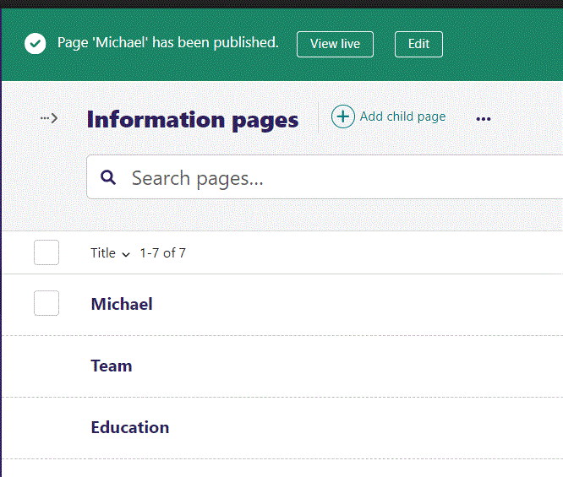
Click View live to open your webpage and see what you created.

Slide 7
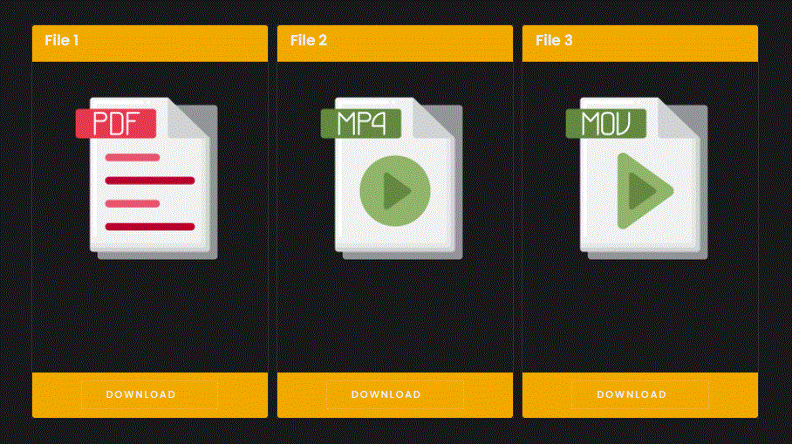
Card Format live. We will get to adding files later.
Notice that each file type have its own icon.

Slide 8
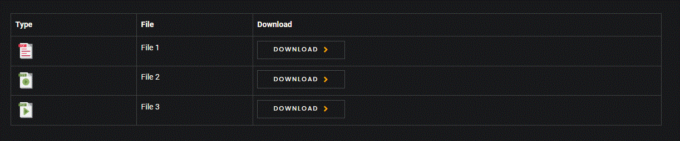
List Format live. We will use this Format for the rest of this guide.

Slide 9
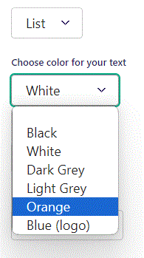
Beneath Format you can Choose color for your text. Let’s change it to Orange.

Slide 10
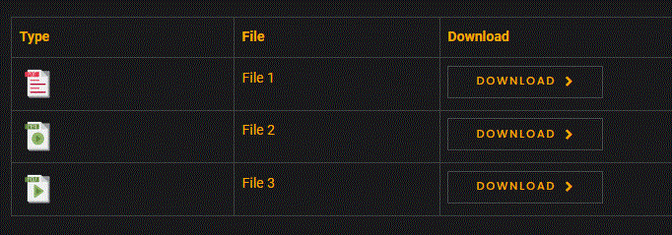
Going live we can see our text is now Orange colored.

Slide 11
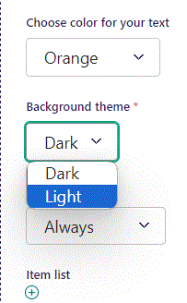
Beneath Choose color for your text you can set Background theme. Let’s change it to Light.

Slide 12
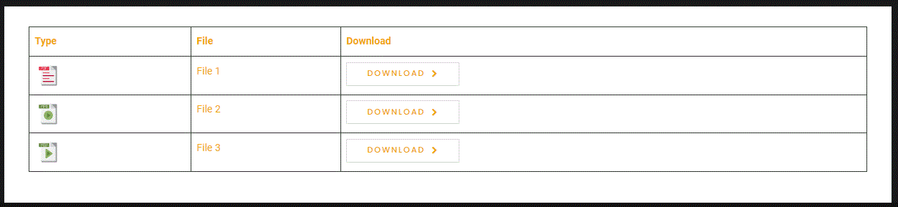
Going live we see our Background theme have changed to Light.

Slide 13
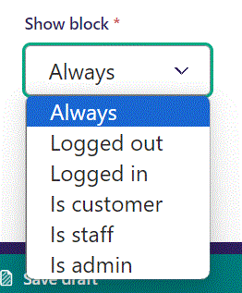
Below Background theme, you can select when or for whom the block will be shown.
Always: Will always show.
Logged out: Only shows when viewer is logged out.
Logged in: Only shows when viewer is logged in.
Is customer: Only shows when viewer is a customer.
Is staff: Only shows if viewer is a staff.
Is admin: Only shows when viewer is an admin.

Slide 14
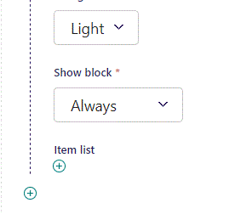
To add an item, click the plus icon.

Slide 15
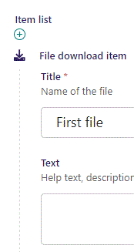
Beneath Show block you can write Title.

Slide 16
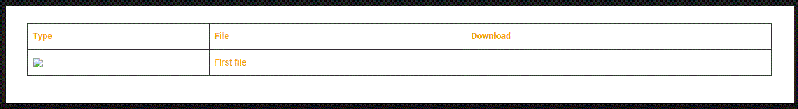
Going live our Title is shown here.
Note the broken Type icon, we have yet to select a file. We will get to that later.

Slide 17
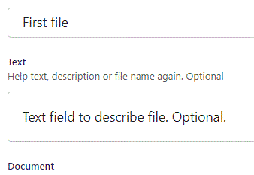
Beneath Title you can write Text.

Slide 18
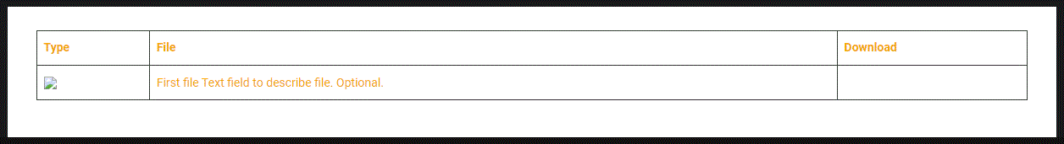
Going live we can see our Text.

Slide 19
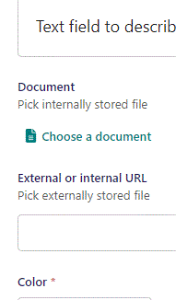
Beneath Text you can Choose a document.

Slide 20
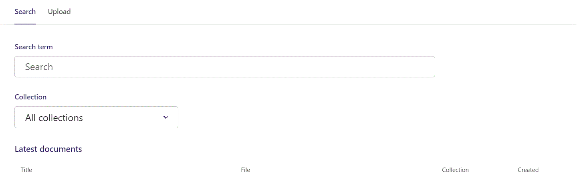
Here you can write Search term.

Slide 21
You can also filter based on Collection.

Slide 22
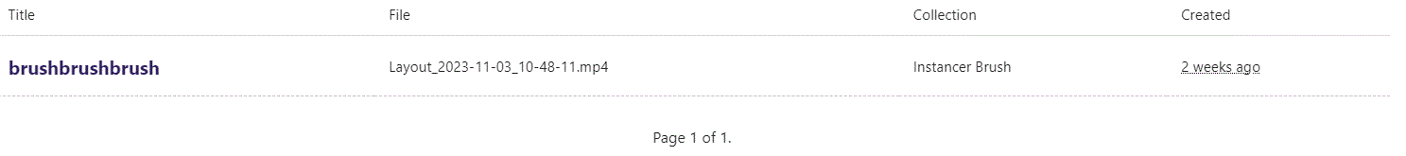
At the bottom section of the Search window, you can select the file you want.

Slide 23
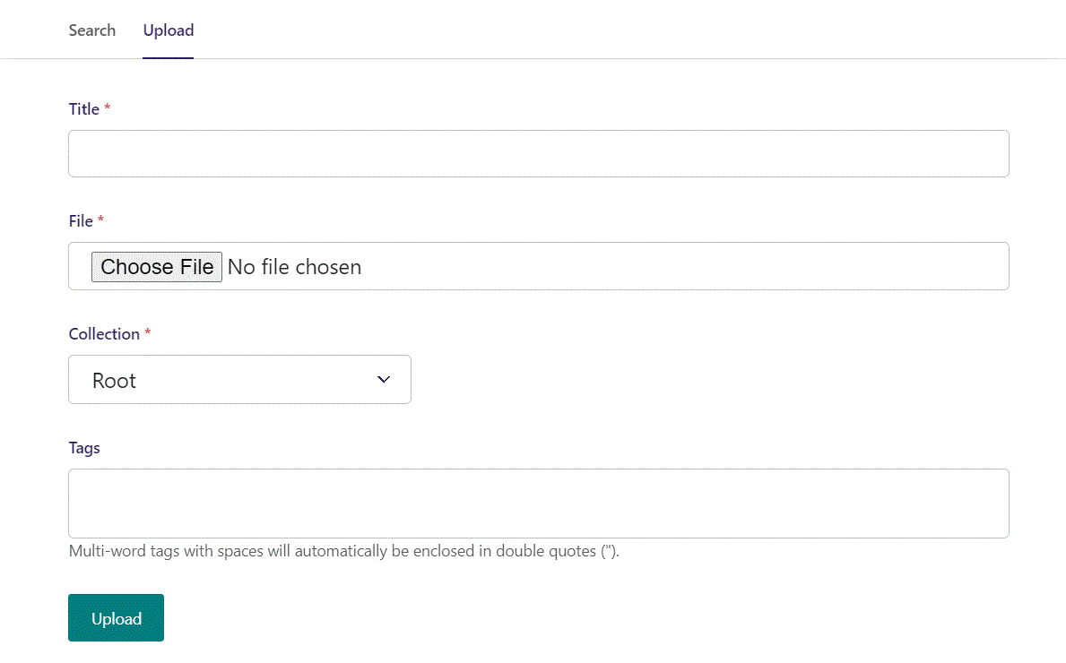
Switching to the Upload window.

Slide 24
Here you can name the file you want to upload.

Slide 25
Here you can pick the file to upload.

Slide 26
Here you can pick a Collection to add your file to.

Slide 27
Here you can associate your file with Tags.

Slide 28
To Upload your file, click here.

Slide 29
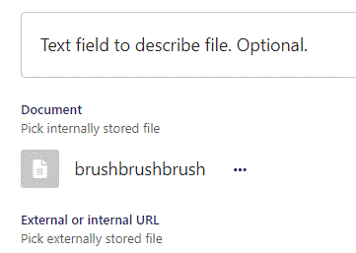
We have now chosen a document.

Slide 30
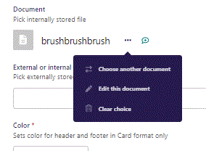
Clicking the 3 dots you can Choose another document, Edit this document or Clear choice.

Slide 31
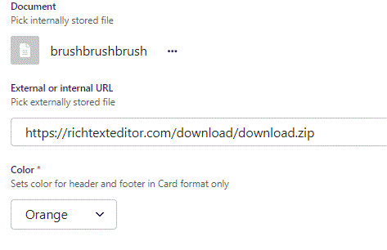
Beneath Choose a document you can set an External or internal URL.

Slide 32
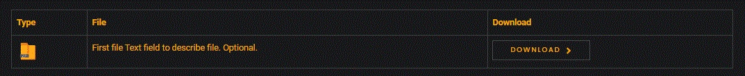
Going live we can see our External file type have been registered.
You can have both an Internal and External download link at the same time. You will in this case have two Download buttons.

Slide 33
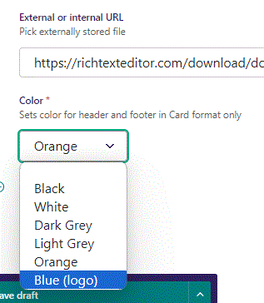
Beneath External or internal URL, you can set Color. This is for the header and footer of the card in the Card Form only. Let’s change it to Blue (logo) and change Form to Card.

Slide 34
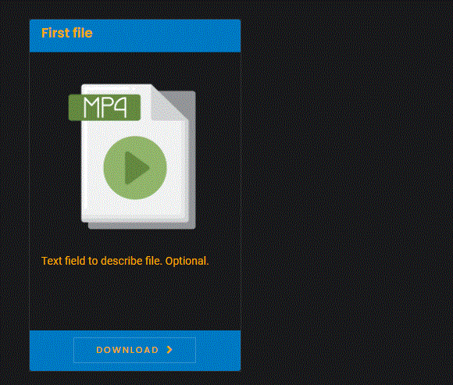
Going live we can see the header and footer of have a blue background.

