Slide 1
Guide for
Column Block

Slide 2
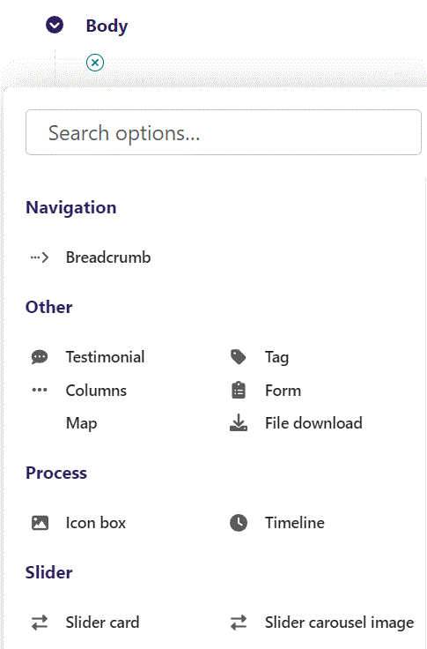
First click the small plus symbol. Then click Columns to begin creating.

Slide 3
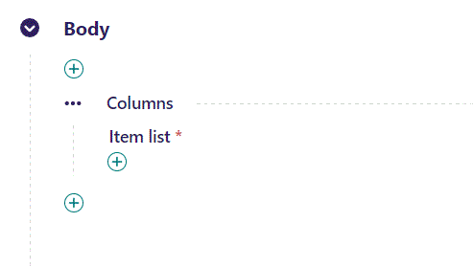
Columns is a special Block, where you can use many of the other Blocks.
To begin, let’s add a new item by clicking the plus icon.

Slide 4
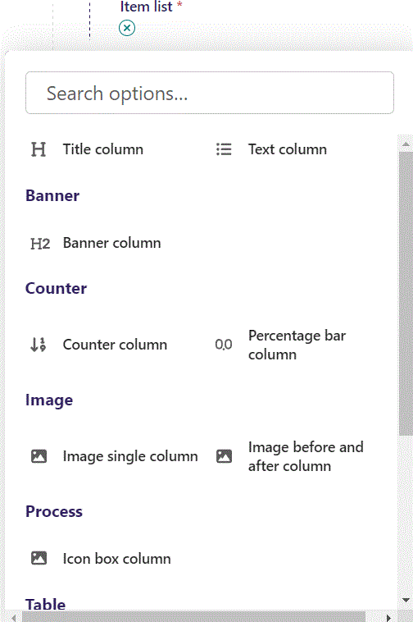
You have several options. Let’s start simple by adding a, Image single column.

Slide 5
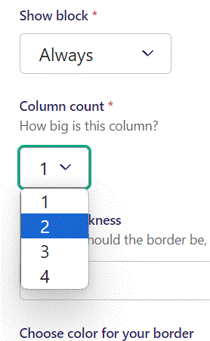
Most fields are the same as the normal image single with text, you can check the guide for more info.
There are a few fields that are special to columns, we will go through those.
Column count let’s you set how big the column will be. 1 is 25% 2 is 50% etc. up to 4 at 100% of the screen width. Here we set the column to 2 (50%).

Slide 6
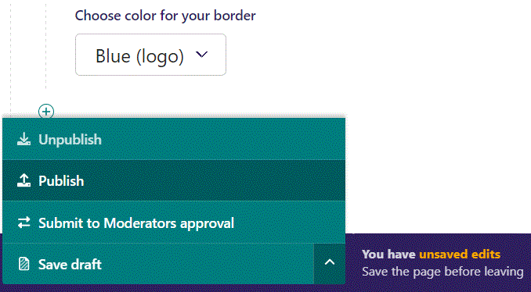
To go live first click the arrow to open the menu. Then click Publish.

Slide 7
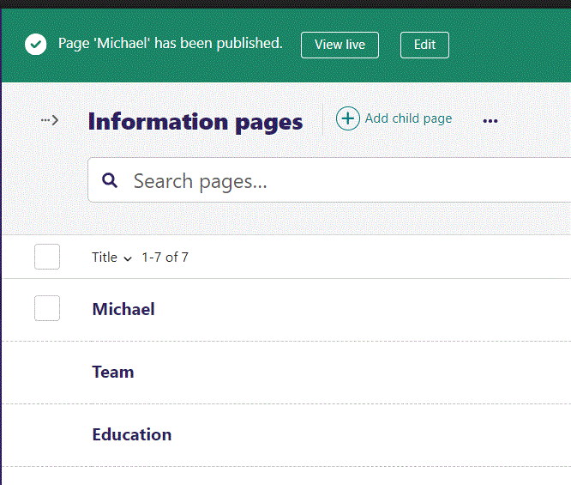
Click View live to open your webpage and see what you created.

Slide 8
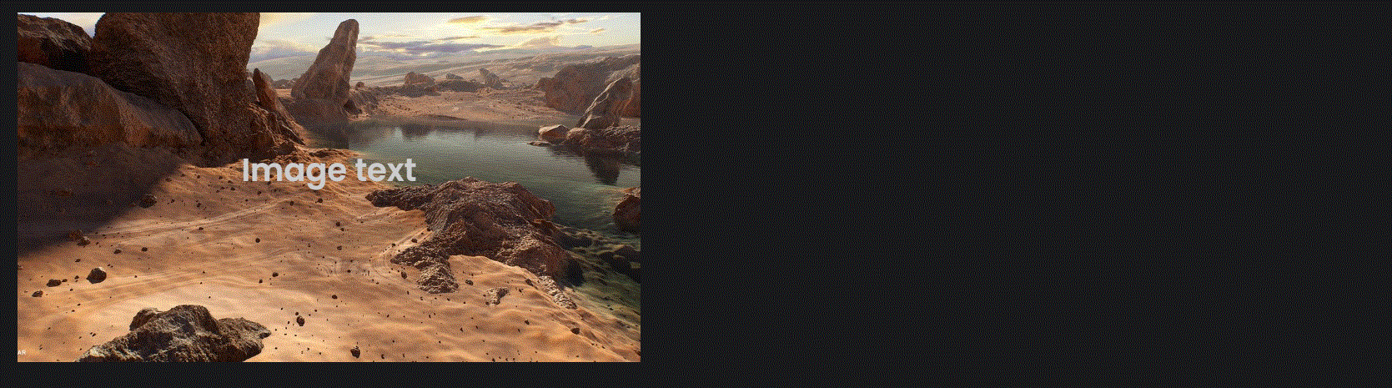
Going live we can see our Image takes up half the width of the viewport.

Slide 9
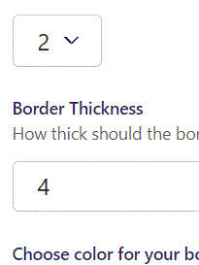
Beneath Column count you can set Border Thickness. This will surround the column with a border, at the thickness you set. Here we set a Thickness of 4.

Slide 10
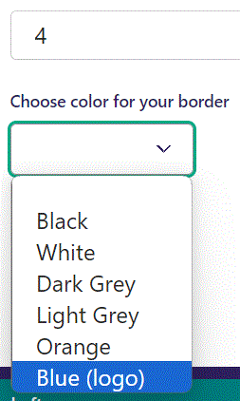
Before a border appears, we need to give it a color. Beneath Border Thickness you can Choose color for your border. Here we set it to Blue (logo).

Slide 11
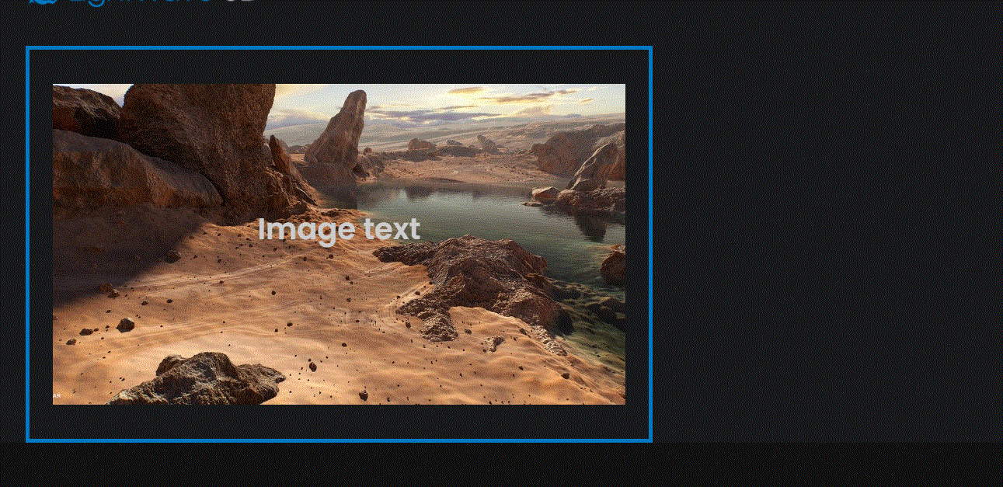
Going live we can see our image now have a blue border.

Slide 12
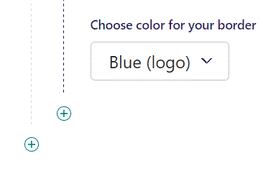
To add another item, click the plus icon.

Slide 13
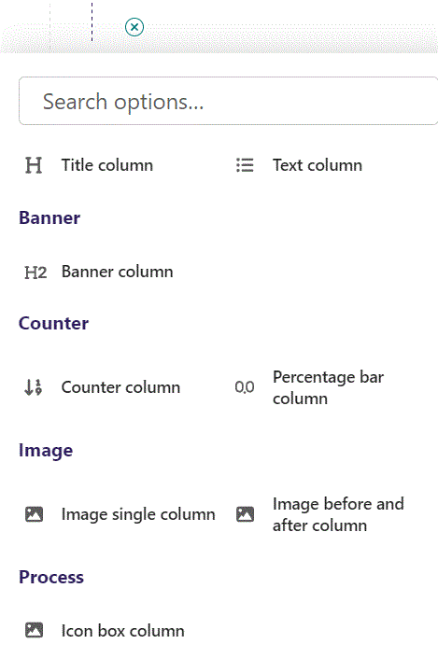
Let’s add a Text column as our second column item.

Slide 14
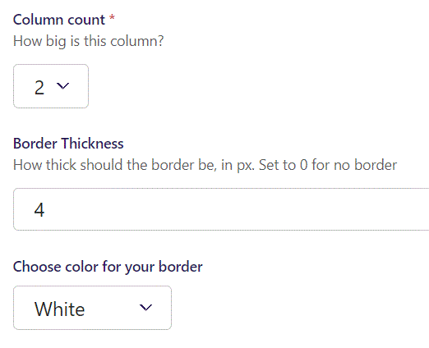
We set it to Column count 2 and give it a White border.

Slide 15
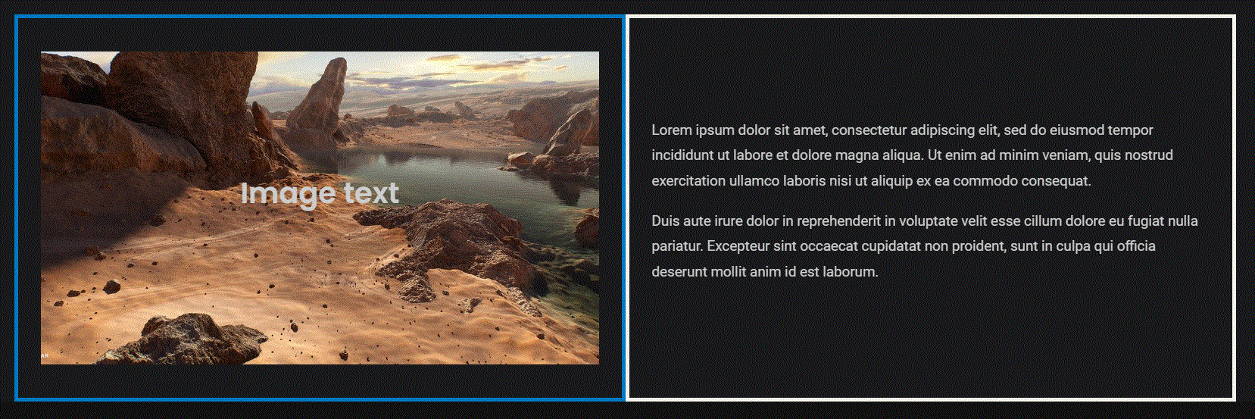
Going live we can see our new column item next to our image.

Slide 16
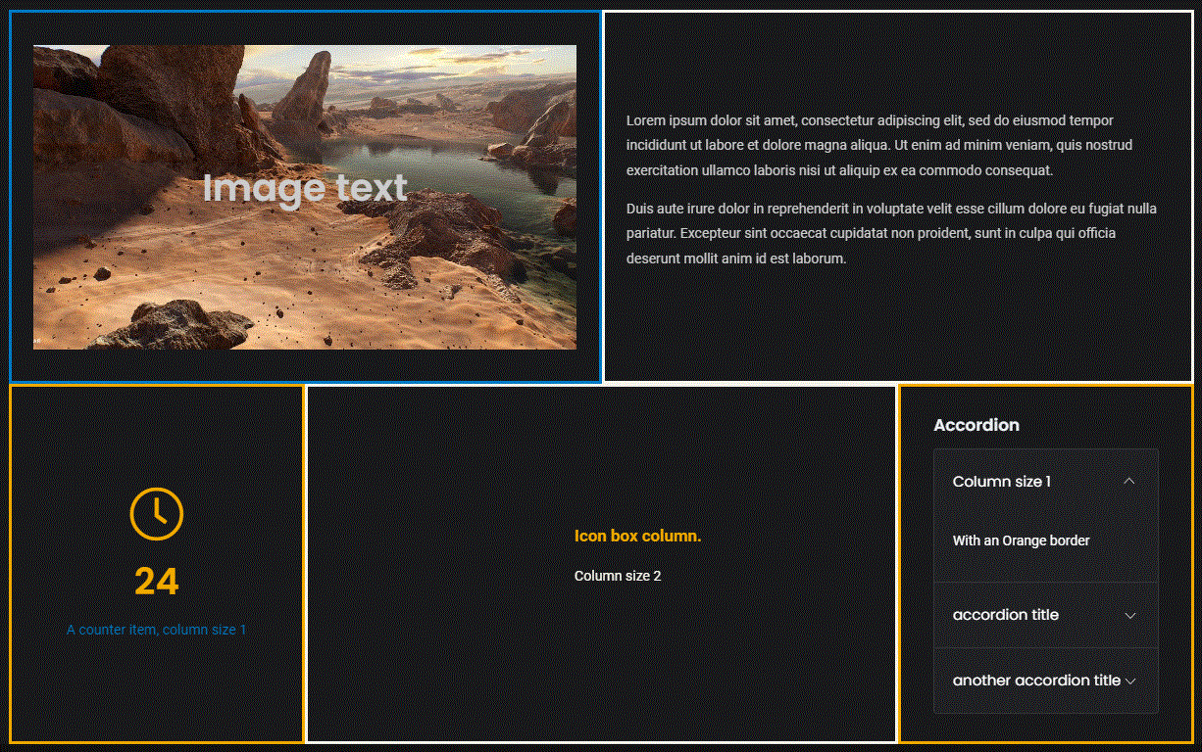
You can build complex pages. Here we have added 3 more items to our previous example.

