Slide 1
Guide for
Breadcrumb Block

Slide 2
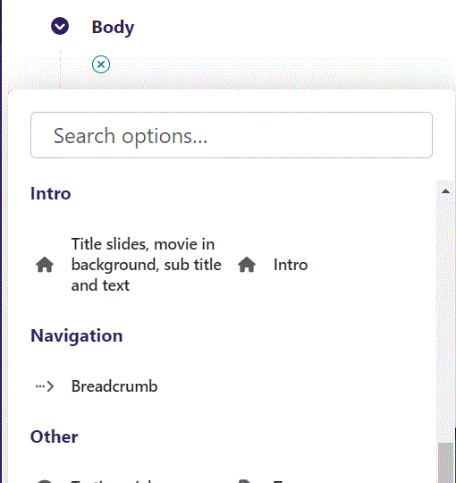
First click the small plus symbol. Then click Breadcrumb to begin creating.

Slide 3
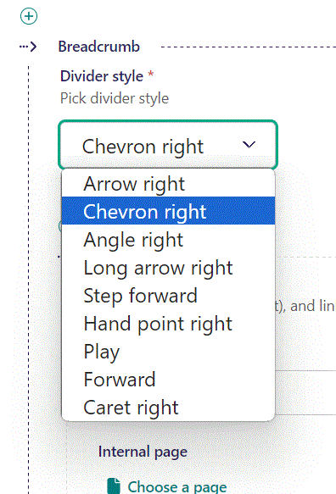
At top you can set Divider style. Here we set it to Chevron right.

Slide 4
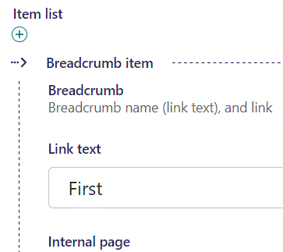
At the top of the Item list, you can set Link text.

Slide 5
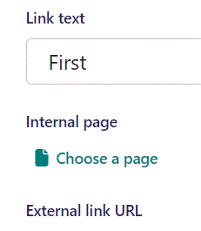
Beneath Link text you can set Internal page link at Choose a page.

Slide 6
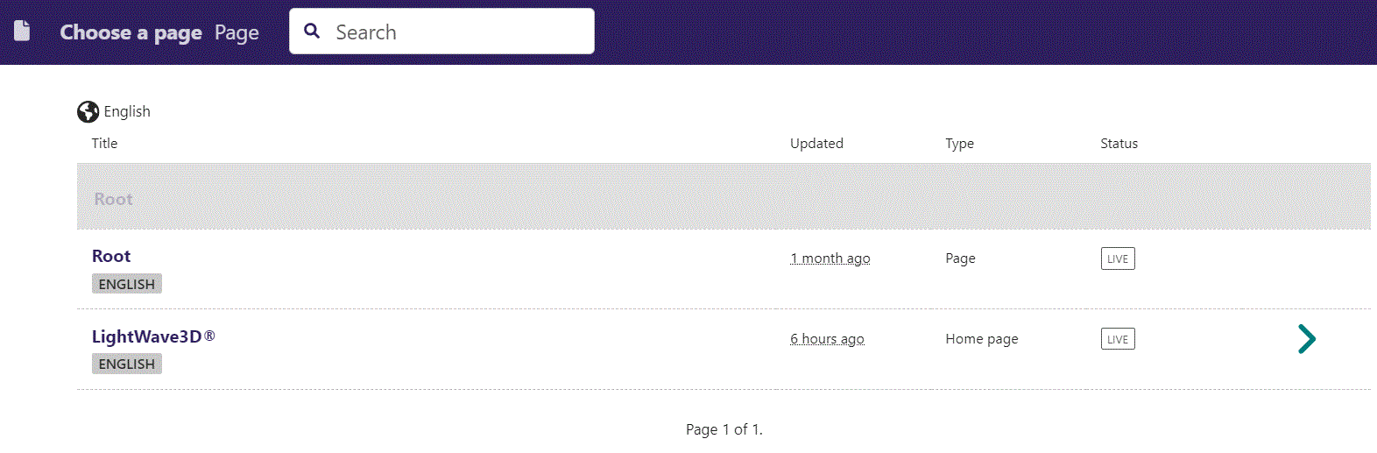
In the page chooser window you can search for the page here.

Slide 7
If a page on the list have pages under it, you can click here to see them.

Slide 8
You select a page by clicking here.

Slide 9
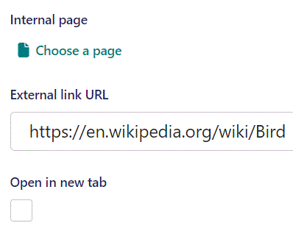
Beneath Choose a page you can set External link URL.

Slide 10
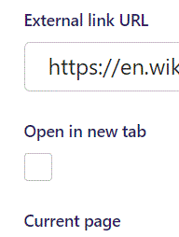
Beneath External link URL you can set Open in new tab. If set True, the browser will open the link in a new tab when viewer clicks the breadcrumb.

Slide 11
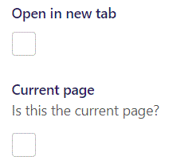
Beneath Open in new tab, you can set Current page. If set to True, the Breadcrumb will be specially formatted.

Slide 12
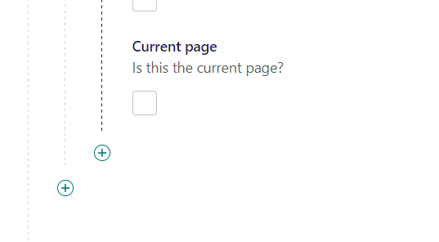
You can add a new item by clicking the plus icon.

Slide 13
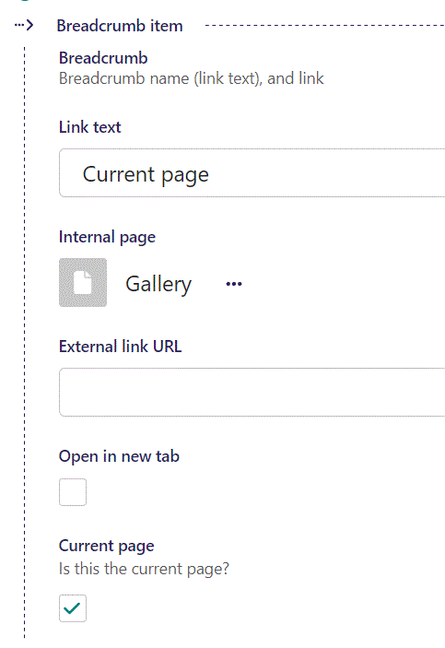
Fill out the fields as before. This Breadcrumb we set to Current page.

Slide 14
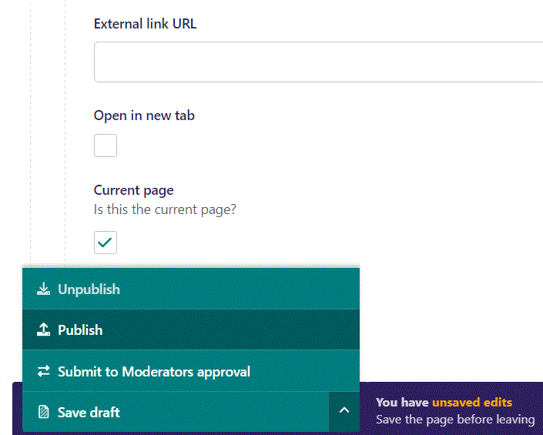
To go live first click the arrow to open the menu. Then click Publish.

Slide 15
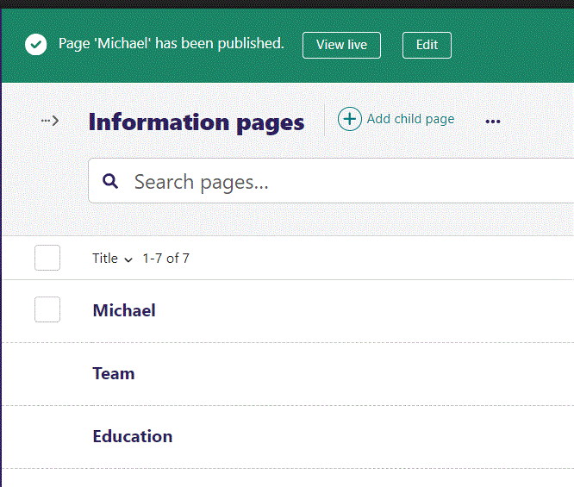
Click View live to open your webpage and see what you created.

Slide 16

Going live we can see our First breadcrumb is in white and our Current page is in grey. The chevron > separates the breadcrumbs.

