Slide 1
Guide for
Title slides, movie in background, sub title and text Block

Slide 2
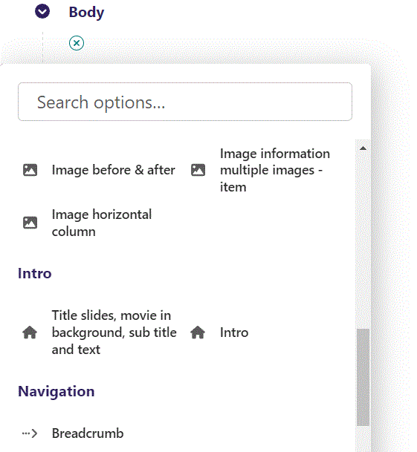
First click the small plus symbol. Then click Title slides, movie in background, sub title and text to begin creating.

Slide 3
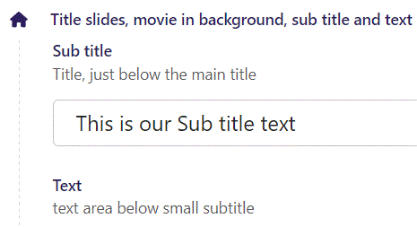
At the top you can write Sub title.

Slide 4
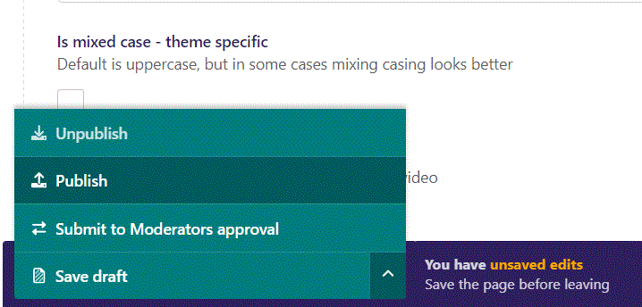
To go live first click the arrow to open the menu. Then click Publish.

Slide 5
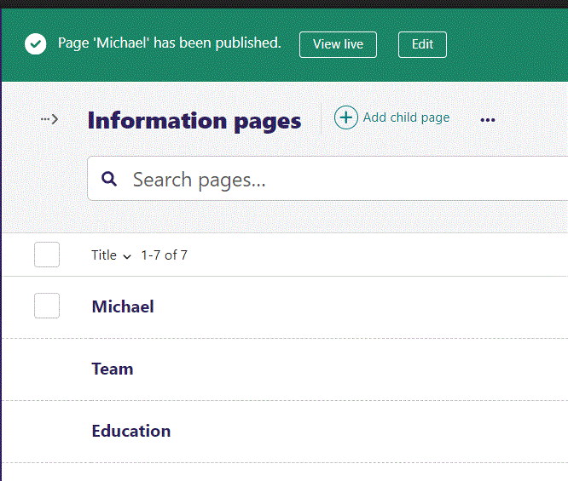
Click View live to open your webpage and see what you created.

Slide 6

Going live we can see our Sub title text.

Slide 7
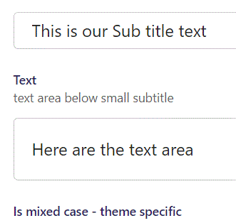
Beneath Sub title you can write Text.

Slide 8

Going live we can see our Text beneath the Sub title.

Slide 9
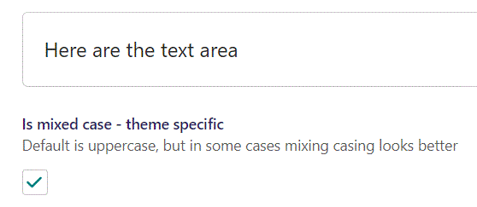
Beneath Text you can set Is mixed case – theme specific. Default is False, here we change it to True.

Slide 10

Going live we can see the two Title parts are not all in uppercase.
We will get to adding Title parts later.

Slide 11
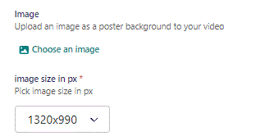
Beneath Is mixed case you can Choose an image as a poster background to your video.

Slide 12
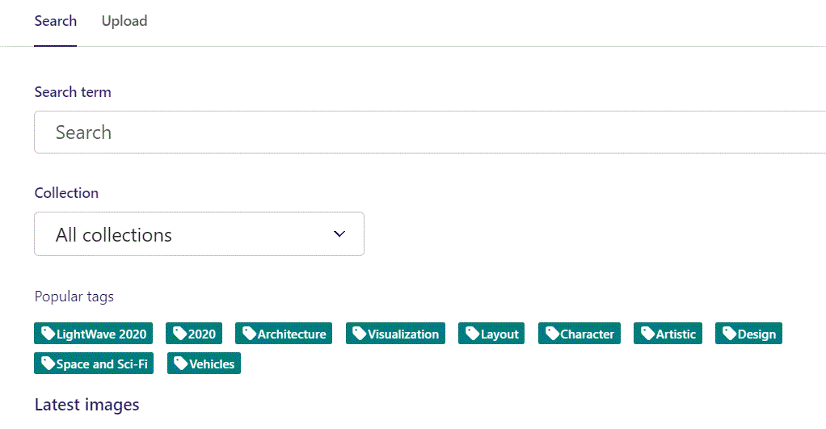
Here we see the top part of the image chooser screen. You can choose to either use an image on the server already or Upload a new image here.
First let’s use an image already on the server.

Slide 13
Here you can write a search term.

Slide 14
Here you can select a Collection of images.

Slide 15
At the bottom you can also sort with Popular tags.

Slide 16
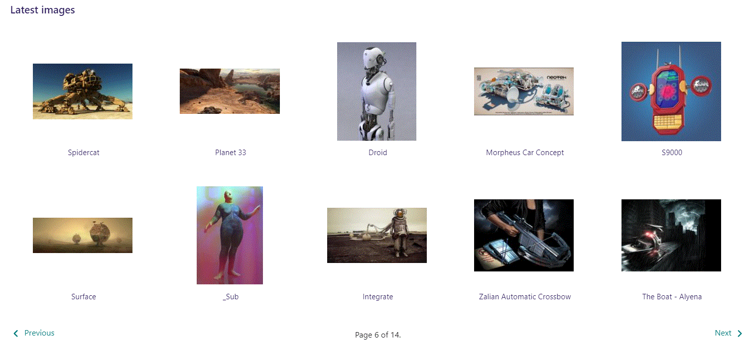
At the bottom of the image selector screen there are navigation buttons.

Slide 17
You can select an image by clicking it.

Slide 18
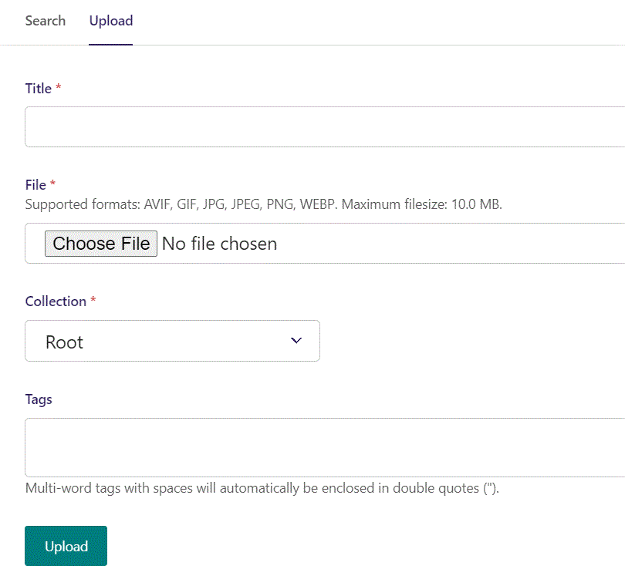
You can also upload an image by clicking Upload.

Slide 19
Name your image here.

Slide 20
Click Choose File to pick your image.

Slide 21
Select which Collection the uploaded image belongs to.

Slide 22
Assign tags to your image. Separate them with a comma.

Slide 23
Finally click Upload, to upload the image.

Slide 24
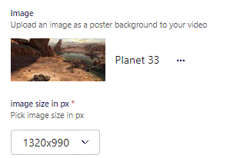
We have now chosen an image.

Slide 25
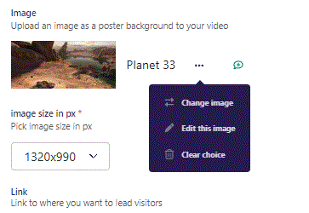
If you click the 3 dots you can Change image, Edit this image or Clear choice.

Slide 26
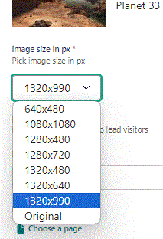
Beneath Choose an image you can set image size in px. Original keeps the original size of the image.

Slide 27
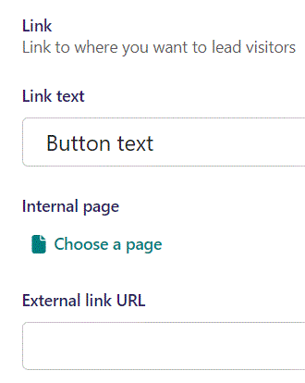
Beneath Choose image you can write Link text. It functions as a Button text and is only visible if you provide a link below.

Slide 28
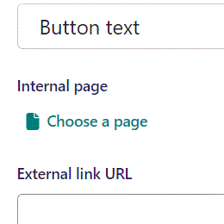
Beneath Link text you can Choose a page, an Internal page, to send the viewer to when they click the button.

Slide 29
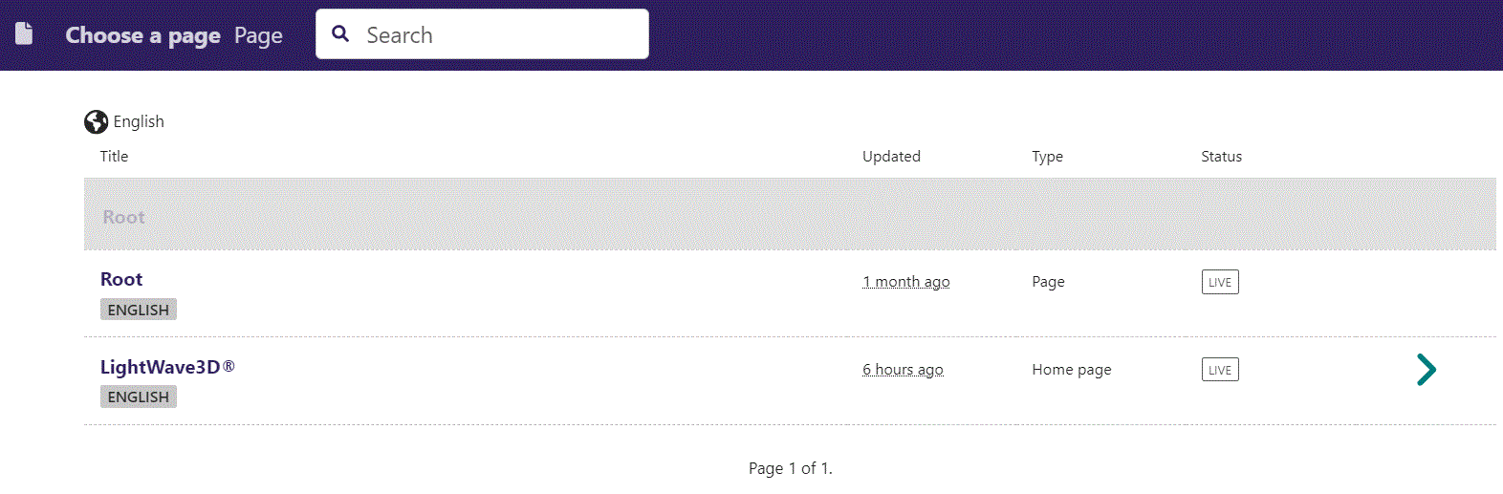
In the page chooser window you can search for the page here.

Slide 30
If a page on the list have pages under it, you can click here to see them.

Slide 31
You select a page by clicking here.

Slide 32
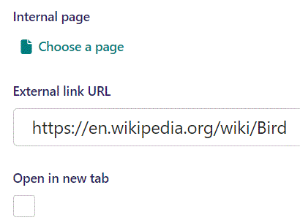
Beneath Choose a page you can set External link URL, to lead the viewer to if they click the button.

Slide 33
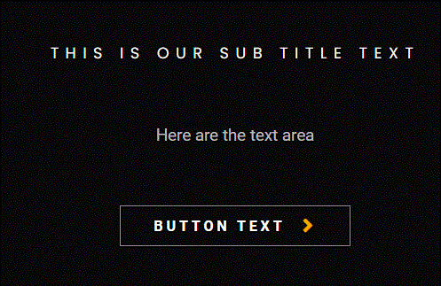
Going live we can see our button, with button text, below our Text.

Slide 34
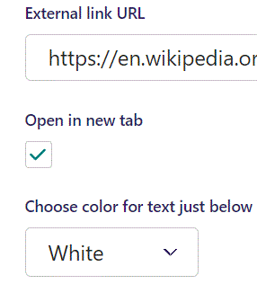
Beneath External link URL you can set Open in new tab. Default is False, here we set it to True. This makes the browser open the link in a new tab when viewer clicks the button.

Slide 35
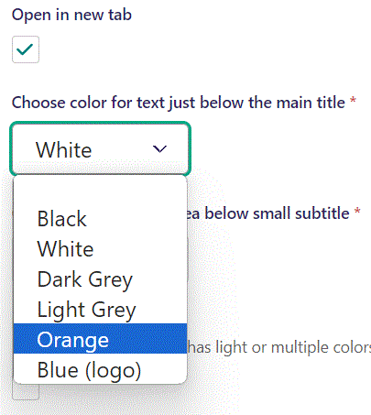
Beneath Open in new tab, you can Choose color for text just below the main title. Here we change it to Orange.

Slide 36
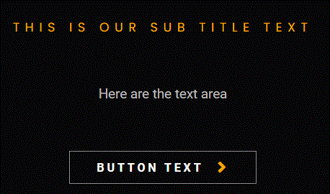
Going live we can see our Sub title text have change to Orange. Later we will be adding the Title text above the Sub title.

Slide 37
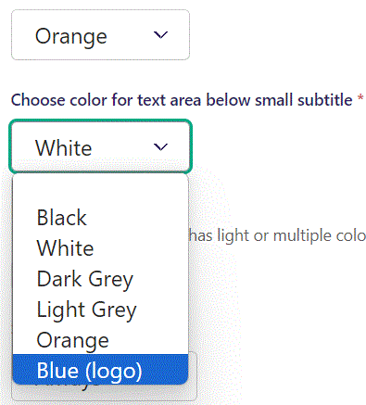
Beneath Choose color for text just below the main title you can Choose color for text area below small subtitle. Here we set it to Blue (logo).

Slide 38
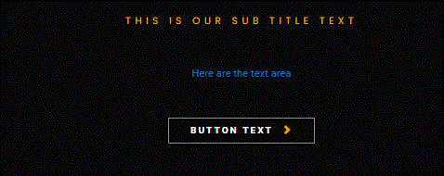
Going live we can see the color of our text below sub title have changed color to blue.

Slide 39
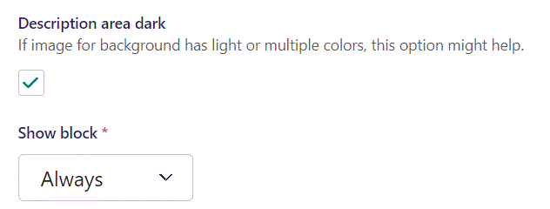
Beneath Choose color for text area below small subtitle you can set Description area dark. Default is False, here we set it to True. Also, we have added a video in this example, we will get to adding video later.

Slide 40

Going live we can see a Dark Grey area have been added.

Slide 41
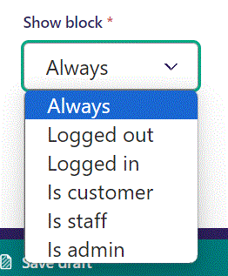
Below Description area dark, you can select when or for whom the block will be shown.
Always: Will always show.
Logged out: Only shows when viewer is logged out.
Logged in: Only shows when viewer is logged in.
Is customer: Only shows when viewer is a customer.
Is staff: Only shows if viewer is a staff.
Is admin: Only shows when viewer is an admin.

Slide 42
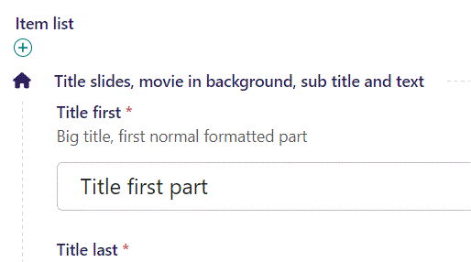
Beneath Show block you can write Title first.

Slide 43

Going live our Title first part is at the top.

Slide 44
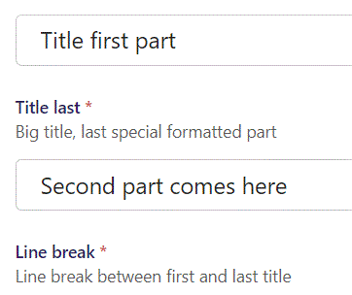
Beneath Title first you can write Title last.

Slide 45

Going live we can see our Second title.

Slide 46
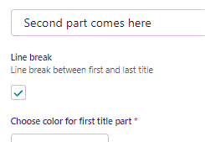
Beneath Title last you can set Line break. Default is True, which puts a line break between Title first and Title last.
If set to False Title first and Title last will be on the same line.

Slide 47
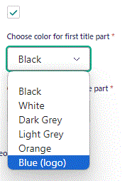
Beneath Line break you can Choose color for first title part. Here we change it to Blue (logo).

Slide 48

Going live we can see our Title first part is now in blue.

Slide 49
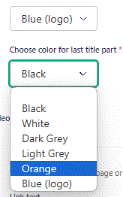
Beneath Choose color for first title part you can Choose color for last title part. Here we set it to Orange.

Slide 50

Going live we can see our Second part comes here text is now in Orange.

Slide 51
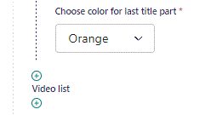
To add another Title section, click the plus icon.

Slide 52
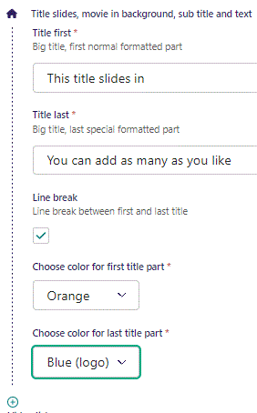
Fill out the fields like last Title section.

Slide 53
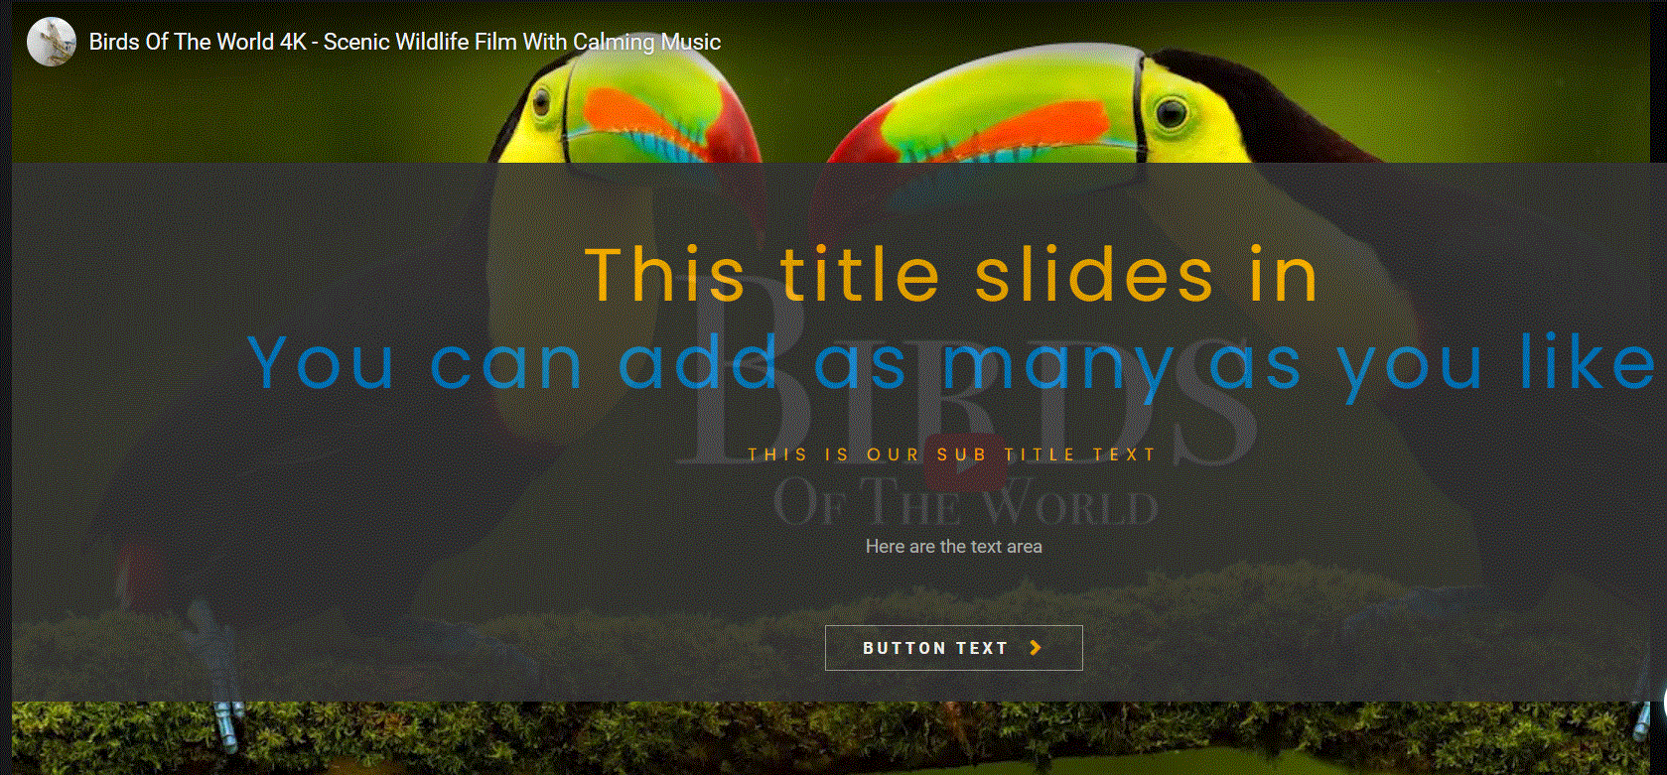
Going live we can see our new Title section slides in after the first one we build.
Note that the Sub title and Text stays the same.

Slide 54
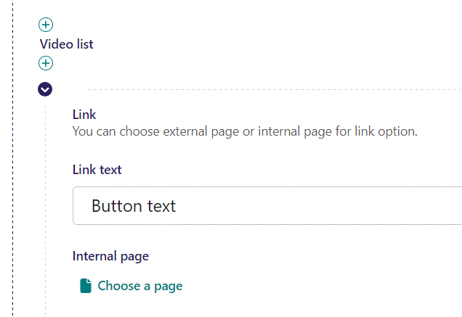
In Video list at the top, you can write Link text. It functions as Button text but is only visible when we add a link below.

Slide 55
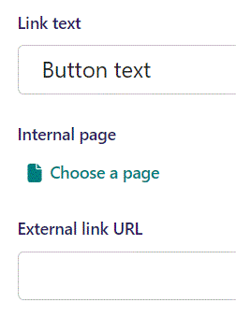
Beneath Link text you can Choose a page as an Internal page link to lead the viewer to if they click the button.

Slide 56
In the page chooser window you can search for the page here.

Slide 57
If a page on the list have pages under it, you can click here to see them.

Slide 58
You select a page by clicking here.

Slide 59
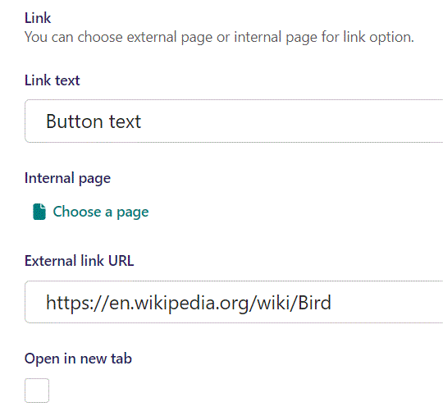
Beneath Internal page you can set an External link URL to lead the viewer to if they click the button.

Slide 60
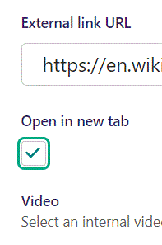
Beneath External link URL you can set Open in new tab. We have here set it to True, which will open a new tab to the link when viewer clicks the button.

Slide 61

Going live we can see our button below Text.

Slide 62
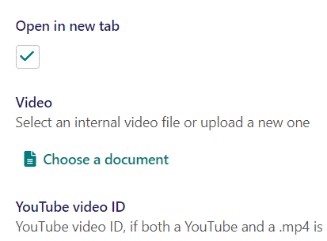
Beneath Open in new tab, you have a Video section. You can pick a video from internal or external source.
Choose a document let’s you pick an internally stored video.

Slide 63
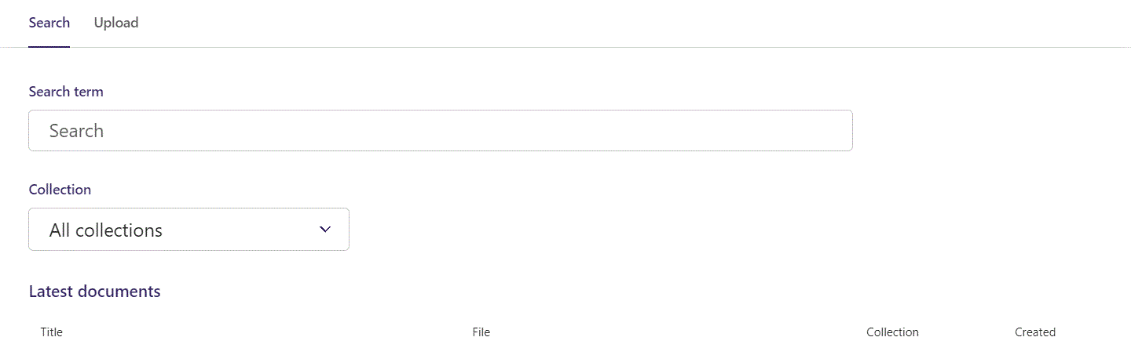
Here you can write Search term.

Slide 64
You can also filter based on Collection.

Slide 65
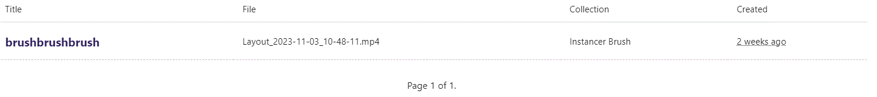
At the bottom section of the Search window, you can select the file you want.

Slide 66
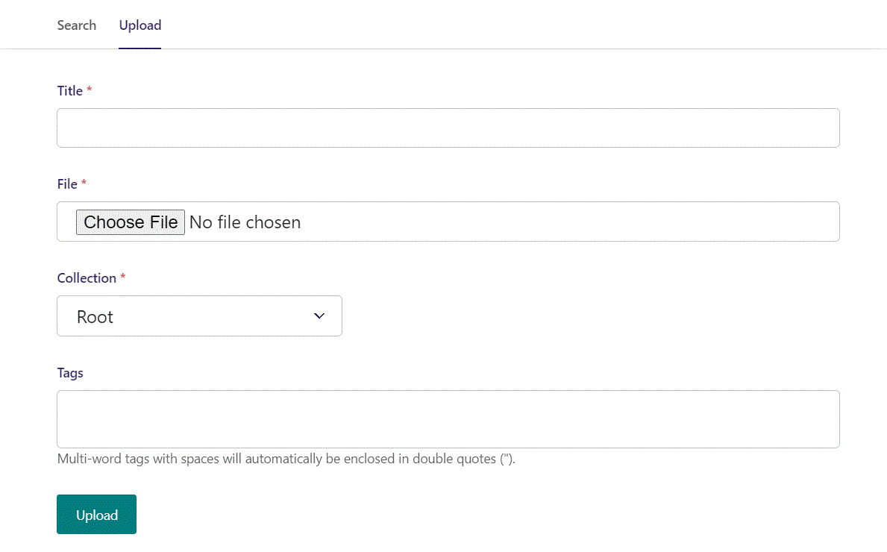
Switching to the Upload window.

Slide 67
Here you can name the file you want to upload.

Slide 68
Here you can pick the file to upload.

Slide 69
Here you can pick a Collection to add your file to.

Slide 70
Here you can associate your file with Tags.

Slide 71
To Upload your file, click here.

Slide 72
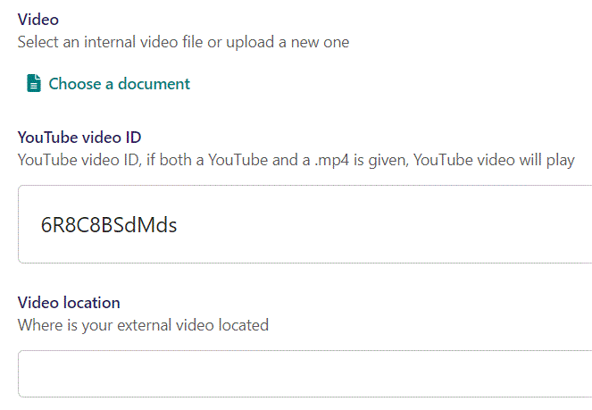
Beneath Choose a document you can set YouTube video ID.
Remember to use only the ID and not the entire embed code.

Slide 73
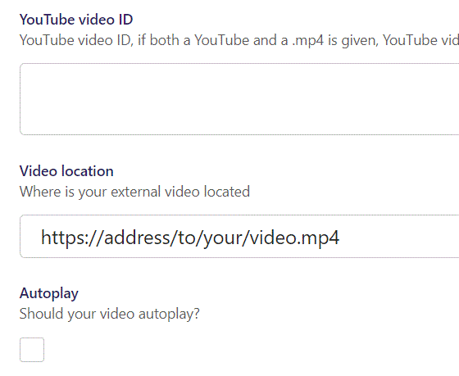
Beneath YouTube video ID you can set Video location. Insert the address to your .mp4 video.

Slide 74
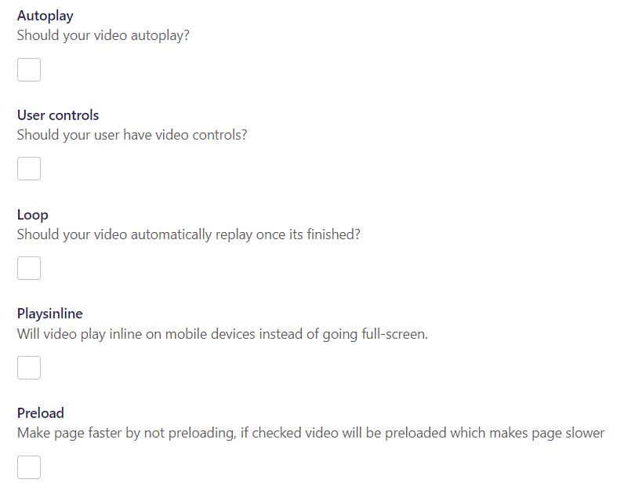
You have several Video options:
Autoplay: Makes your video start automatically when page loads.
User controls: Give your user video controls in the player.
Loop: makes the video automatically repeat.
Playsinline: On mobile devices makes the video play inline instead of full-screen.
Preload: Preload the video before showing page.

