Slide 1
Guide for
Intro Block

Slide 2
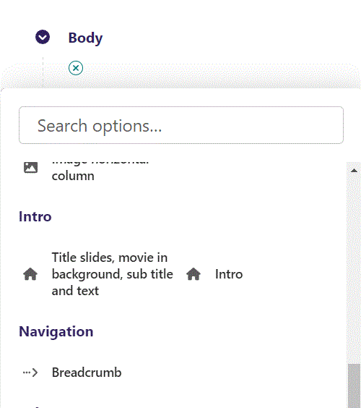
First click the small plus symbol. Then click Intro to begin creating.

Slide 3
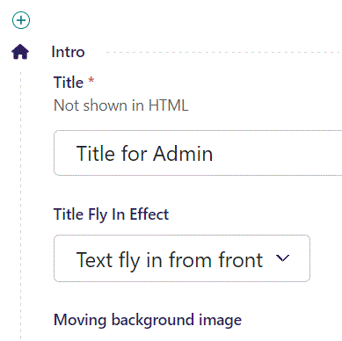
At the top you can write Title. This will not be shown in HTML, but will be the title of the block in the admin.

Slide 4
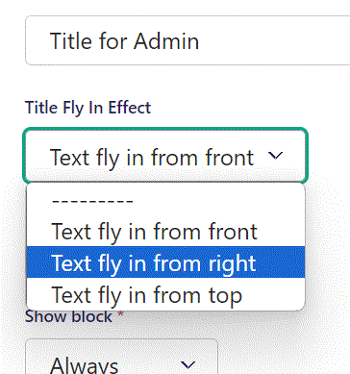
Beneath Title you can set Title Fly in Effect.
This will make the text fly in from the selected direction.

Slide 5
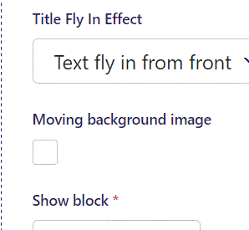
Beneath Title Fly in Effect, you can set Moving background image.
This will make the page show part of the background image and slowly move over the rest.

Slide 6
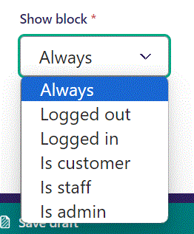
Below Moving background image, you can select when or for whom the block will be shown.
Always: Will always show.
Logged out: Only shows when viewer is logged out.
Logged in: Only shows when viewer is logged in.
Is customer: Only shows when viewer is a customer.
Is staff: Only shows if viewer is a staff.
Is admin: Only shows when viewer is an admin.

Slide 7
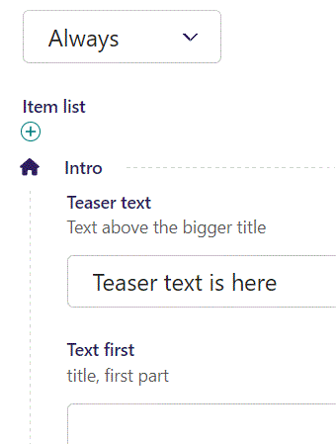
Beneath Show block you can write Teaser text.

Slide 8
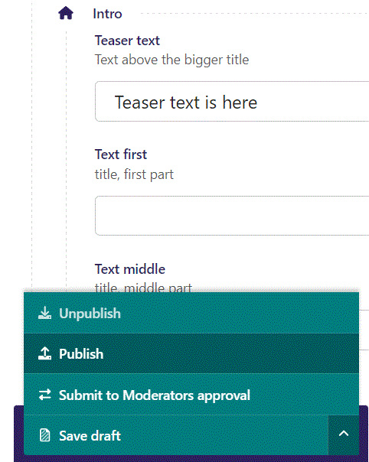
To go live first click the arrow to open the menu. Then click Publish.

Slide 9
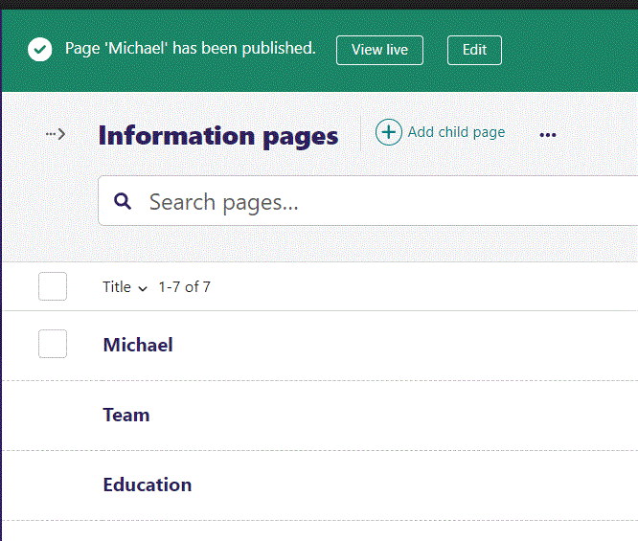
Click View live to open your webpage and see what you created.

Slide 10
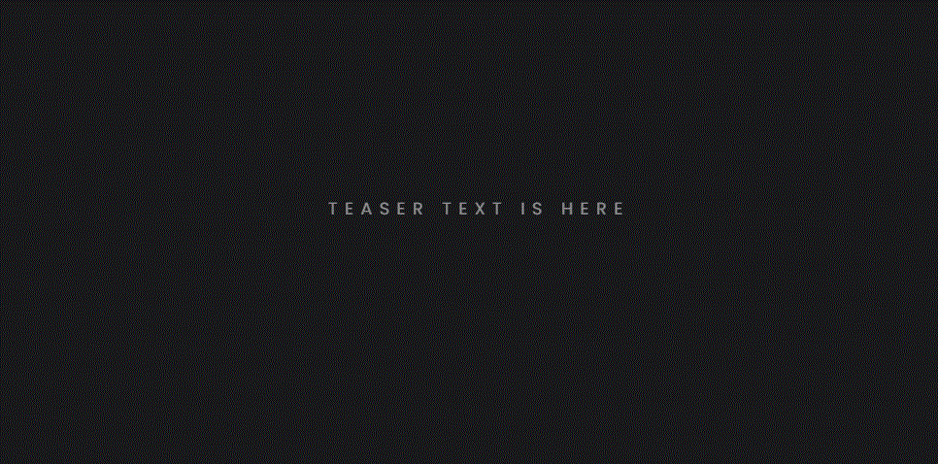
Going live we see our Teaser text.

Slide 11
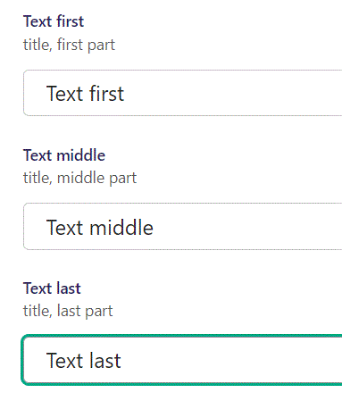
Beneath Teaser text you can write Text first, Text middle and Text last.

Slide 12

Going live we can see our 3 text entries.

Slide 13
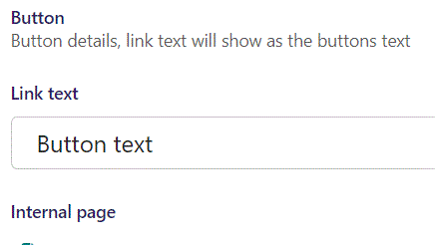
Beneath Text last you can set Link text. It functions as the Button text. It will first show when we give our button a link.

Slide 14
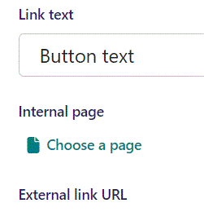
Beneath Link text you can pick an Internal page link for the button under Choose a page.

Slide 15
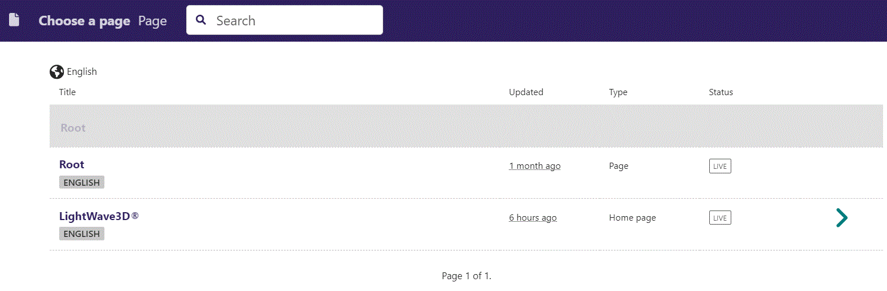
In the page chooser window you can search for the page here.

Slide 16
If a page on the list have pages under it, you can click here to see them.

Slide 17
You select a page by clicking here.

Slide 18
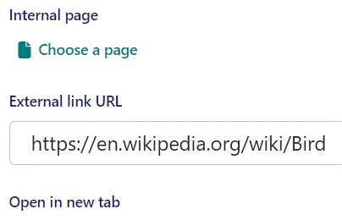
Beneath Choose a page you can set External link URL.

Slide 19
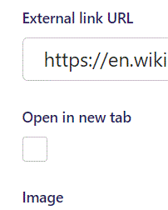
Beneath External link URL you can set Open in new tab. If set to True it will open the link in a new tab if button is clicked. Default is False.

Slide 20

Going live we can see our button at the bottom.

Slide 21
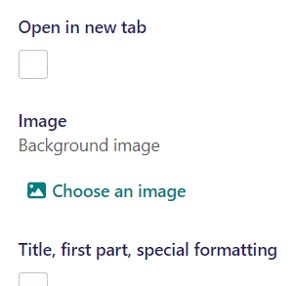
Beneath Open in new tab, you can Choose an image for background image.

Slide 22
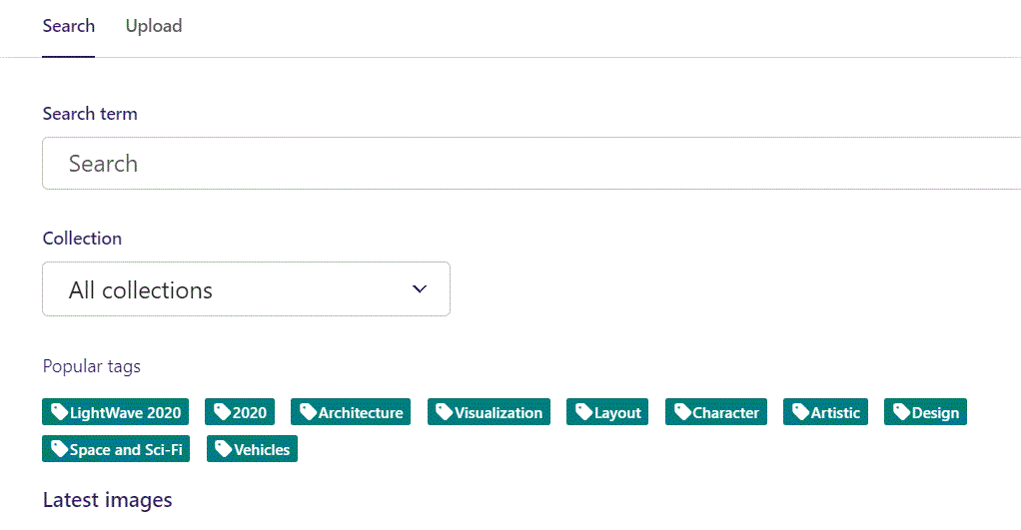
Here we see the top part of the image chooser screen. You can choose to either use an image on the server already or Upload a new image here.
First let’s use an image already on the server.

Slide 23
Here you can write a search term.

Slide 24
Here you can select a Collection of images.

Slide 25
At the bottom you can also sort with Popular tags.

Slide 26
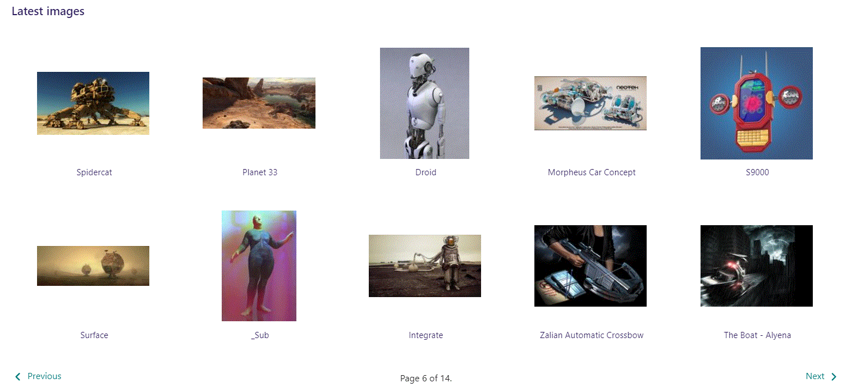
At the bottom of the image selector screen there are navigation buttons.

Slide 27
You can select an image by clicking it.

Slide 28
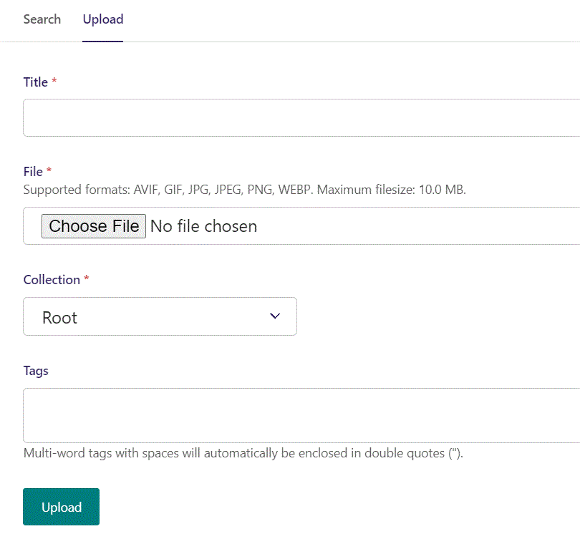
You can also upload an image by clicking Upload.

Slide 29
Name your image here.

Slide 30
Click Choose File to pick your image.

Slide 31
Select which Collection the uploaded image belongs to.

Slide 32
Assign tags to your image. Separate them with a comma.

Slide 33
Finally click Upload, to upload the image.

Slide 34
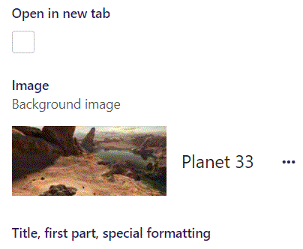
We have now chosen an image.

Slide 35
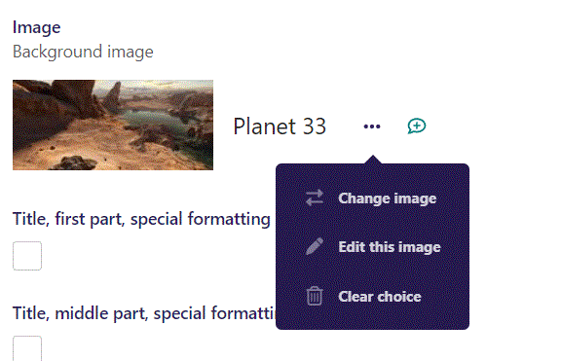
If you click the 3 dots you can Change image, Edit this image or Clear choice.

Slide 36
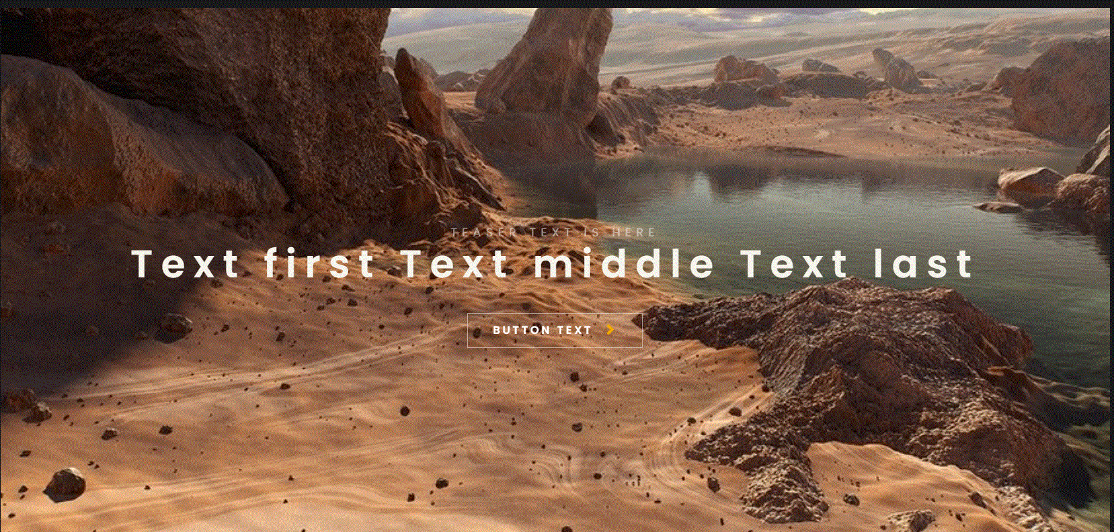
Going live we now have a background image.

Slide 37
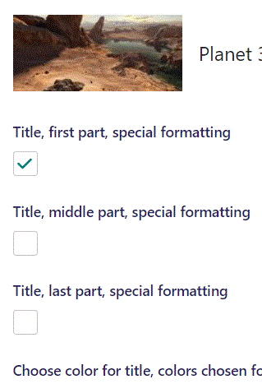
Beneath Choose an image you can set special formatting for the 3 title parts. Here we set special formatting for the first part.

Slide 38
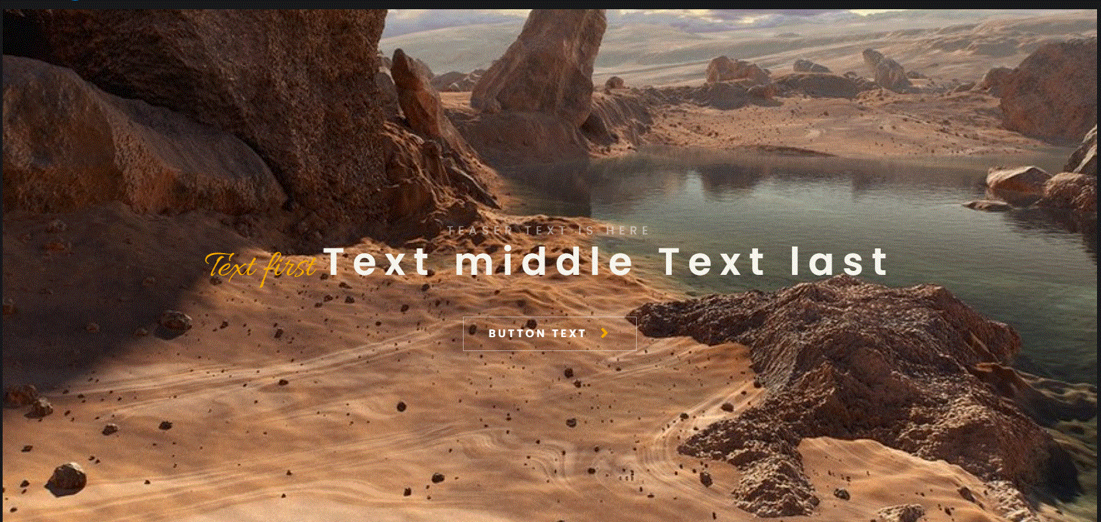
Going live we can see that our first part of the title now is specially formatted.

Slide 39
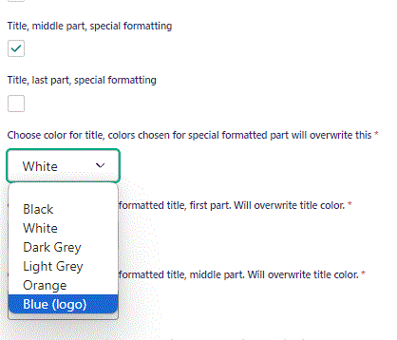
Note we have set Title, middle part, special formatting to True.
Beneath Title, last part, special formatting you can set Choose color for title. Here we set it to Blue (logo). This color change will not affect the middle part, since it have special formatting.

Slide 40
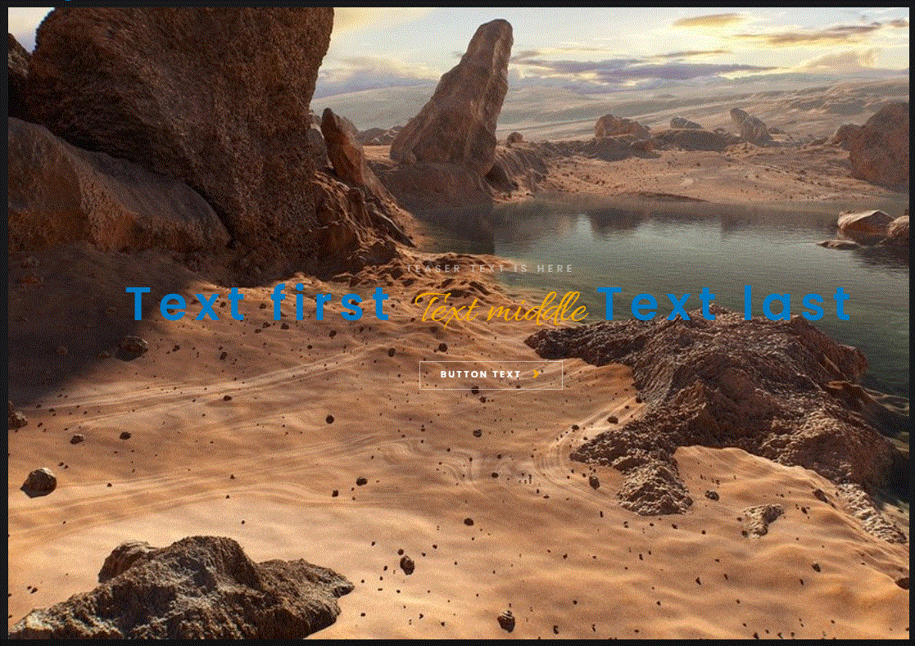
Going live we can see two of our title parts are now blue (first and last) but the middle one (with special formatting) is yellow.

Slide 41
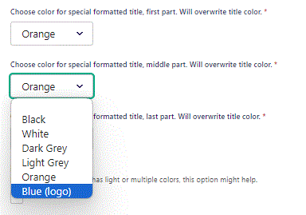
Since our middle title have special formatting, we can change its color by Choose color for special formatted title, middle part. Will overwrite title color. Let’s change it to Blue (logo).

Slide 42
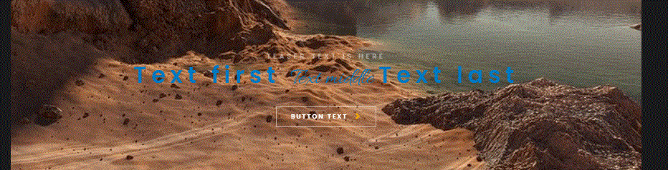
Going live we can see that our special formatted middle title section is now colored blue.

Slide 43
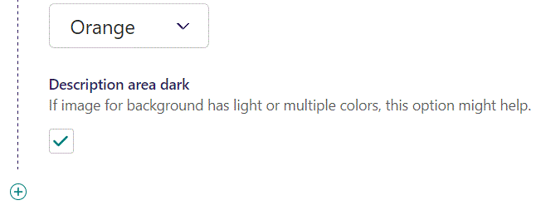
Beneath Choose color for special formatted title, last part you can set Description area dark. Here we have set it to True.

Slide 44
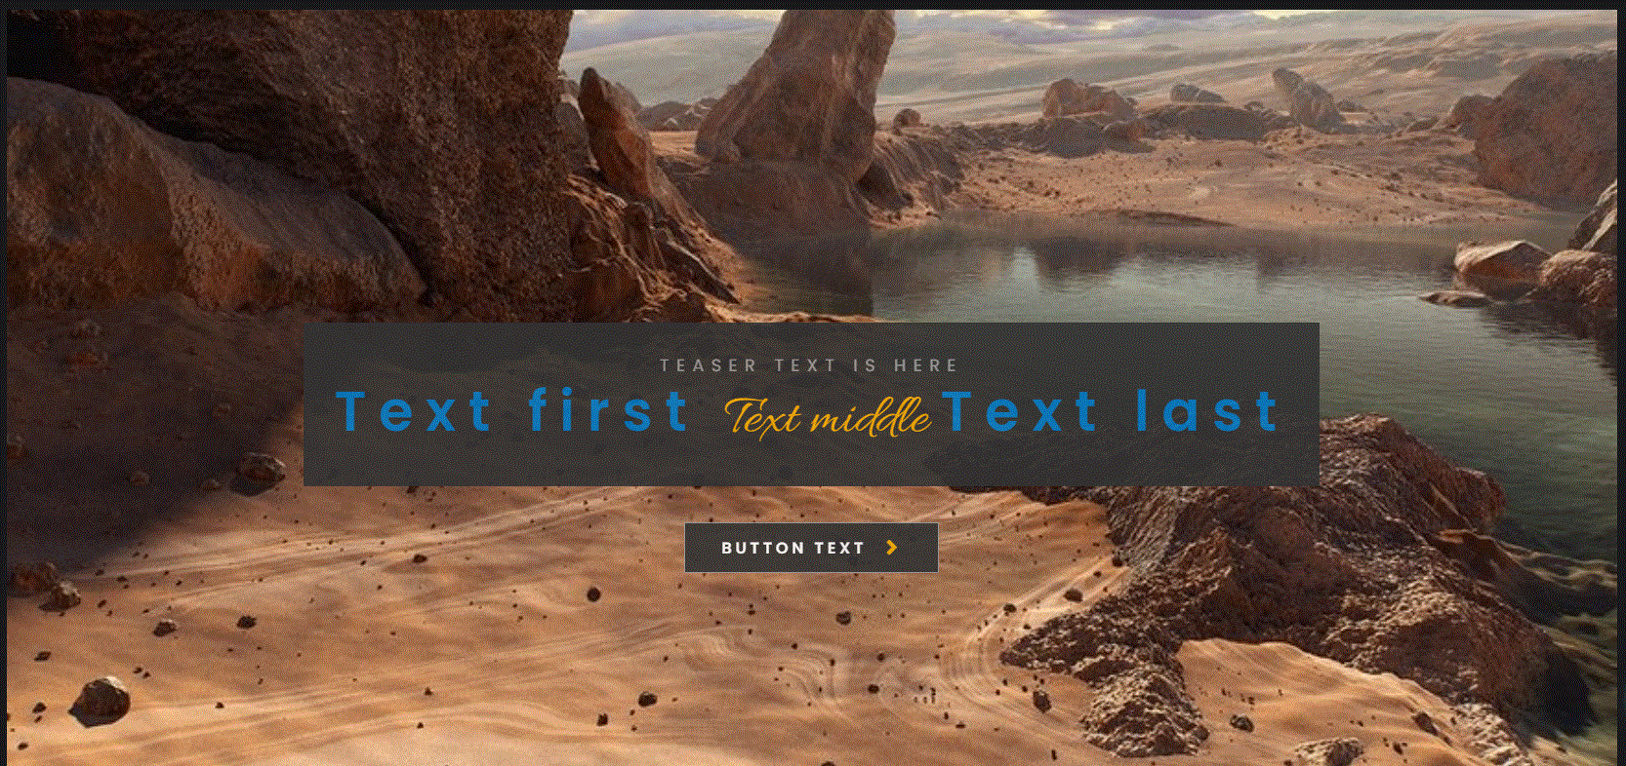
Going live we can see our Title and Button have a Dark background.

Slide 45
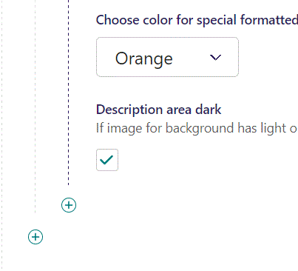
Click the plus icon to add a new item.

Slide 46
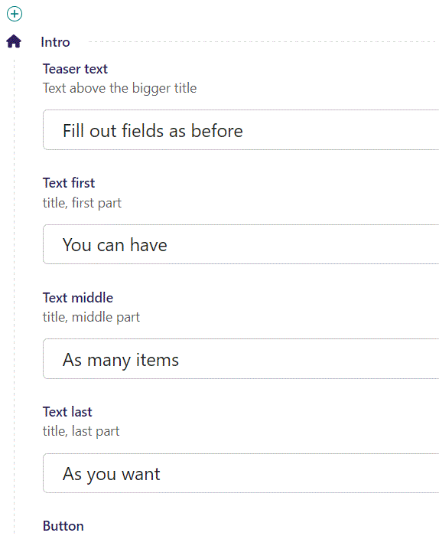
Fill out the fields as before.

Slide 47
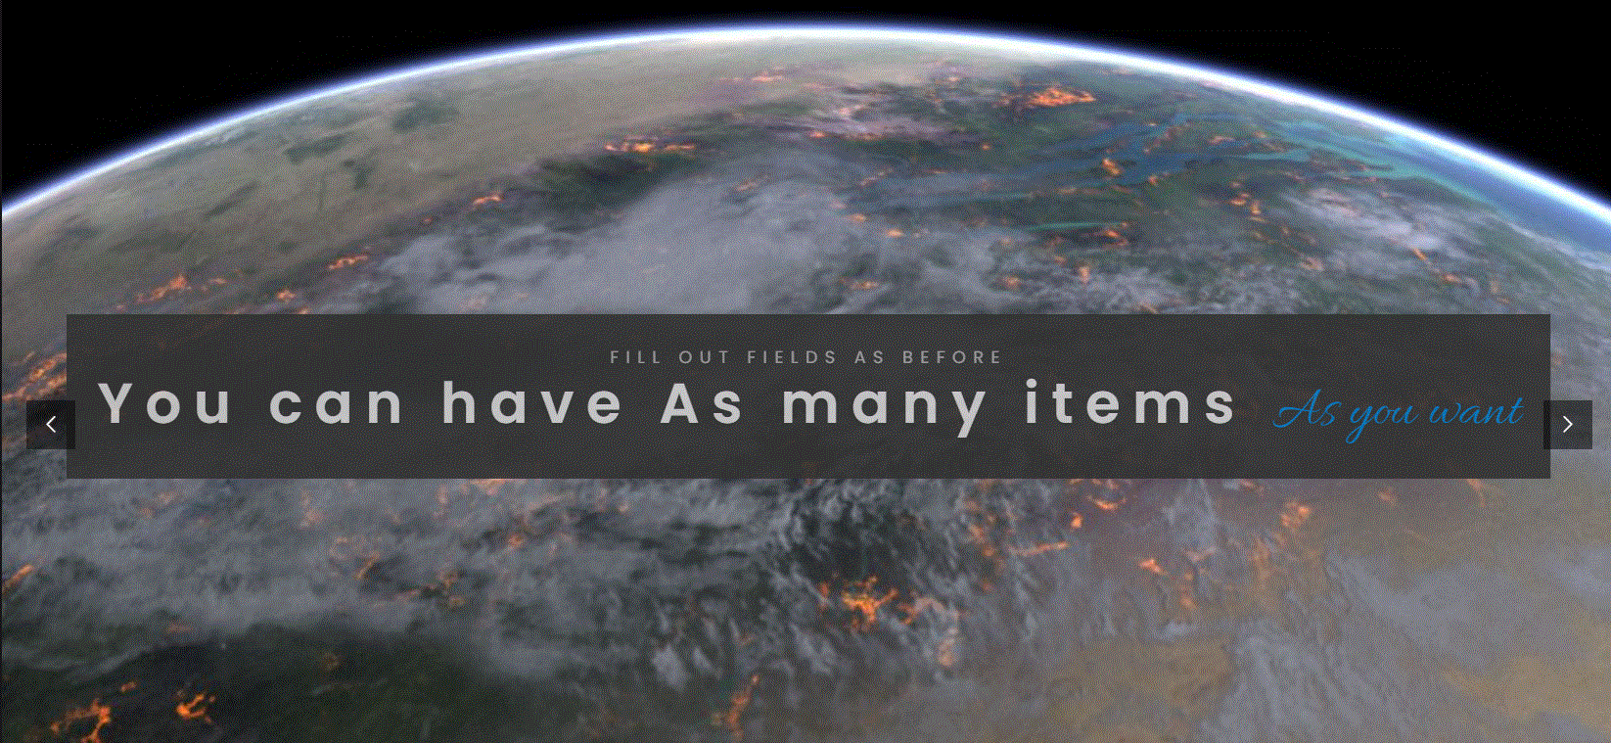
Going live we can see our new item. Note there are now also navigational arrows on the left and right side of the window.

