Slide 1
Guide for
Image single with text Block

Slide 2
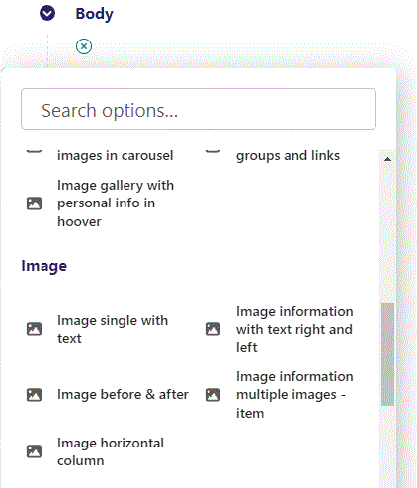
First click the small plus symbol. Then click Image single with text to begin creating.

Slide 3
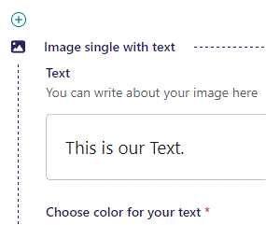
At the top you can write Text.

Slide 4
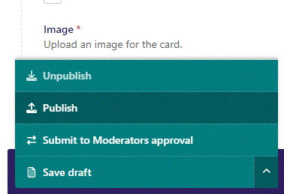
To go live first click the arrow to open the menu. Then click Publish.

Slide 5
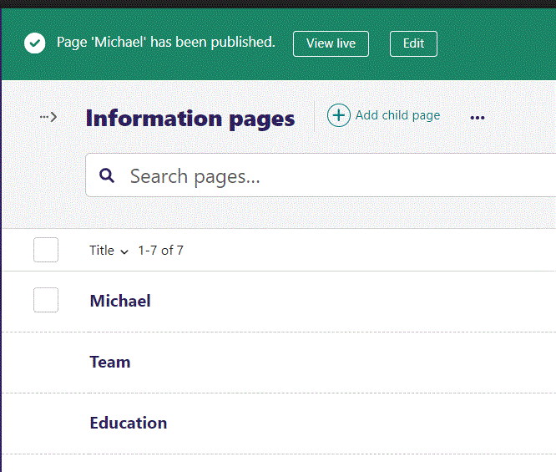
Click View live to open your webpage and see what you created.

Slide 6
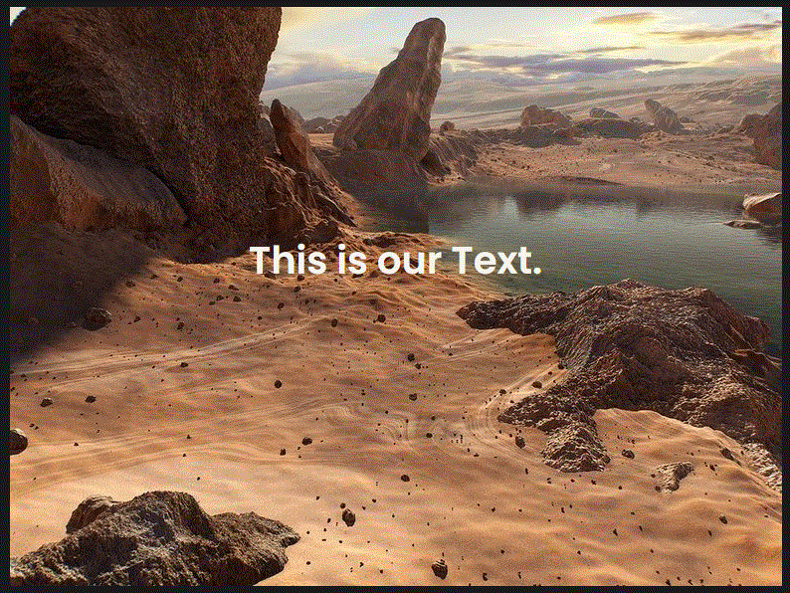
Going live we can see our Text inside the image.
We will get to selecting image later.

Slide 7
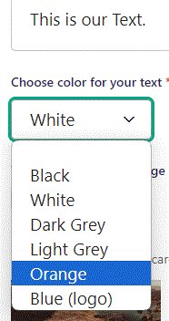
Beneath Text you can Choose color for your text. Let’s make it Orange.

Slide 8

Going live we can see our text is now in Orange color.

Slide 9
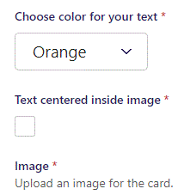
Beneath Choose color for your text you can select Text centered inside image. Default is True, here we set it to False.

Slide 10
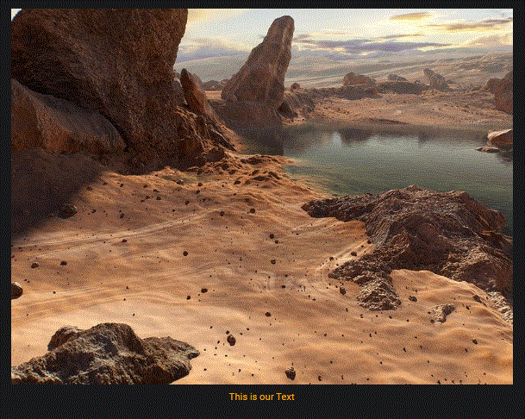
Going live we can see our Text is now not centered inside of image.

Slide 11
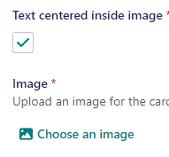
Beneath Text centered inside image you can Choose an image.

Slide 12
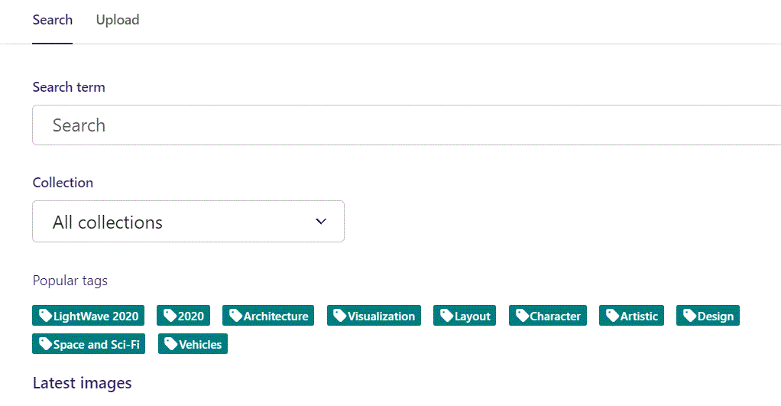
Here we see the top part of the image chooser screen. You can choose to either use an image on the server already or Upload a new image here.
First let’s use an image already on the server.

Slide 13
Here you can write a search term.

Slide 14
Here you can select a Collection of images.

Slide 15
At the bottom you can also sort with Popular tags.

Slide 16
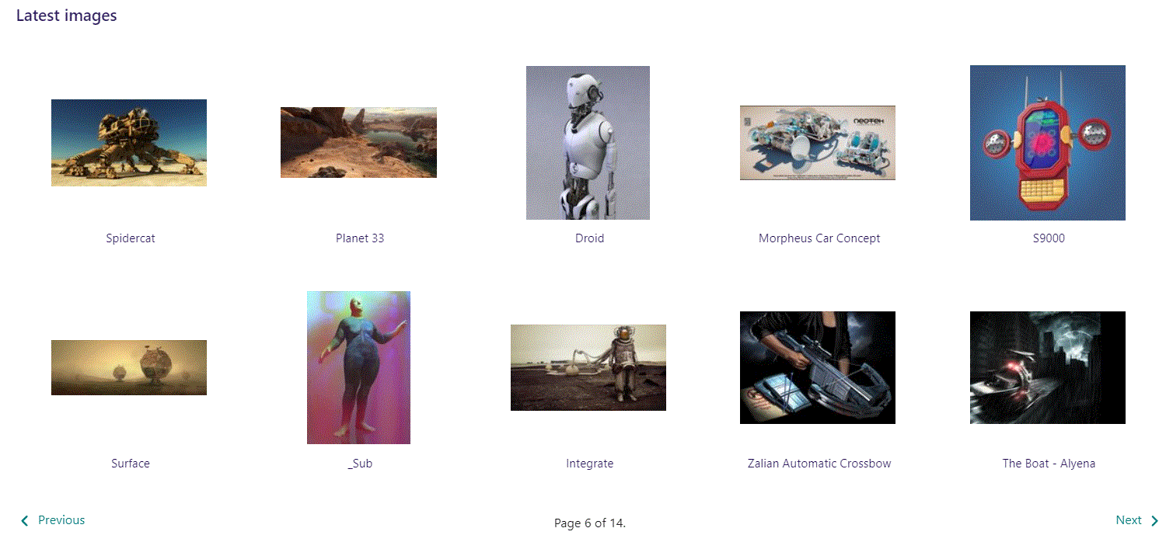
At the bottom of the image selector screen there are navigation buttons.

Slide 17
You can select an image by clicking it.

Slide 18
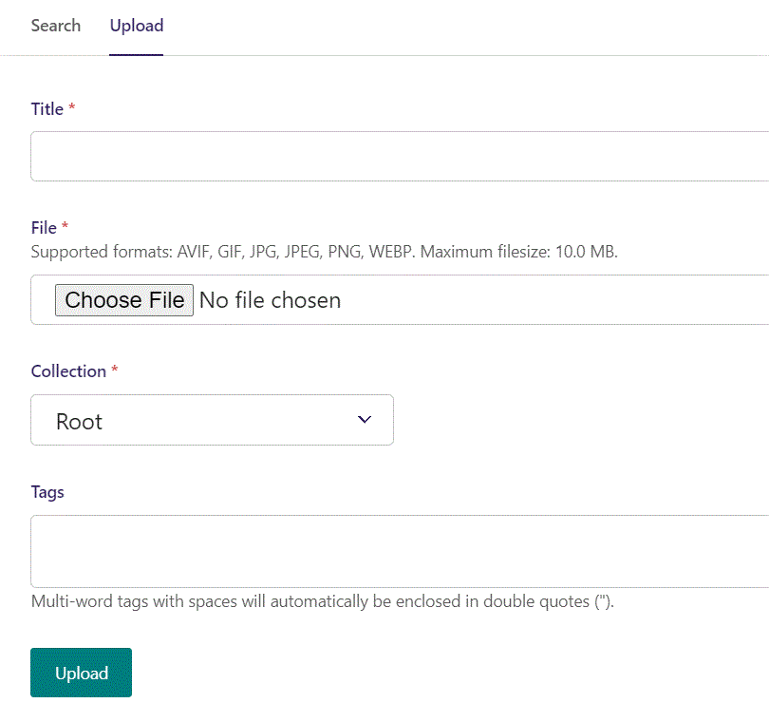
You can also upload an image by clicking Upload.

Slide 19
Name your image here.

Slide 20
Click Choose File to pick your image.

Slide 21
Select which Collection the uploaded image belongs to.

Slide 22
Assign tags to your image. Separate them with a comma.

Slide 23
Finally click Upload, to upload the image.

Slide 24
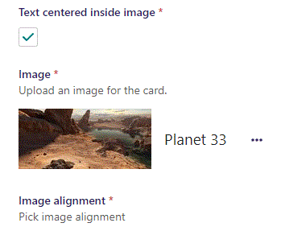
We have now chosen an image.

Slide 25
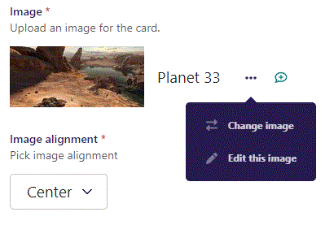
If you click the 3 dots you can Change image or Edit this image.

Slide 26
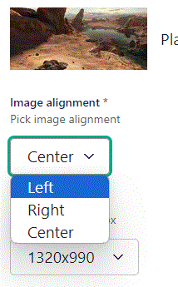
Beneath Choose image you can set Image alignment. Here we change it to Left.

Slide 27
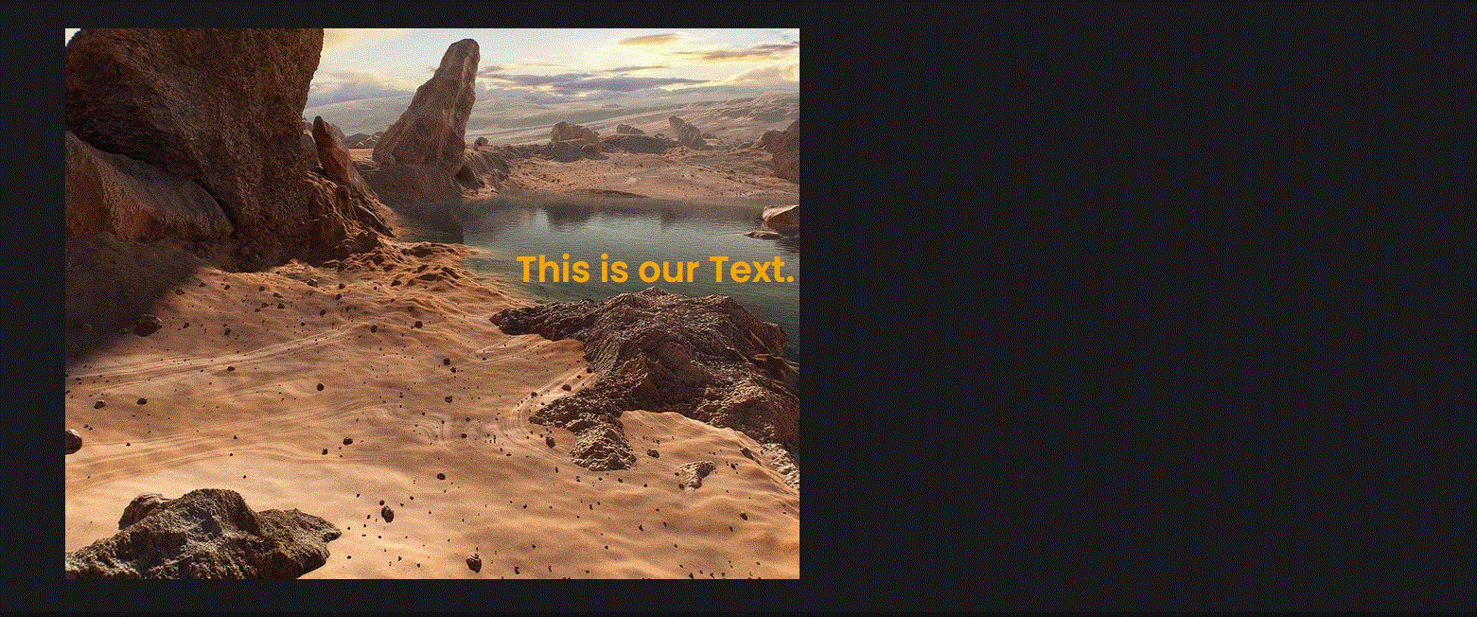
Going live we can see our image is now aligned to the left.

Slide 28
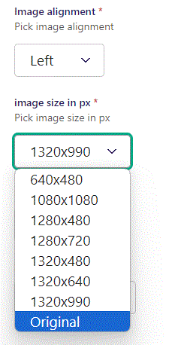
Beneath Image alignment you can set image size in px. Here we set it to Original, which will make it the size of the image.

Slide 29
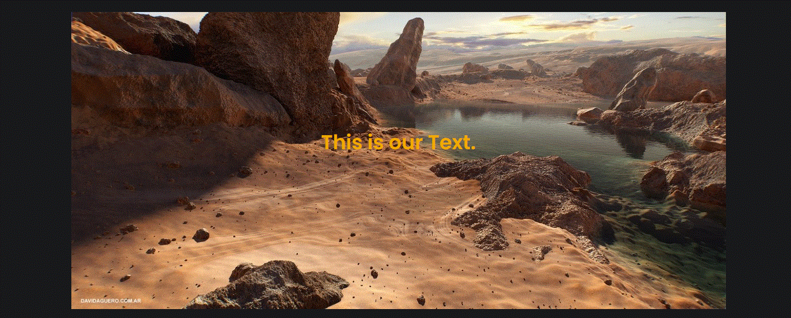
Going live we can see our image have changed size.

Slide 30
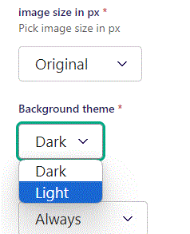
Beneath image size in px you can set Background theme. Default is Dark, we change it to Light.

Slide 31
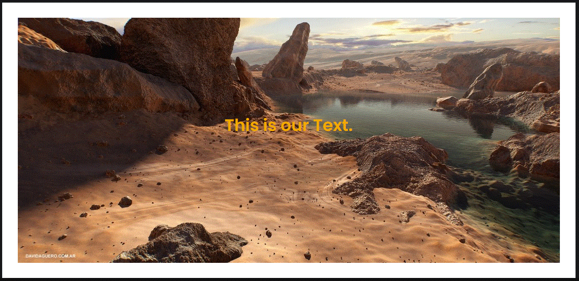
Going live we can see our Background theme is now Light.

Slide 32
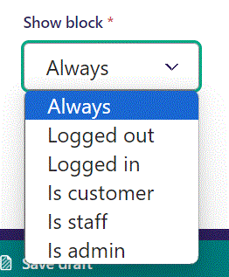
Below Background theme, you can select when or for whom the block will be shown.
Always: Will always show.
Logged out: Only shows when viewer is logged out.
Logged in: Only shows when viewer is logged in.
Is customer: Only shows when viewer is a customer.
Is staff: Only shows if viewer is a staff.
Is admin: Only shows when viewer is an admin.

