Slide 1
Guide for
Image information with text right and left Block

Slide 2
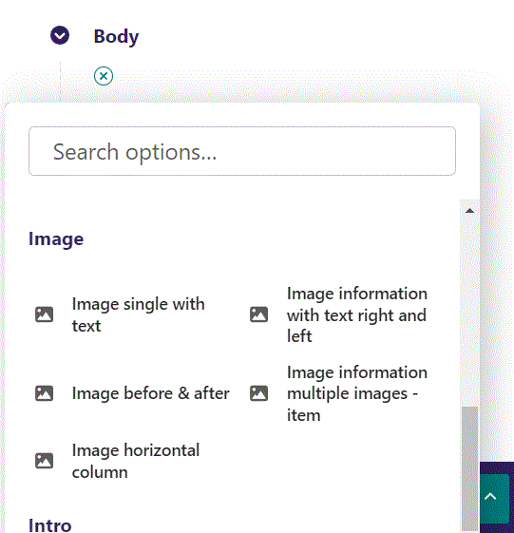
First click the small plus symbol. Then click Image information with text right and left to begin creating.

Slide 3
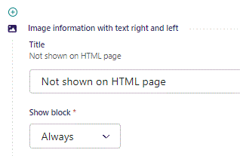
At the top you can write a Title. It will not be shown on the HTML page, but will be the block title in admin.

Slide 4
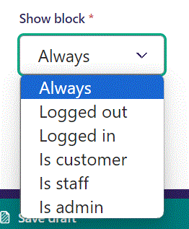
Below Title, you can select when or for whom the block will be shown.
Always: Will always show.
Logged out: Only shows when viewer is logged out.
Logged in: Only shows when viewer is logged in.
Is customer: Only shows when viewer is a customer.
Is staff: Only shows if viewer is a staff.
Is admin: Only shows when viewer is an admin.

Slide 5
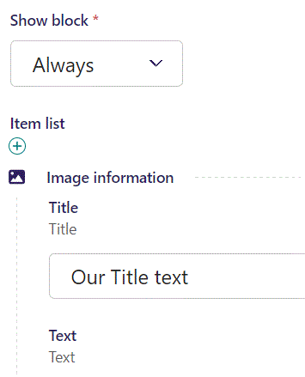
Beneath Show block you can write Title for your image.

Slide 6
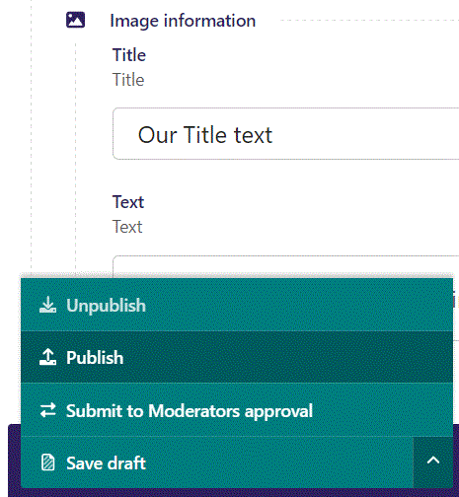
To go live first click the arrow to open the menu. Then click Publish.

Slide 7
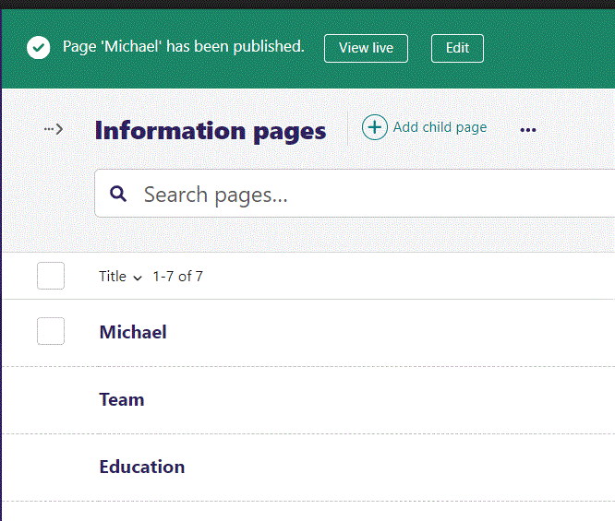
Click View live to open your webpage and see what you created.

Slide 8

Going live we can see our Title text.

Slide 9
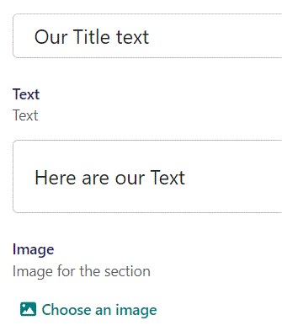
Beneath Title we can write Text.

Slide 10

Going live we can see our Text is below the Title.

Slide 11
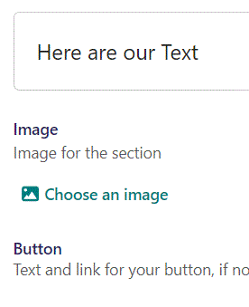
Beneath Text you can Choose an image.

Slide 12
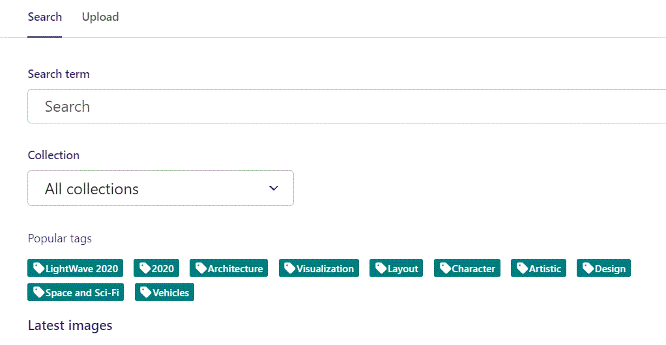
Here we see the top part of the image chooser screen. You can choose to either use an image on the server already or Upload a new image here.
First let’s use an image already on the server.

Slide 13
Here you can write a search term.

Slide 14
Here you can select a Collection of images.

Slide 15
At the bottom you can also sort with Popular tags.

Slide 16
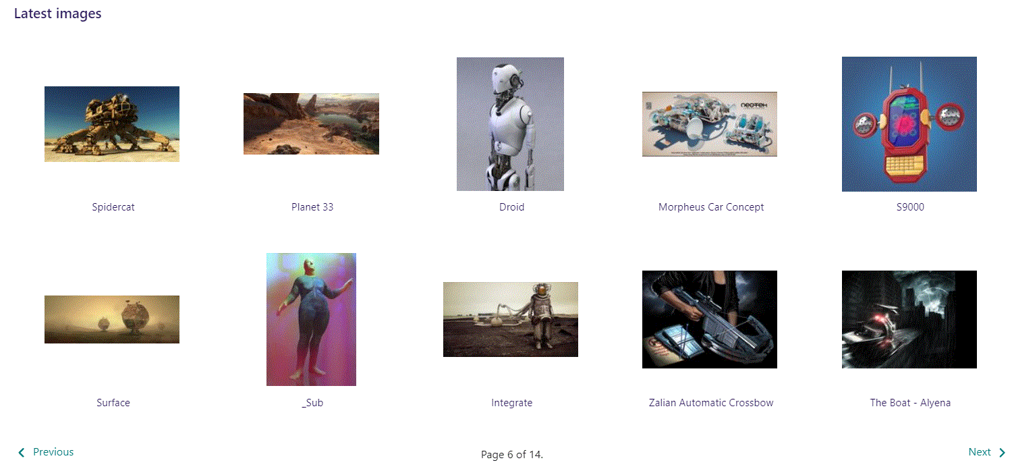
At the bottom of the image selector screen there are navigation buttons.

Slide 17
You can select an image by clicking it.

Slide 18
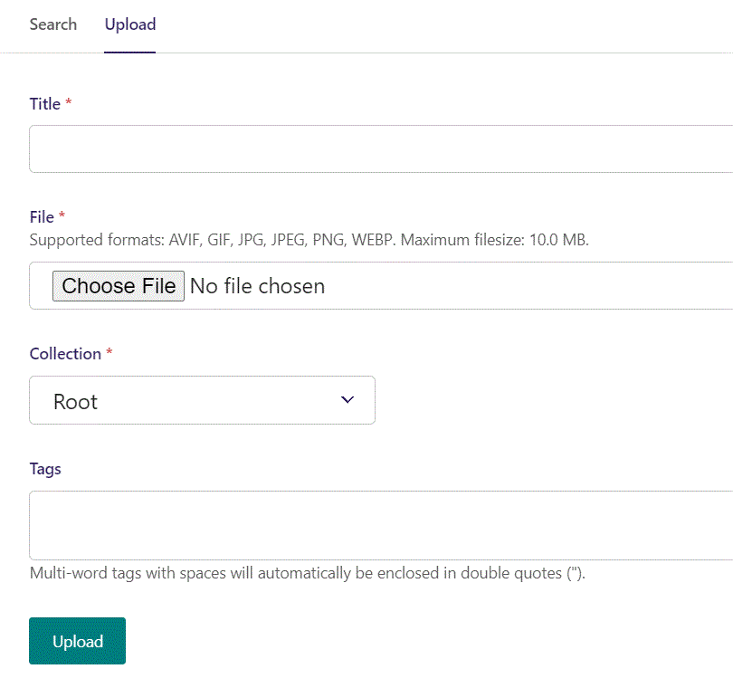
You can also upload an image by clicking Upload.

Slide 19
Name your image here.

Slide 20
Click Choose File to pick your image.

Slide 21
Select which Collection the uploaded image belongs to.

Slide 22
Assign tags to your image. Separate them with a comma.

Slide 23
Finally click Upload, to upload the image.

Slide 24
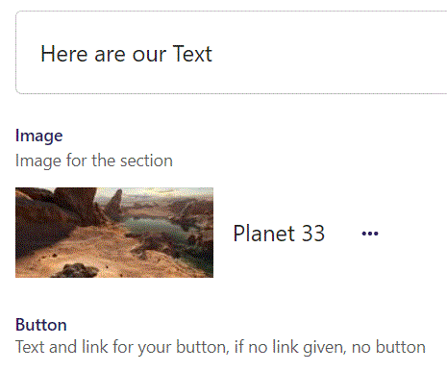
We have now chosen an image.

Slide 25
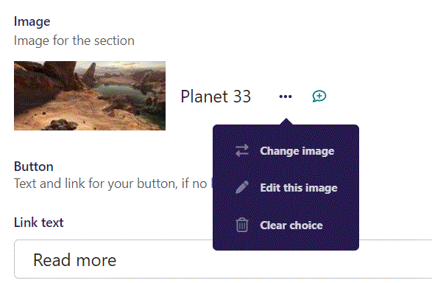
By clicking the 3 dots you can Change image, Edit this image or Clear choice.

Slide 26
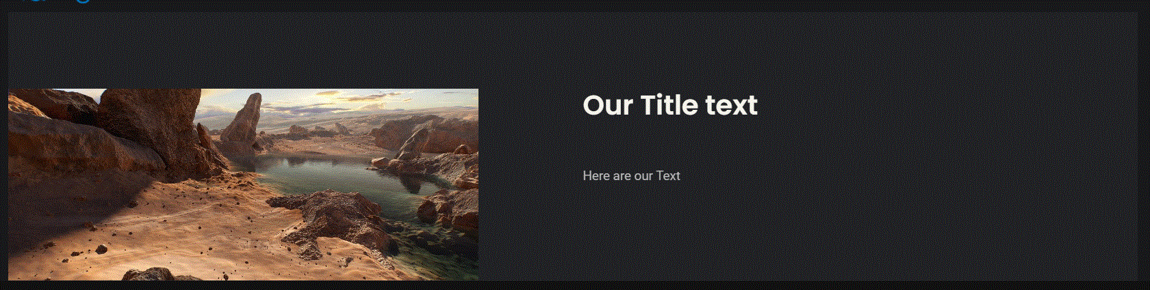
Going live we can see our image have now been added.

Slide 27
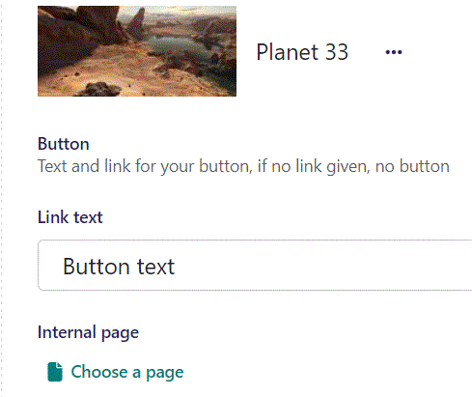
Beneath Choose image you can write Link text. This will function as our button text, when a link is given below.

Slide 28
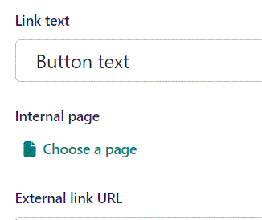
Beneath Link text you can Choose a page as an Internal page link to take the viewer to when they click the button.

Slide 29
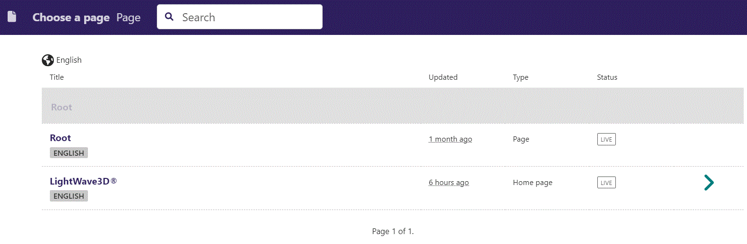
In the page chooser window you can search for the page here.

Slide 30
If a page on the list have pages under it, you can click here to see them.

Slide 31
You select a page by clicking here.

Slide 32
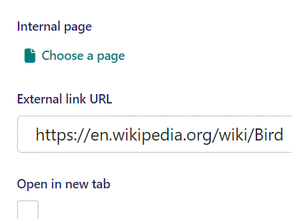
Beneath Internal page you can set an External link URL to take the viewer to when they click the button.

Slide 33
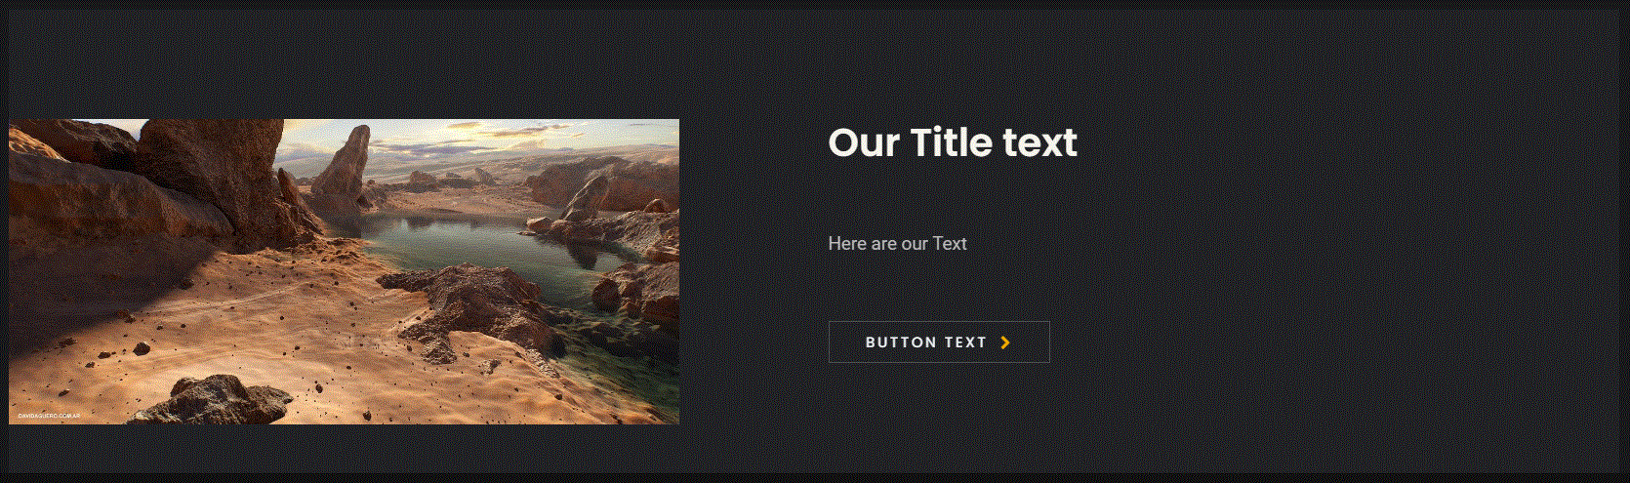

Slide 34
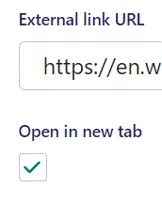
Beneath External link URL you can set Open in new tab. This will make the browser open a new tab when viewer clicks the button. Here we set it to True.

Slide 35
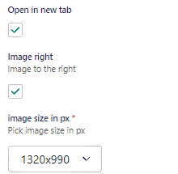
Beneath Open in new tab, you can set Image right. Default is False, let’s set it to True.

Slide 36
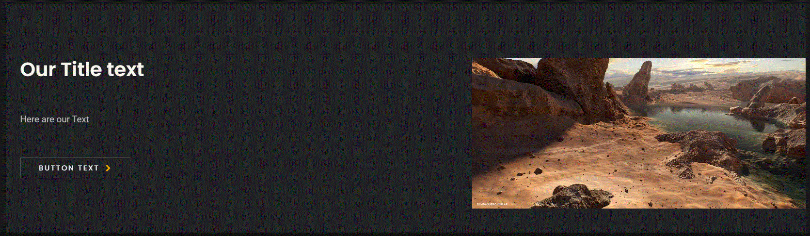
Going live we can see our image is not to the right.

Slide 37
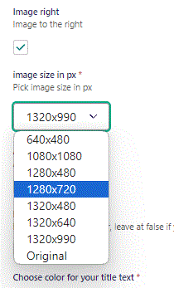
Beneath Image right you can set image size in px. Original keeps the original size of the image chosen.

Slide 38
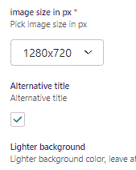
Beneath Image right you can set Alternative title. Default is False, let’s change it to True.

Slide 39
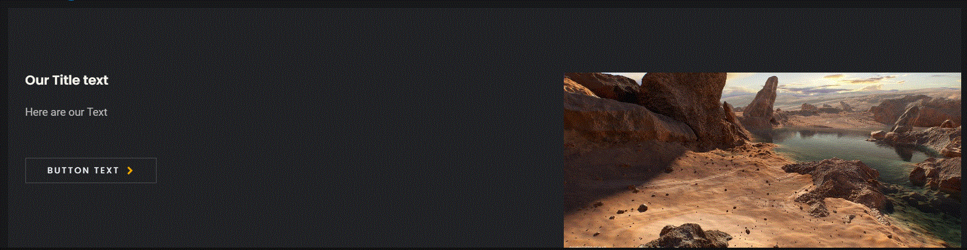
Going live we can see out Title is now a smaller font-size.

Slide 40
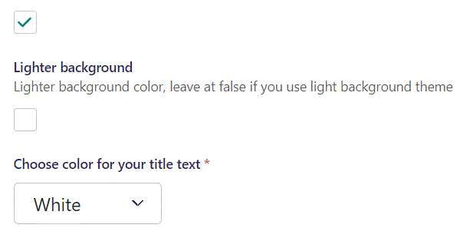
Beneath Alternative title you can set Lighter background. Default is True, here we change it to False.

Slide 41
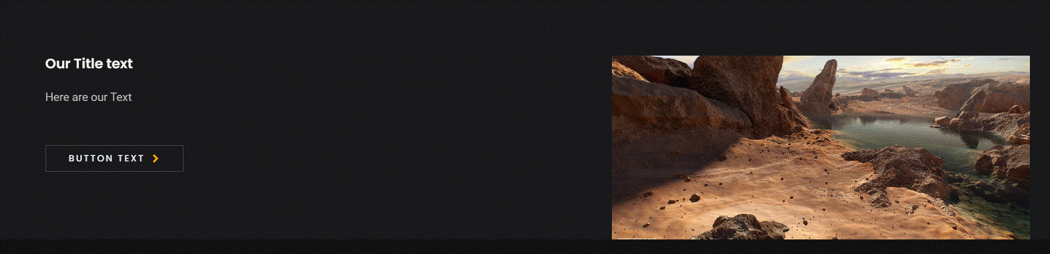
Going live we can see our background is now darker.

Slide 42
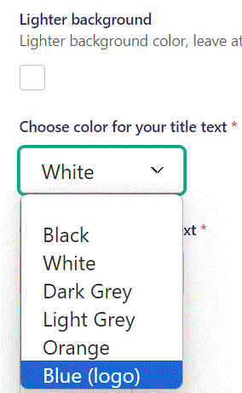
Beneath Lighter background you can Choose color for your title text. Let’s change it to Blue (logo).

Slide 43
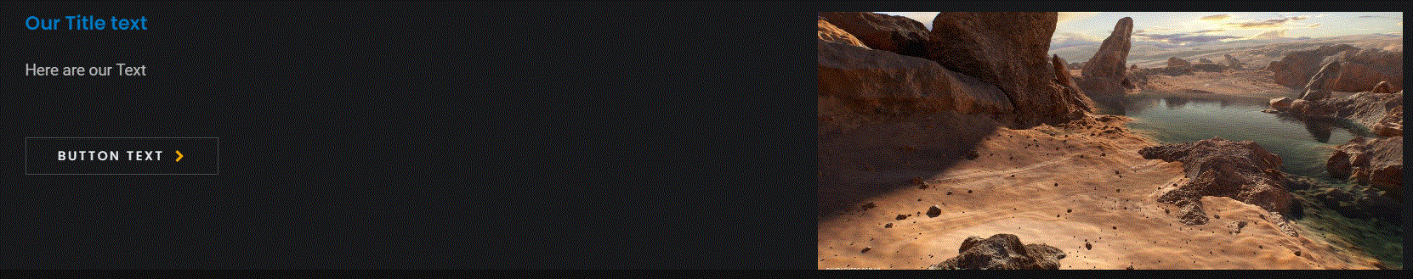
Going live we can see our Title text have changed color to blue.

Slide 44
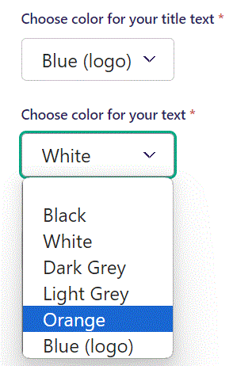
Beneath Choose color for your title text you can Choose color for your text. Let’s change it to Orange.

Slide 45
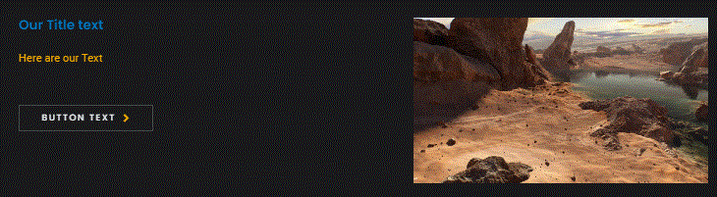
Going live we can see our Text have changed color to Orange.

Slide 46
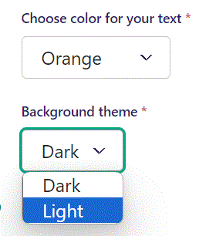
Beneath Choose color for your text you can set Background theme. Let’s change it to Light.

Slide 47
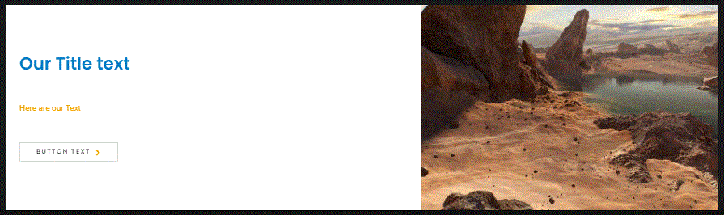
Going live we can see our Background theme is now Light.

Slide 48
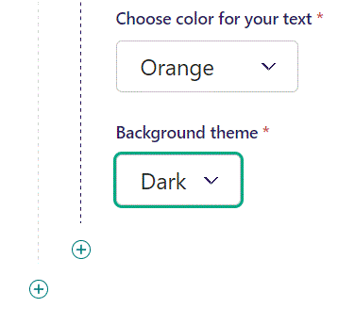
You can add another item by clicking the plus icon.
Note we switched back to a Dark Background theme.

Slide 49
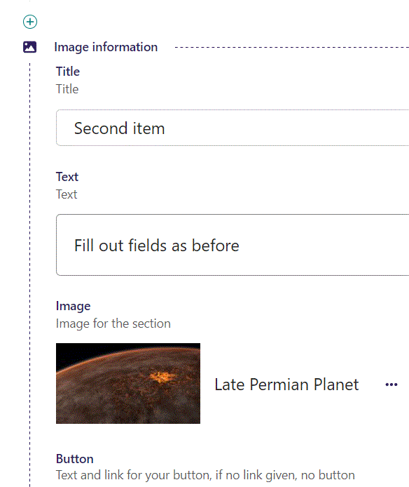
Fill out the fields.

Slide 50
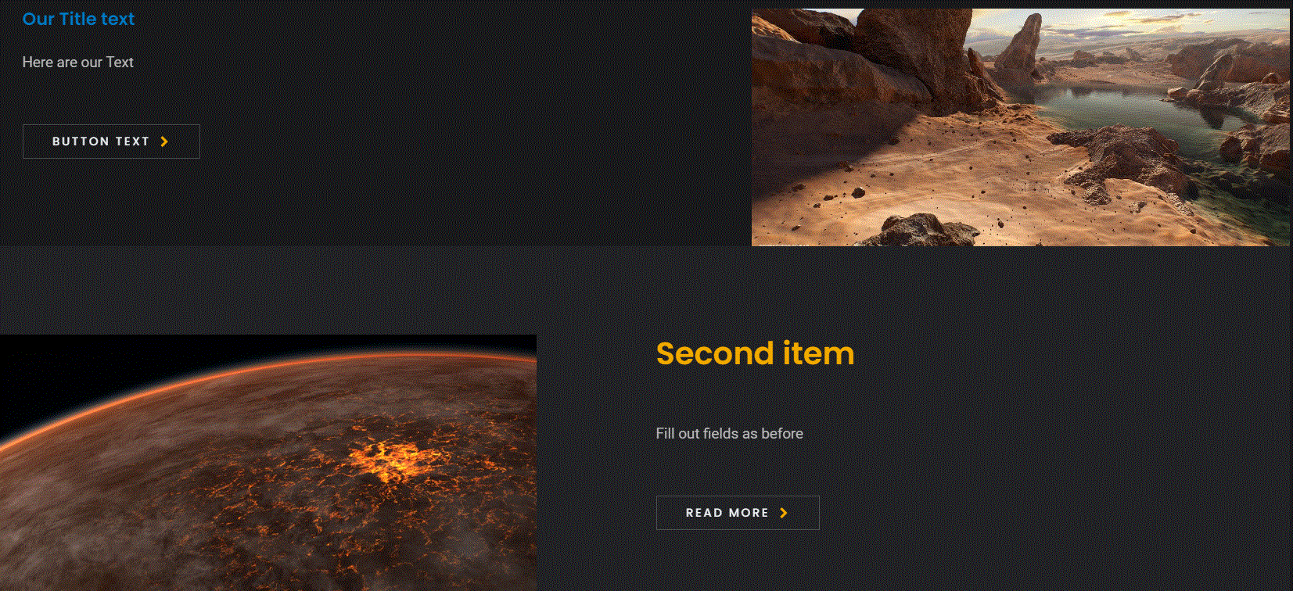
Going live we can see we now have added another item.

