Slide 1
Guide for
Image horizontal column Block

Slide 2
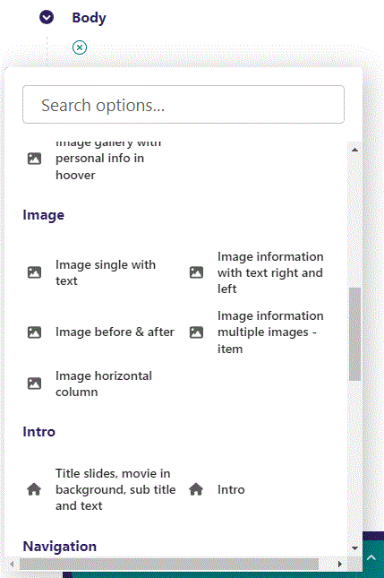
First click the small plus symbol. Then click Image horizontal column to begin creating.

Slide 3
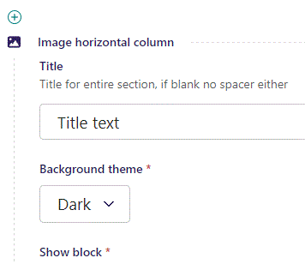
At the top you can write a Title.

Slide 4
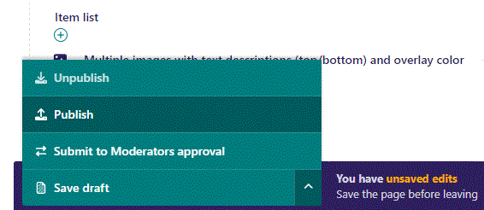
To go live first click the arrow to open the menu. Then click Publish.

Slide 5
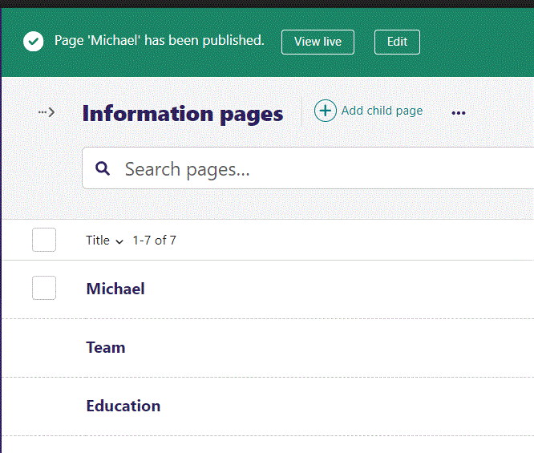
Click View live to open your webpage and see what you created.

Slide 6

Going live we can see our Title. The Title is optional, if no text is given, both the Title text and the spacer (the line and dot) beneath the Title text will not be shown.

Slide 7
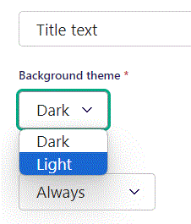
Beneath Title you can set Background theme. Let’s change it to Light.

Slide 8

Going live we can see our Background theme is now Light.

Slide 9
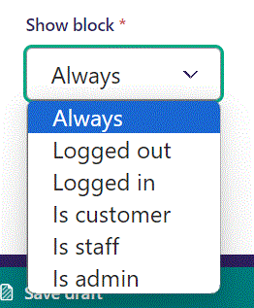
Below Background theme, you can select when or for whom the block will be shown.
Always: Will always show.
Logged out: Only shows when viewer is logged out.
Logged in: Only shows when viewer is logged in.
Is customer: Only shows when viewer is a customer.
Is staff: Only shows if viewer is a staff.
Is admin: Only shows when viewer is an admin.

Slide 10
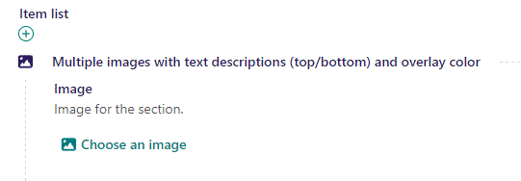
Beneath Show block you can Choose an image.

Slide 11
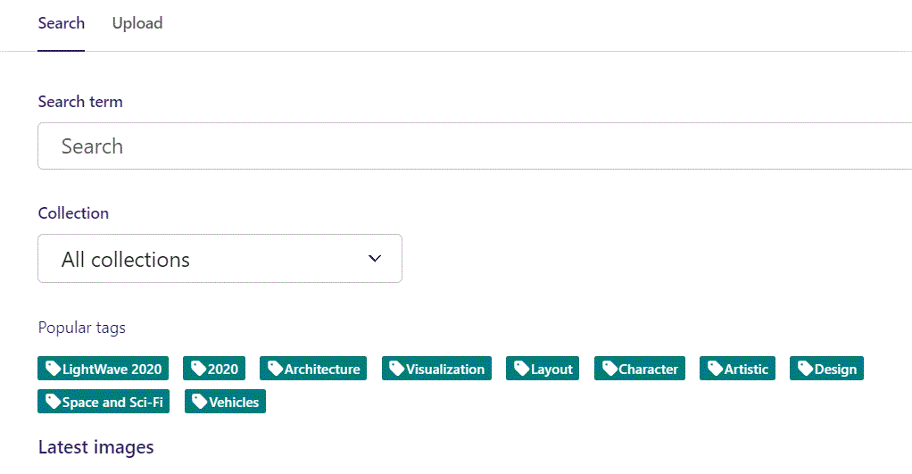
Here we see the top part of the image chooser screen. You can choose to either use an image on the server already or Upload a new image here.
First let’s use an image already on the server.

Slide 12
Here you can write a search term.

Slide 13
Here you can select a Collection of images.

Slide 14
At the bottom you can also sort with Popular tags.

Slide 15
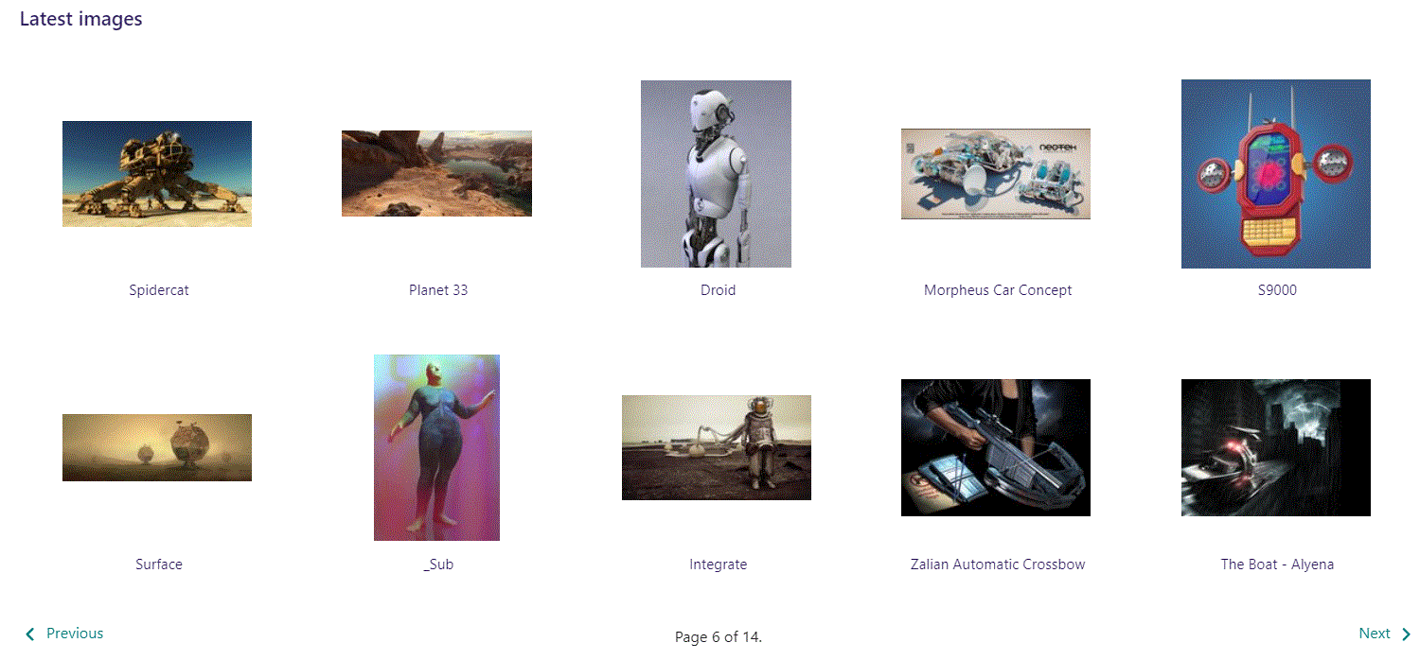
At the bottom of the image selector screen there are navigation buttons.

Slide 16
You can select an image by clicking it.

Slide 17
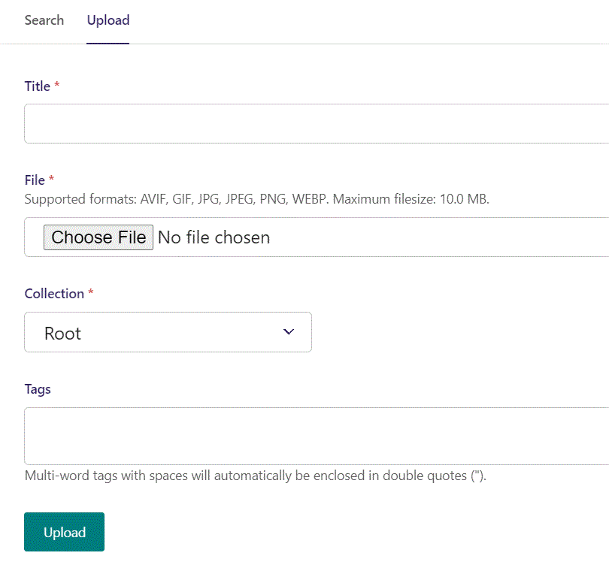
You can also upload an image by clicking Upload.

Slide 18
Name your image here.

Slide 19
Click Choose File to pick your image.

Slide 20
Select which Collection the uploaded image belongs to.

Slide 21
Assign tags to your image. Separate them with a comma.

Slide 22
Finally click Upload, to upload the image.

Slide 23
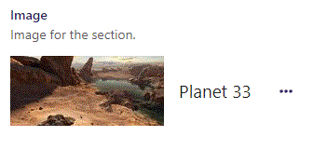
We have now chosen an image.

Slide 24
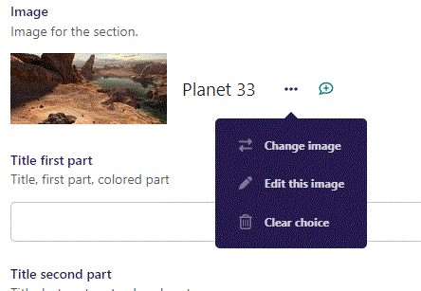
Clicking the 3 dots you can Change image or Edit this image. Also you can Clear choice.

Slide 25
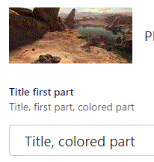
Beneath Choose an image you can write Title first part. This part is colored.

Slide 26
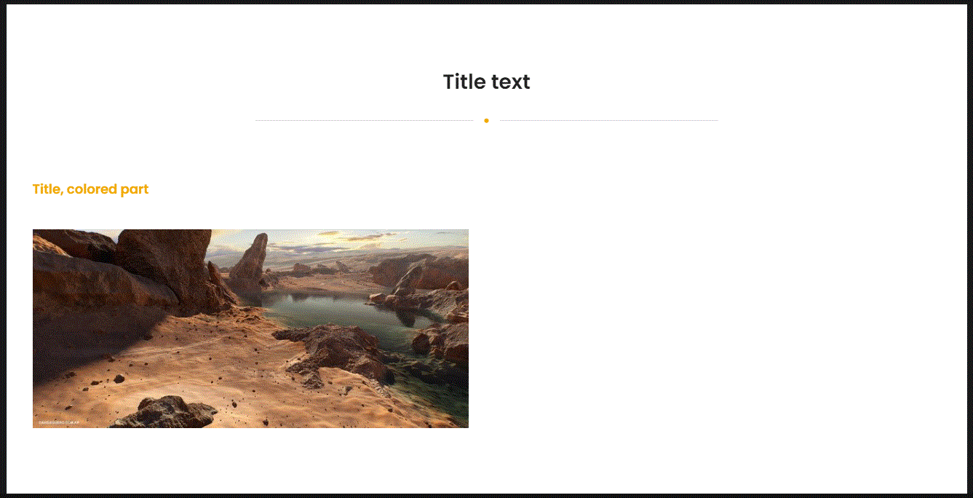
Going live we can see Title, first part above the image.

Slide 27
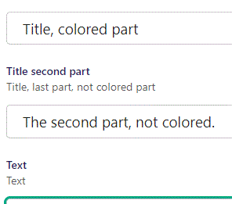
Beneath Title first part, you can write Title second part. This is the not colored part.

Slide 28
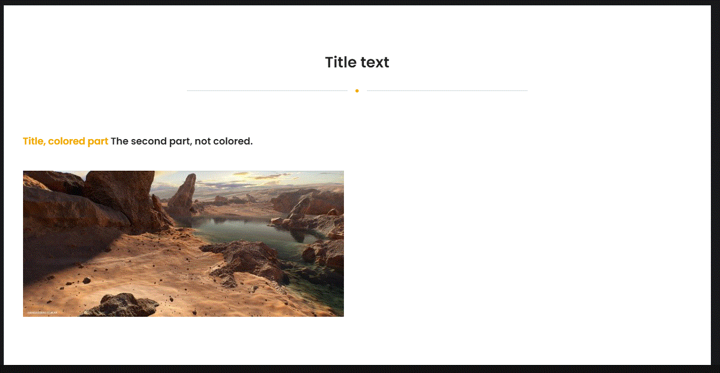
Going live we can see our Title second part right after the first part.

Slide 29
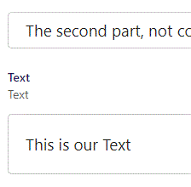
Beneath Title second part, you can write Text.

Slide 30
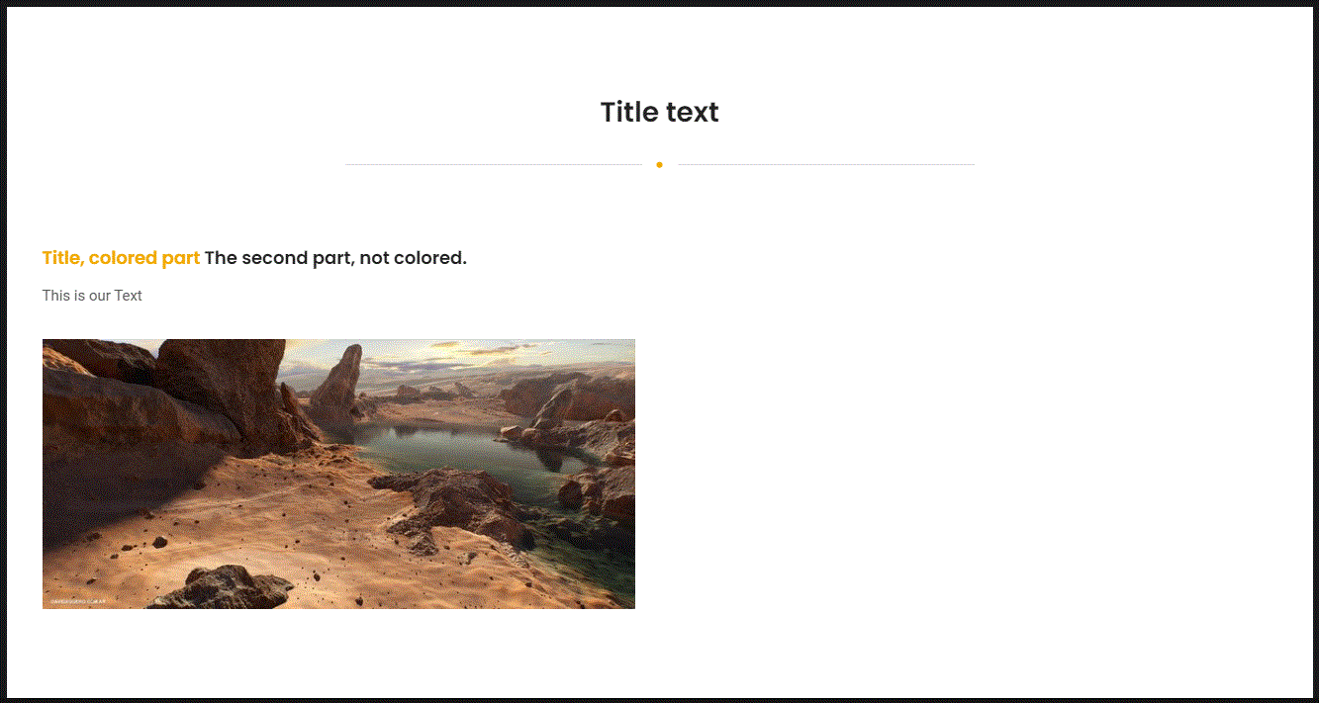
Going live we can see our Text below our Title parts.

Slide 31
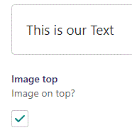
Beneath Text you can set Image top. Default is False, here we set it to True.

Slide 32
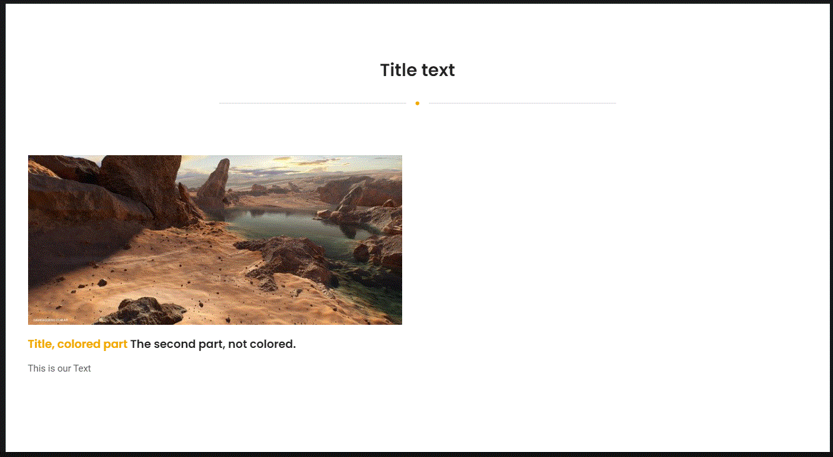
Going live we can see our image is now above our Title sections and Text.

Slide 33
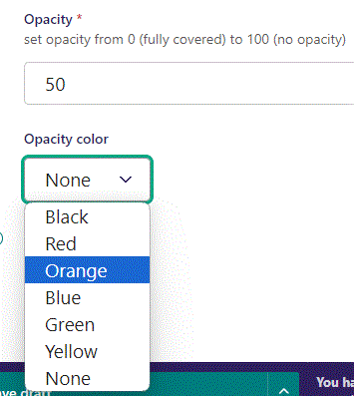
Beneath Image top you can set Opacity. The lower the number the more fully covered the image will be. We set it to 50.
Beneath Opacity you set the Opacity color to overlay the image with. Here we pick Orange.

Slide 34
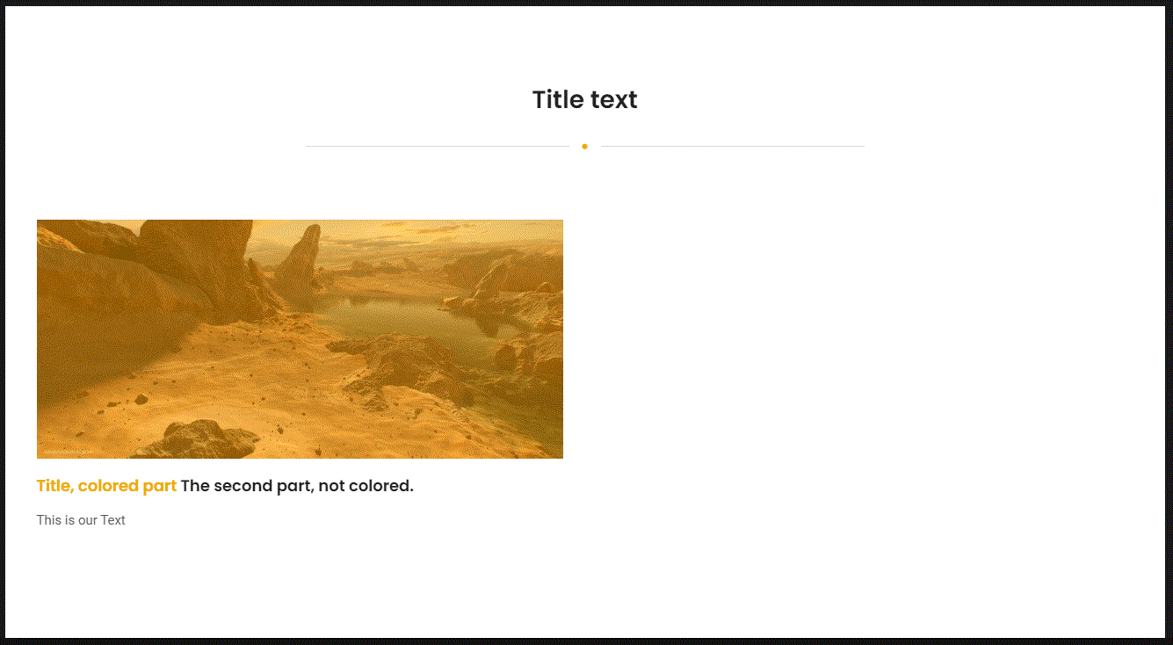
Going live we can see our image is now partly covered in Orange color.

Slide 35
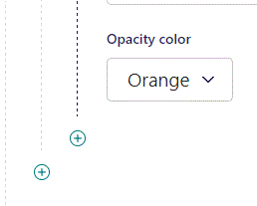
You can add another item by clicking the plus icon.

Slide 36
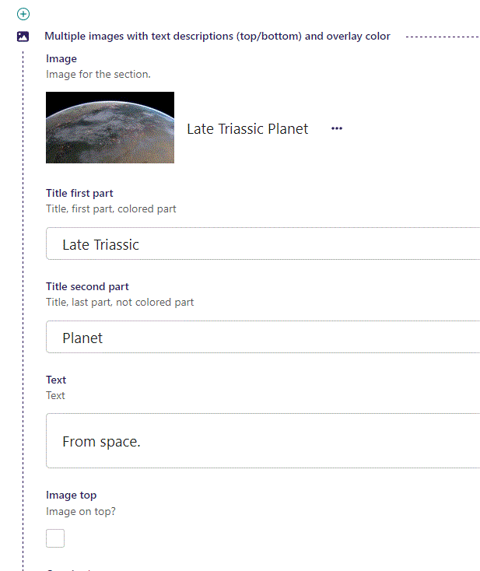
Fill out the fields etc. in the same manner as before.

Slide 37
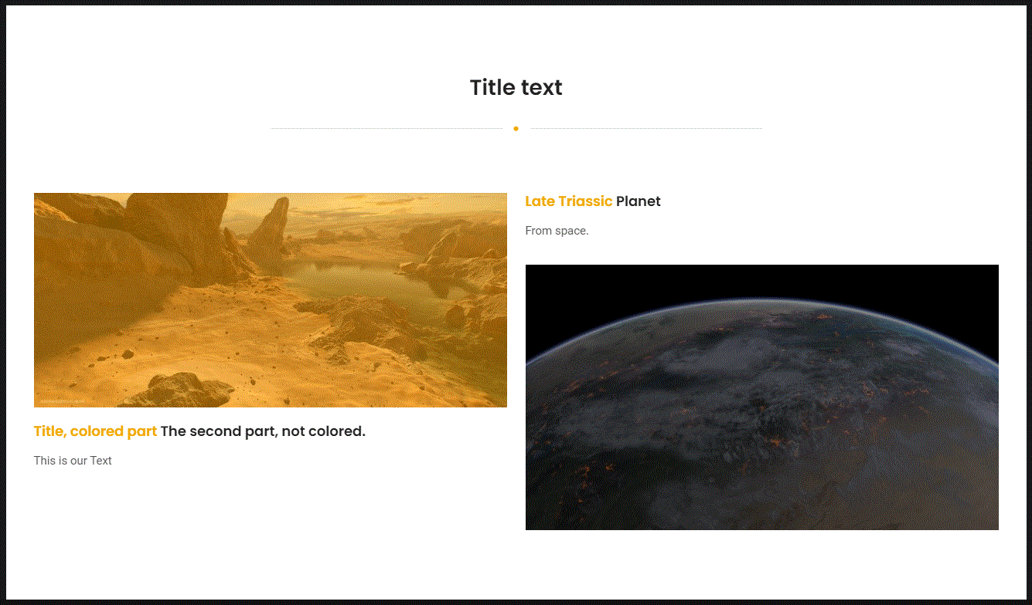
Going live we can see we have added another item.

