Slide 1
Guide for
Image before & after Block

Slide 2
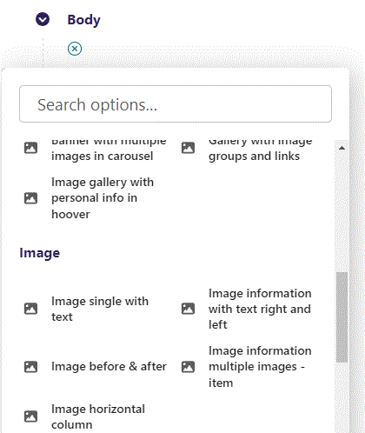
First click the small plus symbol. Then click Image before & after to begin creating.

Slide 3
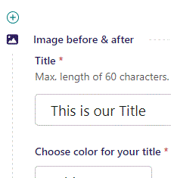
At the top you can write your Title.

Slide 4
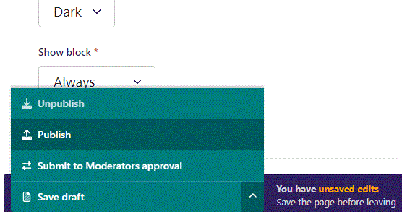
To go live first click the arrow to open the menu. Then click Publish.

Slide 5
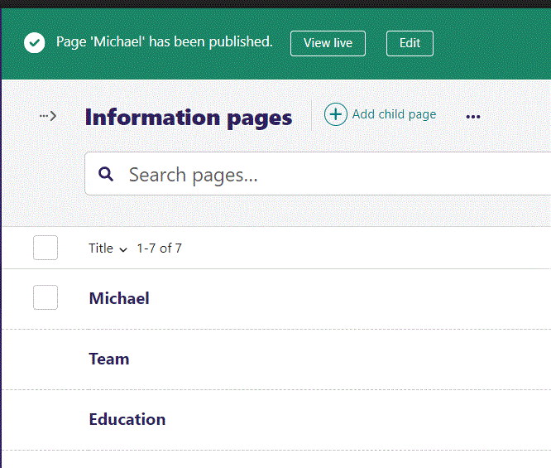
Click View live to open your webpage and see what you created.

Slide 6
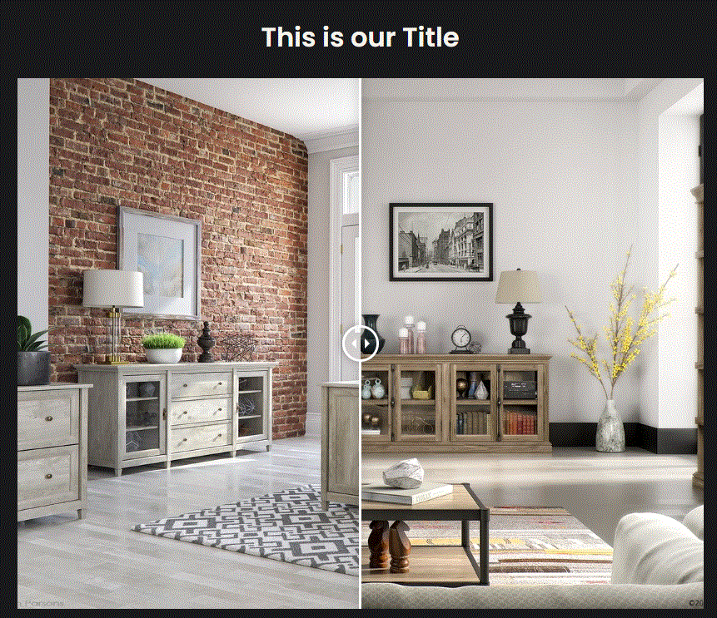
Going live we can see our Title.
We will get to the other content later.

Slide 7
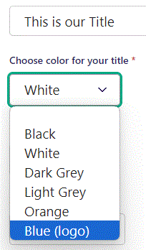
Beneath Title you can Choose color for your title. Let’s set it to Blue (logo).

Slide 8
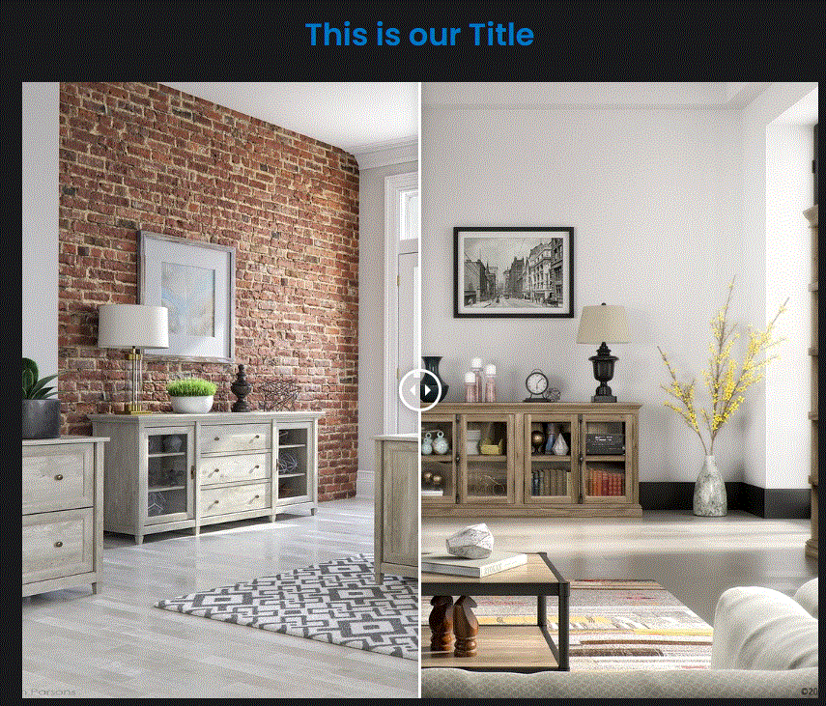
Going live we can see our Title is now in blue color.

Slide 9
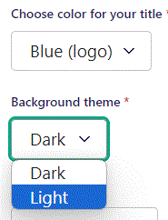
Beneath Choose color for your title you can set Background theme. Let’s change it to Light.

Slide 10
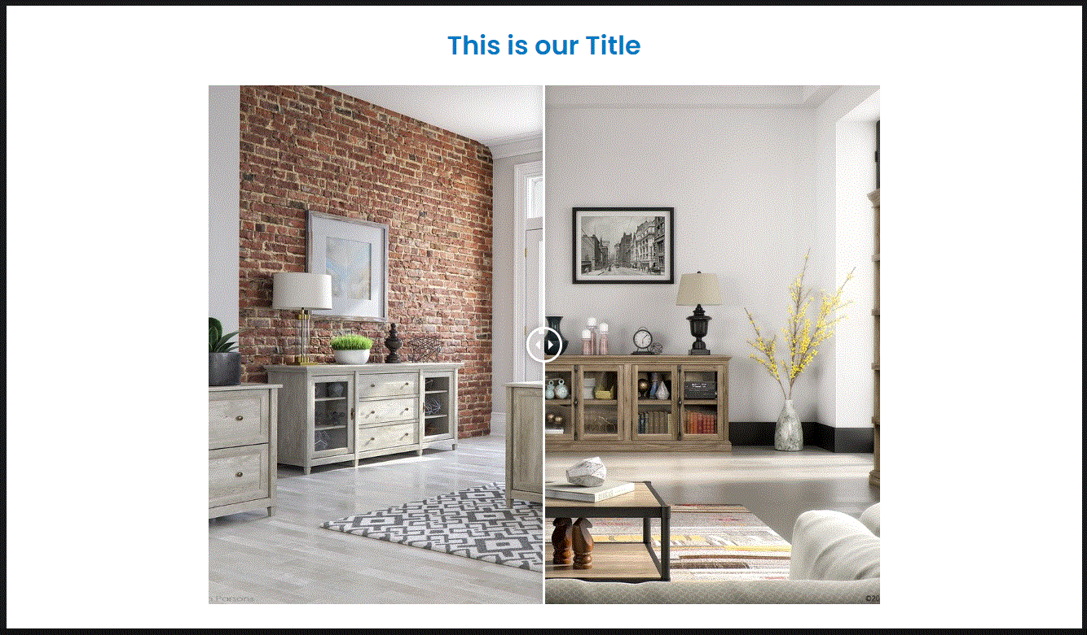
Going live we can see our Background theme have been changed to Light.

Slide 11
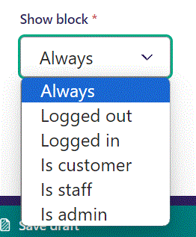
Below Background theme, you can select when or for whom the block will be shown.
Always: Will always show.
Logged out: Only shows when viewer is logged out.
Logged in: Only shows when viewer is logged in.
Is customer: Only shows when viewer is a customer.
Is staff: Only shows if viewer is a staff.
Is admin: Only shows when viewer is an admin.

Slide 12
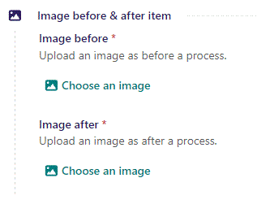
Beneath Show block we can Choose an image. We need to choose an image for Image before and Image after.

Slide 13
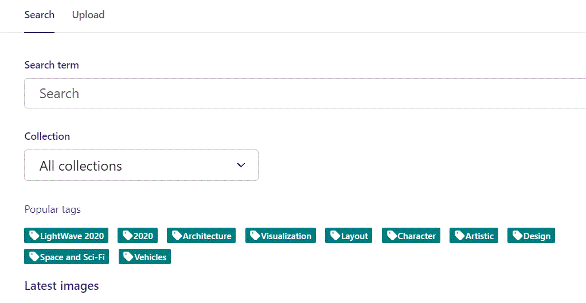
Here we see the top part of the image chooser screen. You can choose to either use an image on the server already or Upload a new image here.
First let’s use an image already on the server.

Slide 14
Here you can write a search term.

Slide 15
Here you can select a Collection of images.

Slide 16
At the bottom you can also sort with Popular tags.

Slide 17
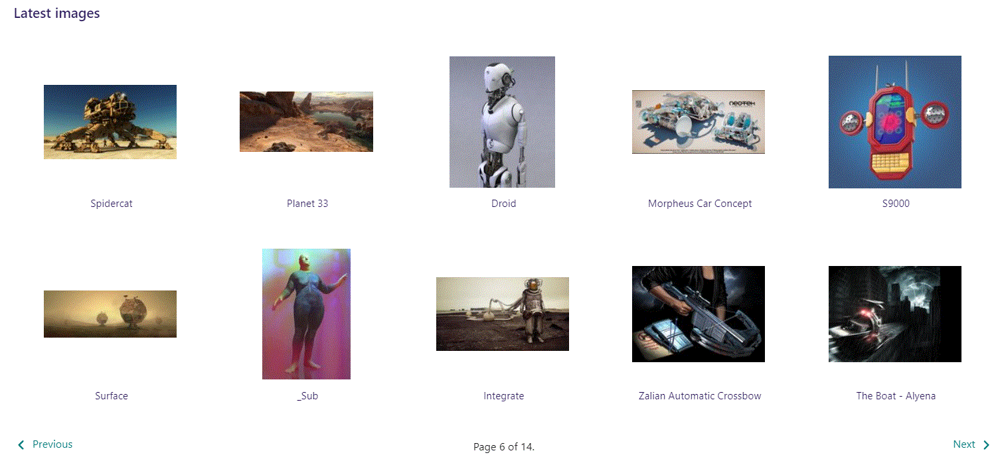
At the bottom of the image selector screen there are navigation buttons.

Slide 18
You can select an image by clicking it.

Slide 19
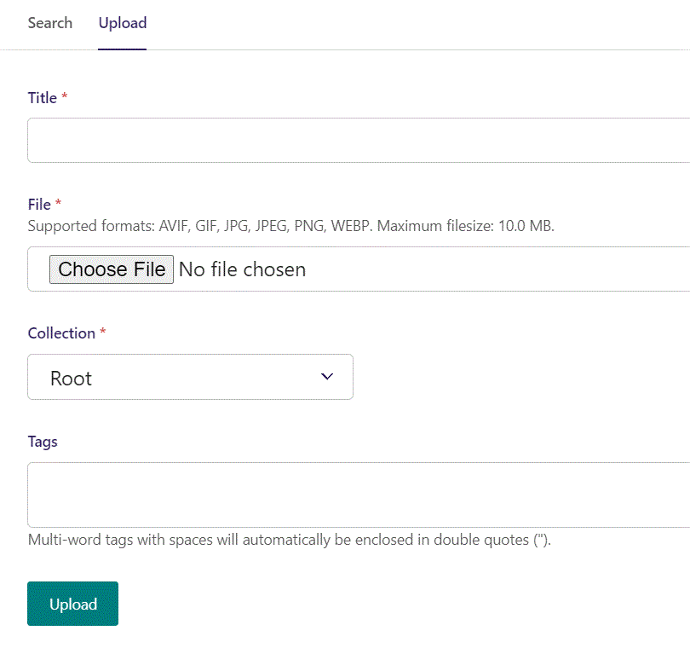
You can also upload an image by clicking Upload.

Slide 20
Name your image here.

Slide 21
Click Choose File to pick your image.

Slide 22
Select which Collection the uploaded image belongs to.

Slide 23
Assign tags to your image. Separate them with a comma.

Slide 24
Finally click Upload, to upload the image.

Slide 25
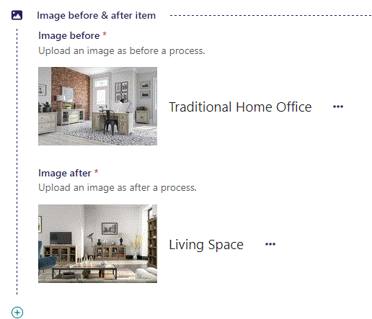
We have now chosen our two images.

Slide 26
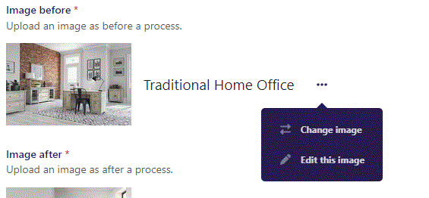
If you click the 3 dots you can Change image or Edit this image.

Slide 27
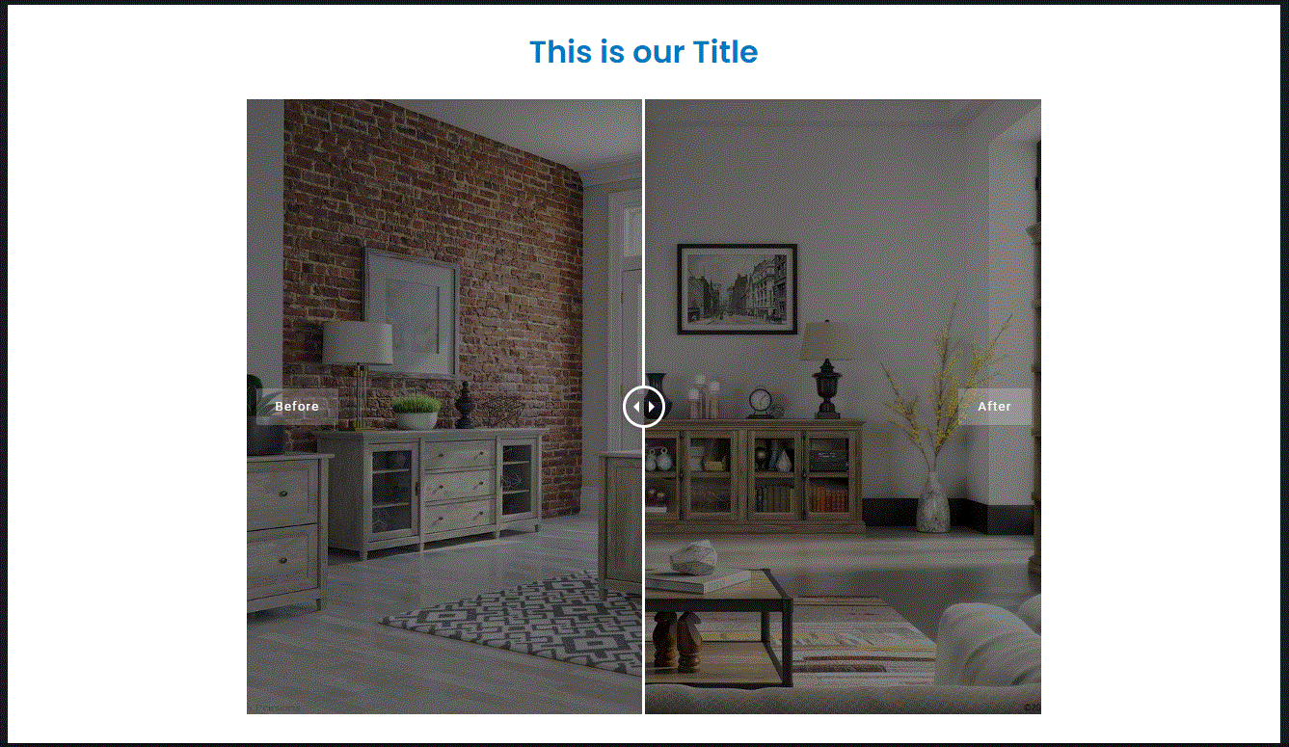
Going live, if you hoover the mouse over the images tool tips appear.
The slider in the middle can be dragged to either side to reveal the image behind.

Slide 28
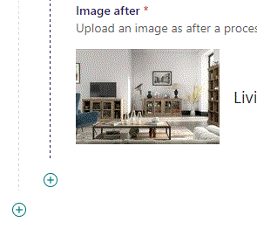
By clicking the plus icon, you can add another item.

Slide 29
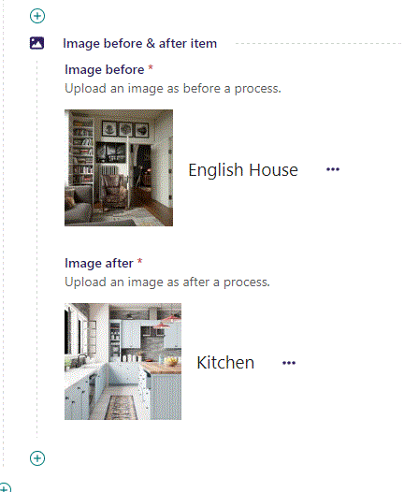
Add images the same way as before.

Slide 30
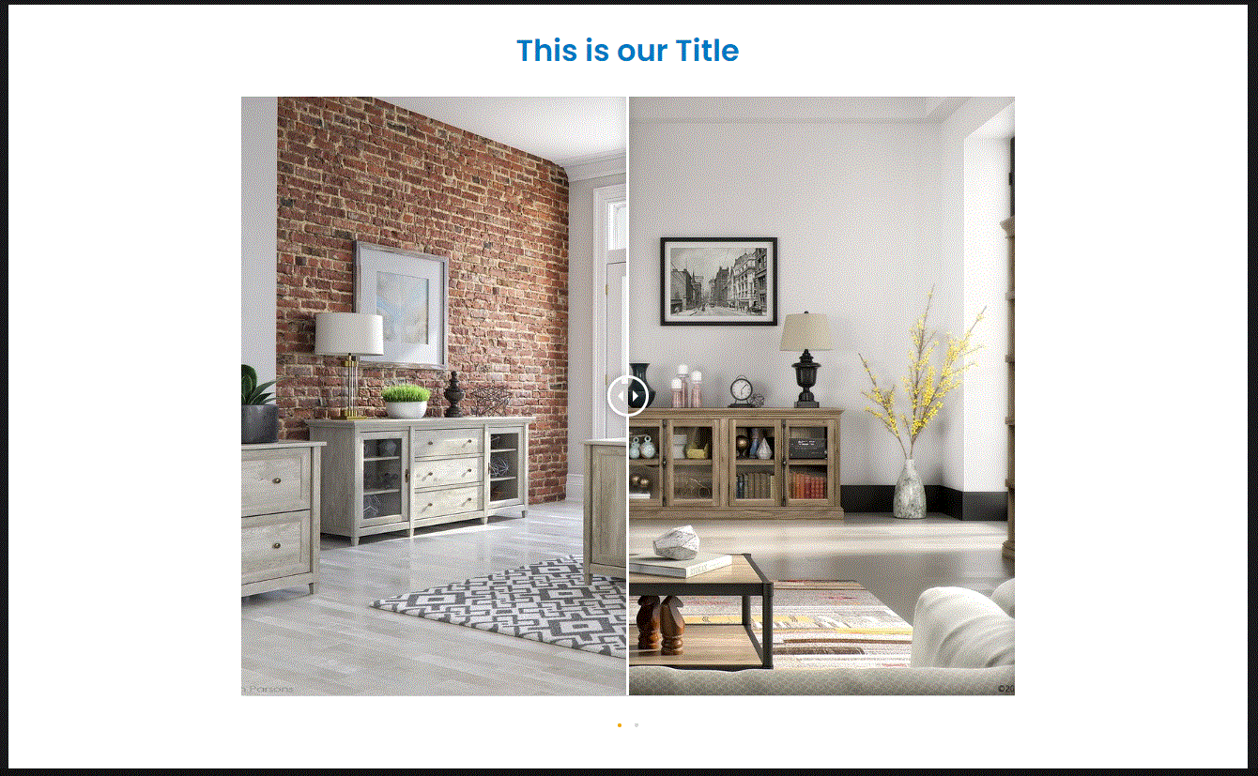
Going live we now have navigation dots below our images.
Clicking these switches between the image sets.

