Slide 1
Guide for
Image gallery with personal info on hoover Block

Slide 2
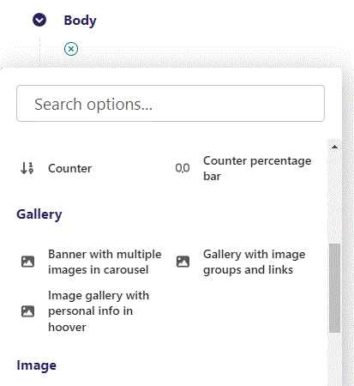
First click the small plus symbol. Then click Image gallery with personal info on hoover to begin creating.

Slide 3
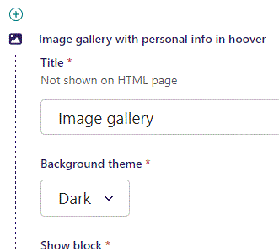
At the top you can write a Title. This will not be shown on HTML page, but will work as a title in the admin.

Slide 4
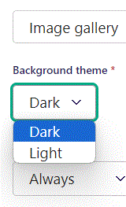
Beneath Title you can set Background theme.

Slide 5
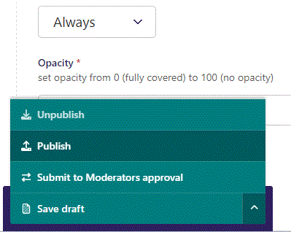
To go live first click the arrow to open the menu. Then click Publish.

Slide 6
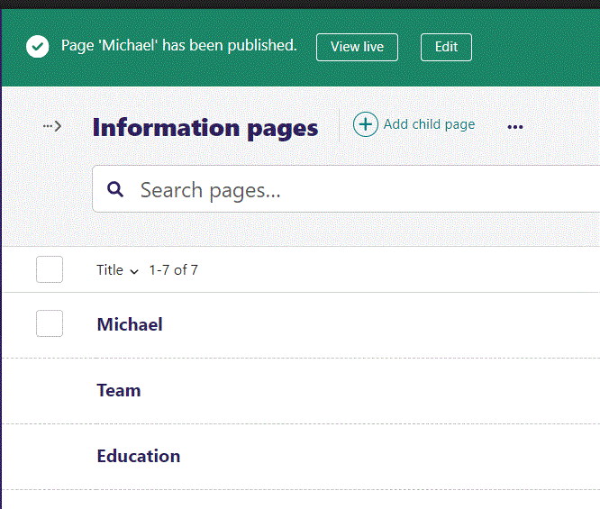
Click View live to open your webpage and see what you created.

Slide 7

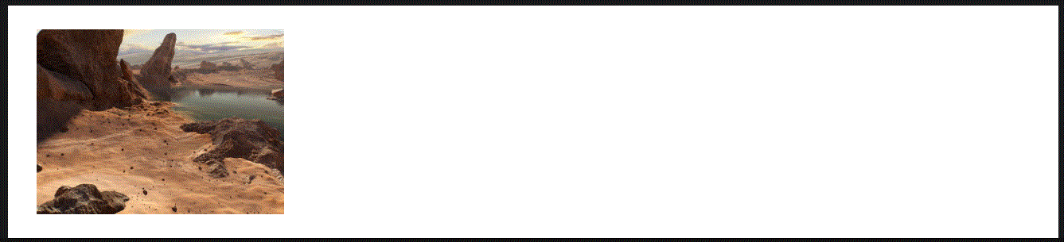
Going live we can see our Dark background theme.
And our Light background theme.
We will get to the content later.

Slide 8
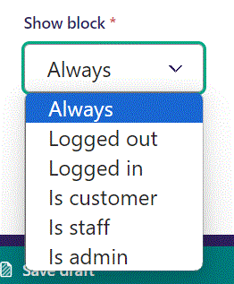
Below Background theme, you can select when or for whom the block will be shown.
Always: Will always show.
Logged out: Only shows when viewer is logged out.
Logged in: Only shows when viewer is logged in.
Is customer: Only shows when viewer is a customer.
Is staff: Only shows if viewer is a staff.
Is admin: Only shows when viewer is an admin.

Slide 9
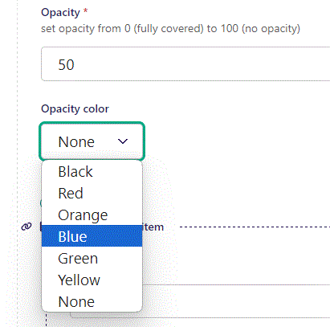
Beneath Show block you can set Opacity. The lower the number, the more covered the image will be.
Below Opacity you can set Opacity color. Here we set it to Blue.

Slide 10

Going live we can see our image is now covered by a blue color.

Slide 11
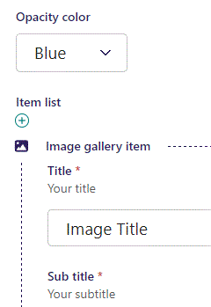
Beneath Opacity color you can write an image Title.

Slide 12

Going live we can see Image Title when we hoover our mouse over the image.

Slide 13
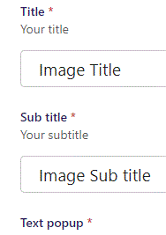
Beneath Title you can write a Sub title.

Slide 14

Going live we can see our Image Sub title

Slide 15
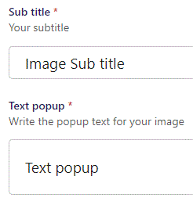
Beneath Sub title you can write Text popup.

Slide 16

Going live we can see our Text popup when we hoover our mouse over the image.

Slide 17
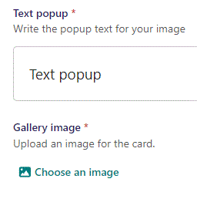
Beneath Text popup you can Choose an image.

Slide 18
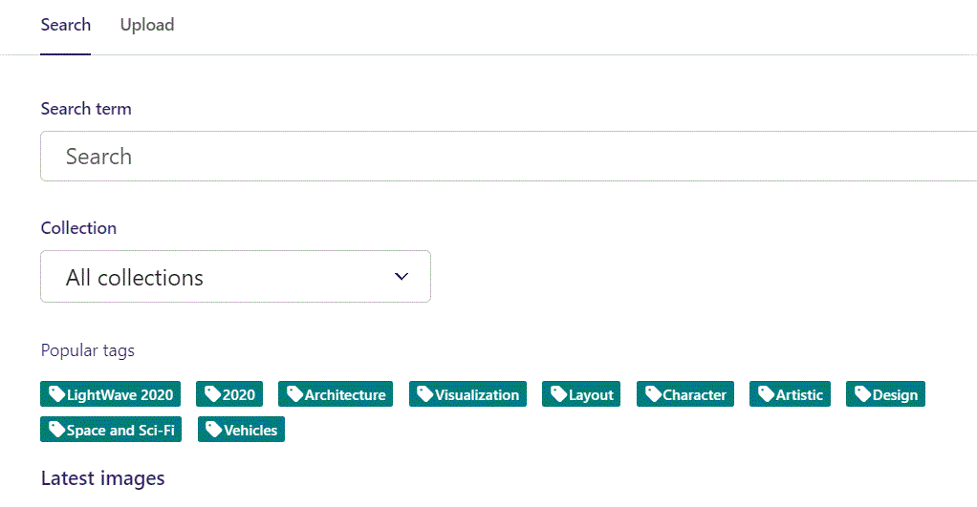
Here we see the top part of the image chooser screen. You can choose to either use an image on the server already or Upload a new image here.
First let’s use an image already on the server.

Slide 19
Here you can write a search term.

Slide 20
Here you can select a Collection of images.

Slide 21
At the bottom you can also sort with Popular tags.

Slide 22
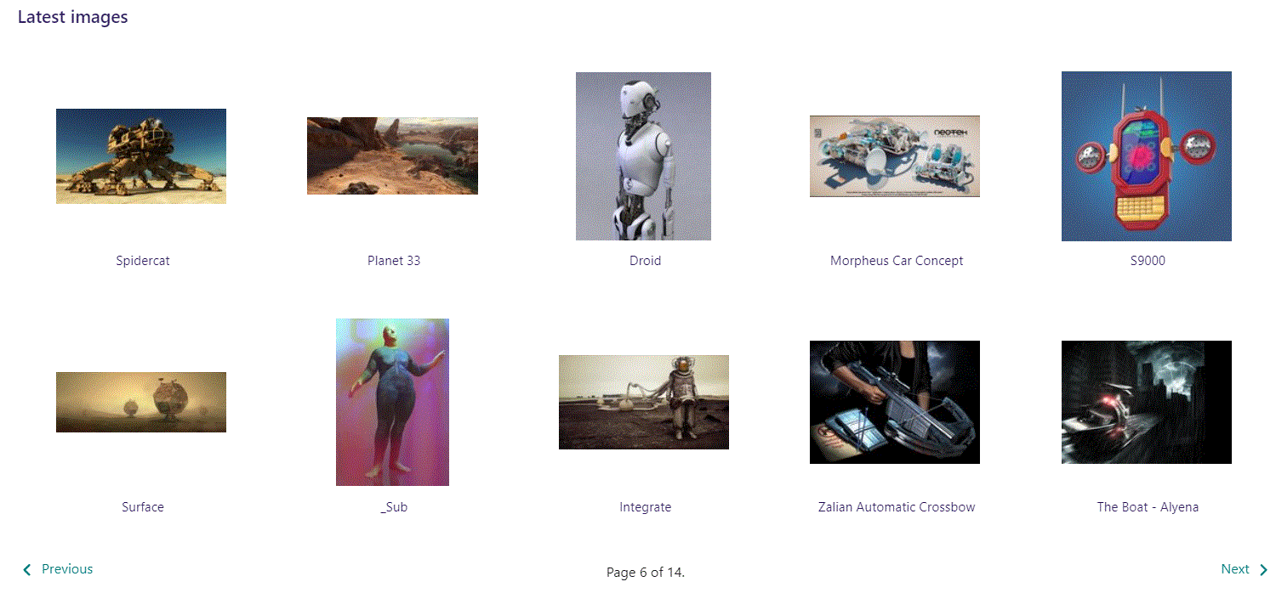
At the bottom of the image selector screen there are navigation buttons.

Slide 23
You can select an image by clicking it.

Slide 24
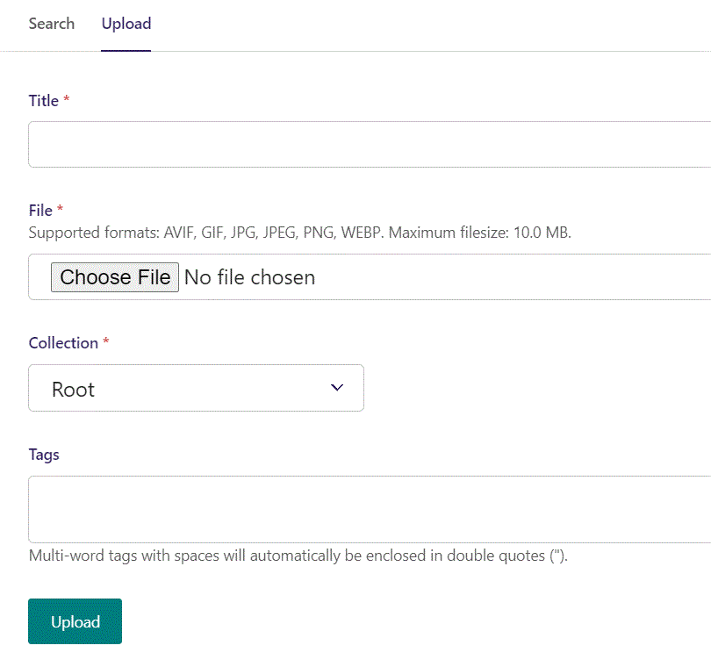
You can also upload an image by clicking Upload.

Slide 25
Name your image here.

Slide 26
Click Choose File to pick your image.

Slide 27
Select which Collection the uploaded image belongs to.

Slide 28
Assign tags to your image. Separate them with a comma.

Slide 29
Finally click Upload, to upload the image.

Slide 30
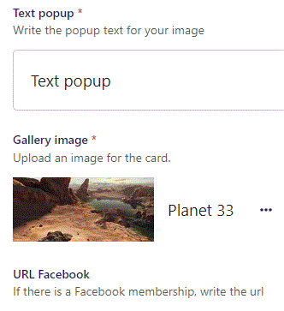
We have now chosen an image.

Slide 31
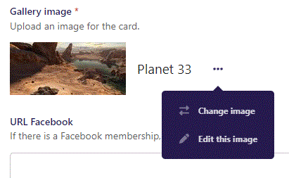
By clicking the 3 dots you can Change image or Edit this image if you like.

Slide 32
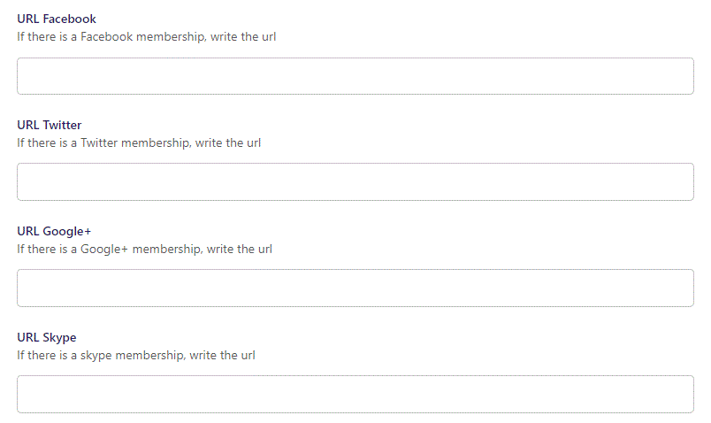
Beneath Gallery image you can link the image to social media.

Slide 33
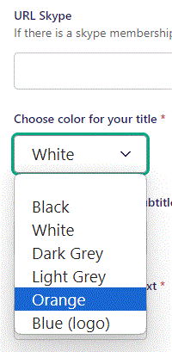
Beneath URL Skype you can Choose color for your title. Let’s make it Orange.

Slide 34

Going live we can see our Title is now in Orange.

Slide 35
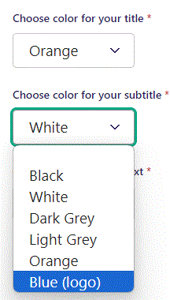
Beneath choose color for your title you can Choose color for your subtitle.

Slide 36

Going live we can see our Sub title is now in blue.

Slide 37
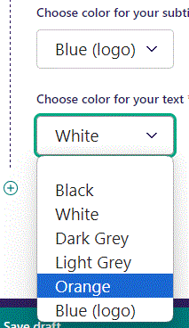
Beneath Choose color for your subtitle you can Choose color for your text. Let’s set it to Orange.

Slide 38

Going live we can see our Text popup is now in Orange.

Slide 39
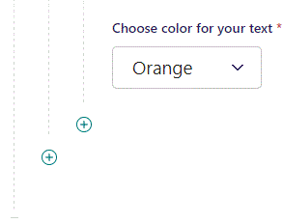
By clicking the plus symbol, you can add another item.

Slide 40
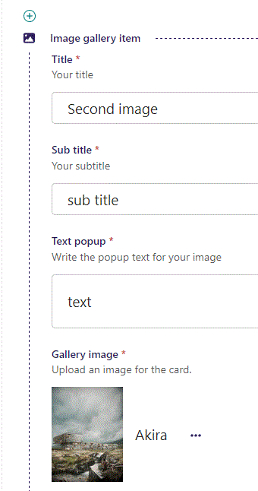
Fill out the fields in the same manner as for first item.

Slide 41

You can add as many images as you like. Note they all have the same Opacity.

