Slide 1
Guide for
Gallery with image groups and links Block

Slide 2
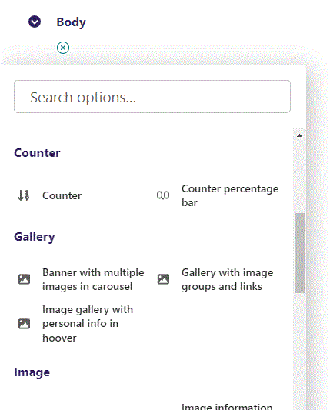
First click the small plus symbol. Then click Gallery with image groups and links to begin creating.

Slide 3
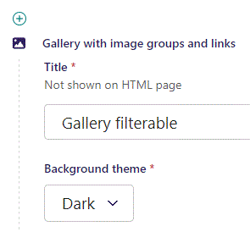
At the top you can write a Title. This will not be shown on HTML page, but will be a Title to your block in Admin.

Slide 4
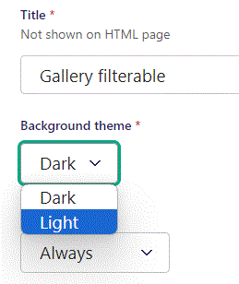
Beneath Title you can set Background theme.

Slide 5
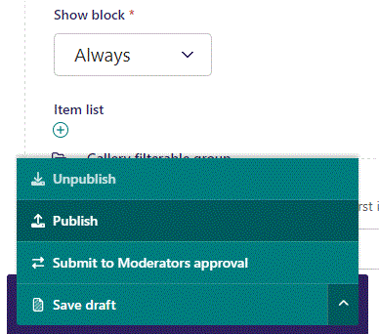
To go live first click the arrow to open the menu. Then click Publish.

Slide 6
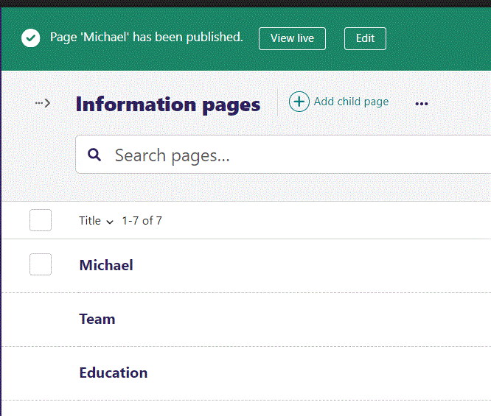
Click View live to open your webpage and see what you created.

Slide 7
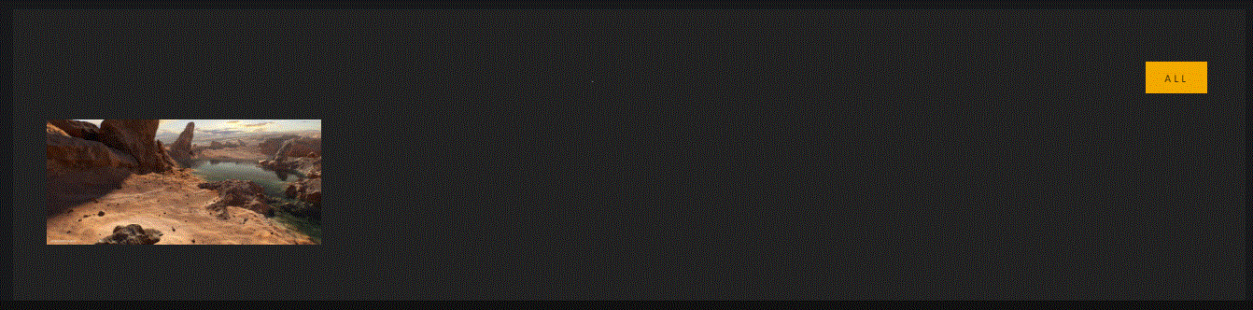
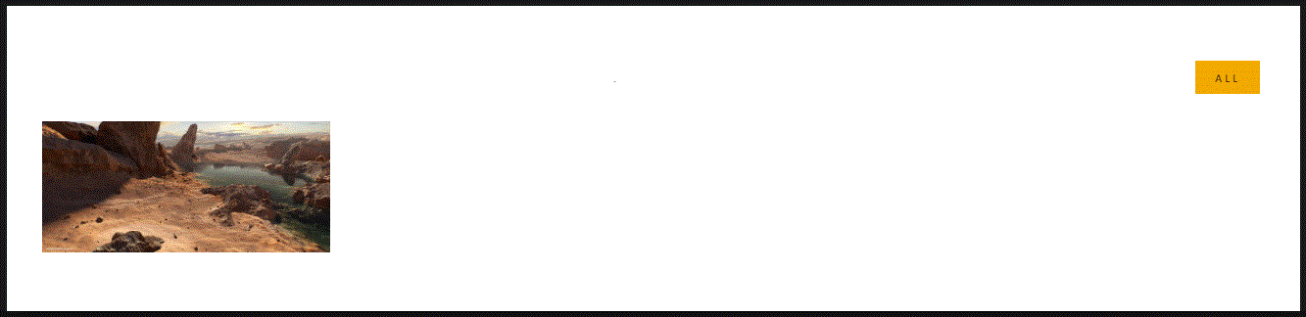
Going live we can see our Dark background theme.
And our Light background theme.
The content will be explained later.

Slide 8
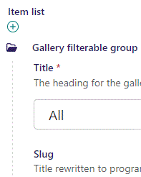
Beneath Show block you can write a Title. The Title functions as the heading for the gallery categories. Since this is the first gallery group, we name it All. The first group is special, as it will generate a special button that will show all groups images.

Slide 9

Going live we can see our Gallery Group have given us a button “All” that the user can click to sort for all images in this group.
Also, it is shown as a filterable link.

Slide 10
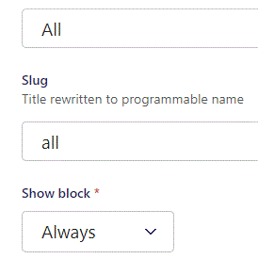
Beneath Title are Slug. This is automatically filled out.

Slide 11
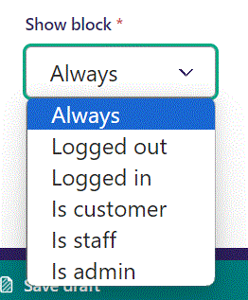
Below Slug, you can select when or for whom the block will be shown.
Always: Will always show.
Logged out: Only shows when viewer is logged out.
Logged in: Only shows when viewer is logged in.
Is customer: Only shows when viewer is a customer.
Is staff: Only shows if viewer is a staff.
Is admin: Only shows when viewer is an admin.

Slide 12
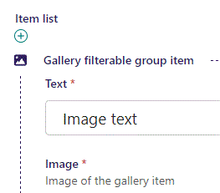
Beneath Show block you can write Text.

Slide 13
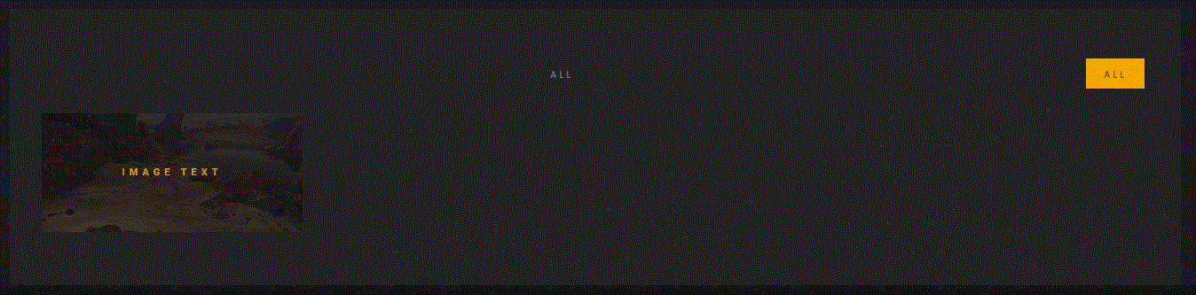
Going live we can see our Text is shown when you hoover the mouse over the image.

Slide 14
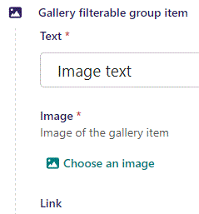
Beneath Text you can Choose an image.

Slide 15
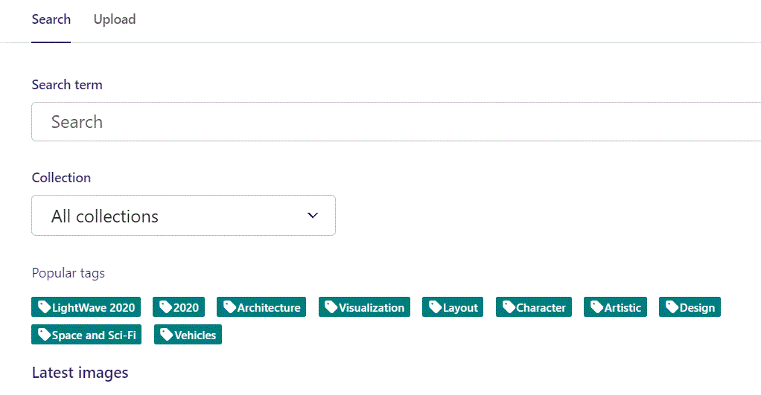
Here we see the top part of the image chooser screen. You can choose to either use an image on the server already or Upload a new image here.
First let’s use an image already on the server.

Slide 16
Here you can write a search term.

Slide 17
Here you can select a Collection of images.

Slide 18
At the bottom you can also sort with Popular tags.

Slide 19
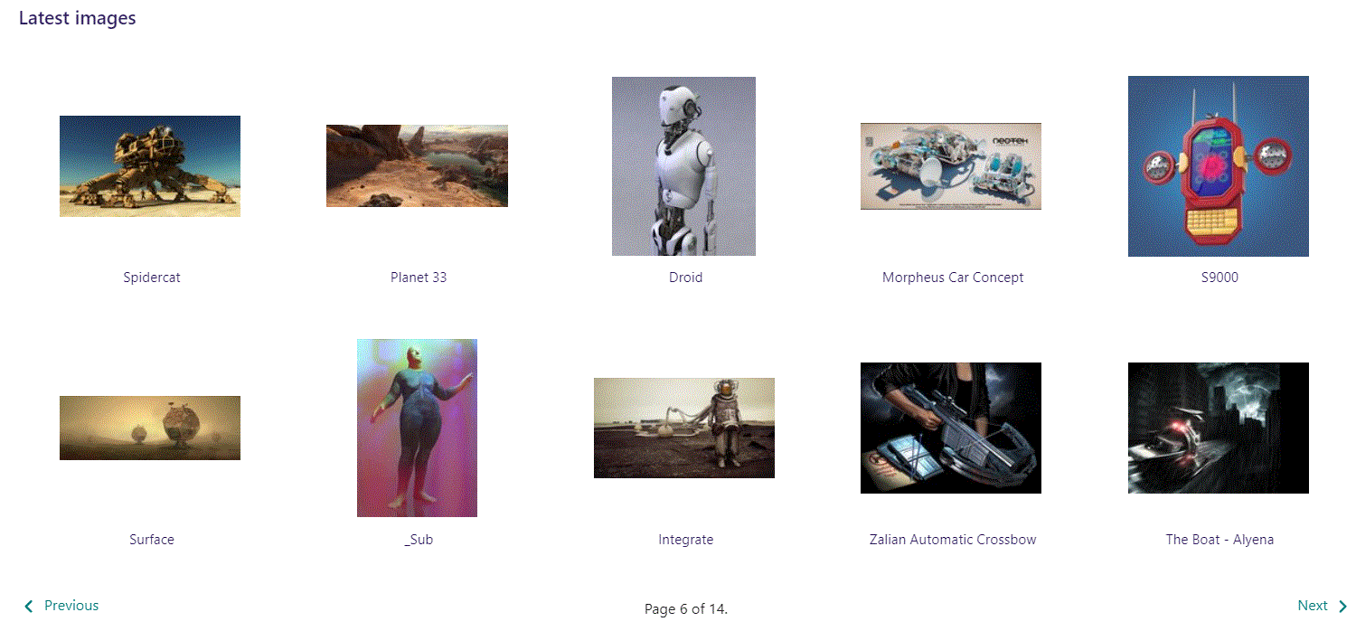
At the bottom of the image selector screen there are navigation buttons.

Slide 20
You can select an image by clicking it.

Slide 21
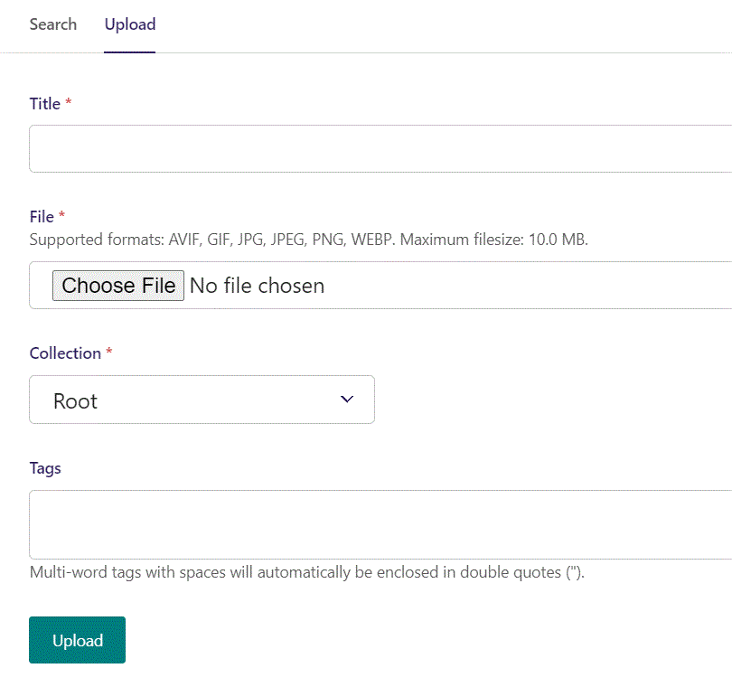
You can also upload an image by clicking Upload.

Slide 22
Name your image here.

Slide 23
Click Choose File to pick your image.

Slide 24
Select which Collection the uploaded image belongs to.

Slide 25
Assign tags to your image. Separate them with a comma.

Slide 26
Finally click Upload, to upload the image.

Slide 27
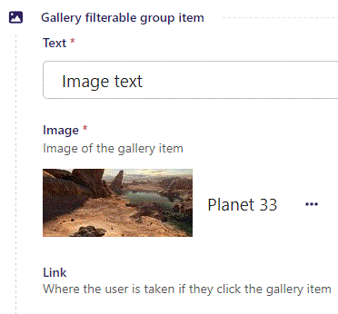
We have now chosen an image.

Slide 28
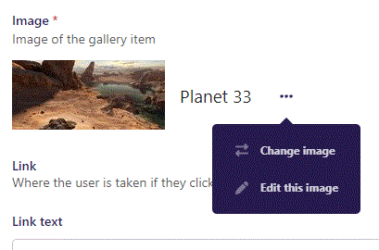
By clicking the 3 dots you can Change image or Edit this image.

Slide 29
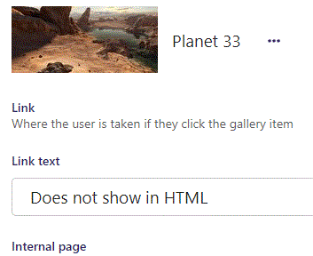
Beneath Choose image you can write a Link text. It does not show in HTML.

Slide 30
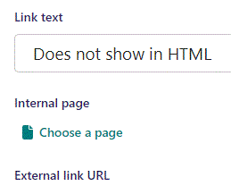
Beneath Link text you can Choose a page to send user to when they click the image.

Slide 31
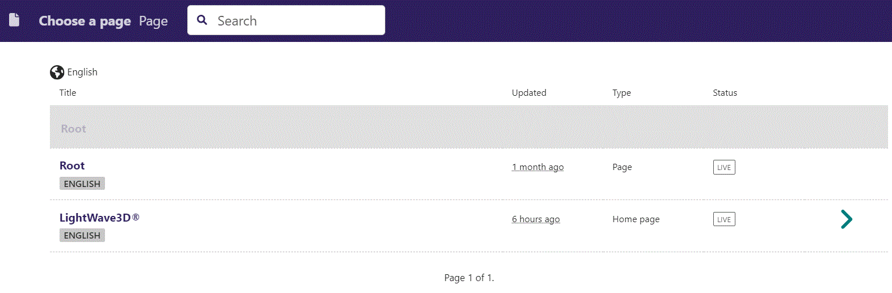
In the page chooser window you can search for the page here.

Slide 32
If a page on the list have pages under it, you can click here to see them.

Slide 33
You select a page by clicking here.

Slide 34
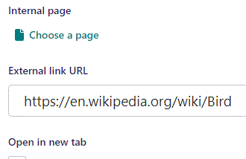
Beneath Choose a page you can write an External link URL, where the user is taken if they click the image.

Slide 35
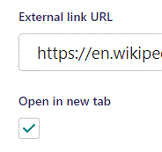
Beneath External link URL you can make it Open in new tab when image is clicked.

Slide 36
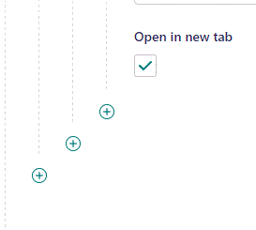
You can add more images to the Group by clicking the plus icon.

Slide 37
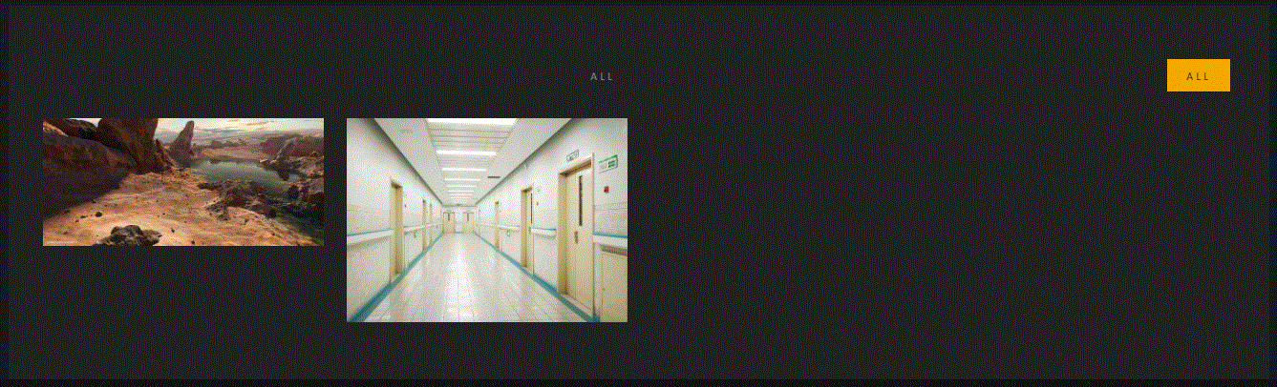
Going live we can see we now have 2 images in the All group.

Slide 38
You can add another Group by clicking this plus icon.

Slide 39
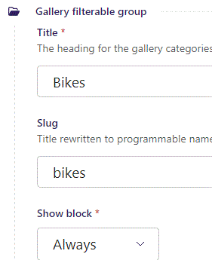
Here we have added a group called Bikes. We also added an image to the group.

Slide 40
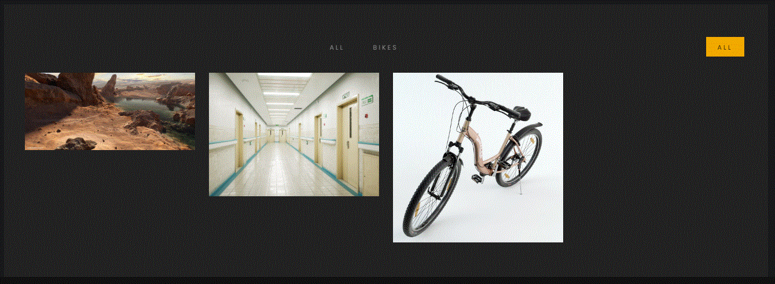
Going live we can see our new group (Bikes) in the filterable links.

Slide 41
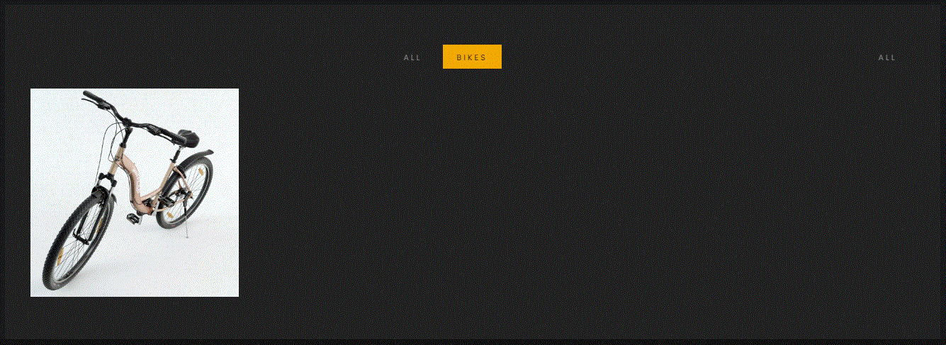
If you click the filterable link Bikes, only the images in the Bikes group will be shown.

