Slide 1
Guide for
Banner with multiple images in carousel Block

Slide 2
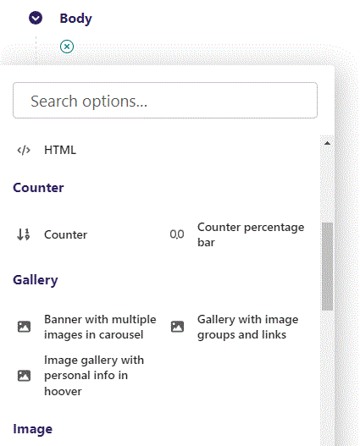
First click the small plus symbol. Then click Banner with multiple images in carousel to begin creating.

Slide 3
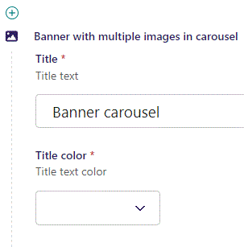
At the top you can write a Title.

Slide 4
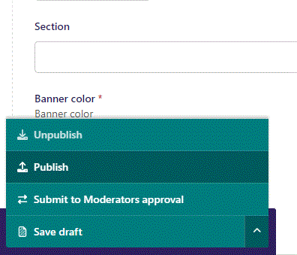
To go live first click the arrow to open the menu. Then click Publish.

Slide 5
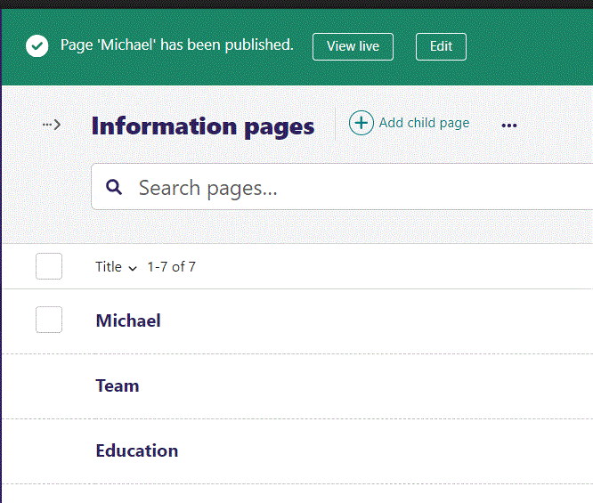
Click View live to open your webpage and see what you created.

Slide 6
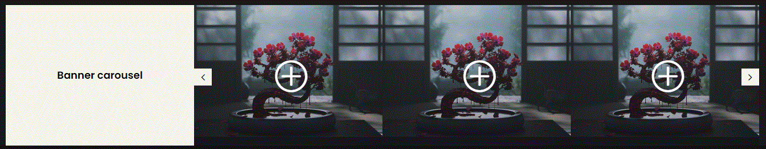
Going live we can see our Title.

Slide 7
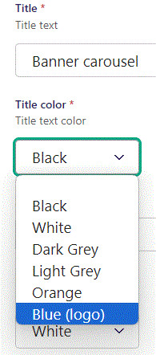
Beneath Title you can set Title color. Let’s set it to Blue (logo).

Slide 8
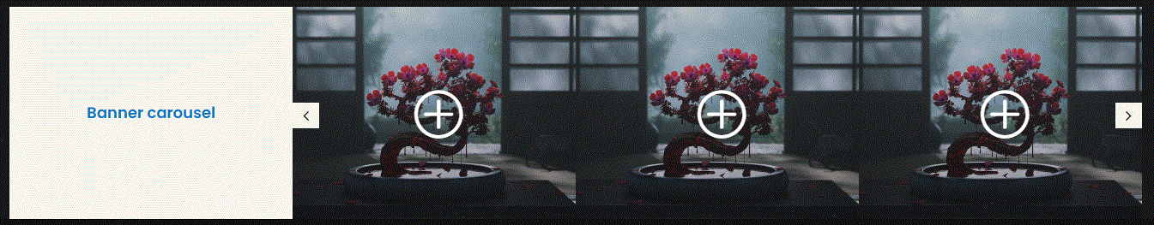
Going live we can see our Title color have changed to blue.

Slide 9
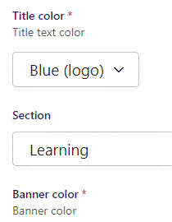
Below Title color, you can designate a section that your page will belong to. It is a bookmark for the menu.

Slide 10
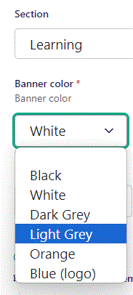
Beneath Section you can set Banner color. Let’s set it to Light Grey.

Slide 11
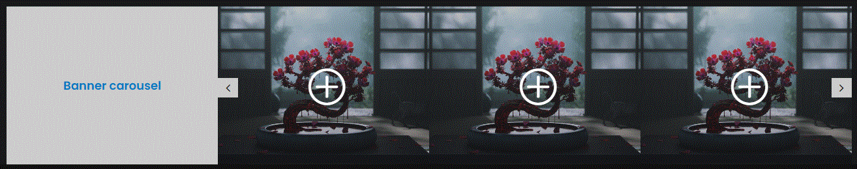
Going live we can see the Banner color have changed to Light Grey.

Slide 12
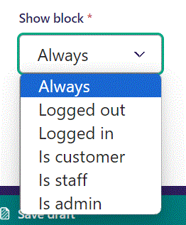
Below Banner color, you can select when or for whom the block will be shown.
Always: Will always show.
Logged out: Only shows when viewer is logged out.
Logged in: Only shows when viewer is logged in.
Is customer: Only shows when viewer is a customer.
Is staff: Only shows if viewer is a staff.
Is admin: Only shows when viewer is an admin.

Slide 13
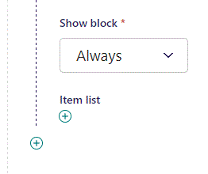
Click the plus symbol to add an item.

Slide 14
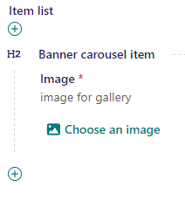
Click Choose an image.

Slide 15
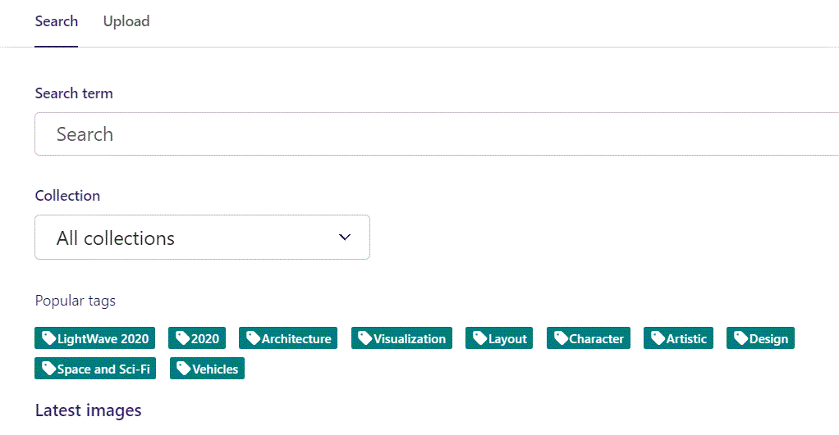
Here we see the top part of the image chooser screen. You can choose to either use an image on the server already or Upload a new image here.
First let’s use an image already on the server.

Slide 16
Here you can write a search term.

Slide 17
Here you can select a Collection of images.

Slide 18
At the bottom you can also sort with Popular tags.

Slide 19
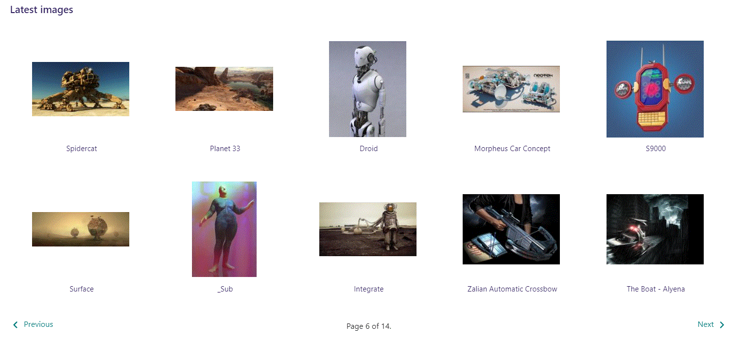
At the bottom of the image selector screen there are navigation buttons.

Slide 20
You can select an image by clicking it.

Slide 21
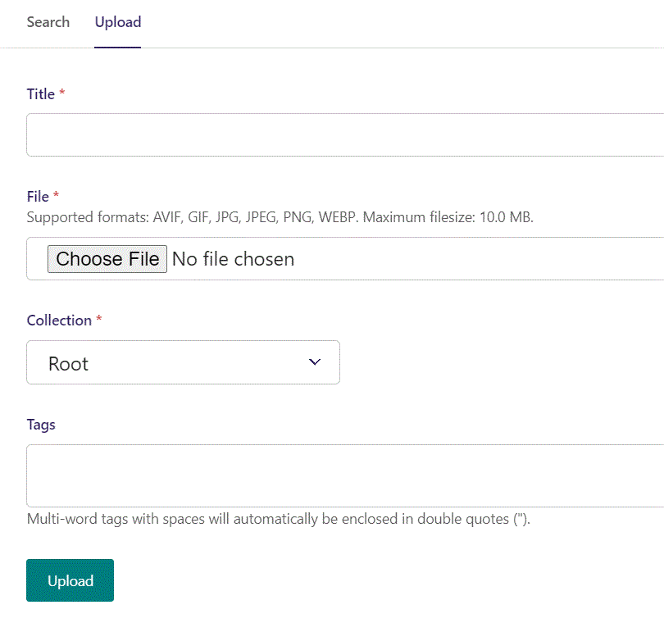
You can also upload an image by clicking Upload.

Slide 22
Name your image here.

Slide 23
Click Choose File to pick your image.

Slide 24
Select which Collection the uploaded image belongs to.

Slide 25
Assign tags to your image. Separate them with a comma.

Slide 26
Finally click Upload, to upload the image.

Slide 27
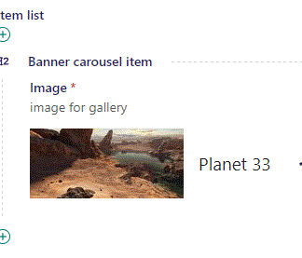
We have now chosen an image.

Slide 28
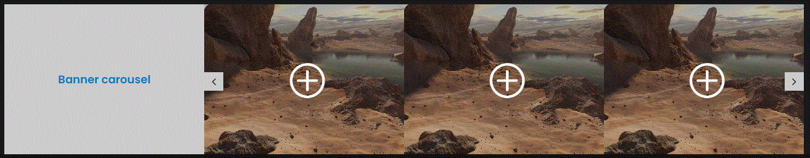
Going live we can see our banner now shows the image we chose.

Slide 29
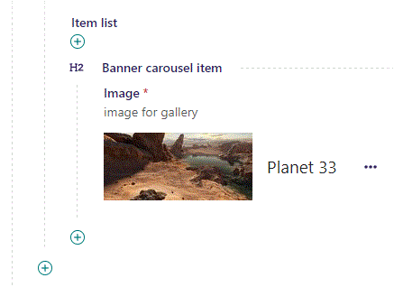
Click the plus icon to add another image.

Slide 30
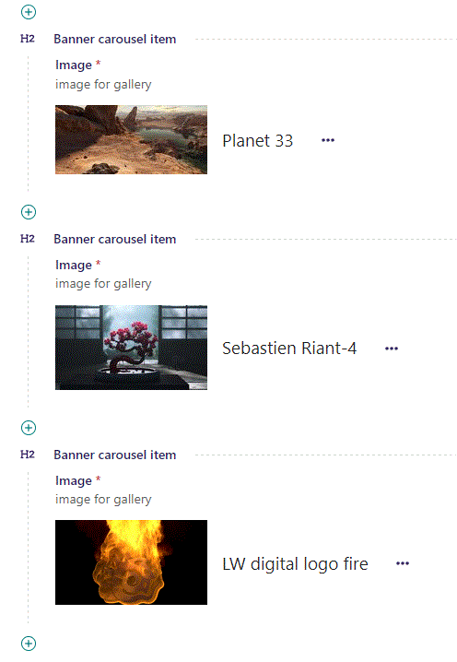
You can add as many images as you want.

Slide 31
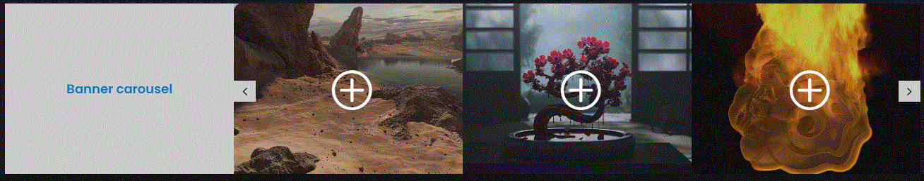
Going live we can see our banner now show the images we selected.
To Scroll to the other images, click these navigation arrows.

