Slide 1
Guide for
Counter percentage bar Block

Slide 2
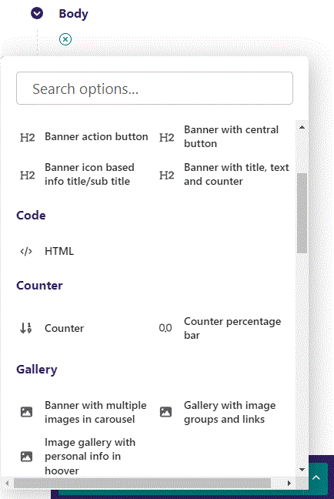
First click the small plus symbol. Then click Counter percentage bar to begin creating.

Slide 3
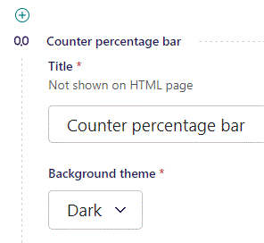
At the top you can write a Title. This will not be shown on HTML page, but will give your block a Title in the admin.

Slide 4
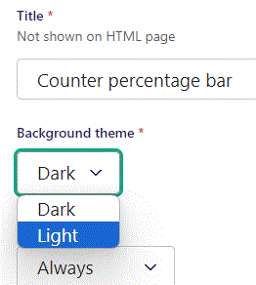
Beneath Title you can set Background theme.

Slide 5
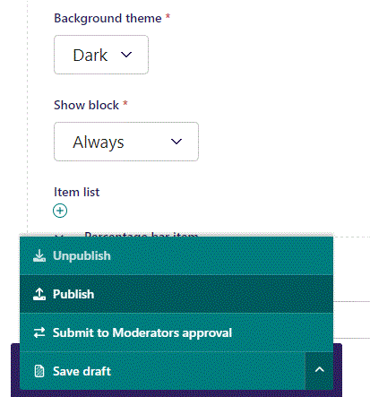
To go live, first click the arrow to open the menu. Then click Publish.

Slide 6
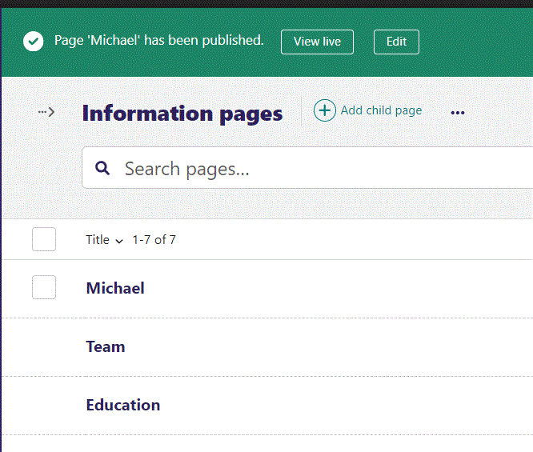
Click View live to open your webpage and see what you created.

Slide 7
Going live we can see our Dark background theme at the top.
And our Light background theme
We will get to the contents on the banner later.

Slide 8
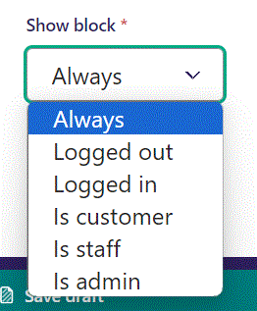
Below Background theme, you can select when or for whom the block will be shown.
Always: Will always show.
Logged out: Only shows when viewer is logged out.
Logged in: Only shows when viewer is logged in.
Is customer: Only shows when viewer is a customer.
Is staff: Only shows if viewer is a staff.
Is admin: Only shows when viewer is an admin.

Slide 9
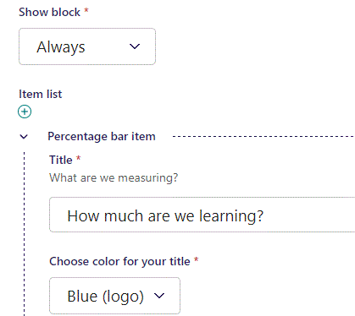
Beneath Show block you can write a Title.

Slide 10
Going live we can see our Title.

Slide 11
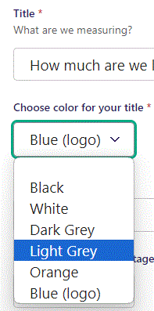
Beneath Title you can Choose color for your title. Let’s make it Light Grey.

Slide 12
Going live we can see our Title is now Light Grey in color.

Slide 13
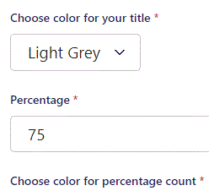
Beneath Choose color for your title you can set Percentage.

Slide 14
Going live we can see our 75% showing up in number, and the yellow bar beneath the title is now 75% of the width.

Slide 15
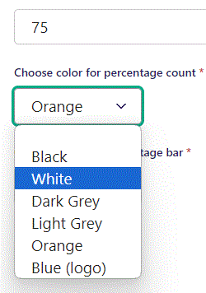
Beneath Percentage you can Choose color for percentage count. Let’s make it White.

Slide 16
Going live we can see our Percentage is now shown in White.

Slide 17
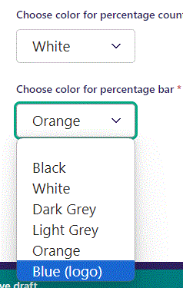
Beneath Choose color for percentage count you can Choose color for percentage bar. Let’s make it Blue (logo).

Slide 18
Going live we can see our Percentage bar is now shown in a blue color.

Slide 19
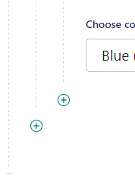
You can add another item by clicking the plus icon.

Slide 20
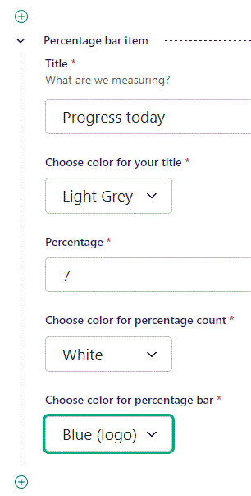
Fill out the fields like before.

Slide 21
Going live we can see our new item.

