Slide 1
Guide for
Code Block

Slide 2
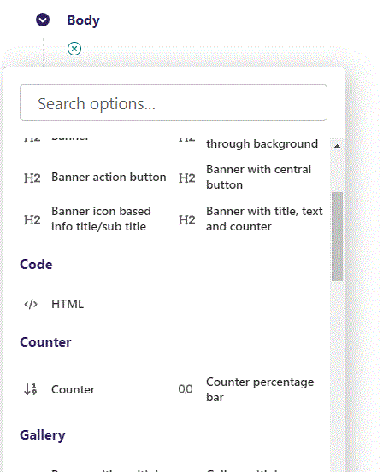
First click the small plus symbol. Then click HTML to begin.

Slide 3
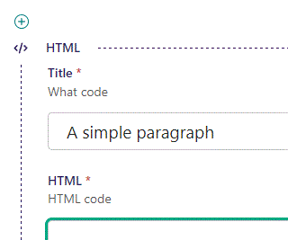
At the top you can write a Title. This will not be shown live but helps you in Admin to keep track of your blocks.

Slide 4
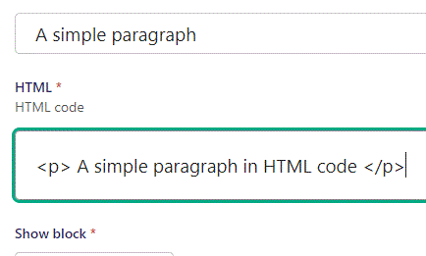
Beneath Title you can write your HTML code. Here we are making a simple paragraph.

Slide 5
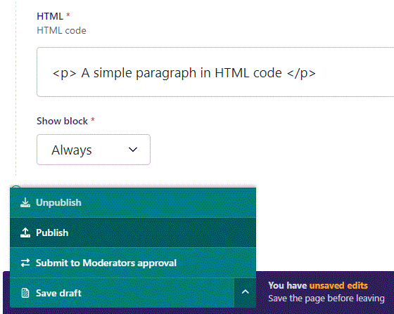
To go live first click the arrow to open the menu. Then click Publish.

Slide 6
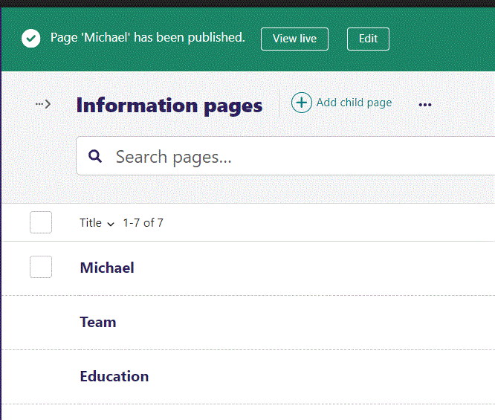
Click View live to open your webpage and see what you created.

Slide 7

Going live we can see how our simple paragraph turned out.

Slide 8
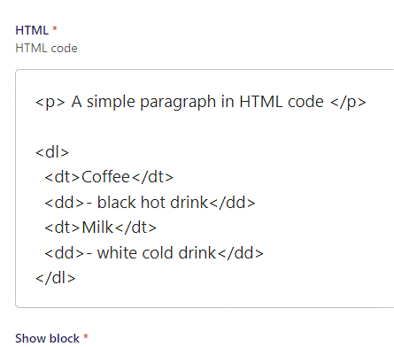
You can build complex HTML structures as well. Here we add a description list beneath our paragraph.

Slide 9
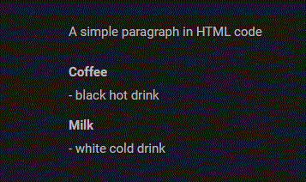
Going live we can see the result of our HTML code.
Our description list shows correctly beneath our paragraph.

Slide 10
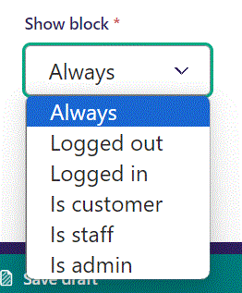
Below Background theme, you can select when or for whom the block will be shown.
Always: Will always show.
Logged out: Only shows when viewer is logged out.
Logged in: Only shows when viewer is logged in.
Is customer: Only shows when viewer is a customer.
Is staff: Only shows if viewer is a staff.
Is admin: Only shows when viewer is an admin.

