Slide 1
Guide for
Banner with see through background

Slide 2
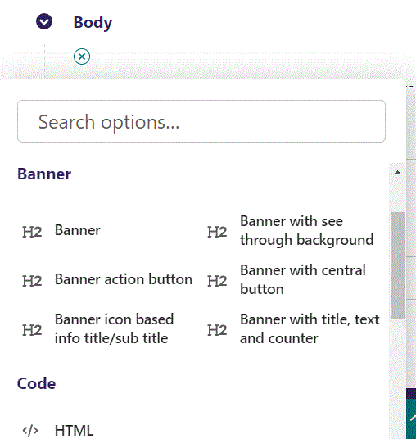
First click the small plus symbol. Then click Banner with see through background to begin creating a Text block.

Slide 3
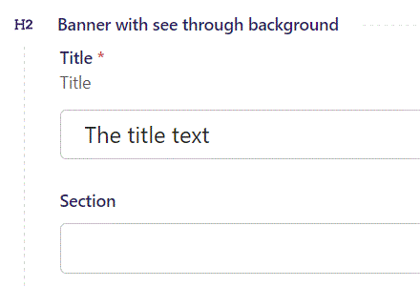
At the top you can write Title.

Slide 4
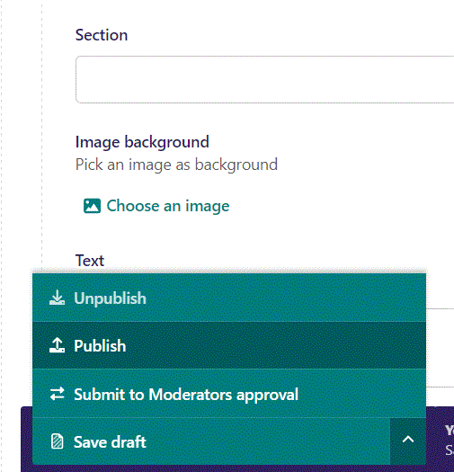
To publish first click the arrow to open the menu. In the menu click Publish.

Slide 5
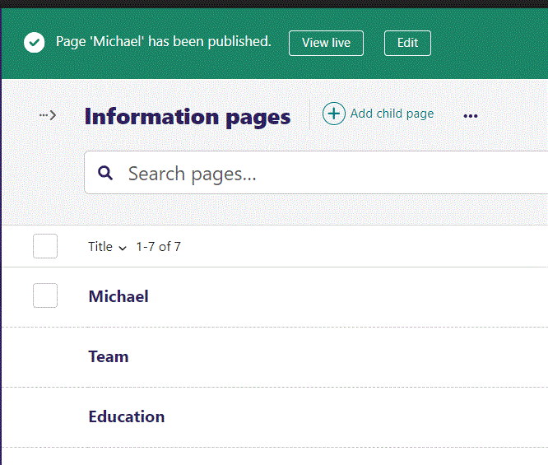
Click View live to open your webpage and see what you created.

Slide 6

Going live we can see our title text.

Slide 7
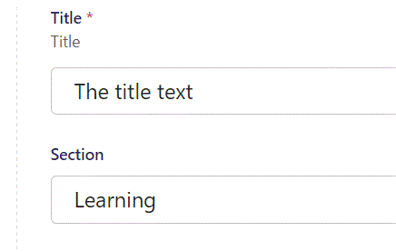
Below Title, you can designate a section that your page will belong to. It is a bookmark for the menu.

Slide 8
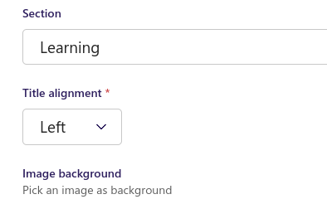
Beneath Section you can set Title alignment.

Slide 9
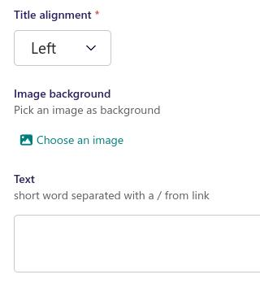
Beneath Title alignment you can Choose an image for background.

Slide 10
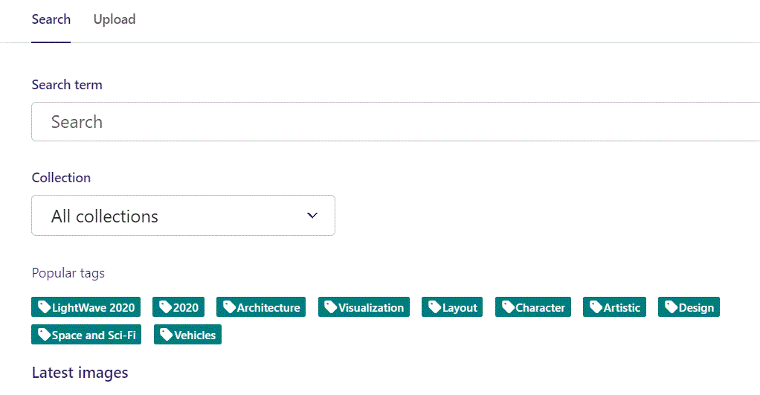
Here we see the top part of the image chooser screen. You can choose to either use an image on the server already or Upload a new image here.
First let’s use an image already on the server.

Slide 11
Here you can write a search term.

Slide 12
Here you can select a Collection of images.

Slide 13
At the bottom you can also sort with Popular tags.

Slide 14
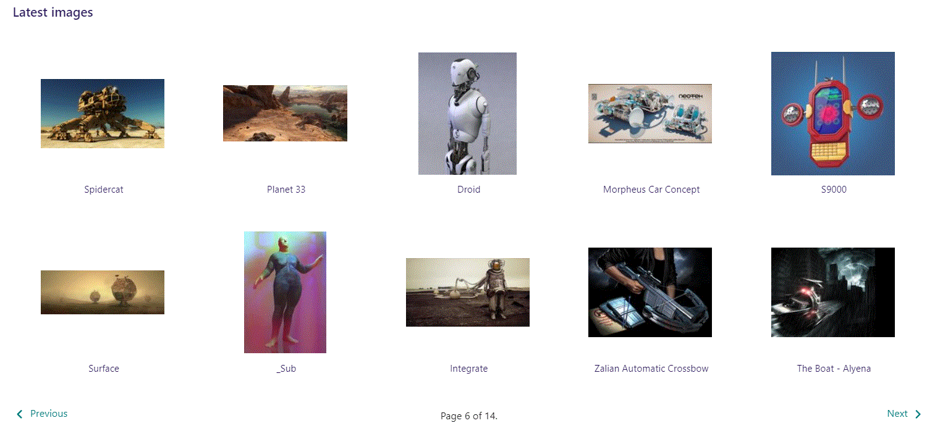
At the bottom of the image selector screen there are navigation buttons.

Slide 15
You can select an image by clicking it.

Slide 16
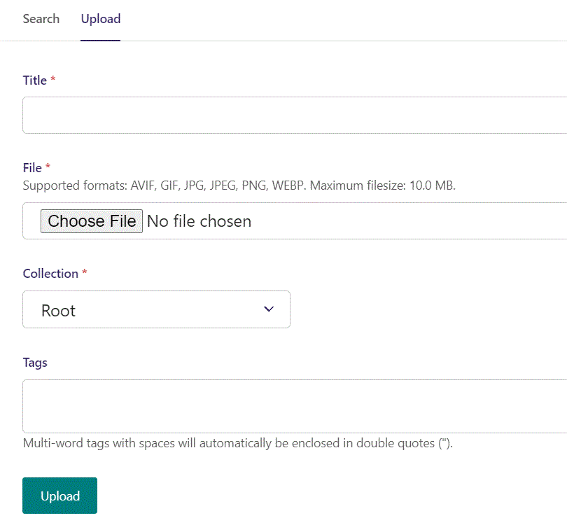
You can also upload an image by clicking Upload.

Slide 17
Name your image here.

Slide 18
Click Choose File to pick your image.

Slide 19
Select which Collection the uploaded image belongs to.

Slide 20
Assign tags to your image. Separate them with a comma.

Slide 21
Finally click Upload, to upload the image.

Slide 22
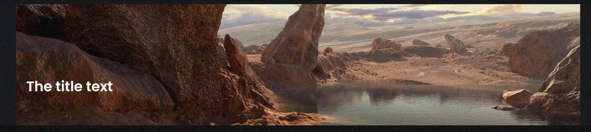
Going live our banner now have an image background.

Slide 23
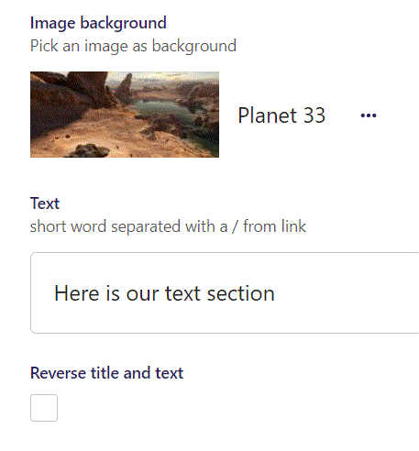
Beneath Image background you can write Text.

Slide 24
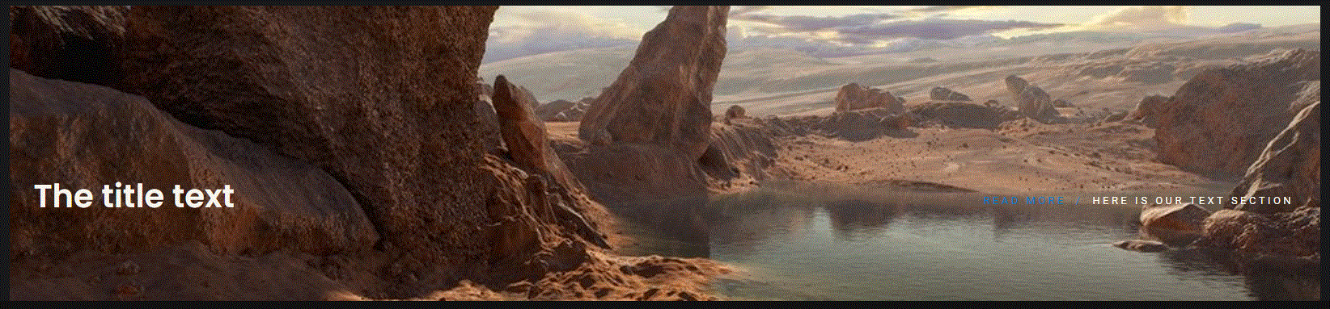
Going live we can see our text, now that we have text our link text also shows up.

Slide 25
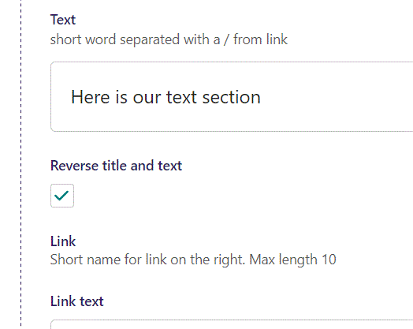
Beneath Text you can Reverse title and text. Let’s do that and see what it looks like live.

Slide 26
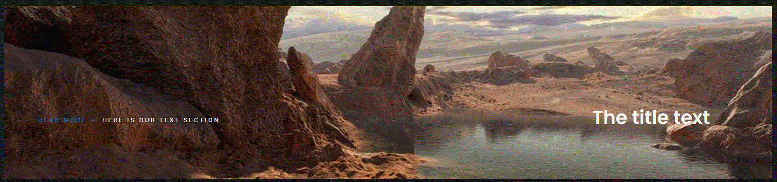
Going live we can see our Text section is now at the left side and our Title is on the right side.

Slide 27
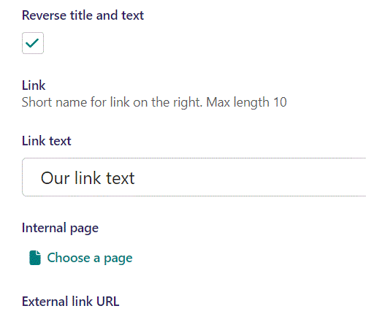
Beneath Reverse title and text you can write a Link text.

Slide 28
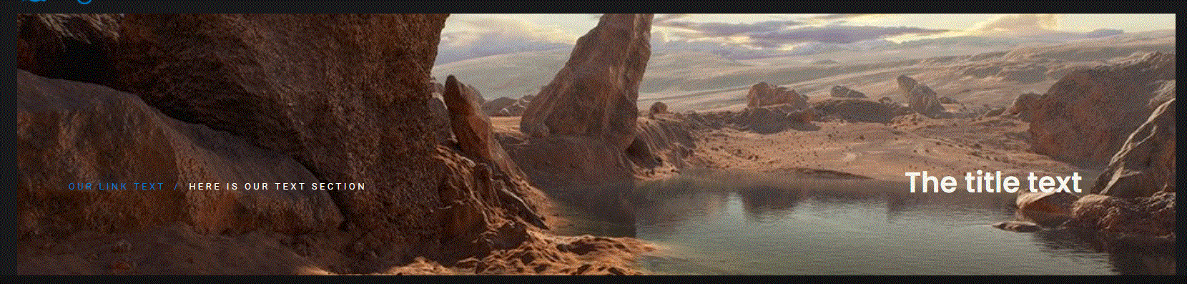
Going live we can see our Link text have changed.

Slide 29
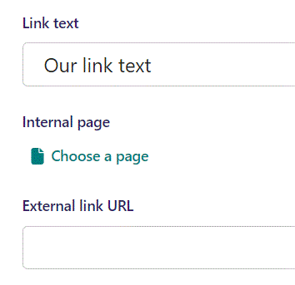
Beneath Link text you can set Internal page as a link to lead the viewer to when they click the Link text.

Slide 30
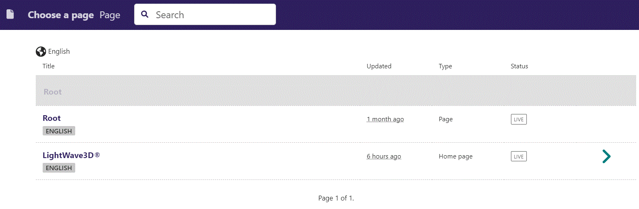
In the page chooser window you can search for the page here.

Slide 31
If a page on the list have pages under it, you can click here to see them.

Slide 32
You select a page by clicking here.

Slide 33
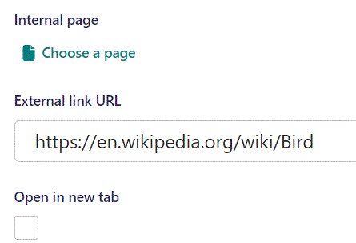
Beneath Internal page you can set an External link URL to lead the viewer to when they click the link text.

Slide 34
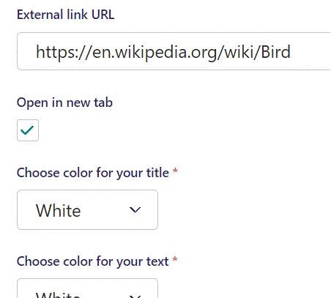
Beneath External link URL you can select if clicking the link should Open in new tab. Here we have set it to True.

Slide 35
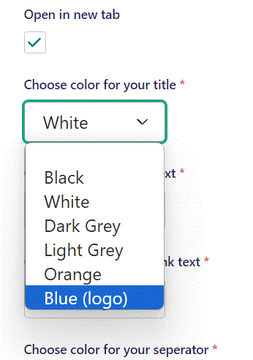
Beneath Open in new tab you can Choose color for your title. Let’s make it Blue (logo).

Slide 36
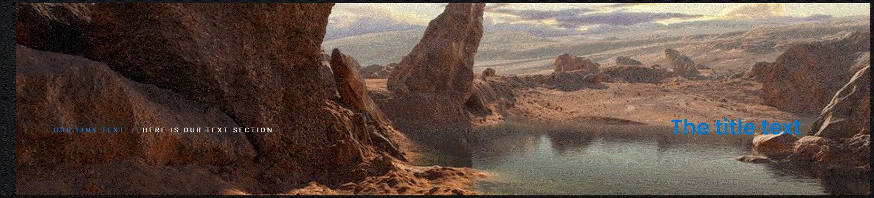
Going live we can see our title is now in blue.

Slide 37
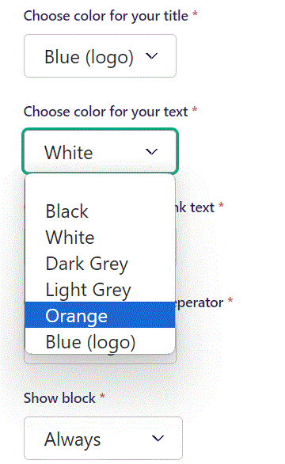
Beneath Choose color for your title you can Choose color for your text. Let’s make it Orange.

Slide 38
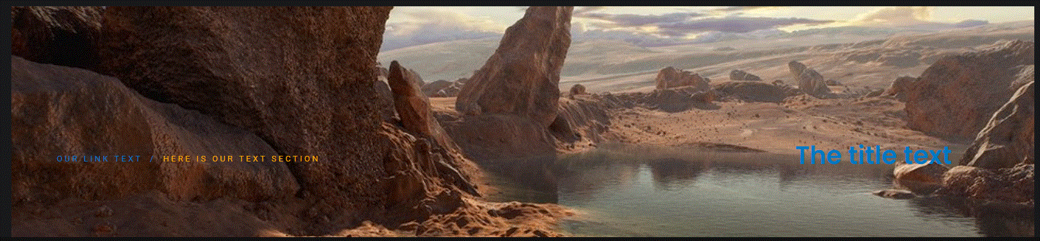
Going live we can see our text is now in orange.

Slide 39
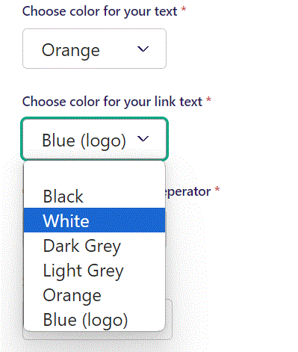
Beneath Choose color for your text you can Choose color for your link text. Let’s make it White.

Slide 40

Going live we can see our link text is now white.

Slide 41
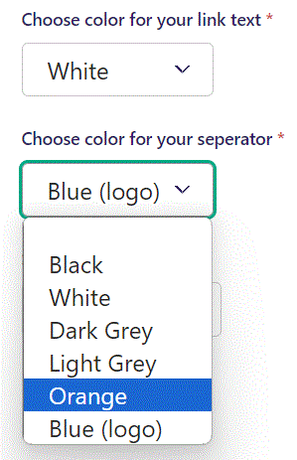
Beneath Choose color for your link text you can Choose color for your separator. Let’s make it Orange.

Slide 42

Going live and zooming in on our separator we can see it is now orange.

Slide 43
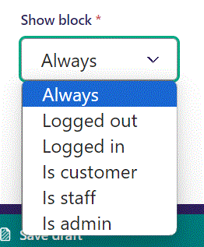
Below Background theme, you can select when or for whom the block will be shown.
Always: Will always show.
Logged out: Only shows when viewer is logged out.
Logged in: Only shows when viewer is logged in.
Is customer: Only shows when viewer is a customer.
Is staff: Only shows if viewer is a staff.
Is admin: Only shows when viewer is an admin.

