Slide 1
Guide for
Banner with central button

Slide 2
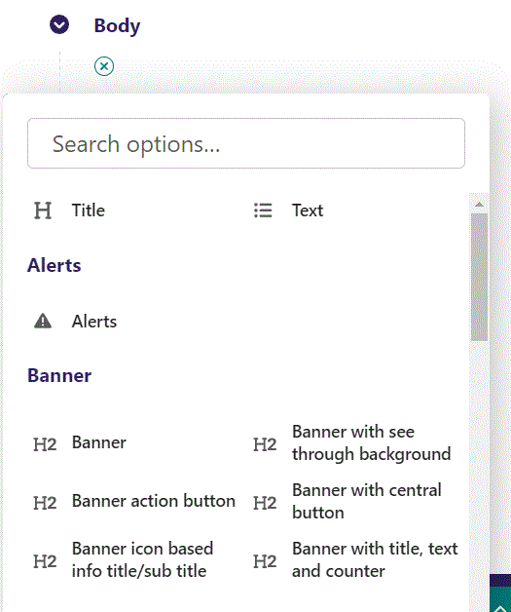
First click the small plus symbol. Then click Banner with central button to begin creating.

Slide 3
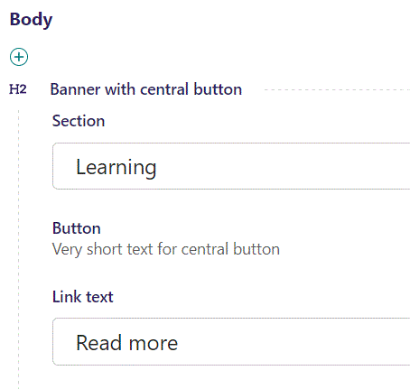
You can designate a Section that your page will belong to. It is a bookmark for the menu.

Slide 4
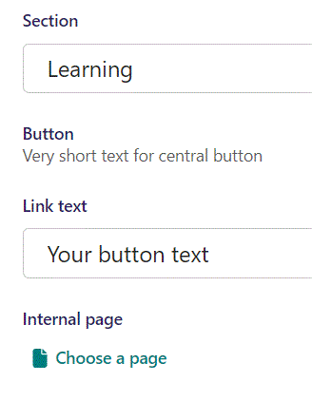
Beneath Section you can write a Link text. It functions as the buttons text.

Slide 5
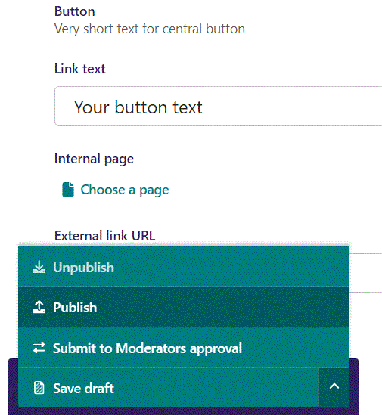
To Publish first click the arrow, then in the menu click Publish.

Slide 6
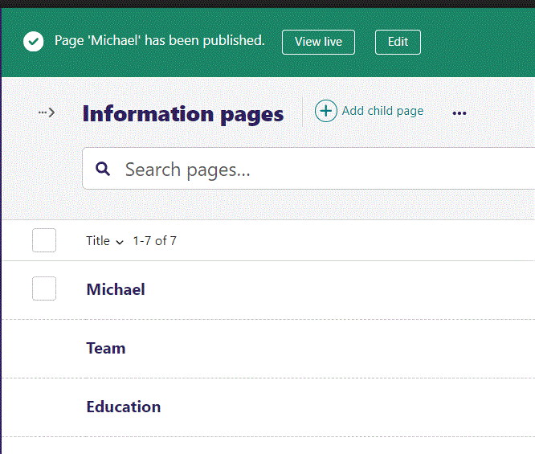
Click View live to open your webpage and see what you created.

Slide 7

Going live we can see our Link text inside our button.

Slide 8
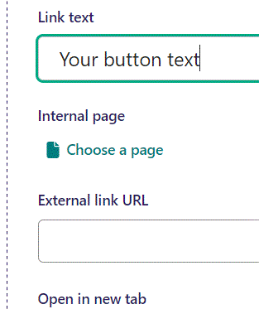
Beneath Link text you can set an Internal page as button link.

Slide 9
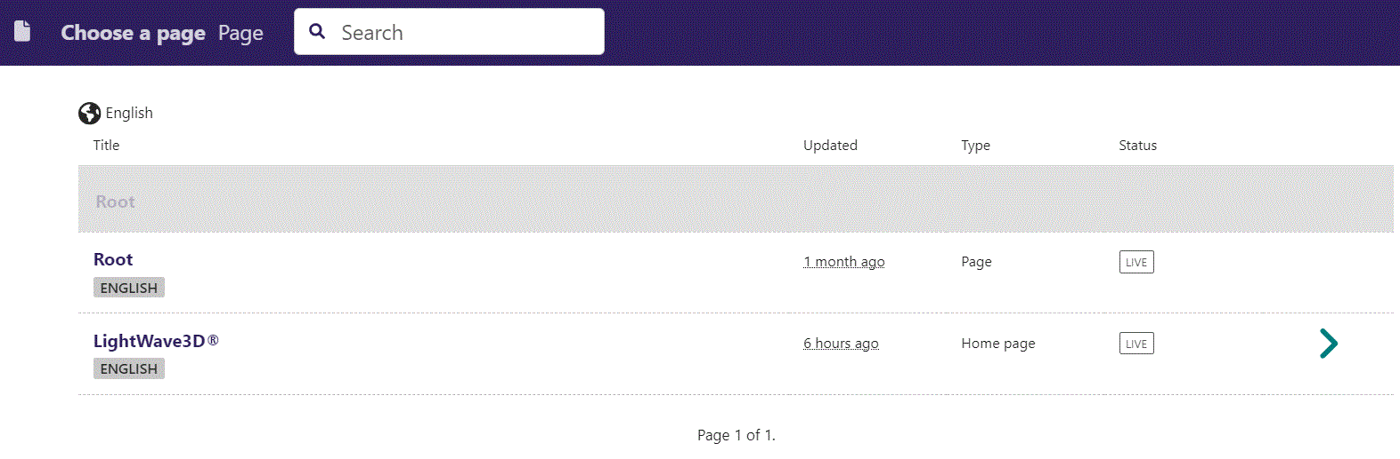
In the page chooser window you can search for the page here.

Slide 10
If a page on the list have pages under it, you can click here to see them.

Slide 11
You select a page by clicking here.

Slide 12
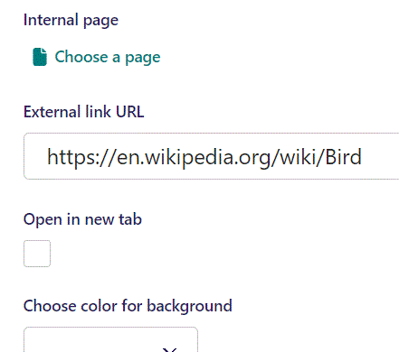
Beneath Internal page you can set an External link URL as the button link.

Slide 13
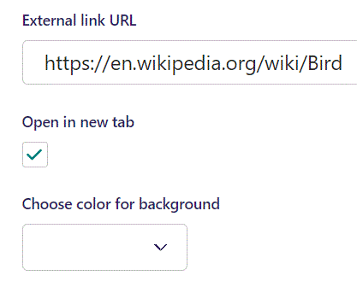
Beneath External link URL you can have the link be opened in a new tab. Here we set it to True.

Slide 14
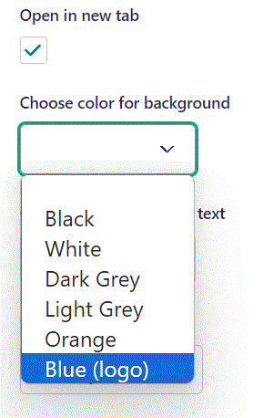
Beneath Open in new tab you can Choose color for background. Let’s set it to Blue (logo).

Slide 15

Going live we can see our banner’s background color is now blue.

Slide 16
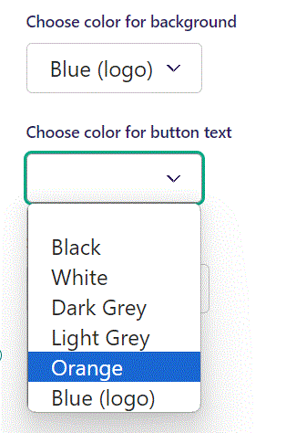
Beneath Choose color for background you can Choose color for button text. Let’s set it to Orange.

Slide 17

Going live we can see our button text have changed color to orange.

Slide 18
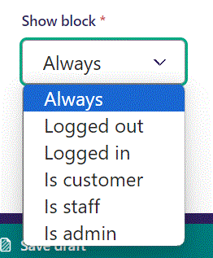
Below Background theme, you can select when or for whom the block will be shown.
Always: Will always show.
Logged out: Only shows when viewer is logged out.
Logged in: Only shows when viewer is logged in.
Is customer: Only shows when viewer is a customer.
Is staff: Only shows if viewer is a staff.
Is admin: Only shows when viewer is an admin.

