Slide 1
Guide for
Banner icon based info title/sub title

Slide 2
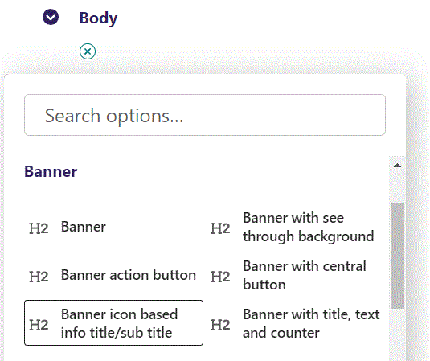
First click the small plus symbol. Then click Banner icon based info title/sub title to begin creating.

Slide 3
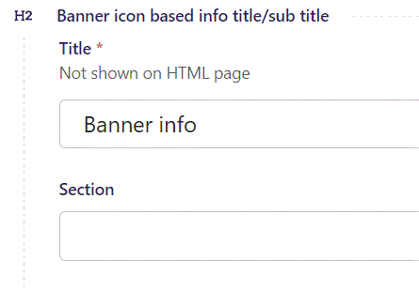
Title is not shown on the HTML page. It functions as the title for the block in the admin section.

Slide 4
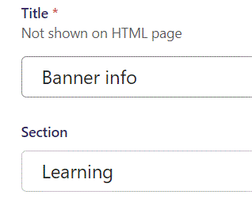
Below Title, you can designate a section that your page will belong to. It is a bookmark for the menu.

Slide 5
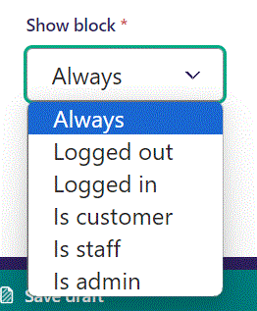
Below Section, you can select when or for whom the block will be shown.
Always: Will always show.
Logged out: Only shows when viewer is logged out.
Logged in: Only shows when viewer is logged in.
Is customer: Only shows when viewer is a customer.
Is staff: Only shows if viewer is a staff.
Is admin: Only shows when viewer is an admin.

Slide 6
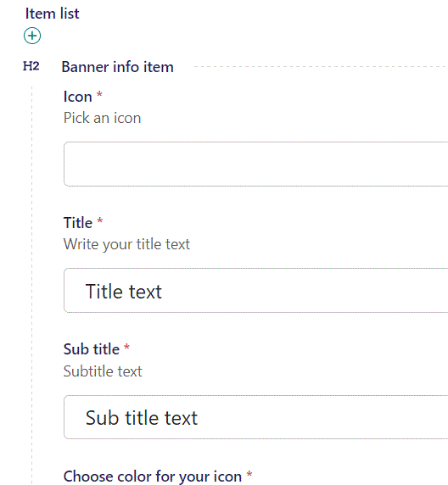
Beneath Show block you can pick an Icon for your banner.
First, we need to find an icon code.

Slide 7
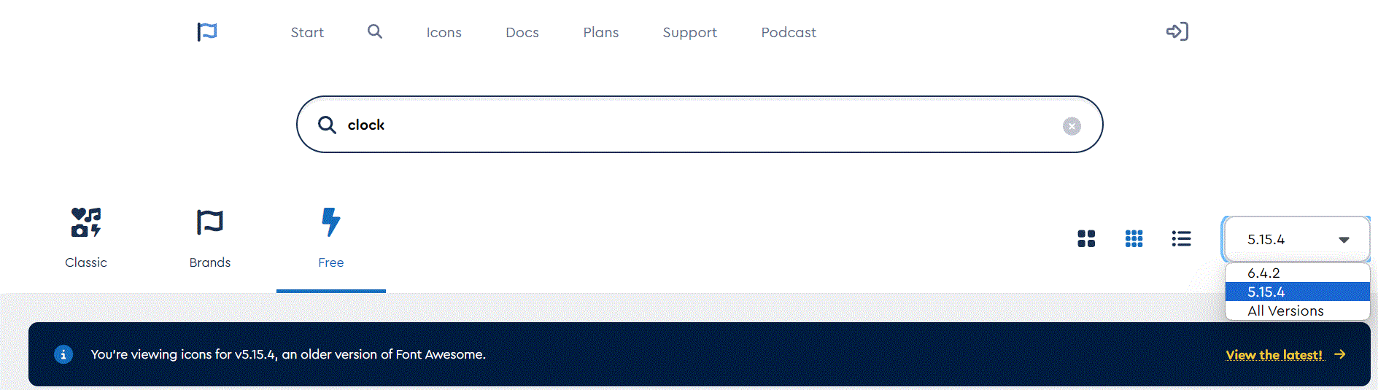
To find icons go to: https://fontawesome.com/search?o=r&m=free
In the right lower side of the top section, you can select icon version. Select version 5.15.4.

Slide 8
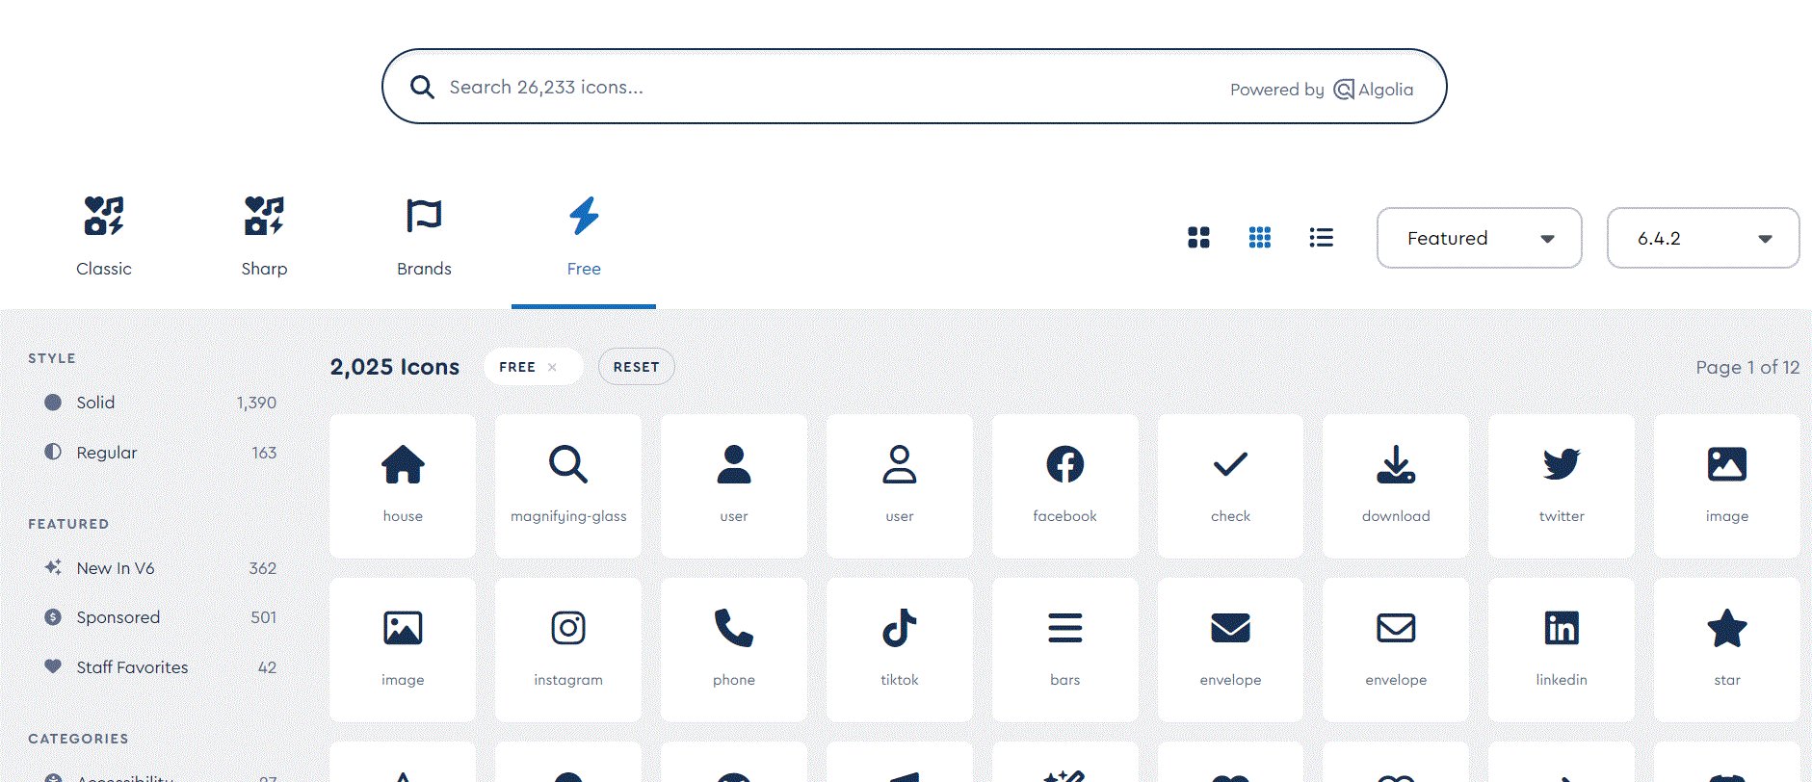
In the top you can search for an icon

Slide 9
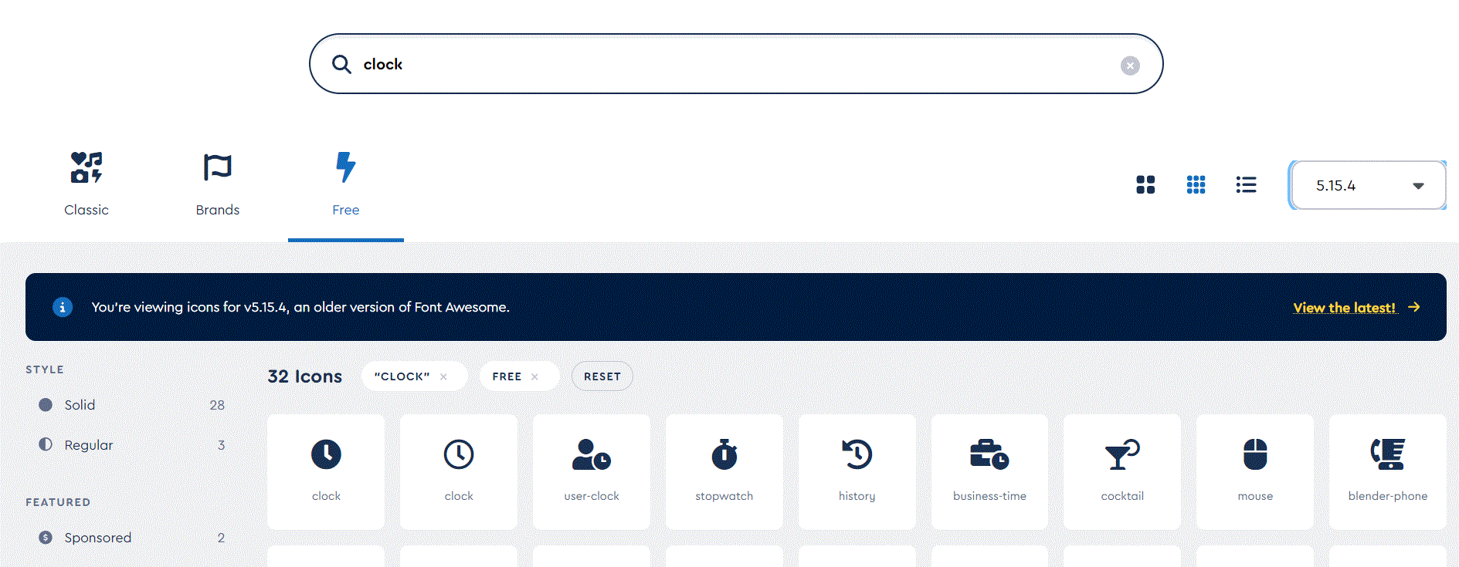
When you find an icon click it.

Slide 10
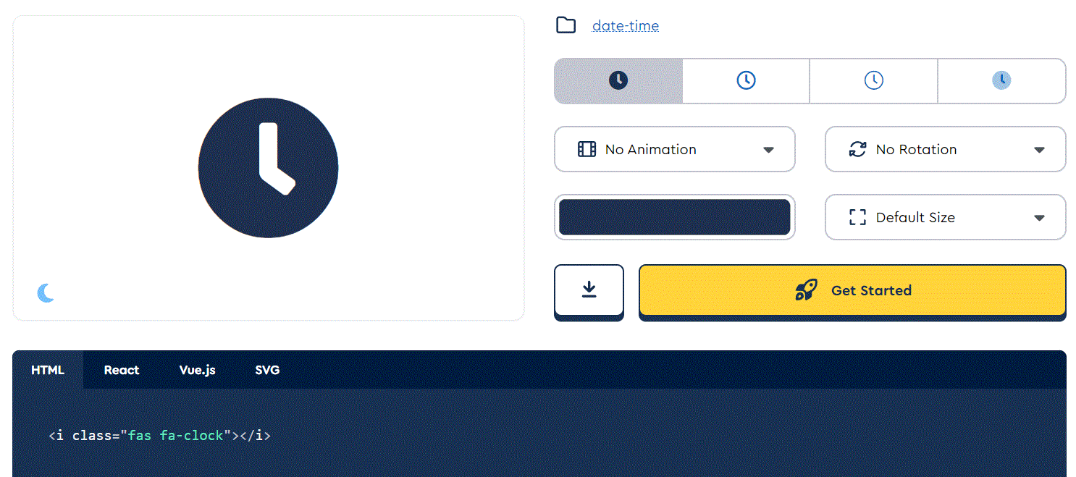
A window pop up, where you can see the code, you need to use in the Icon field. Here the code is:
fas fa-clock

Slide 11
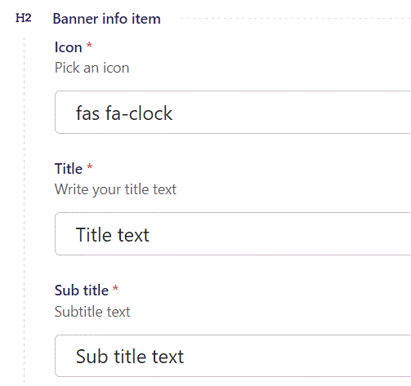
Insert the icon code into Icon text field.

Slide 12
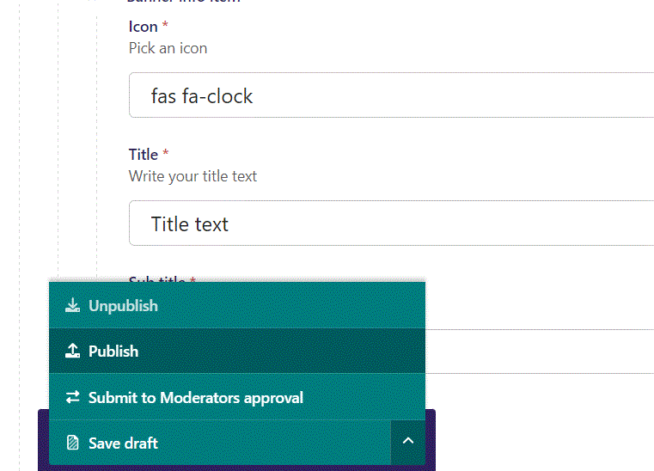
To Publish first click the arrow, then in the menu click Publish.

Slide 13
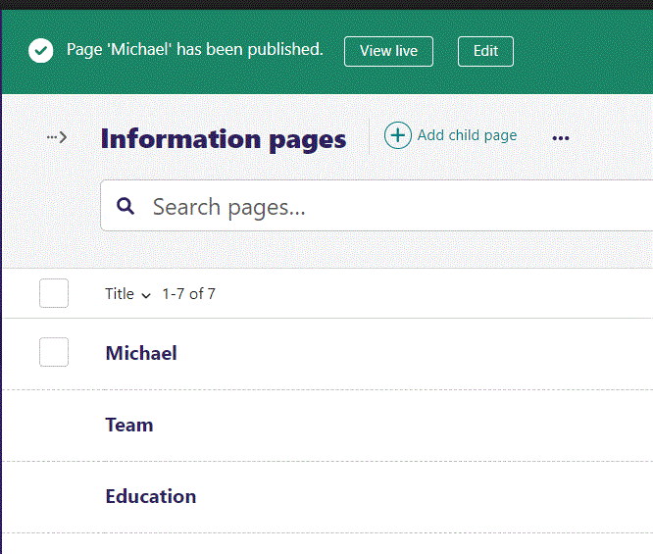
Click View live to open your webpage and see what you created.

Slide 14

Going live we can see our banner icon.

Slide 15
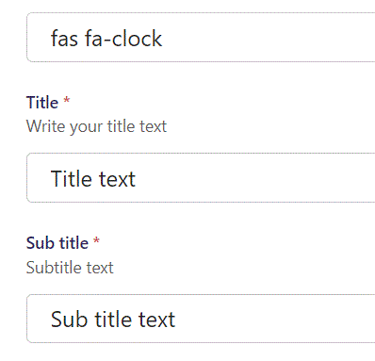
Under Icon you can write a Title text.
Under Title you can write a Sub title text.

Slide 16
Going live we can see our Title text and our Sub title text beneath the Title text.

Slide 17
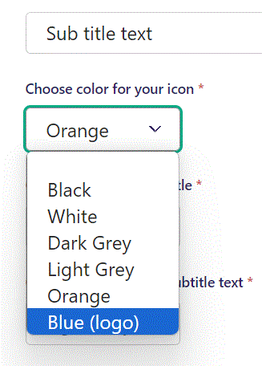
Beneath Sub title you can Choose color for your icon. Let’s make our icon Blue (logo).

Slide 18

Going live our icon is now blue.

Slide 19
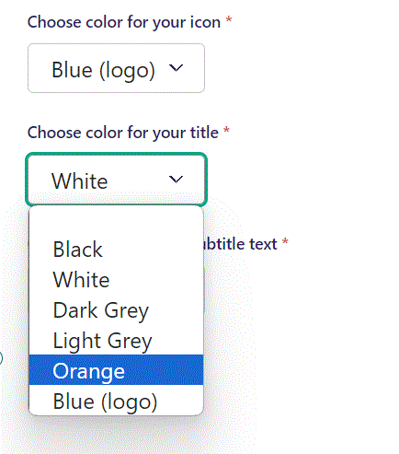
Beneath Choose color for your icon you can Choose color for your title. Let’s change the color to Orange.

Slide 20

Going live we can see our Title is now in orange color.

Slide 21
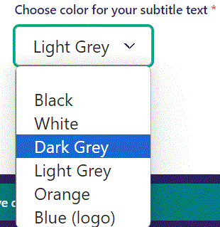
Beneath Choose color for your title text you can Choose color for your subtitle text. Let’s change the color to Dark Grey.

Slide 22

Going live we can see our Sub title text is now Dark Grey.

Slide 23
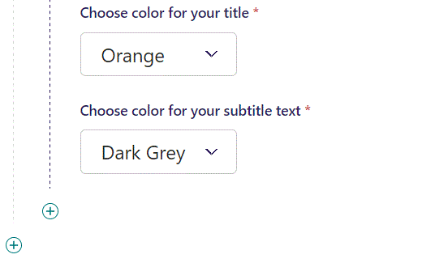
You can add another item to your banner by clicking the plus icon.

Slide 24
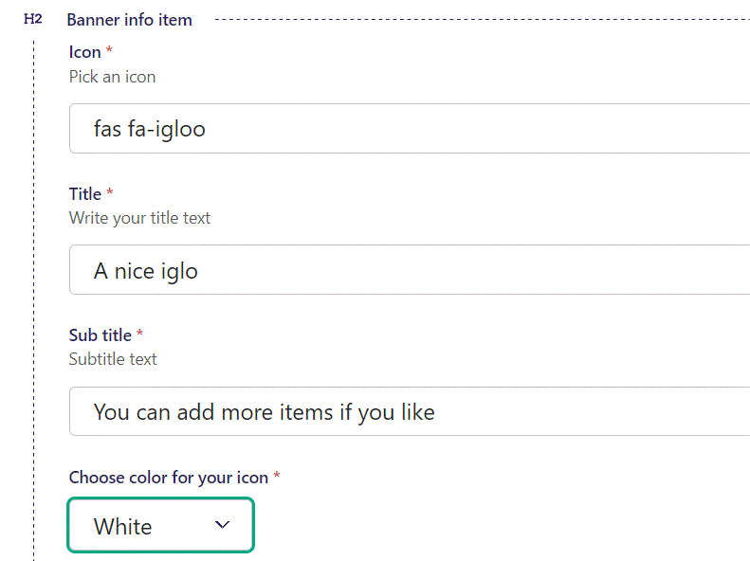
Adding another item works in the same way as adding the first item.
Here we add a nice igloo icon.

Slide 25
Going live we can see our second item added.
You can add more items if you like.

