Slide 1
Guide for
Banner action button Block

Slide 2
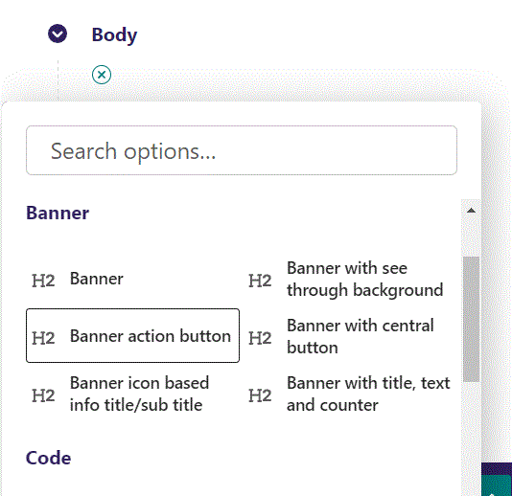
First click the small plus symbol. Then click Banner action button to begin creating a Banner with a button.

Slide 3
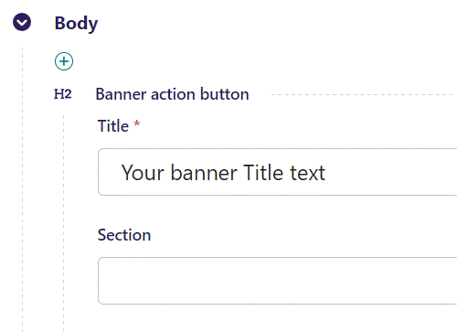
Here you can write the text for your banner.

Slide 4
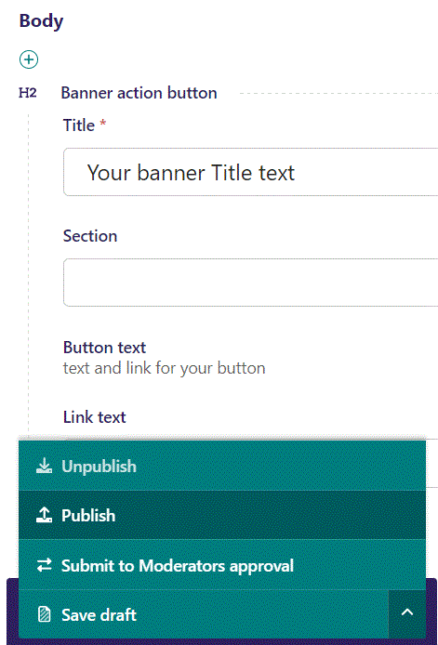
To Publish first click the arrow, then in the menu click Publish.

Slide 5
Click View live to open your webpage and see what you created.

Slide 6
Going live we can see our banner text.
Note the button to the right, we will get to that later.

Slide 7
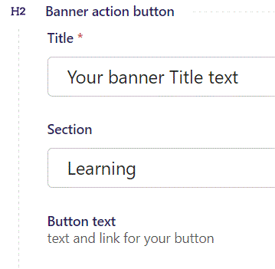
Below Title, you can designate a section that your page will belong to. It is a bookmark for the menu.

Slide 8
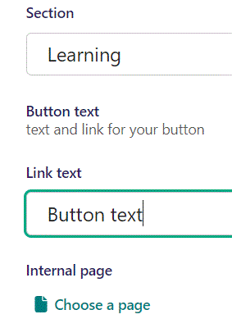
Below Section you can begin to work on the button.
First the Link text, will function as the button text.

Slide 9
Going live we can see the text in the button have changed to Button text.

Slide 10
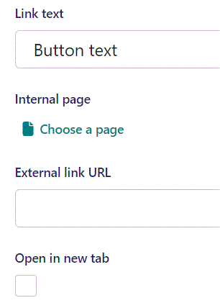
Below Link text you can select an Internal page to lead the viewer to when they click the button.

Slide 11
In the page chooser window you can search for the page here.

Slide 12
If a page on the list have pages under it, you can click here to see them.

Slide 13
You select a page by clicking here.

Slide 14
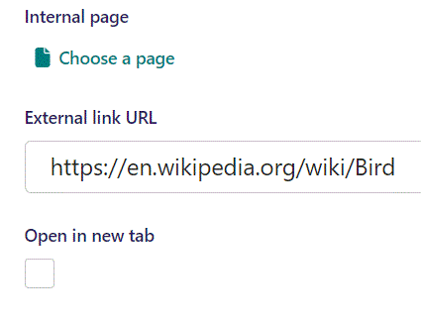
Below Internal page you can choose an External link URL.

Slide 15
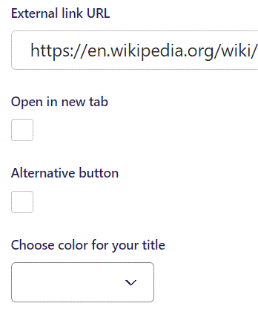
Under External link URL you can set if clicking the button, will Open a new tab.

Slide 16
Under Open in new tab, you can select to use an Alternative button (default setting) or not. We will not use the Alternative button.

Slide 17
Going live we can see the new button style.

Slide 18
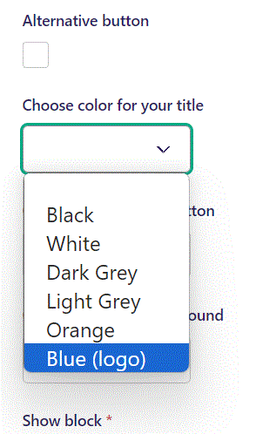
Beneath Alternative button, you can Choose color for your title. Lets choose Blue (logo).

Slide 19
Going live we can see that our text is now blue.

Slide 20
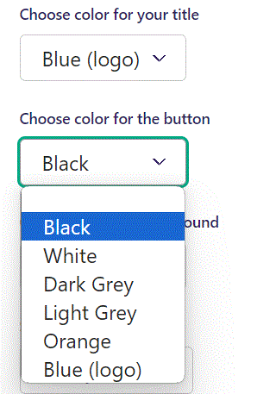
Under Choose color for your title you can Choose color for the button. Let’s make it Black.

Slide 21
Going live we can see the button is now colored black

Slide 22
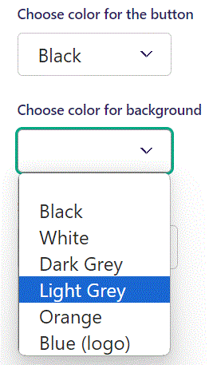
Beneath Choose color for the button you can Choose color for background. Let’s make it Light Grey.

Slide 23
Going live we can see our banner background is now Light Grey.

Slide 24
Below Background theme, you can select when or for whom the block will be shown.
Always: Will always show.
Logged out: Only shows when viewer is logged out.
Logged in: Only shows when viewer is logged in.
Is customer: Only shows when viewer is a customer.
Is staff: Only shows if viewer is a staff.
Is admin: Only shows when viewer is an admin.

