Slide 1
Guide for
Banner Block

Slide 2
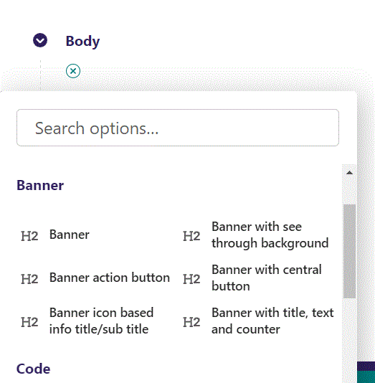
First click the small plus symbol. Then click Banner to begin creating a Banner block.

Slide 3
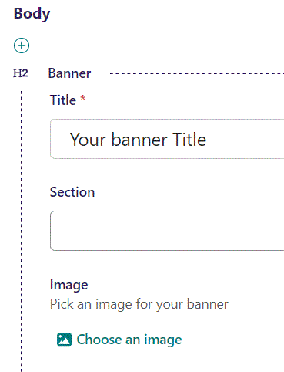
Write your Banner Title text.

Slide 4
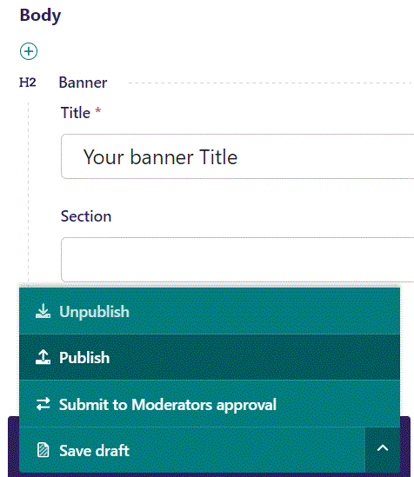
To Publish first click the arrow, then in the menu click Publish.

Slide 5
Click View live to open your webpage and see what you created.

Slide 6
Going live we can see our banner.

Slide 7
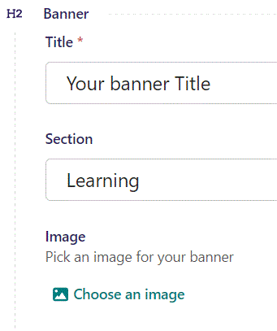
Below Title, you can designate a section that your page will belong to. It is a bookmark for the menu.

Slide 8
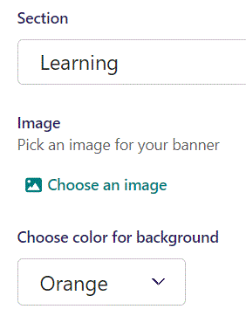
Under Section you can click here to select an image as a background for your banner.

Slide 9
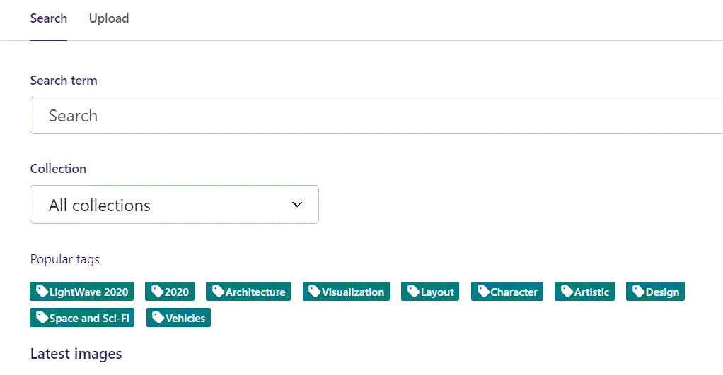
Here we see the top part of the image chooser screen. You can choose to either use an image on the server already or Upload a new image here.
First let’s use an image already on the server.

Slide 10
Here you can write a search term.

Slide 11
Here you can select a Collection of images.

Slide 12
At the bottom you can also sort with Popular tags.

Slide 13
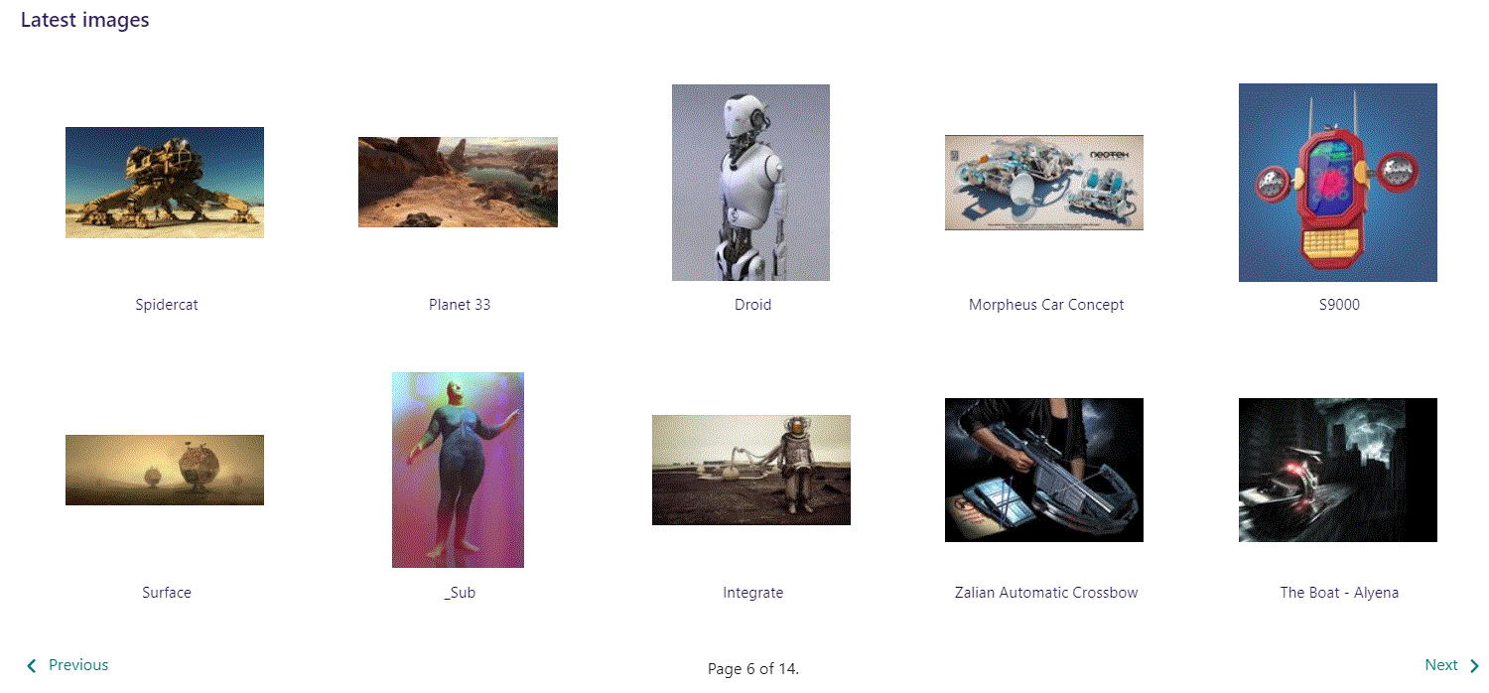
At the bottom of the image selector screen there are navigation buttons.

Slide 14
You can select an image by clicking it.

Slide 15
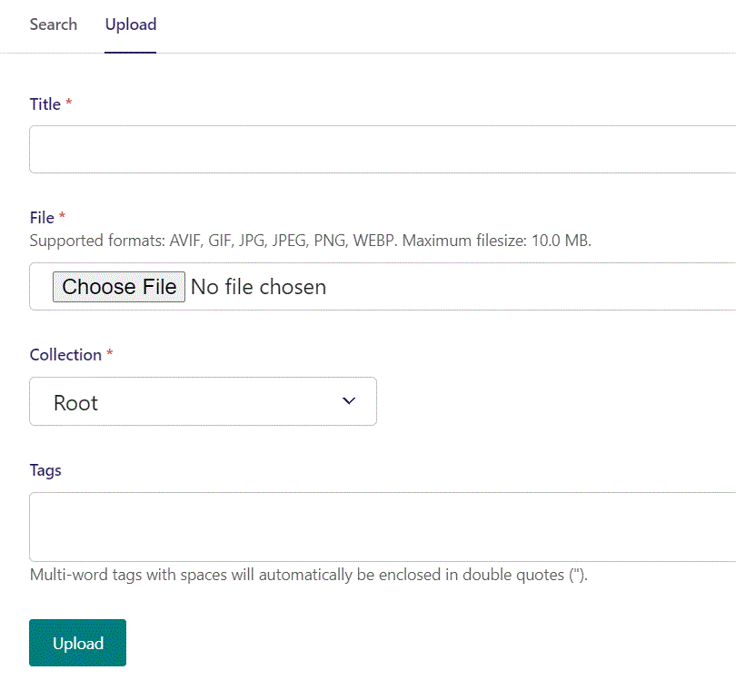
You can also upload an image by clicking Upload.

Slide 16
Name your image here.

Slide 17
Click Choose File to pick your image.

Slide 18
Select which Collection the uploaded image belongs to.

Slide 19
Assign tags to your image. Separate them with a comma.

Slide 20
Finally click Upload, to upload the image.

Slide 21
Going live, we can see our Banner now have an image as a background.

Slide 22
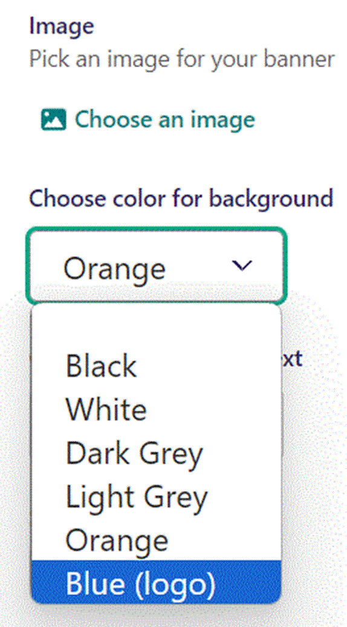
Below picking an image, you can Choose color for background. Let’s pick the Blue (logo) color.
Notice we have removed the Image as a background. Images will cancel out background color choice.

Slide 23
Going live, our banner now have a blue background color.

Slide 24
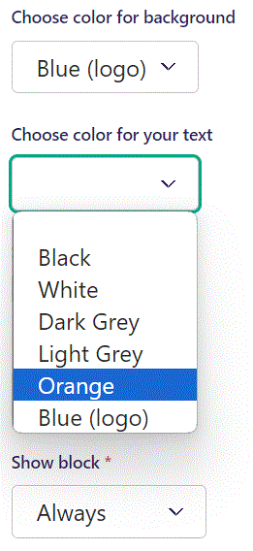
Below background color, you can Choose color for your text. Let’s make our text Orange.

Slide 25
Going live, we can see our text is now Orange.

Slide 26
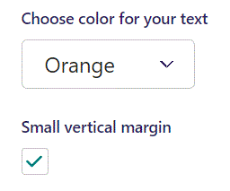
Below Choose color for your text, you can set Small vertical margin. Here we set it to True.

Slide 27
Going live we can see the effect of the Small vertical margin. The banner is now not as high.

Slide 28
Below Background theme, you can select when or for whom the block will be shown.
Always: Will always show.
Logged out: Only shows when viewer is logged out.
Logged in: Only shows when viewer is logged in.
Is customer: Only shows when viewer is a customer.
Is staff: Only shows if viewer is a staff.
Is admin: Only shows when viewer is an admin.

