Slide 1
Guide for
Alerts Block

Slide 2
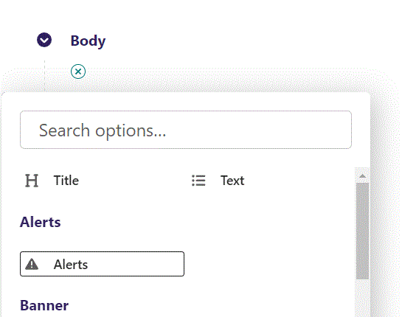
First click the small plus symbol. Then click Alerts to begin creating an Alerts block.

Slide 3
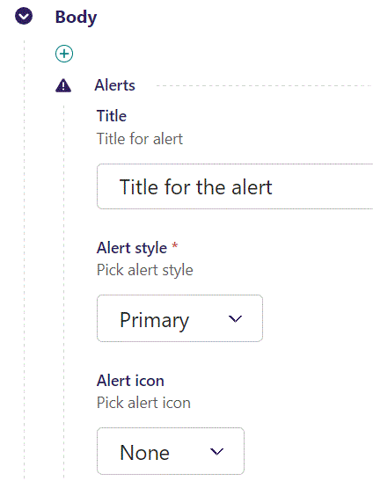
At the top you can write Title.

Slide 4
Going live we can see our Title text have been added.
We will get to the styling of the alert later.

Slide 5
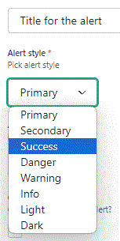
Beneath Title you can set Alert style. You can see examples of the different alerts here:
https://getbootstrap.com/docs/5.0/components/alerts/
Let’s change it to Success.

Slide 6
Going live we can see the new Alert style.

Slide 7
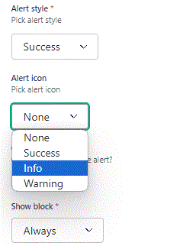
Beneath Alert style you can set Alert icon. Let’s set it to Info.

Slide 8
Going live we can see our Alert icon have been added.

Slide 9
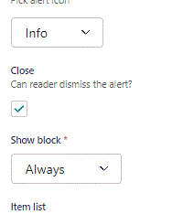
Beneath Alert icon you can set Close. This makes it possible to dismiss the alert. Here we change it to True.

Slide 10
Going live we can see a x have been added. If reader clicks this, the alert will disappear.

Slide 11
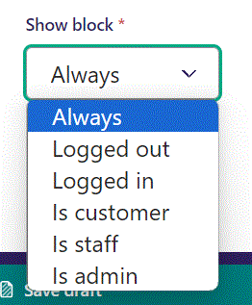
Below Close, you can select when or for whom the block will be shown.
Always: Will always show.
Logged out: Only shows when viewer is logged out.
Logged in: Only shows when viewer is logged in.
Is customer: Only shows when viewer is a customer.
Is staff: Only shows if viewer is a staff.
Is admin: Only shows when viewer is an admin.

Slide 12
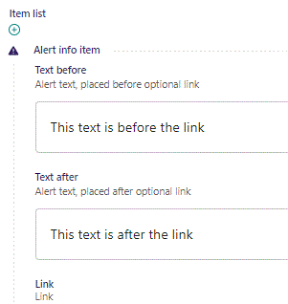
Beneath Show block you can write Text before
and Text after an optional link.
We will add the link later.

Slide 13
Going live we can see our two Text sections.

Slide 14
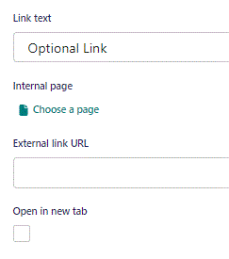
Beneath Text after you can write Link text. This will only show once we add a link below.

Slide 15
Beneath Link text you can Choose a page as an Internal page link.

Slide 16
In the page chooser window, you can search for the page here.

Slide 17
If a page on the list have pages under it, you can click here to see them.

Slide 18
You select a page by clicking here.

Slide 19
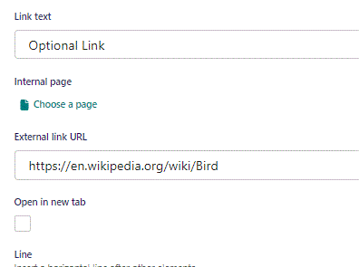
Beneath Choose a page you can set an External link URL.

Slide 20
Going live we can see the link have been added between our two text sections.

Slide 21
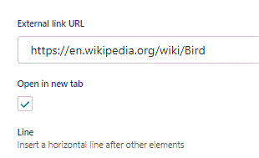
Beneath External link URL you can set Open in new tab. If set to True, like here, it will make the browser open the link in a new tab.

Slide 22
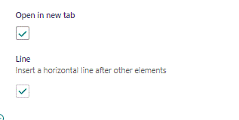
Beneath Open in new tab, you can set Line. Let’s change it to True.

Slide 23
Going live we can see a line have been added beneath the other elements.

Slide 24
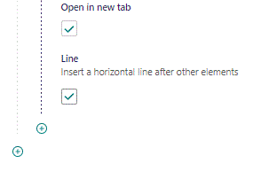
To add another item, click the plus icon.

Slide 25
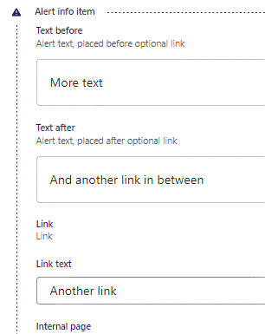
Fill out the fields as before.

Slide 26
Going live we can see our new item added beneath the line.

